Slide 1

語音語言模型的發展史
Speaker:
Hung-yi Lee 李宏毅
Notes:
進一步思考
Tokenization , LLM, detokern 三者的分界
開頭 - 7段 – 結尾
說有 demo
Is it possible to demo gemini live???
Research about find boundary
======
Audio word2vec
Encoder, SUPERB
Speech LLM -> LLM prompting
All decoding + Strating from text
TASTE-1
TASTE-2 (survey)
Alignment (RL?)
Reasoning: STICH-1
Reasoning: STICH-2 (survey)
Full duplex (game-time, full-duplex)
=====
Q:
Why wav2vec 2 is so poor in the last layer?
Q: Does SSL achieve SOTA? How about whisper?
TODO:
-- What do we find from SUPERB?
-- a timeline for instruction fine-tuning
All speech encoder + LLM approach
Need a results for text-guided VC
Many work for universal model
Speech LM survey?
Codec survey
=====
Task specific head, some labelled data
Universal Model, some labelled data
Zero-shot Tasks?
======
TODO:
Check SUPERB journal ???
Where should we put WavLM?
Should I introduce encode? And Speech LM
======
Question: Speech encoder + LLaMA -> Try different encoders like WavLM?
Question: Read the paper about whether things are right?
Question: I want to put some Any Liu’s results
Question: What do we learn from ML-SUPERB and AV-SUPERB?
======
On the Road to a Speech Version of ChatGPT
===
Q: what do we find from ML SUPERB? How about google’s USM?
Q: Speech has limited tasks?
====
I need to mention google usm
====
要不要講更多 ICASSP 的文章:
-- Still missing: robust, compressioni, estimation
--I cannot remember how we use wavform as prompt
Advancing Universal Speech Models Through Self-Supervised Learning: Progress, Challenges, and Future Directions
Motivation
Encoder
SQA: movitvation
SQA: results / method
What SQA is universal
Prompt: motivation
Prompt: Approach
Prompt: results
Prompt: future
Prompt: Conclusion
SUPERB? -> bigger model?
Sampling ???
SQA
Prompt

Slide 2
免責聲明
本課程並非完整介紹語音語言模型，而是以講者經驗講述語音語言模型的發展
Notes:
因此內容難免偏頗

Slide 3


語音語言模型 (Speech Language Model)
(Text)
LLM
Speech
LLM

Slide 4
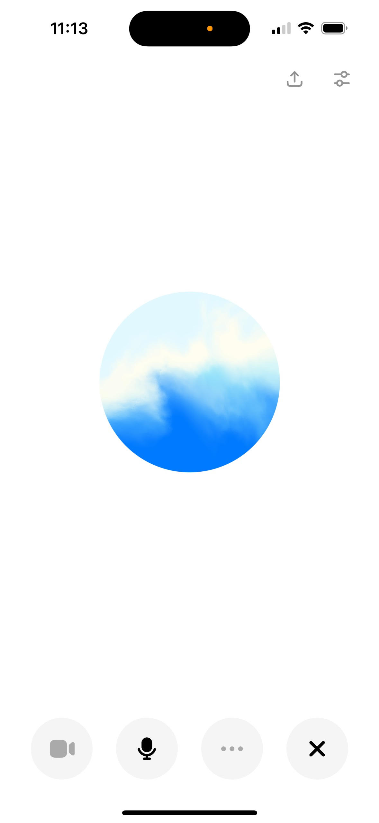
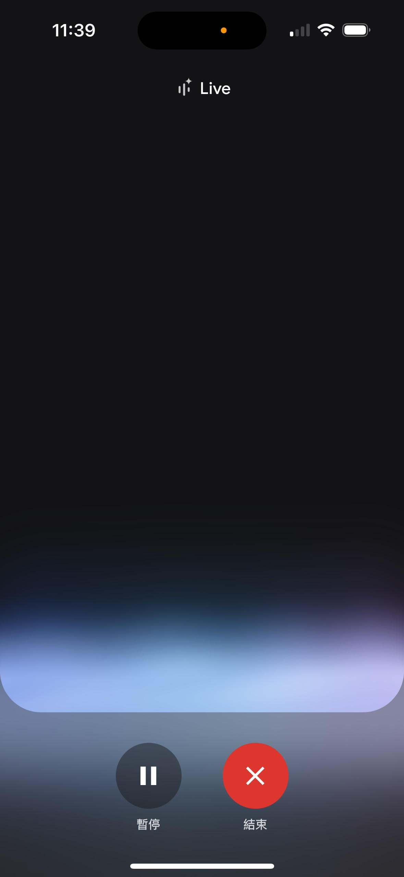
Moshi
  https://arxiv.org/abs/2410.00037
Sesame
  https://www.sesame.com/research/crossing_the_uncanny_valley_of_voice
GLM-4-Voice
  https://arxiv.org/abs/2412.02612
Step-Audio
  https://arxiv.org/abs/2502.11946
Qwen2.5-Omni
  https://arxiv.org/abs/2503.20215
Kimi-Audio
  https://arxiv.org/abs/2504.18425
SpeechGPT
  https://github.com/OpenMOSS/SpeechGPT-2.0-preview
Doubao Realtime Voice Model
  https://seed.bytedance.com/en/realtime_voice
ChatGPT
voice mode
Gemini
Live
…… just to name a few
Notes:
just to name a few

Slide 5
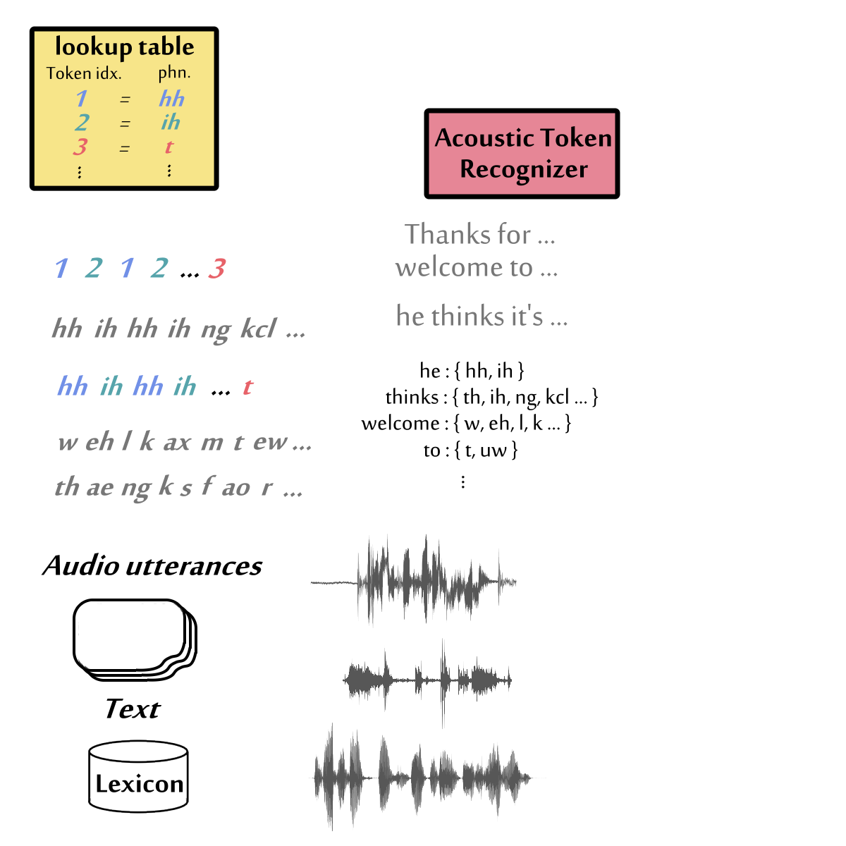
語音語言模型 (Speech Language Model)
Dialogue Mode
Speech
LLM
How are you?
I am good.
the focus of today
Command Mode
Speech
LLM
Happy
Instruction
你好
Identify the emotion
How are you?
translate the input
Speech-aware language model

Slide 6
語音語言模型 (Speech Language Model)
Dialogue Mode
Speech
LLM
How are you?
I am good.
the focus of today
Not TTS
TTS
How are you?
How are you?
Some TTS models also claim themselves to be speech LMs.

Slide 7


Non end-to-end solution
Speech
LLM
Cascade
Most speech-to-speech systems use this solution.
ASR
(Text)
LLM
TTS
Speech Synthesis
Speech Recognition
Agentic Solution
(Text)
LM
Speech Enhancement
Speech Separation
Sound
Detection
Style
Transfer
AudioGPT:https://arxiv.org/abs/2304.12995
Speech-Copilot:https://arxiv.org/abs/2407.09886
Notes:
一些其他的解法
(information loss)
(latency)

Slide 8
ASR
(Text)
LLM
TTS
Strength: Easy to construct
在 2025 年會有比較好的結果
Weakness: Information loss (e.g., emotion), latency
Speech
LLM
Strength: Capture all speech information, probably low latency
較高的能力上限
Weakness: Still under investigation

Slide 9
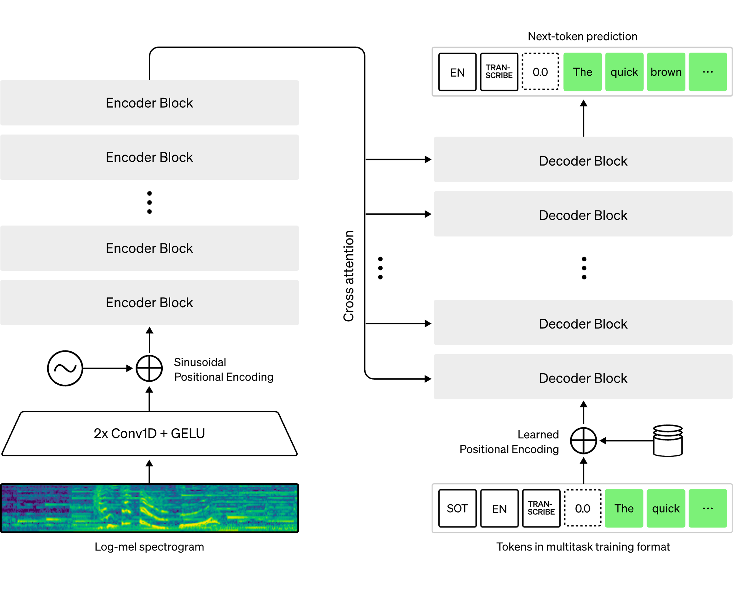
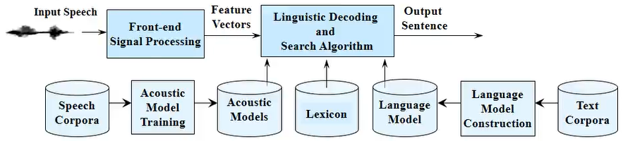
History of Automatic Speech Recognition …
Whisper (End-to-end)
Cascade
(圖片來源：李琳山教授《數位語音處理》)

Slide 10
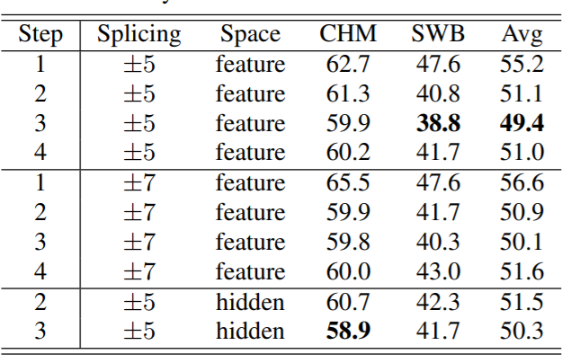
History of Automatic Speech Recognition …
https://www.isca-archive.org/interspeech_2015/lu15e_interspeech.html
10.4% on SWB …
https://ieeexplore.ieee.org/abstract/document/6854669 (ICASSP’14)

Slide 11
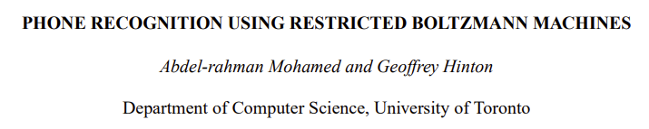
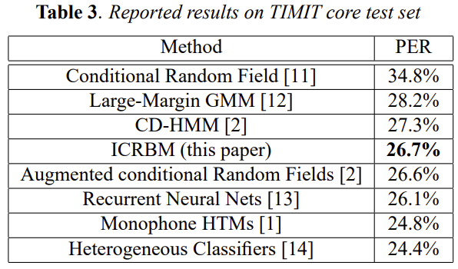
History of Automatic Speech Recognition …
https://ieeexplore.ieee.org/abstract/document/5495651 (ICASSP 2010)

Slide 12
一般人想像中的技術發展
End-to-end
開始吹捧
performance
Deep learning
開始吹捧
HMM
time

Slide 13
實際上可能是這樣 ……
End-to-end
開始吹捧
performance
Deep learning
開始吹捧
HMM
time
Notes:
要畫張圖嗎?

Slide 14
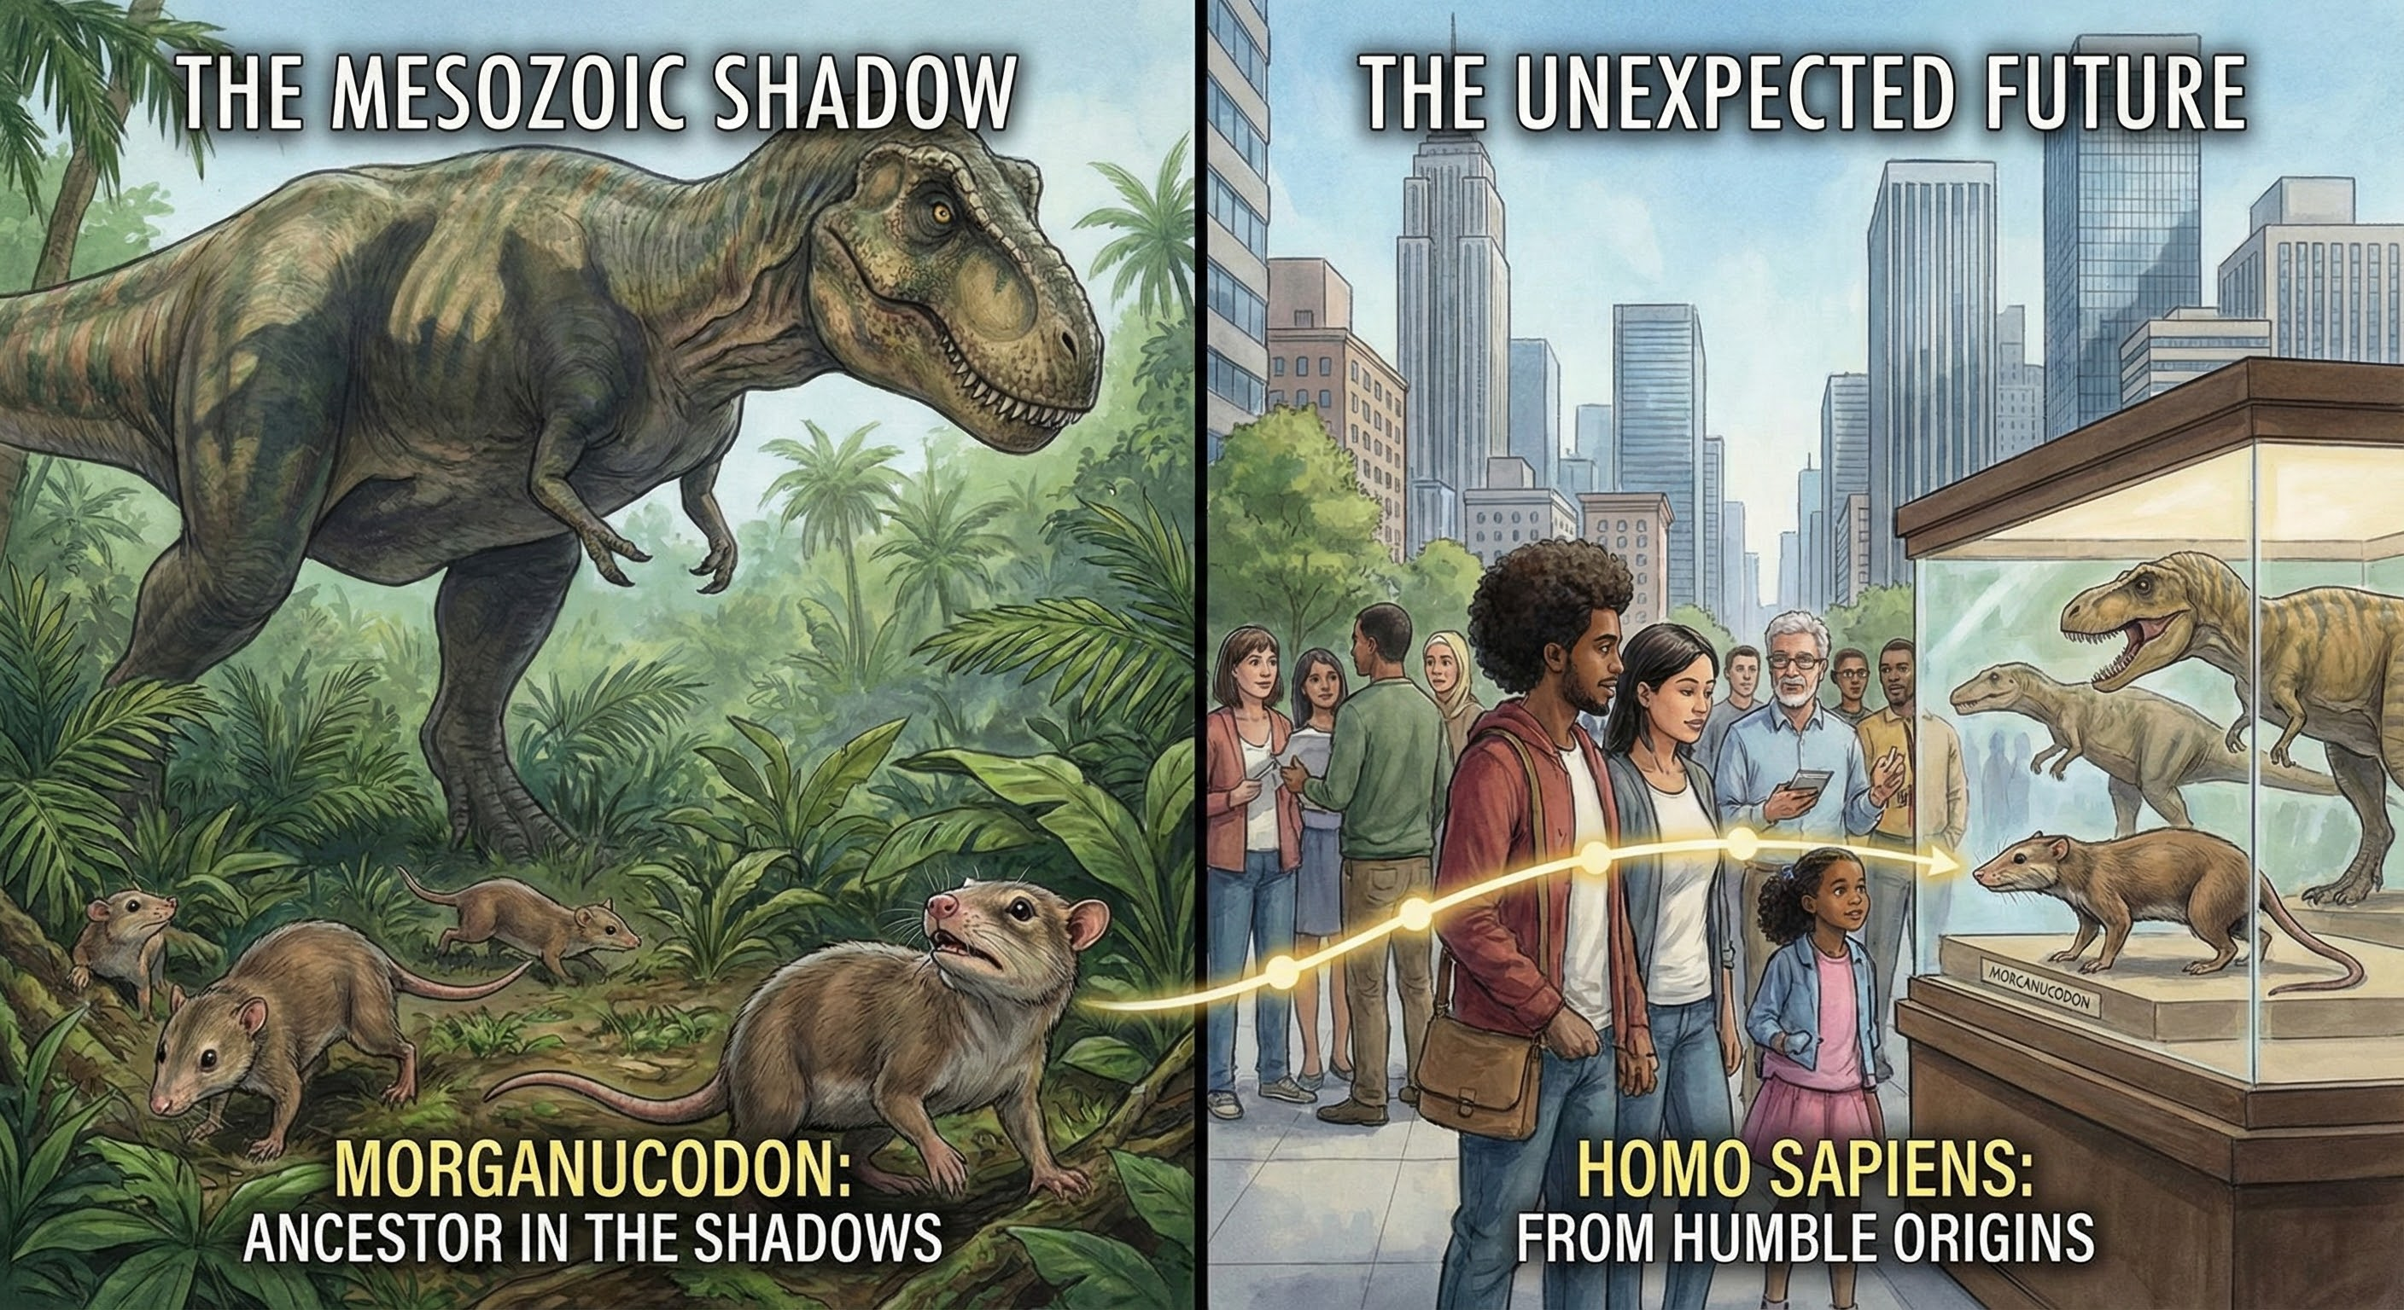

Slide 15
1. 序章

Slide 16
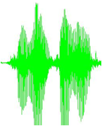
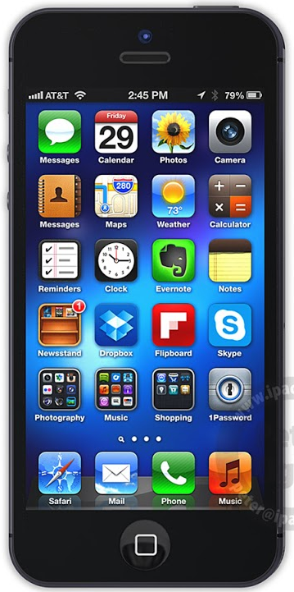

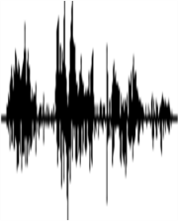
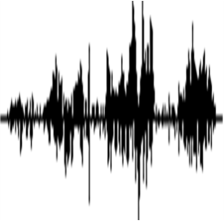

Spoken Content Retrieval
  spoken query
“ICASSP”
user
“ICASSP”
“ICASSP”
Spoken Content
Compute similarity between spoken queries and audio files on acoustic level, and find the query term
Notes:
We have to mention some evolutions here!!!!!!!!!!!!!!!!!!!!!!!!!!!!!!!!!!!!!!!!!!!!!!?????????????????????
Also known as unsupervised spoken term detection, zero-resource spoken content retrieval, etc.
Evaluation program

Slide 17
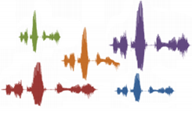
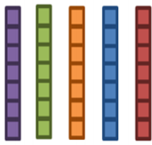


Audio archive divided into variable-length audio segments
Off-line
Audio Word to Vector
Audio Word to Vector
Similarity
Spoken Query
On-line
Search Result

Slide 18

Audio Word2Vector
This work is done by 鍾毓安.
https://arxiv.org/abs/1603.00982
LSTM
LSTM
LSTM
LSTM
LSTM
LSTM
how
are
you

Slide 19
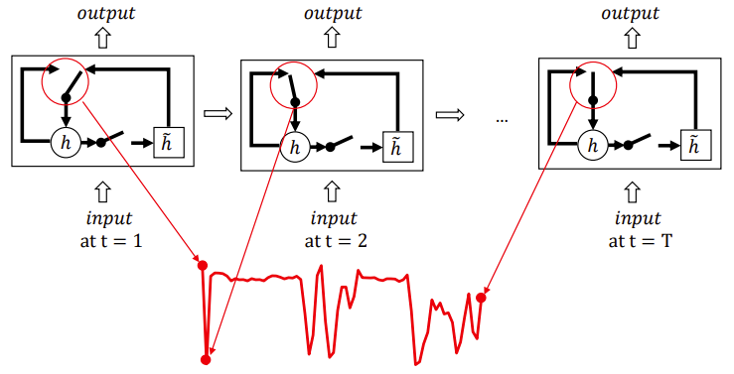
How can we automatically find certain types of boundaries in speech?
This work is done by 王育軒
https://arxiv.org/abs/1703.07588

Slide 20
Segmental Audio Word2Vector
3 1 4 1 5 9 2 7 1 8 3 1 4 1 5 9 2 7 1 8 3 1 4 1 5 9
3 1 4 1 5 9 2 7 1 8 3 1 4 1 5 9 2 7 1 8 3 1 4 1 5 9
A
B
A
B
A

Slide 21
Joint Learning of Segmentation
and Seq2seq Auto-encoder
Segmental Audio Word2Vector https://arxiv.org/abs/1808.02228
This work is done by 王育軒
At each time step, LSTM encoder determines whether it is right before a boundary.
If it is determined as right before a boundary, a vector (an embedding for an audio segment) is outputted.
Where to segment is determined automatically.
embedding for x
LSTM
Encoder
audio segment x

Slide 22
Joint Learning of Segmentation
and Seq2seq Auto-encoder
Segmental Audio Word2Vector https://arxiv.org/abs/1808.02228
This work is done by 王育軒
LSTM decoder reconstructs the input utterance
LSTM
Decoder
embedding for x
LSTM
Encoder
audio segment x

Slide 23
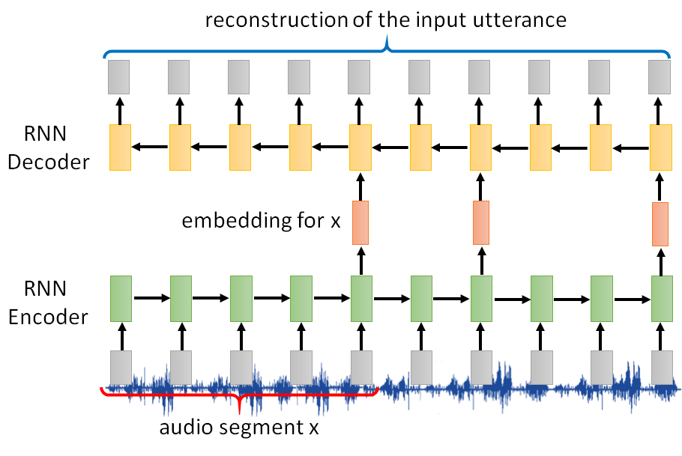
Joint Learning of Segmentation
and Seq2seq Auto-encoder
Segmental Audio Word2Vector https://arxiv.org/abs/1808.02228
This work is done by 王育軒
The learning criterion of LSTM encoder and decoder is the weighted sum of the following two terms.
  1. Minimizing Reconstruction error
  2. Minimizing the number of segments, that is the number of output embedding
The second term is necessary.
If we only minimize reconstruction error,
LSTM encoder would output embedding at all of the time steps.

Slide 24

GAN
Discriminator
Generated or real text?
Generated Phoneme Seq
Real Phoneme Seq
Downstream
Phonemicize
Unsupervised
Text
(Segmental) Audio Word2vec
This is the first unsupervised ASR in the world.
Unsupervised
(Self-supervised)
https://arxiv.org/abs/1804.00316
This work is done by 劉達融

Slide 25
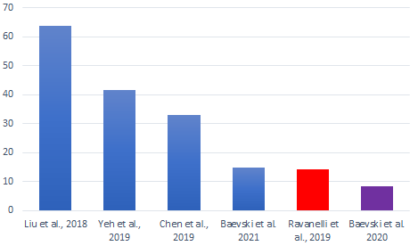
Is Unsupervised Speech Recognition possible?
https://arxiv.org/abs/1812.09323
PER on TIMIT
https://arxiv.org/abs/1804.00316
https://arxiv.org/abs/1904.04100
https://arxiv.org/abs/1811.07453

Slide 26
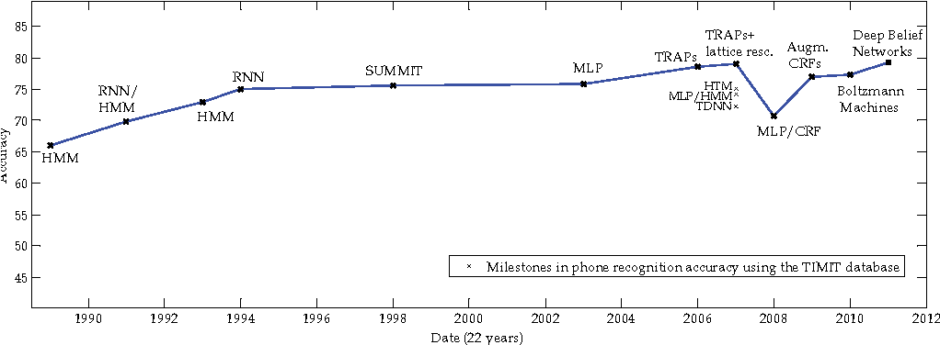
The progress of supervised learning
Accuracy
Unsupervised learning is already as good as supervised learning 30 years ago.
https://arxiv.org/abs/1904.04100
This work is done by 陳冠宇
The image is modified from: Phone recognition on the TIMIT database Lopes, C. and Perdigão, F., 2011. Speech Technologies, Vol 1, pp. 285--302.

Slide 27

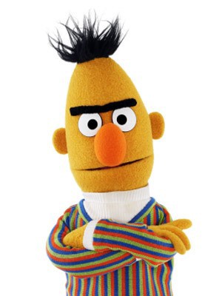

Speech
BERT
Learn to reconstruct
https://arxiv.org/abs/1910.12638
Linear
Andy T. Liu
Mockingjay
mimic sound it hears
Like BERT
(also, like MaskGIT)
Some of the input are masked
masked
masked

Slide 28
Masking
Masking consecutive features
Smoothness of acoustic features
Masking strategies for speech
https://arxiv.org/abs/1910.12638
Masking specific dimensions
Learn more speaker information in this way
TERA: https://arxiv.org/abs/2007.06028
Notes:
I don’t know why we can get speaker information freq masking.

Slide 29
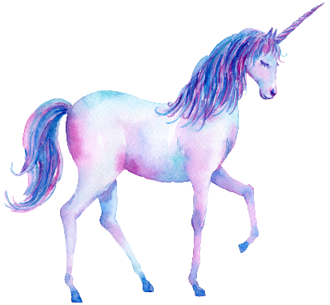





Speech
GPT
$$n=1$$
$$2$$
$$3$$
https://arxiv.org/abs/1910.12607
APC = Autoregressive Predictive Coding
Linear classifier
For text:
$$n=1$$
APC
For speech:
Usually $n>3$
Similar to GPT
Notes:
n = 3 - 5

Slide 30
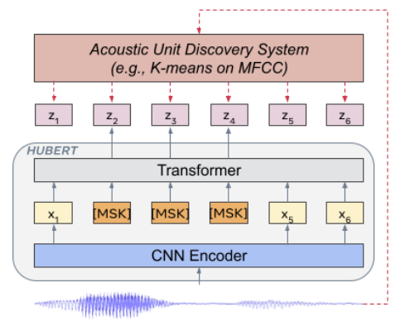
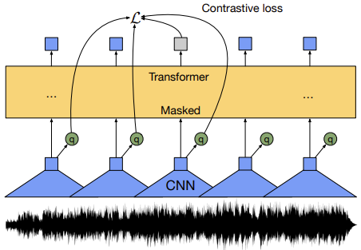
Wav2vec / HuBERT
Wav2vec
HuBERT
https://arxiv.org/abs/1904.05862
https://arxiv.org/abs/2006.11477
https://arxiv.org/abs/2106.07447

Slide 31
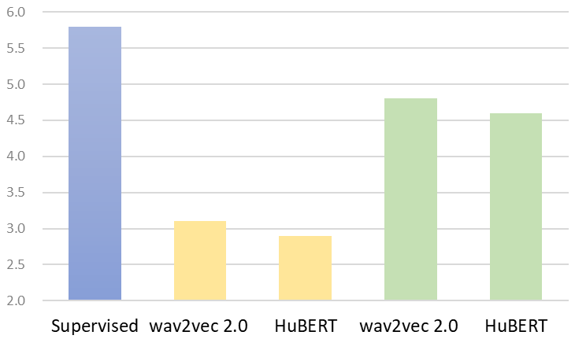
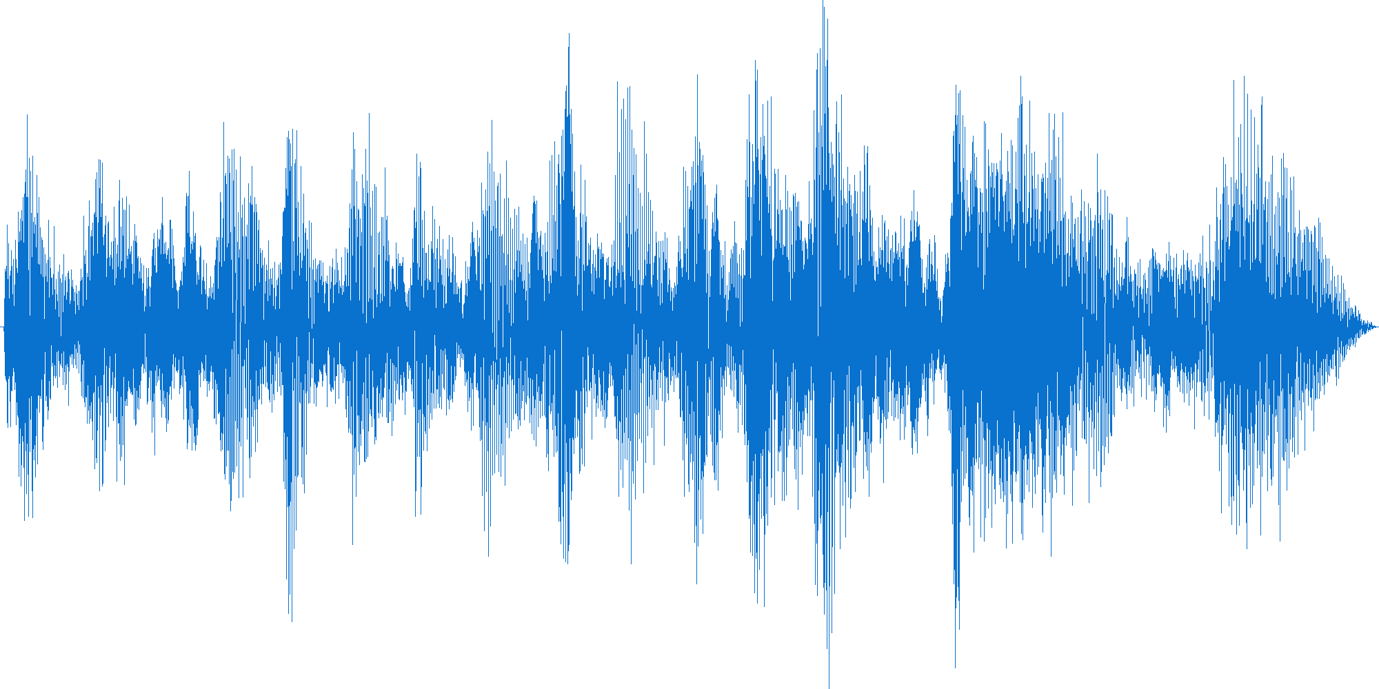
WER (Librispeech)
“How are you?”
Supervised
6-layer LSTM
Downstream
2-layer LSTM
RepresentationModel
Unsupervised
(Self-supervised)
100 hours
labeled data
10 minutes
labeled data
https://arxiv.org/abs/1905.03072
https://arxiv.org/abs/2006.11477
https://arxiv.org/abs/2106.07447
https://arxiv.org/abs/2105.01051
Notes:
--General-purpose knowledge for speech processing, from acoustic signals to semantics
--Easy to add new tasks
--Storage saving
=========
但 SSL 的 generalizability 使其更易於對所有 task 都有幫助，甚至是 unseen task。然後就更強調 SSL 之所以重要是因為他能 generalize for new task。反之若 SSL 不能輕易 generalize for many tasks 那可能還不如就每個 task 都做 dedicated self-training，反正每個 task 都要花一堆資源。SSL for many task 的重要性出來後，GLUE-like benchmark 就也很重要了
=========
computation of upstream model is heavy,
use cases (tasks) and model proliferation (hard to maintain, not scalable, etc.),
need computation sharing, simple/common/handy architecture with ok performance is more desirable than complicated/specialized architecture with slightly better accuracy。
這個motivation 或許是在介紹SUPERB這個challenge 的時候可以提到 (i.e., motivated both why Decathlon and why simple/upstream fixed)
========
(apc, mockingjay, pase,
Tera, wav2vec series, hubert)
All datasets are open
Fixed the upstream model
Keep the downstream as simple as possible
We have a toolkit
A leaderboard can submit now

Slide 32
GAN
Discriminator
Generated or real text?
Generated Phoneme Seq
Real Phoneme Seq
Downstream
Phonemicize
Text
Segmental Audio Word2vec
Unsupervised
Wav2vec 2.0
(Self-supervised)

Slide 33
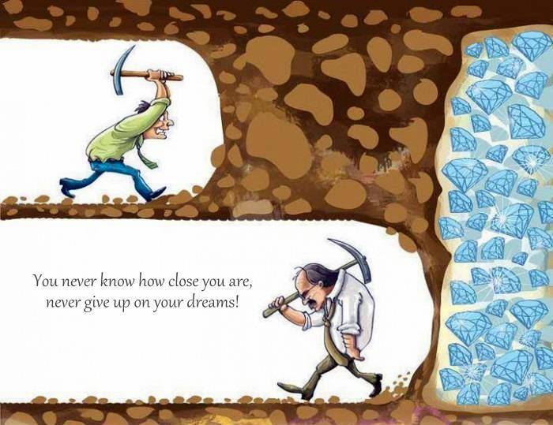
Using the last layer of wav2vec 2.0
Groundbreaking performance of Unsupervised ASR
wav2vec 2.0 model is not helpful
wav2vec 2.0 is overpraised.

Slide 34



Are speech representation models universal?
ASR
SID
PASE+
DeCoAR
Head
Head
APC
CPC
VQ-APC
wav2vec
Speech Representation
NPC
HuBERT
?
Mockingjay
WavLM
TERA
……
Unlabeled
Speech Data
Dated back to 2021 …
Speech Representation Models
This is not obvious.

Slide 35


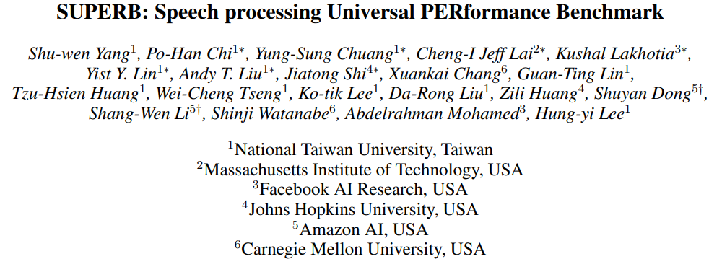

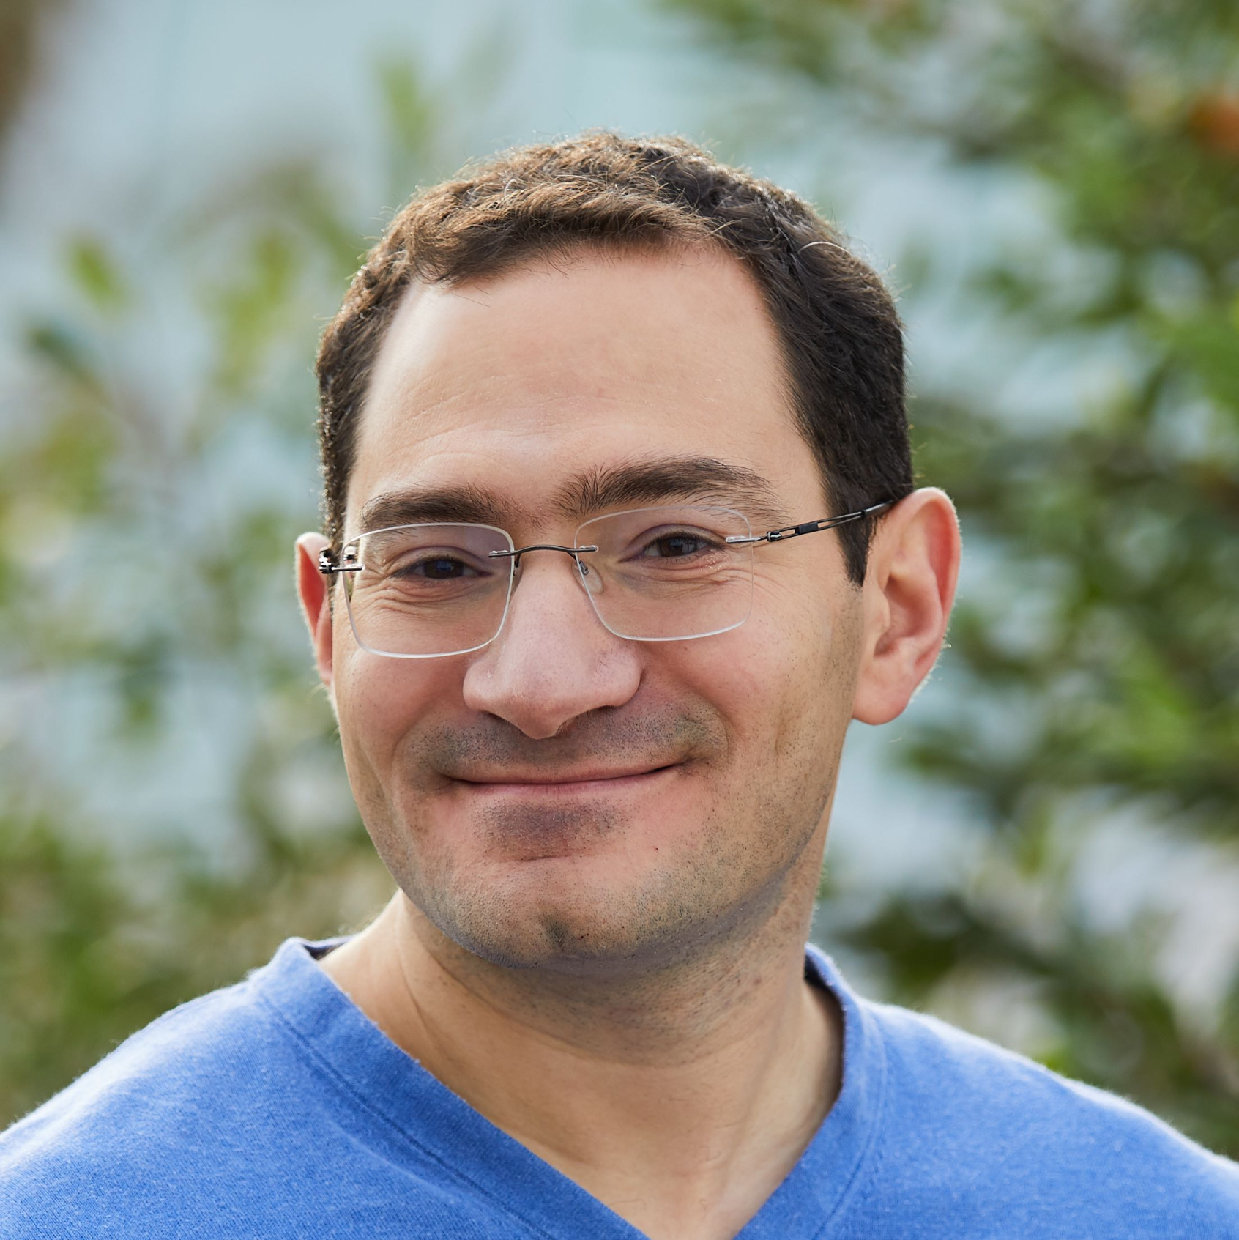


Speech processing Universal PERformance Benchmark
Shu-wen
(Leo) Yang
Shang-Wen
Li
Abdelrahman Mohamed
Shinji
Watanabe
Hung-yi
Lee
Notes:
Pixio
thanks Hung-yi for putting this together. It looks great to me. One thing we could mention is the next step of SUPERB. I think you have mentioned greener model (perhaps on-device as well). We can also mention that we plan to organize challenge in SLT (and talk about the goal of challenge is not ranking but analyzing self-supervised learning models in various scenarios) and will share more info with the community in April

Slide 36
Speech processing Universal PERformance Benchmark
Evaluate a wide range of speech representation models on many speech tasks
Phoneme
Recognition (PR)
Speaker Identification (SID)
Emotion
Recognition (ER)
Intent
Classification (IC)
Voice Conversion (VC)
Keyword
Spotting (KS)
Speaker Verification (SV)
Sentiment Analysis (SA)
Spoken
Slot Filling (SF)
Speech Enhancement (SE)
Speech Recognition (ASR)
Speaker Diarization (SD)
Sarcasm Detection (SarD)
Speech Translation (ST)
Speaker Separation (SS)
Query-by-Example
(QbyE)
Persuasiveness Prediction (PP)
https://arxiv.org/abs/2105.01051
https://arxiv.org/abs/2203.06849
Content
Speaker
Prosody
Semantic
Synthesis
Notes:
thanks Hung-yi for putting this together. It looks great to me. One thing we could mention is the next step of SUPERB. I think you have mentioned greener model (perhaps on-device as well). We can also mention that we plan to organize challenge in SLT (and talk about the goal of challenge is not ranking but analyzing self-supervised learning models in various scenarios) and will share more info with the community in April

Slide 37
Most speech representation models are worse than acoustic features (fbank) for speaker verification.
Last Layer
...
I knew it. Speech representation models cannot be universal.
Layer 2
Layer 1
Hung-yi Lee
Large models such as wav2vec-large and HuBERT-large perform as poorly as fbank on some tasks.
Does not always lead to decent performance.
Notes:
Start from the first layer …….???

Slide 38
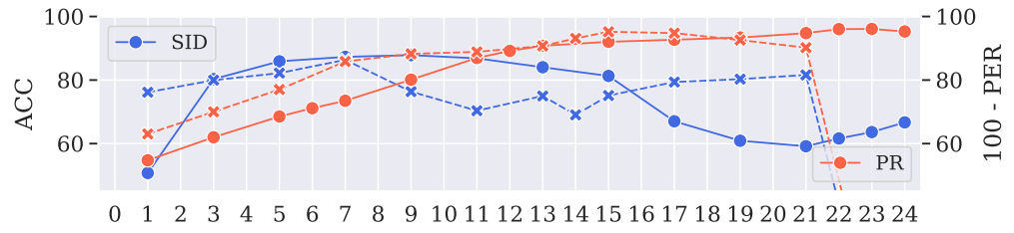

Different Layers Encode Different Information
Figure credit: Shu-wen Yang
layers
PR (phoneme recognition) - phonetic information in the last few layers
SID (speaker identification) - speaker information in the first few layers
The last layer of Wav2vec 2.0 large encodes either phonetic and speaker information.
Notes:
Larger the better

Slide 39






......
$$w_{3}$$
Last Layer
Layer 3
Head
$$x^{2}$$
...
$$w_{2}$$
Layer 2
Layer 2
+
$$x^{1}$$
$$w_{1}$$
$$w_{1}x^{1}+w_{2}x^{2}+…$$
Layer 1
Layer 1
Jointly learned with task-specific parameters
Does not always lead to decent performance.
“Weighted-sum” is very effective!
Notes:
Start from the first layer …….???

Slide 40
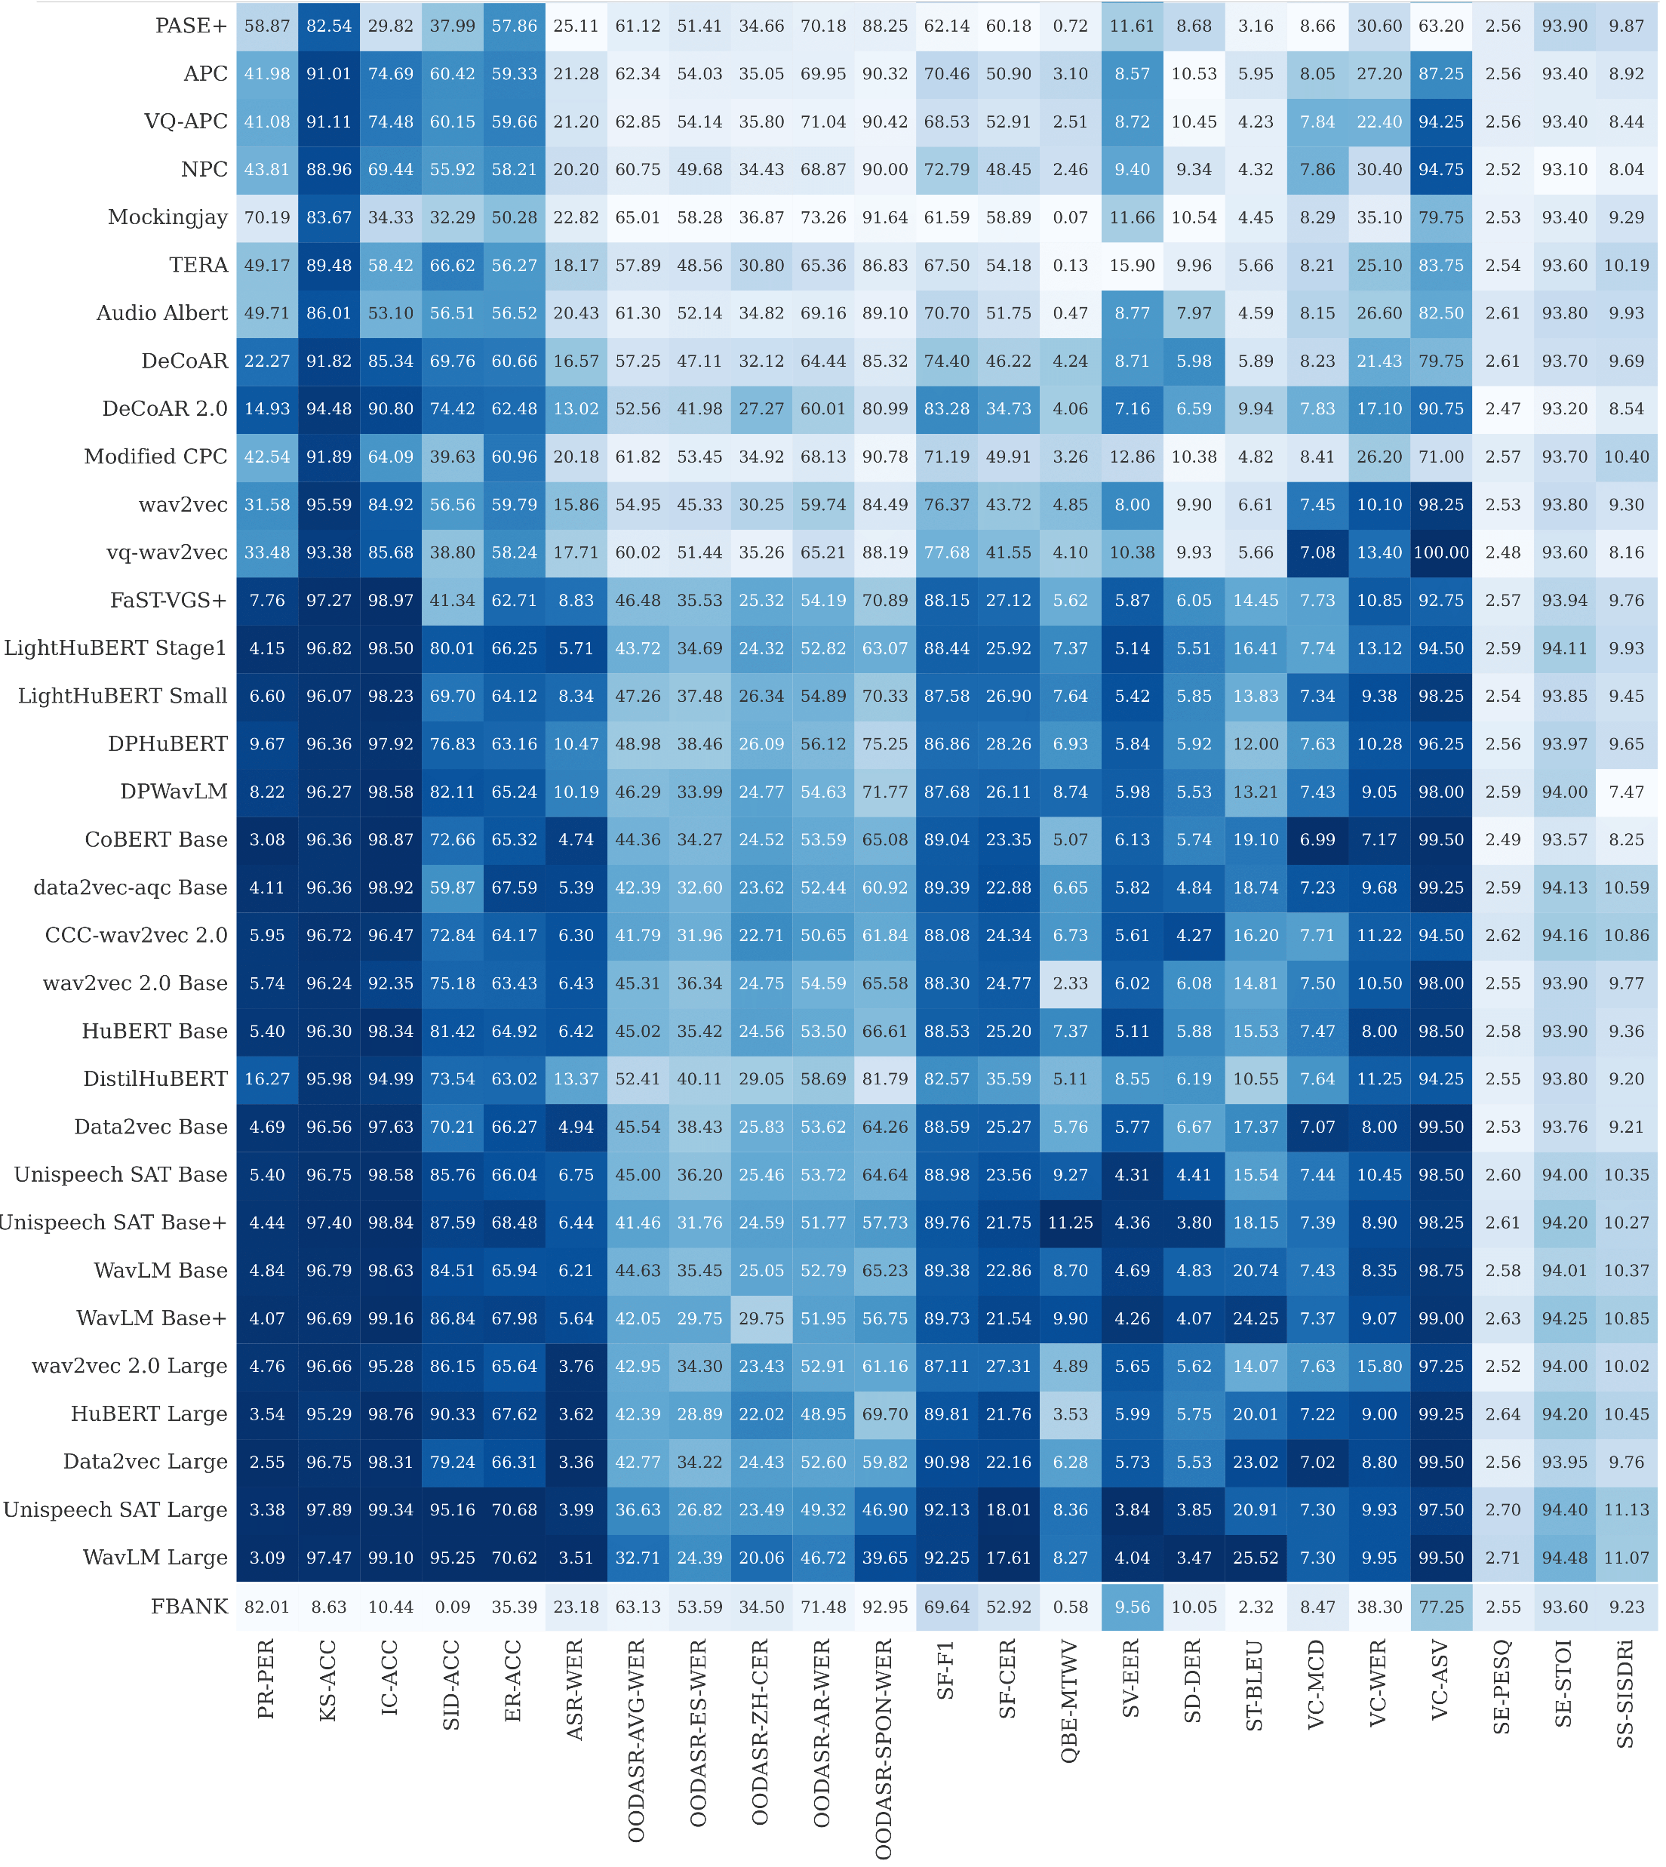
Row - SSL model
Column – Task
Value – The darker, the better
Speech SSL models can be universal!
Table credit: Shu-wen Yang
Notes:
The darker, the better

Slide 41
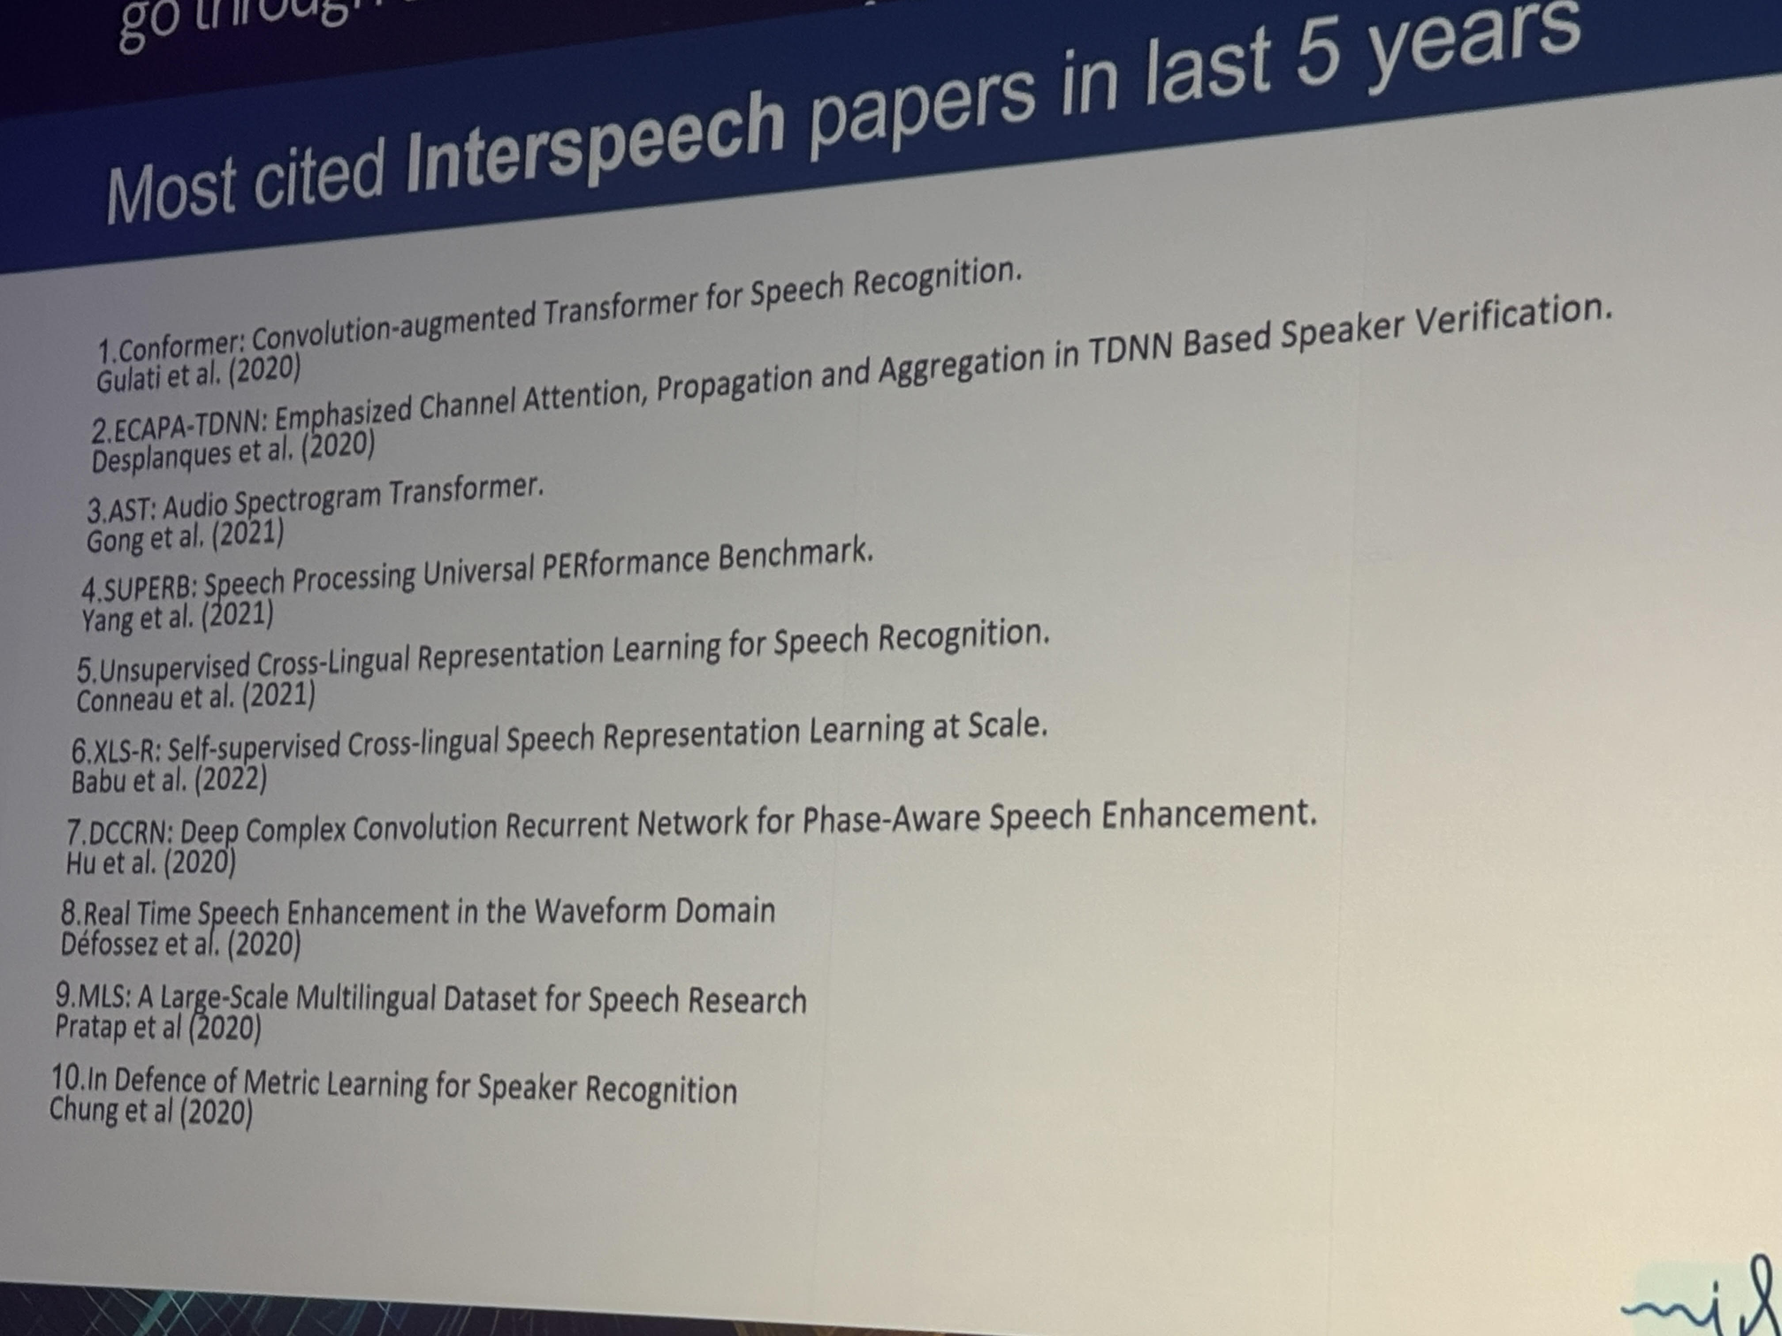
INTERSPEECH is one of the top three internationally recognized conferences in the field of speech processing.

Slide 42
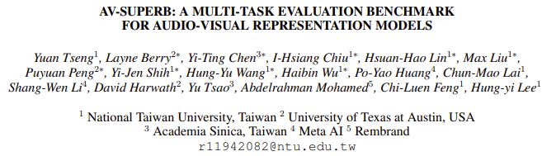
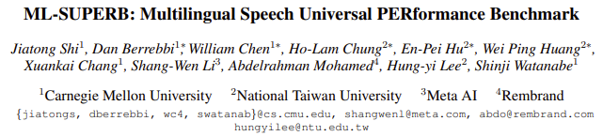
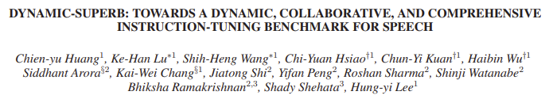
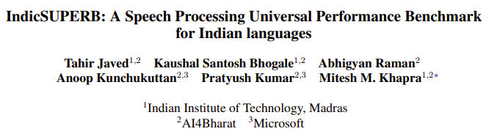
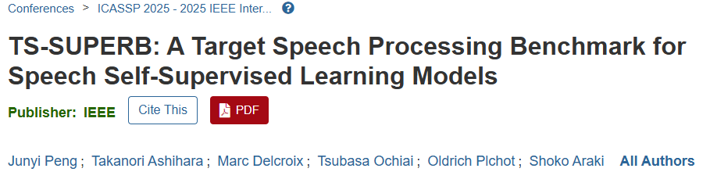
The SUPERB Universe

Slide 43
Wav2vec-U: Unsupervised ASR with Wev2vec
Unsupervised learning
Supervised learning
https://arxiv.org/abs/1812.09323
PER on TIMIT
Wav2vec-U
https://arxiv.org/abs/2105.11084
Wav2vec-U uses the 15th layer instead of the last layer.
https://arxiv.org/abs/1804.00316
https://arxiv.org/abs/1904.04100
https://arxiv.org/abs/1811.07453

Slide 44
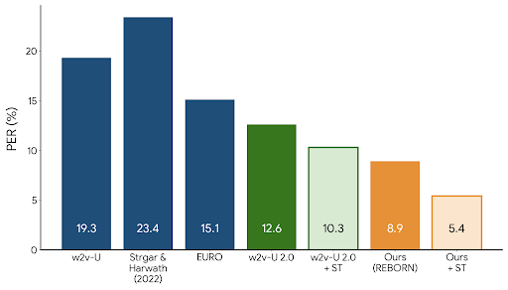
REBORN
https://arxiv.org/abs/2402.03988
Librispeech
training data:
  100 hours

Slide 45
Listening Comprehension (Speech QA)
Answer
Speech QA
Spoken Document
Question

Slide 46

Listening Comprehension
TOEFL Listening Comprehension Test by Machine
(The original story is 5 min long.)
Audio Story:
Question: “ What is a possible origin of Venus’ clouds? ”
Choices:
(A) gases released as a result of volcanic activity
(B) chemical reactions caused by high surface temperatures
(C) bursts of radio energy from the plane's surface
This work is done by 曾柏翔
(D) strong winds that blow dust into the atmosphere
https://arxiv.org/abs/1608.06378

Slide 47
Listening Comprehension (Speech QA)
Answer
Text QA
Text document
Text question
ASR
ASR
This work is done by 李佳軒https://arxiv.org/abs/1804.00320
https://arxiv.org/abs/1808.02280
Spoken Document
Question

Slide 48
End-to-End Speech QA
Answer
Downstream Head
Speech Representation Model
(HuBERT)
This work is done by 林冠廷
https://arxiv.org/abs/2203.04911
Spoken Document
Question

Slide 49
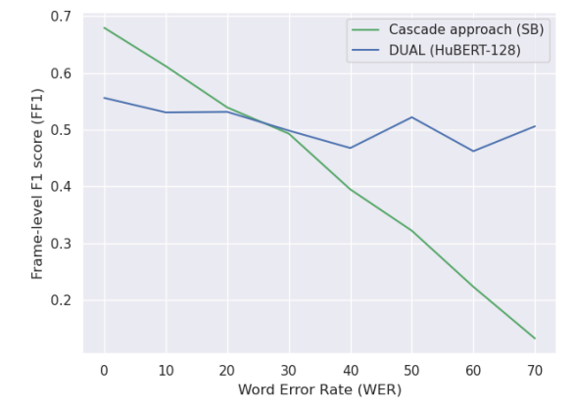
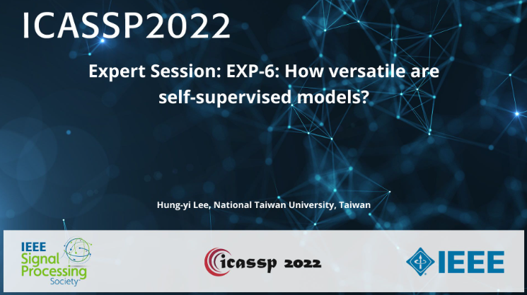
End-to-End Speech QA
https://arxiv.org/abs/2203.04911
End-to-end speech QA
(without ASR)
Cascade:
ASR + Text QA
https://rc.signalprocessingsociety.org/conferences/icassp-2022/spsicassp22vid1971

Slide 50
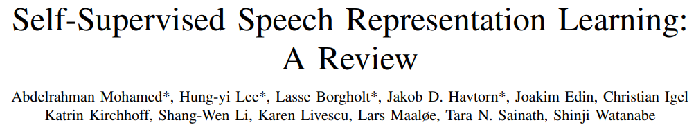
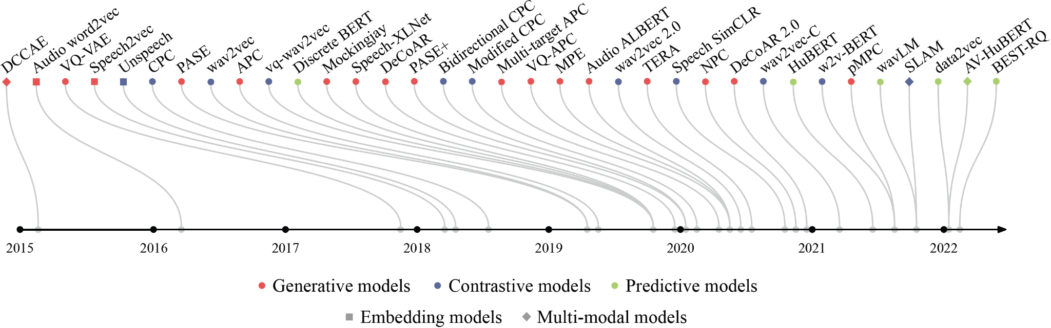
https://arxiv.org/abs/2205.10643

Slide 51
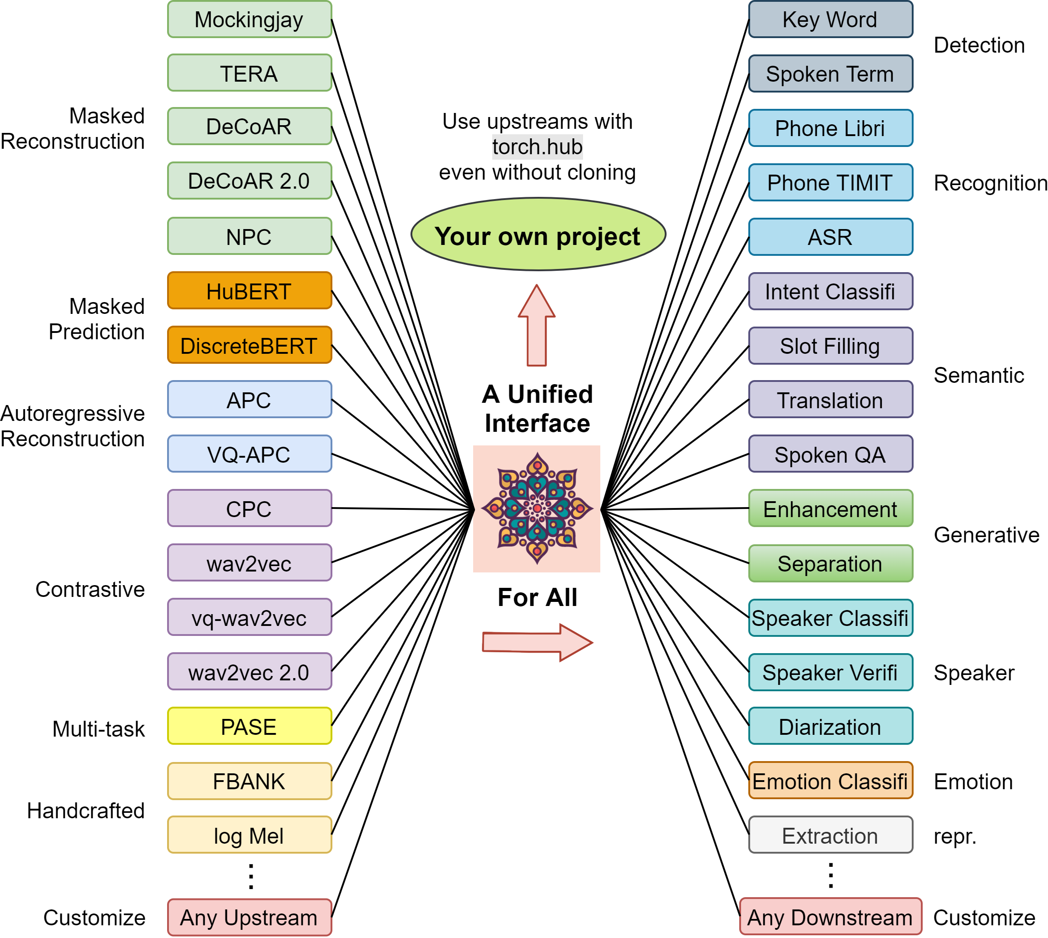

Useful Toolkit!
The S3PRL toolkit
https://github.com/s3prl/s3prl
Creator
Andy T. Liu
Shu-wen
(Leo) Yang
Over 2.5k stars & used by over 180 repos

Slide 52
2. 初代語音語言模型
Notes:
要不要講 continuous

Slide 53
Speech LLM
Generative Spoken Language Modeling (GSLM) from Raw Audio
https://arxiv.org/abs/2102.01192
Waveform
Waveform
Tokenizer
Detokenizer
Token Sequence
Token Sequence
Speech
LLM
Notes:
LLM generates one text token each time in an auto-regressive way

Slide 54

5
77
5
Representation Model
Detokenization
Model
Tokenization
K-means or VQ-layer
3
2
2
2
77
3
3
2
Deduplicate
?????
3
2
77
3
2
BPE (Byte Pair Encoding)
5
77
5
Notes:
What is a “token” in the context of speech?

Slide 55
Another possible pipeline of speech tokenization
Neural Speech Codec
The tokenizer and detokenizer are learned jointly.
Tokenizer
3
77
23
4
Codec
Detokenizer
decompression
compression
Notes:
Need a vocoder?
Many types of vocoder???

Slide 56
Various Types of Speech Tokenizers
Two Types of Tokens
Speech
Representation
Tokenizer
Tokenizer
Neural Codec
“Sematic Token”
“Acoustic Token”
Which one is the best choice?
Notes:
Discrete features are sometimes categorized into ``semantic'' and ``acoustic'' tokens~\citep{audiolm}. Semantic tokens are usually derived from SSL or supervised pre-trained speech encoders; they are assumed to capture the linguistic content and are often used as a replacement for text tokens, particularly in ``textless'' scenarios. On the other hand, acoustic tokens are derived from neural audio codec models and %usually consist of multiple streams due to RVQ. They capture finer-grained acoustic information such as speaker style and acoustic environment, which is crucial for high-fidelity speech synthesis.\footnote{Note that the term "semantic" here differs from the linguistic notion of semantics and that the distinction between semantic and acoustic tokens can be vague. Semantic tokens also contain certain acoustic information that might affect the synthesized speech~\citep{Peng2024AnES}, while acoustic tokens also contain linguistic information since they are designed for audio compression~\citep{soundstream, encodec}. Some recent work has tried to unify the two types of speech tokens~\citep{speechtokenizer}. In addition to semantic and acoustic tokens, some spoken language models, such as pGSLM and dGSLM, also incorporate discretized speech features (e.g., fundamental frequency and token duration) into language modeling.}
Streaming is another issue?
Decoding strategies
Multiple stages
Spirit LM
Or other decoding strategies -> 哪一篇 問一下凱為
https://arxiv.org/abs/2306.05284

Slide 57
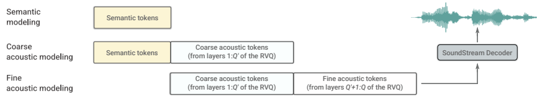
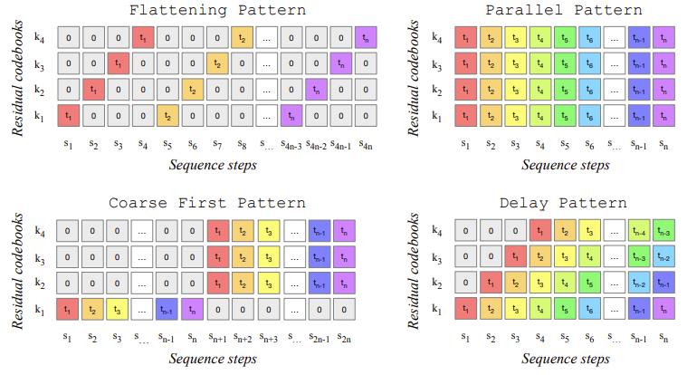
Just use all of them!
Audio LM https://arxiv.org/abs/2209.03143
How to arrange the order of their generation
https://arxiv.org/abs/2306.05284

Slide 58
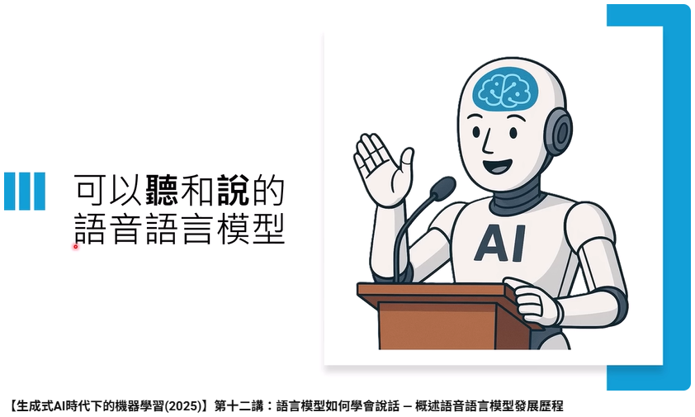
https://www.youtube.com/watch?v=gkAyqoQkOSk
27:00 – 39:00

Slide 59

Very challenging!
Speech LLM
(speech token only)
He assassinated the president
He assassinated the president and gave mister johnson the last charge of improvement in his writing possible three point eight nine.
https://arxiv.org/abs/2306.02207
Does this sentence make sense?
… while the sentence has recognizable English words and phrases, as it is currently constructed, it doesn't coherently communicate a clear, singular idea or sequence of connected ideas. …
Chat GPT
Notes:
It is challenging to generate semantically coherent sentences.

Slide 60
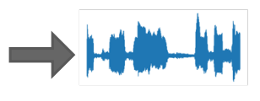
In-context Learning
happy
Speech Language Model
happy
sad
Demonstration
Text LLM usually has the in-context learning capability, but speech LM (GSLM) has not shown similar capability.
https://arxiv.org/abs/2310.12477

Slide 61
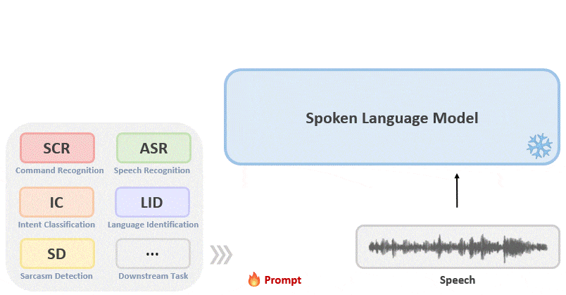

Prompting Speech LLM for Different Tasks
https://ga642381.github.io/SpeechPrompt/
Kai-Wei Chang
Notes:
https://ga642381.github.io/SpeechPrompt/speechgen.html
Kai-Wei Chang

Slide 62


Why is training speech LM so challenging?
Pre-trained Speech LLM
1M hours of speech data
100 text tokens
per minute
LLaMA 3 pre-trained on 15T text tokens …
6B text tokens
285k years of speech data
Notes:
10^{12 ->}
10^10 min -> 166,666,666.7 hours -> 2,500,000,000

Slide 63
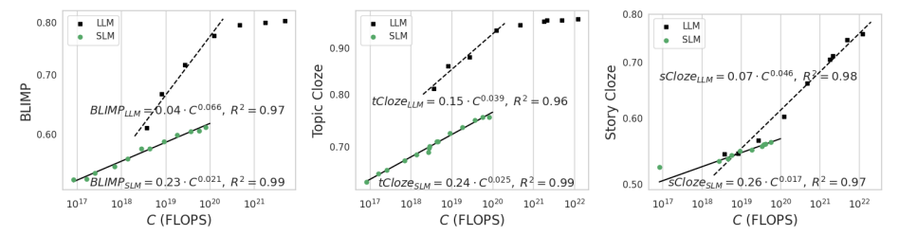
Why is training speech LM so challenging?
https://arxiv.org/abs/2404.00685
Text LLM
Speech
LLM
Besides content, speech LLMs also have to learn to understand other information (such as speaker identity, emotion, etc.) that text LLMs do not have to.
Notes:
Scaling Properties of Speech Language Models
https://arxiv.org/abs/2404.00685
We show that the linguistic performance of SLMs scales up to three orders of magnitude more slowly than that of text-based LLMs.

Slide 64
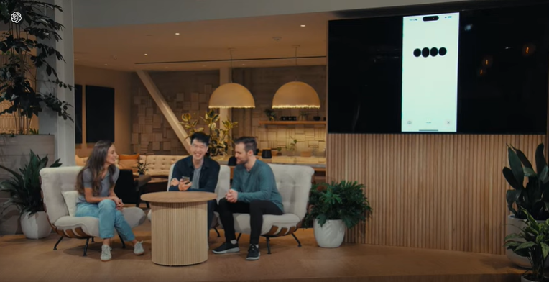
Until …….
GPT-4o Voice Mode
Source of image: https://www.youtube.com/watch?v=DQacCB9tDaw
Notes:
OpenAI Spring Update – streamed live on Monday, May 13, 2024.

Slide 65
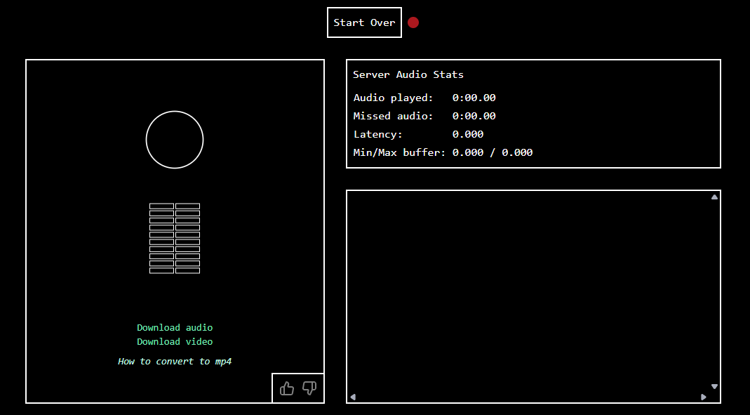
Moshi
https://moshi.chat/
Notes:
7 月

Slide 66
3. 如何利用強大的文字模型

Slide 67

https://youtu.be/CgQ3lUOpXgc?si=LhzquKSJTdOTjZCw
Notes:
Video of audio-4o-audio

Slide 68
Starting from Text LLM
Answer
Downstream Head
Initialized by text LLM (BERT)
Speech Representation Model
(HuBERT)
DUAL
https://arxiv.org/abs/2203.04911
GSQA
https://arxiv.org/abs/2312.09781
Spoken Document
Question

Slide 69
Starting from Text LLM
Text
LLM
How are you?
I am good.
Initialization
Spoken
LLM
3
77
23
12
71
34
3
23
TWIST
https://arxiv.org/abs/2305.13009

Slide 70


Jointly learned from the speech and text
Widely studied in the era of shared encoder
Speech
LLM
Source:
speechT5
How to better alignment between speech and text
https://arxiv.org/abs/2110.10329
https://arxiv.org/abs/2110.07205
https://arxiv.org/abs/2204.03409

Slide 71
Jointly learned from the speech and text
Methods for spoken LM
how
are
you
how
12
71
34
you
paired data available
Pre-training on hybrid sequences
interleaving
(Unlike typical pre-training, some labeling is required here.)
3
77
23
12
71
34
3
23
3
77
23
are
3
23
Toward Joint Language Modeling for Speech Units and Text
https://arxiv.org/abs/2310.08715
Spirit LM
https://arxiv.org/abs/2402.05755
Notes:
https://arxiv.org/pdf/2504.02398

Slide 72
Text-Speech Hybrid Generation
Text
LLM
how
are
you
Initialization
Prevent forgetting the text LLM's capabilities.
Speech
LLM
how
3
77
23
are
12
71
you
34
3
23
Detokenization

Slide 73
Text-Speech Hybrid Generation
Each corresponds to a fixed period of time, such as 0.02s.
Speech Tokens
longer
……
how are you
Complex Alignment: Each text token corresponds to a different number of speech tokens.
how
are
you
Text Tokens
shorter
Notes:
This is similar to an inner monologue, allowing the model to consider what it wants to say in text before actually expressing it in speech.
Hybrid decoding
ASR in mind (Spenctron)
Spectron

Slide 74
Text then speech (sentence-level):
https://arxiv.org/abs/2305.15255
This is almost TTS
how
are
you
3
77
23
12
71
34
3
23
Drawback: cannot streaming
Text then speech (word-level):
https://arxiv.org/abs/2411.07111
https://arxiv.org/abs/2505.17496
how
3
77
23
are
12
71
34
you
3
23
We need alignment between text and speech during training.
Text then speech (chunk-level):
https://arxiv.org/abs/2412.02612
……
how
3
77
are
23
12
you
71
34
3
23
Notes:
Hybrid decoding
ASR in mind (Spenctron)
Spectron

Slide 75
Text-Speech Hybrid Generation
Text and speech at the same time
…….
how
3
are
77
you
23
Two LM heads
Spoken LLM
The text token and speech token do not have the same scale (their lengths differ significantly).

Slide 76



















3
77
23
12
71
34
3
23
Mini-Omni
https://arxiv.org/abs/2408.16725
how
are
you
$$ε$$
$$ε$$
$$ε$$
$$ε$$
$$ε$$
CTC loss
$$ε$$
3
77
$$ε$$
23
$$ε$$
12
71
LLaMA-Omni
https://arxiv.org/abs/2409.06666
how
$$ε$$
$$ε$$
$$ε$$
are
$$ε$$
$$ε$$
$$ε$$
fixed number
fixed number
3
77
23
12
71
34
3
23
Moshi
https://arxiv.org/abs/2410.00037
how
$$ε$$
$$ε$$
are
$$ε$$
you
$$ε$$
$$ε$$
This is similar to a duration model.

Slide 77


Text then speech (word-level)
https://arxiv.org/abs/2411.07111
https://arxiv.org/abs/2505.17496
 | I am hungry now. Can you give me some ideas? |  | I'd be happy to help you with some ideas for something to eat. What kind of food are you in the mood for? Are you craving something sweet, savory, or something else? Do you have any dietary restrictions or preferences? Let me know and I can suggest some options for you.
The training data is approximately 1,000 hours.
音檔由蕭淇元同學提供
Notes:
(與群聯合作的成果)

Slide 78
3 – 4 Hz
Text
LLM
how
are
you
Initialization
Speech
LLM
how
3
77
23
are
12
71
you
34
3
23
50 Hz
Ten times the length and one hundred times the computational cost for attention...

Slide 79
4. 尋找更合適的語音表示方式

Slide 80




https://arxiv.org/abs/2504.07053
Liang-Hsuan Tseng
(NTU)
Yi-Chang Chen
(MediaTek)
Kuan-Yi Lee
(NTU)
Notes:
Liang-Hsuan Tseng∗23 Yi-Chang Chen∗

Slide 81
Can we have speech tokens designed for text-speech hybrid generation?
1. Straightforward relationship with text (cannot be fixed duration)
e.g., one speech token corresponds to one text token
0.02s
Tokenizer
Tokenizer
same number
how
are
you

Slide 82
Can we have speech tokens designed for text-speech hybrid generation?
1. Straightforward relationship with text (cannot be fixed duration)
e.g., one speech token corresponds to one text token
Text-speech hybrid generation can be so simple.
how
56
are
33
you
162
Speech LLM
Notes:
https://arxiv.org/abs/2504.07053
Just one text token and one speech token

Slide 83
Can we have speech tokens designed for text-speech hybrid generation?
2. No need to include content information.
Speech tokens focus on information that cannot be expressed by text.
Detokenizer
are
……
how
you
Speech LLM
Notes:
Speech tokens focus on information that cannot be expressed by text. to include content information.

Slide 84
different layers
Each corresponds to a fixed period of time.
Pre-trained Speech Encoder
e.g., Whisper Encoder

Slide 85
Detokenizer
Use the network architecture of the TTS model (CozyVoice)
how
are
you
Aggregator (several attention layers)
query
how are you
key
value
Tokenizer
ASR
Pre-trained Speech Encoder
e.g., Whisper Encoder

Slide 86
Detokenizer
How to pronounce a text token
how
are
you
Aggregator (several attention layers)
query
how are you
key
value
Tokenizer
ASR
Pre-trained Speech Encoder
e.g., Whisper Encoder

Slide 87
Detokenizer
how
are
you
Aggregator (several attention layers)
query
how are you
key
TASTE (Text-Aligned Speech Tokenization and Embedding)
value
Pre-trained Speech Encoder
Minimize reconstruction error

Slide 88
Detokenizer
Detokenizer
… but now Murdoch came around to stare at the gang …
Any news on the dancer‘s assault case?
……
……
Tokenizer
Tokenizer
… but now Murdoch came around to stare at the gang …
Any news on the dancer‘s assault case?

Slide 89
Detokenizer
Detokenizer
… but now Murdoch came around to stare at the gang …
Any news on the dancer‘s assault case?
……
……
Tokenizer
Tokenizer
… but now Murdoch came around to stare at the gang …
Any news on the dancer‘s assault case?

Slide 90
Training Speech LLM
https://arxiv.org/abs/2504.07053
at
56
my
33
eyes
162
Text LLM as initialization
Speech LLM
look
101
at
56
my
33
Tokenizer
101
56
33
162
a large amount of unlabeled audio data
look
at
my
eyes

Slide 91
Compared with Other Pretrained Models
Continuation
Model A
Evaluation
ASR+GPT-4o: semantic coherence
UTMOS: audio quality
Human: how reasonable the utterances are
Model B
Model C

Slide 92

Compared with Other Pretrained Models
Compared with the spoken LLM with supervised instruction fine-tuning
Notes:
https://chatgpt.com/c/689853b3-2b64-8333-9742-3d410716db9d

Slide 93

English Demo
https://www.youtube.com/watch?v=gkAyqoQkOSk&t=4450s

Slide 94
Chinese Demo
大家好
你這個廢物
我是李宏毅
台灣最高的山
大家好我是李宏毅
今天很高興來給這場演講
感謝陳竣瑋同學產生結果

Slide 95
Chinese Demo
不要瞎掰好嗎
我信你個鬼
唉唷~我老爸得了 MVP
亮你好厲害
又拿到了全學年的第一名
啊能能
感謝陳竣瑋同學產生結果
Notes:
啊難啊難 那你現在回家 那是什麼 喝酒嗎 喝酒嗎對對對對

Slide 96
More ….
Dynamic Token Rate
SyllableLM: Learning Coarse Semantic Units for Speech Language Models
  https://arxiv.org/abs/2410.04029
Sylber: Syllabic Embedding Representation of Speech from Raw Audio
  https://arxiv.org/abs/2410.07168
CodecSlime: Temporal Redundancy Compression of Neural Speech Codec via Dynamic Frame Rate
  https://arxiv.org/abs/2506.21074
TaDiCodec: Text-aware Diffusion Speech Tokenizer for Speech Language Modeling
  https://arxiv.org/abs/2508.16790
FlexiCodec: A Dynamic Neural Audio Codec for Low Frame Rates
  https://arxiv.org/abs/2510.00981
TASLA: Text-Aligned Speech Tokens with Multiple Layer-Aggregation
  https://arxiv.org/abs/2510.14934
Text
Text + Dynamic Token Rate
Notes:
Variable-rate hierarchical CPC [20] introduced reinforcement learning to discover acoustic units with dynamic boundaries. Recent innovations like and SyllableLM [21] and Sylber [22] leverage syllable-aligned SSL representations to achieve ultra-low frame rates (≈5 Hz)

Slide 97

5. 語音語言模型
的三部曲
Notes:
For S2S models, GOAT-SLM [6] is the only model emphasizing paralinguistic-aware dialogue with a multi-stage SFT pipeline. These works rely on SFT with carefully curated, high-quality data, whereas we explore RL to reduce this reliance.
W. Yu, S. Wang, X. Yang, X. Chen, X. Tian, J. Zhang, G. Sun, L. Lu, Y. Wang, and C. Zhang, “Salmonn-omni: A codec-free LLM for full-duplex speech understanding and generation,” arXiv Preprint, 2024.

Slide 98

How to Train Speech LLM
Pre-trained Speech LLM
Unlabeled speech data
Next “Speech Token” Prediction
Human annotated data
Speech
LLM
SFT
Text
LLM
Text
conversation
TTS
speech
conversation
https://arxiv.org/abs/2411.07111
Notes:
It is challenging to generate semantically coherent sentences.
(Used in SpeechGPT-2.0-preview)

Slide 99


How to Train Speech LLM
Pre-trained Speech LLM
Unlabeled speech data
Next “Speech Token” Prediction
Human annotated data
Speech
LLM
SFT
Speech
LLM
Preference
data
RLHF
Notes:
It is challenging to generate semantically coherent sentences.

Slide 100



Alignment with Feedback
Speech
LLM
Notes:
Checkt more reference:
Robust Zero-Shot Text-to-Speech Synthesis with Reverse Inference Optimization
Tango 2: Aligning Diffusion-based Text-to-Audio Generations through Direct Preference Optimization
BATON: Aligning Text-to-Audio Model with Human Preference Feedback

Slide 101
Alignment with Feedback
Reward
Model
Speech
LLM
Reward
Model
Speech LLM input
Reward
Model
?
Speech LLM output
Notes:
Checkt more reference:
Robust Zero-Shot Text-to-Speech Synthesis with Reverse Inference Optimization
Tango 2: Aligning Diffusion-based Text-to-Audio Generations through Direct Preference Optimization
BATON: Aligning Text-to-Audio Model with Human Preference Feedback

Slide 102


Alignment with Feedback
Guan-Ting Lin
(with researchers from the Amazon GAI team)
https://arxiv.org/abs/2411.01834
Notes:
Checkt more reference:
Robust Zero-Shot Text-to-Speech Synthesis with Reverse Inference Optimization
Tango 2: Aligning Diffusion-based Text-to-Audio Generations through Direct Preference Optimization
BATON: Aligning Text-to-Audio Model with Human Preference Feedback

Slide 103






Alignment with Feedback
Shu-wen
(Leo) Yang
(with researchers from the ByteDance Seed team)
https://arxiv.org/abs/2511.08723
Same content
Emotion
Gender
Age
Notes:
ParaS2S: Benchmarking and Aligning Spoken Language Models for Paralinguistic-aware Speech-to-Speech Interaction

Slide 104
Alignment with Feedback
https://paras2sbench.github.io/

Slide 105

6. 一邊說一邊思考
Notes:
Qwen2.5 Omni [55] uses WER as a preference signal to ground speech generation. Step-Audio [25] and Step-Audio-AQAA [24] rely on human feedback, which is annotation-heavy.
Although some recent work has adopted CoT in the speech domain, they focus primarily on applications such as speech translation Hu et al. (2025); Du et al. (2025); Gállego et al. (2025), dialogue Arora et al. (2025), or other detection tasks Mai et al. (2025); Park et al. (2025). The integration of CoT in speech LLMs requires answering two research questions: (i) should models reason using text or speech, and (ii) how do we maintain the responsiveness required for spoken interactions? To answer the first question, we investigate both alternatives, showing that text-based CoT is as performant as speech-based CoT for improving reasoning in speech LLMs, while being 2x more token-efficient.

Slide 106




Reasoning (深度思考)
ChatGPT
DeepSeek
Claude
Gemini

Slide 107
Text LLM + Reasoning
Reasoning
(text token, not shown to users)
Text output
Text LLM
Text input
Notes:
Deep Seek R series, ChatGPT o series ……

Slide 108
Speech LLM + Reasoning
(Actually, text-speech hybrid generation is used, but do not show the text token here.)
Reasoning
(text token, not shown to users)
Speech output
Speech LLM
Audio-Reasoner
https://arxiv.org/abs/2503.02318
Speech input
Audio-Thinker
https://arxiv.org/abs/2508.08039
Notes:
Previous work has shown that reasoning is helpful for speech LLM.
https://arxiv.org/abs/2503.02318

Slide 109

Simultaneous Thinking and Talking?
Reasoning
Speech output
Speech input
Waiting …
Do we need a new architecture to achieve it?
Speech output
Simultaneously
Two decoders with cross-attention?
Speech input
NO!
Reasoning
Notes:
STITCH: Simultaneous Thinking and Talking with Chunked Reasoning for Spoken Language Models

Slide 110


https://arxiv.org/abs/2507.15375
Cheng-Han Chiang and Microsoft Researchers

Slide 111

STITCH: Simultaneous Thinking and Talking with Chunked Reasoning
Using GLM-4-Voice-9B as example
On an A100, this only takes ~0.5 seconds.
39 tokens
39 tokens
1.5 seconds buffer?
Detokenizer
Detokenizer
~2 seconds
Notes:
Based on empirical studies, we set b = 0.8 for GLM-4-Voice, which implies that at least 10 speech tokens are required to generate the initial speech output.

Slide 112
STITCH: Simultaneous Thinking and Talking with Chunked Reasoning
On an A100, this only takes ~0.5 seconds.
39 tokens
100 reasoning tokens
39 tokens
1.5 seconds buffer?
Detokenizer
Detokenizer
~2 seconds

Slide 113
Typical Speech LLM + Reasoning
……
Speech input
Reasoning
STITCH
……
Speech input
Notes:
No latency cause by reasoning

Slide 114
How to prepare training data
There is already some speech-to-speech dialogue datasets (e.g., VoiceAssistant400K)
Speech input
Reasoning
Speech output
Text transcription
Text transcription
gpt-4o

Slide 115
Speech input
Reasoning
Speech output
…
…
R1
R2
R3
S1
S2
S3
100 tokens
100 tokens
100 tokens
Speech LLM
S1
R1
S2
R2
S3
R3
……
Finetune
GLM-4-Voice-9B
Learning Target

Slide 116

Same latency
extra training data
reasoning
only slightly degrade the performance
Note: Audio quality is not influenced.
Notes:
https://chatgpt.com/c/68985a1e-1c1c-832b-9299-d4f2162f7755

Slide 117
Dynamic Reasoning Chunk Sizes
device-dependent
Slower GPU
longer
less
On an A100, this only takes ~0.5 seconds.
39 tokens
100 reasoning tokens
39 tokens
1.5 seconds buffer?
shorter
Decoder
Decoder
~2 seconds

Slide 118
Dynamic Reasoning Chunk Sizes
What would happen if the training and testing reasoning chunks have different numbers of tokens?
Training
100 tokens
100 tokens
Testing
< 100 tokens
< 100 tokens
Notes:
Train long test short

Slide 119

Shorter reasoning chunks yield to worse performances
Still better than “no reasoning” in many cases
No reasoning
Tokens in each reasoning chunk during inference
Notes:
如果沒有 reasoning 的話會整個壞掉嗎?

Slide 120

Text Input
Text LLM
ASR
Speech LLM
Can we use the reasoning process generated by a text LLM to improve a speech LLM?
Speech input

Slide 121

GLM-4-9B-Chat provided reasoning.
Reasoning by speech LLM itself
(Finetune GLM-4-Voice-9B)
Llama-3.2-1B-instruct
The speech LLM did leverage the reasoning tokens.
Tokens in each reasoning chunk during inference

Slide 122

Demo Video
Source: https://d223302.github.io/STITCH/

Slide 123
More ……
Mini-Omni-Reasoner: Token-Level Thinking-in-Speaking in Large Speech Models
  https://arxiv.org/abs/2508.15827
Stream RAG: Instant and Accurate Spoken Dialogue Systems with Streaming Tool Usage
  https://arxiv.org/abs/2510.02044
SHANKS: Simultaneous Hearing and Thinking for Spoken Language Models
  https://arxiv.org/abs/2510.06917
Can SpeechLLMs Think while Listening?
  https://arxiv.org/abs/2510.07497

Slide 124

其實還有很多沒有講到的技術 ……

Slide 125
Beyond the Turn-based Game
Text Conversation
User 1:
text
text
Turn-based
User 2:
text
text
Speech Conversation
Speaker 1:
Full-duplex
overlap
Speaker 2:
Notes:
[Nguyen, et al., TACL’23][Zhang, et al., arXiv’24][Tanzer, et al., arXiv’24][Wang, et al., arXiv’24]
Dgslm
https://arxiv.org/abs/2406.15718
https://arxiv.org/abs/2405.13203
https://arxiv.org/pdf/2405.19487

Slide 126



Guan-Ting Lin
https://arxiv.org/abs/2503.04721
https://arxiv.org/abs/2507.23159
Full-Duplex-Bench
https://arxiv.org/abs/2510.07838
(With Shih-Yun Shan Kuan)

Slide 127

Do speech LLMs know how long 10 seconds is?
Kai-Wei Chang
https://arxiv.org/abs/2509.26388

Slide 128



https://arxiv.org/abs/2504.08528
Notes:
On The Landscape of Spoken Language Models: A Comprehensive Survey

