Slide 1

Sustainability policy for listed companies in Taiwan The impact of ESG performance
Oral examination for master's thesis in the Department of Economics
Supervisor: Dr. Wang Shin-shi Student: Jeffrey Chuang

Slide 2

Category
Introduction
Data Introduction
Descriptive Statistics
Research Methodology
Research Findings
Conclusion and Recommendations

Slide 3

Discussion – The importance of ESG to companies
Positive impact：Investment Appetite, Risk Reduction, Credibility Enhancement, Competition and long-term value...
Negative effect： Additional investments, financial burdens, stock compensation...
Notes:
正面影響
投資偏好（投資人偏好，吸引資金，增加公司股債流動性）、降低風險、增強信譽（外部融資較為容易，短長期財務流動性風險降低）
競爭與長期價值（結合產業，在綠色領域獲得新的附加價值）、
…
負面影響
額外投入、財務負擔（落實ESG可能需要企業進行額外的投資和改變商業模式，這可能增加企業的成本，對利潤產生壓力，同時企業的股東價值產生負面影響）
、股票報酬(排除了高污染之能源產業，則會錯過美國石油公司的股價漲幅 oxy 8.3 > 76, xom 30 > 126)

Slide 4
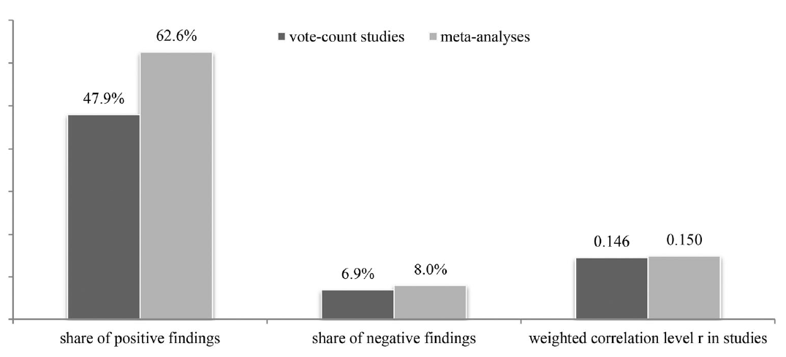
Introduction – ESG and Corporate Finance
綜合研究顯示，2200篇論文的研究統整，大多呈現正面關係
Notes:
vote_count 純粹以論文數量（相關性）的數量數數為研究之統計量。
meat_analysis 由心理學家，Hunter 和 Schmidt(1982 年)，透過將同一領域中多個研究結果整合在一起的統計方法，可以有效解決並解釋這些分歧。

Slide 5
Introduction – Research Objectives
Previous studies have mostly been related studies or often have endogenetic problem Explore: The causal relationship between sustainability policies and relevant regulations and the ESG performance of listed companies

Slide 6

Introduction
Taiwan Economic News Database (TEJ)--TESG Sustainable Development Indicators: In 2015~2021, listed companies + OTC companies (1610) ESG Report: Voluntary/Mandatory Submission, Verification of Operations Company data: amount of paid-up capital, industry category Supplementary data: a total of 45 financial indicators
Notes:
資料介紹。
SASB可持續發展會計準則委員會

Slide 7
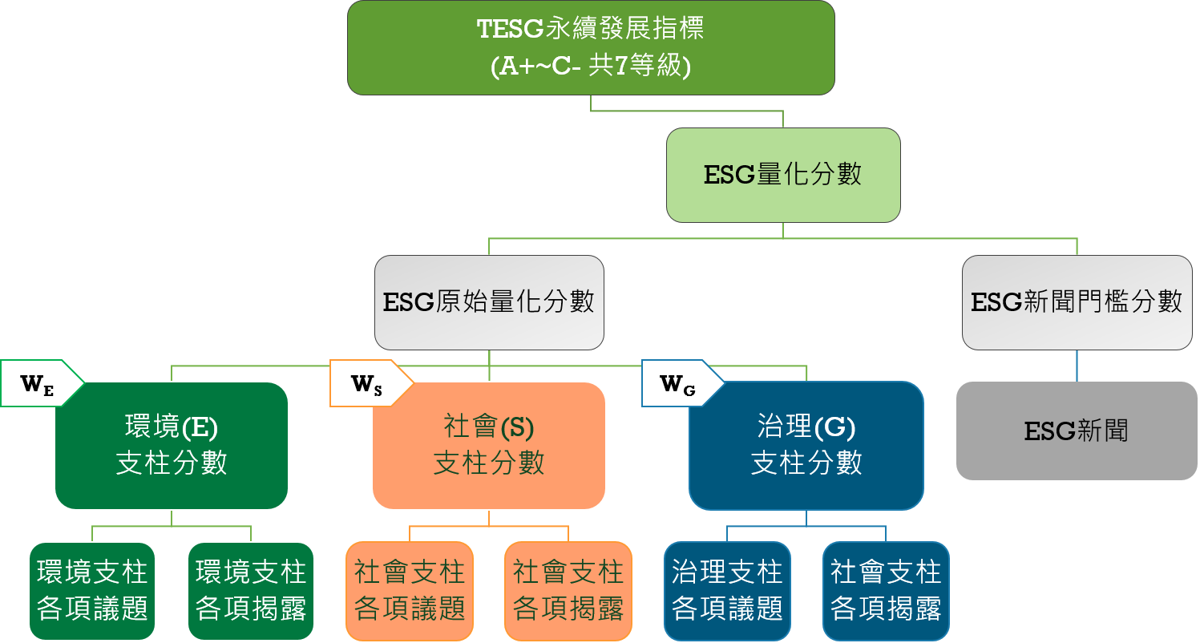
Presentation – Scoring process

Slide 8
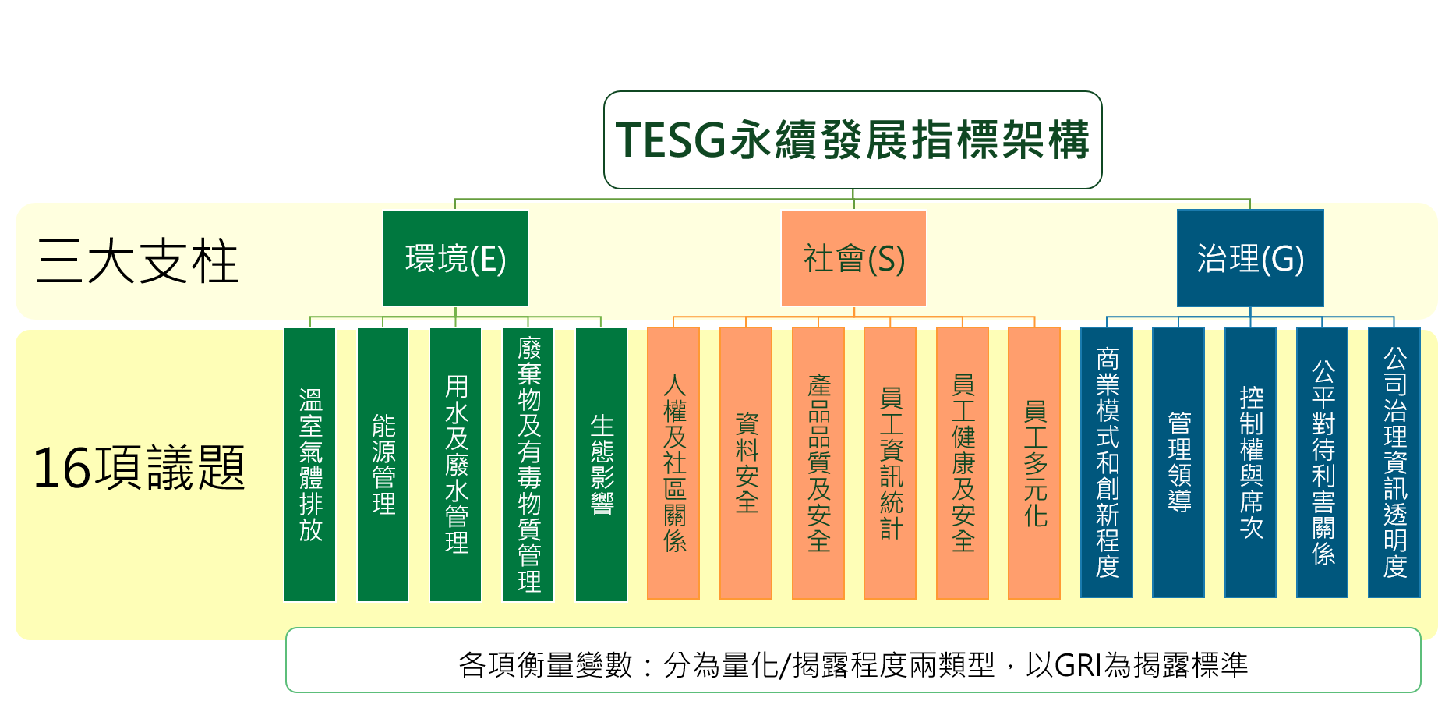
Profile – Scoring details
Notes:
GRI???全球報告倡議組織
Global Reporting Initiative

Slide 9
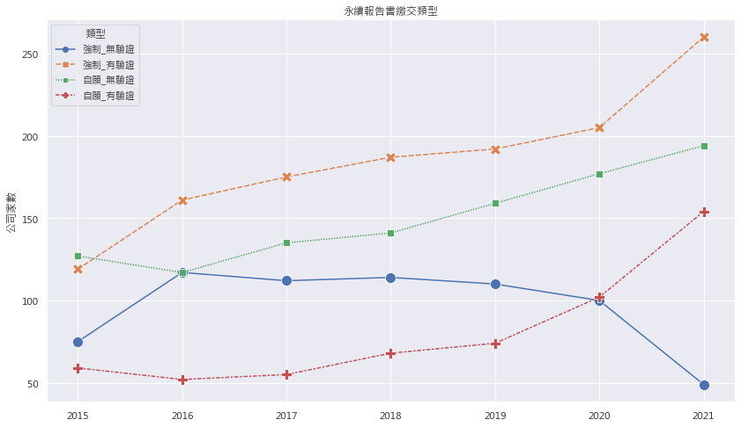
Narrative statistics – the number of companies
Notes:
圖中所示為公司數量
繳交報告書之公司類型可以由（自願強制繳交 ＆ 是否進行第三方驗證作業）分為四種類型。
最消極者（僅強制，無驗證）藍線 > 公司數量於近年來陸續下降，相對表現比較積極之公司數量皆穩定向上（how about整體有繳交報告書之比例？）
顯示整體公司對於ESG議題的重視程度逐年提升。

Slide 10
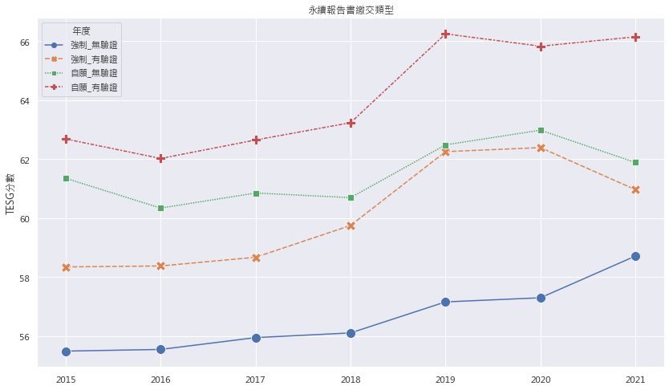
Narrative statistics – TESG performance
Notes:
圖中所示為公司數量
繳交報告書之公司類型可以由（自願強制繳交 ＆ 是否進行第三方驗證作業）分為四種類型。
最消極者（僅強制，無驗證）藍線 > 公司數量於近年來陸續下降，相對表現比較積極之公司數量皆穩定向上（how about整體有繳交報告書之比例？）
顯示整體公司對於ESG議題的重視程度逐年提升。

Slide 11
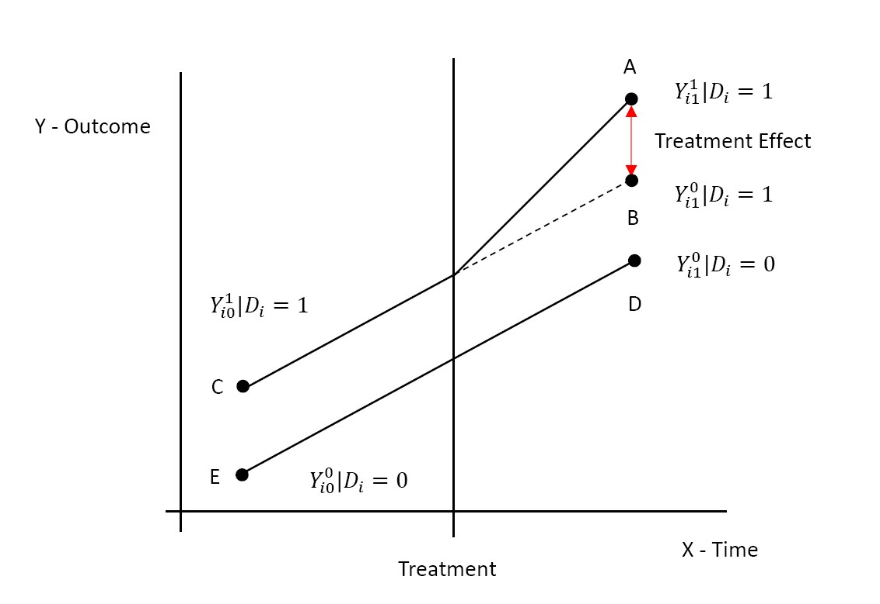
Research Methods – DID
Notes:
DID研究方法在於檢視兩組數據（時間序列）之間是否因為外在因素而導致之因果關係
（證明背起來）
上方實線為實驗組，下方實線為控制組，目的是為了測量在假設若是實驗組未受到外在因素影響前後的程度是否顯著(AB)
重要假設：Common Trend Assumption

Slide 12
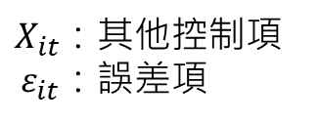
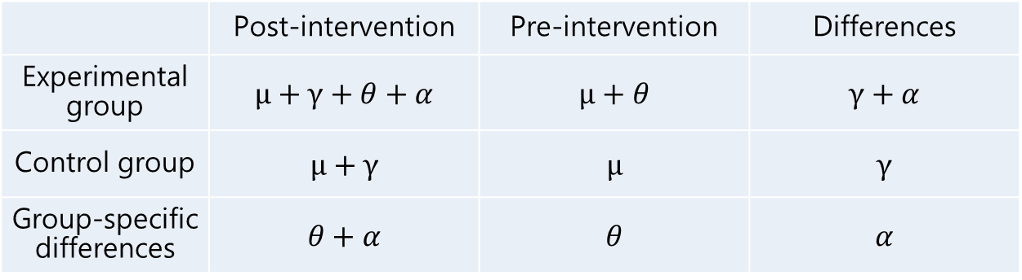
Research Methods – OLS Design for DIDs
Y_𝑖𝑡= μ+γ⋅𝑇_𝑡+𝜃∙𝐷_𝑖+𝛼∙(𝑇_𝑡∙𝐷_𝑖 )+𝜑∙𝑋_𝑖𝑡+𝜀_𝑖𝑡 Define Dummy Variables: T_t=1|factor intervention,
D_i=1|experimental group
$$ε_it: Error termX_it: Other controls$$
 | Post-intervention | Pre-intervention | Differences
Experimental group | $$μ+γ+θ+α$$ | $$μ+θ$$ | $$γ+α$$
Control group | $$μ+γ$$ | $$μ$$ | $$γ$$
Group-specific differences | $$θ+α$$ | $$θ$$ | $$α$$

Slide 13
Research Results – Problems
Hypothetical Verification-1: Does the Regulation Have Its Effect? Hypothesis Check-2: Signaling Effect Assuming Verification-2-1: The report is submitted voluntarily Verification is assumed to be verified by the Verification-2-2: Report

Slide 14
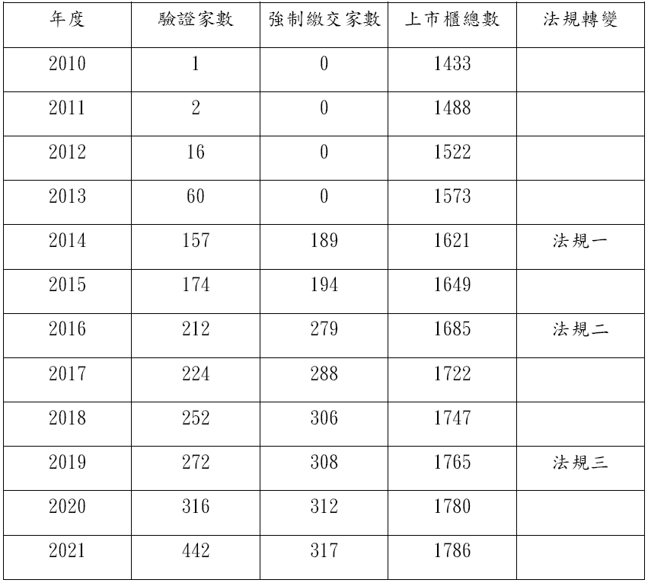
Findings – Regulations
TESG data Start point
Notes:
實收資本額比例

Slide 15
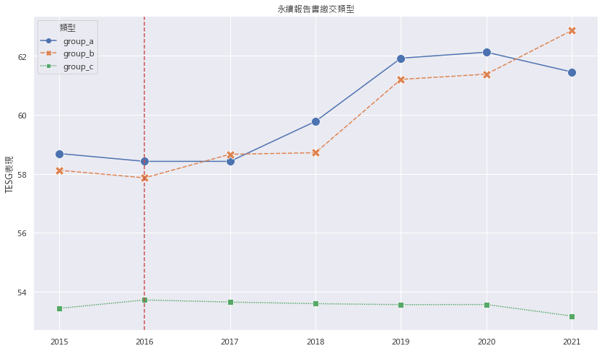
Research Findings – Regulatory Effects (Act 2)
In 2016, the "Mandatory Submission Report" was amended to add: Capital of 10 billion yuan > 5 billion yuan and is a "special industry"
group_a: Mandatory before 2016 group_b: 2016 began to be mandatory group_c: Still not affected

Slide 16
 | 假說檢定一 |  | 假說檢定二
 | 模型一 | 模型二 | 模型三 | 模型四
常數項 | 58.686*** | 51.313*** | 53.432*** | 50.611***
 | (0.55) | (0.99) | (0.20) | (0.38)
C（group_b）[T.1] | -0.568 | -2.250*** | 4.686*** | 4.074***
 | (0.96) | (0.87) | (0.77) | (0.73)
C（Policy_2016）[T.1] | 1.774*** | 1.378*** | 0.109 | -0.104
 | (0.59) | (0.53) | (0.22) | (0.21)
C（可再生能源） |  | -2.881** |  | 3.003***
 |  | (1.33) |  | (0.72)
C（提煉與礦產） |  | 0.706 |  | -0.976**
 |  | (0.86) |  | (0.42)
C（服務） |  | 1.086 |  | 1.321***
 |  | (1.36) |  | (0.46)
C（消費品） |  | -1.486* |  | -0.232
 |  | (0.84) |  | (0.32)
C（科技與通訊） |  | 1.329* |  | -0.299
 |  | (0.70) |  | (0.28)
C（資源轉化） |  | -0.966 |  | 0.051
 |  | (0.72) |  | (0.31)
C（運輸） |  | -0.587 |  | -0.763*
 |  | (0.87) |  | (0.40)
C（醫療保健） |  | 1.867 |  | 2.719***
 |  | (1.37) |  | (0.38)
C（金融） |  | -6.946*** |  | -5.119***
 |  | (0.83) |  | (1.71)
C（食品與飲料） |  | -3.887*** |  | -5.416***
 |  | (0.78) |  | (1.10)
C（上市別）[T.TSE] |  | 3.314*** |  | 1.064***
 |  | (0.46) |  | (0.15)
交乘效果 | 0.199 | 0.081 | 1.864** | 1.749**
 | (1.03) | (0.92) | (0.83) | (0.78)
ROA |  | 0.190*** |  | 0.125***
 |  | (0.02) |  | (0.01)
每股淨值 |  | 0.040*** |  | 0.036***
 |  | (0.01) |  | (0.00)
短期借款比率 |  | -10.285*** |  | -10.653***
 |  | (2.07) |  | (0.82)
負債總額比率 |  | 11.595*** |  | 5.237***
 |  | (0.97) |  | (0.47)
Hypothetical test 1: group_b & group_a Hypothetical test II: group_b & group_c
'***’：p-value<0.01
'**'：p-value <0.05
'*'： p-value <0.1
Sample | 2027 | 2027 | 9815 | 9815
R2 | 0.007 | 0.219 | 0.046 | 0.145
adj_R2 | 0.006 | 0.213 | 0.046 | 0.144
Notes:
係數(標準誤)
結果顯示：交乘效果部分於

Slide 17
Results of the study – Signal effect
In order to solve the problem of the irregular number of companies, the definition of voluntary & verification: Voluntary: D_WFN Validation: Full attendance rewards 2019 (Law 3) Amendment: Grant a concession on the deadline for the first submission of the report and the verifier.

Slide 18
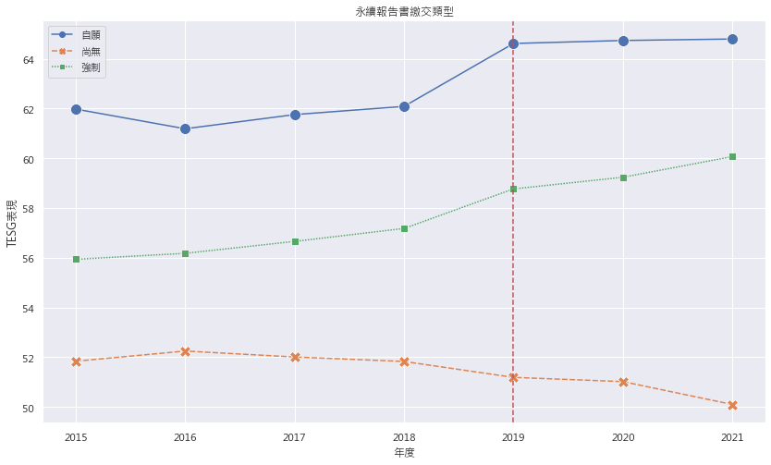
Findings – Voluntary Effect

Slide 19
 | 假說檢定三 |  | 假說檢定四
 | 模型五 | 模型六 | 模型七 | 模型八
常數項 | 56.488*** | 54.250*** | 51.983*** | 50.435***
 | (0.17) | (0.54) | (0.10) | (0.31)
C（D_WFN）[T.自願] | 5.267*** | 4.756*** | 4.506*** | 4.105***
 | (0.28) | (0.28) | (0.19) | (0.19)
C（Policy_2019）[T.1] | 2.873*** | 2.396*** | -1.214*** | -1.440**
 | (0.25) | (0.25) | (0.16) | (0.15)
C（可再生能源） |  | -1.204 |  | 2.352***
 |  | (0.93) |  | (0.63)
C（提煉與礦產） |  | -0.668 |  | -2.054***
 |  | (0.58) |  | (0.39)
C（服務） |  | 2.137*** |  | 1.861***
 |  | (0.79) |  | (0.42)
C（消費品） |  | -1.398*** |  | 0.128
 |  | (0.52) |  | (0.29)
C（科技與通訊） |  | -1.389*** |  | -0.584**
 |  | (0.43) |  | (0.25)
C（資源轉化） |  | -1.149** |  | 0.268
 |  | (0.47) |  | (0.28)
C（運輸） |  | -0.963* |  | -0.587
 |  | (0.58) |  | (0.37)
C（醫療保健） |  | -0.544 |  | 2.480***
 |  | (0.61) |  | (0.35)
C（金融） |  | -4.894*** |  | -2.045***
 |  | (0.60) |  | (0.54)
C（食品與飲料） |  | -2.455*** |  | -2.105***
 |  | (0.56) |  | (0.45)
C（上市別）[T.TSE] |  | 1.008*** |  | 0.651***
 |  | (0.23) |  | (0.13)
交乘效果 | 0.092 | 0.19 | 4.087*** | 3.961***
 | (0.43) | (0.42) | (0.28) | (0.27)
ROA |  | 0.130*** |  | 0.091***
 |  | (0.01) |  | (0.01)
每股淨值 |  | 0.016*** |  | 0.017***
 |  | (0.00) |  | (0.00)
短期借款比率 |  | -9.525*** |  | -6.391***
 |  | (1.36) |  | (0.73)
負債總額比率 |  | 6.181*** |  | 3.508***
 |  | (0.66) |  | (0.42)
Hypothesis test III: Voluntary & Forced Hypothesis test IV: 強制 & 未無
C（D_WFN）[T. Forced]
'***’：p-value<0.01
'**'：p-value <0.05
'*'： p-value <0.1
Sample | 4559 | 4559 | 9681 | 9681
R2 | 0.151 | 0.215 | 0.186 | 0.239
adj_R2 | 0.15 | 0.212 | 0.186 | 0.237

Slide 20
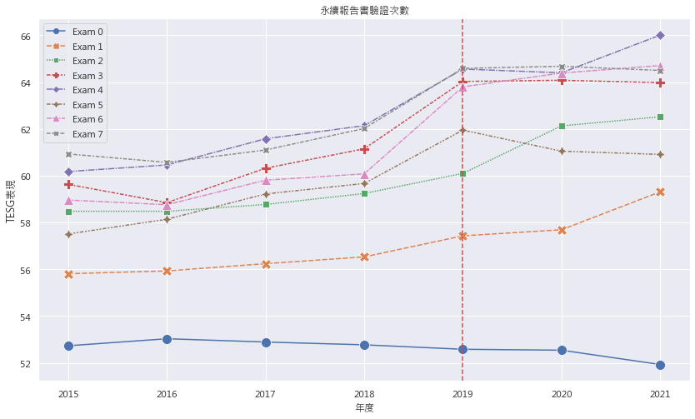
Results of the study – Validating the effect

Slide 21
 | 假說檢定五
 | 模型九 | 模型十
常數項 | 53.827*** | 50.220***
 | (0.10) | (0.33)
C（exam_7）[T.1] | 7.328*** | 7.015***
 | (0.30) | (0.31)
C（Policy_2019）[T.1] | 0.135 | -0.295**
 | (0.15) | (0.14)
C（可再生能源） |  | 2.070***
 |  | (0.65)
C（提煉與礦產） |  | -0.241
 |  | (0.39)
C（服務） |  | 1.446***
 |  | (0.44)
C（消費品） |  | -0.199
 |  | (0.31)
C（科技與通訊） |  | -0.146
 |  | (0.27)
C（資源轉化） |  | 0.569*
 |  | (0.29)
C（運輸） |  | -0.094
 |  | (0.38)
C（醫療保健） |  | 3.022***
 |  | (0.37)
C（金融） |  | -2.991***
 |  | (0.50)
C（食品與飲料） |  | -5.052***
 |  | (0.50)
C（可再生能源） |  | 1.748***
 |  | (0.14)
交乘效果 | 3.299*** | 3.359***
 | (0.46) | (0.44)
ROA |  | 0.127***
 |  | (0.01)
每股淨值 |  | 0.031***
 |  | (0.00)
短期借款比率 |  | -10.403***
 |  | (0.77)
負債總額比率 |  | 5.937***
 |  | (0.43)
Hypothesis Test Five: Examine for full time participation
'***’：p-value<0.01
'**'：p-value <0.05
'*'： p-value <0.1
Sample | 11270 | 11270
R2 | 0.119 | 0.216
adj_R2 | 0.119 | 0.215

Slide 22
Findings – Subsections
DID Effect T value | Regulatory Effects |  | Signal effect (Voluntary) |  | Signal effect
 | Test 1 | Test 2 | Test 3 | Test 4 | Test 5
controls | 0.088 | 2.231 | 0.457 | 14.477 | 7.696
No-controls | 0.192 | 2.252 | 0.213 | 14.469 | 7.136

Slide 23

Conclusions and Recommendations
Effect of regulations: The effect of supervision is obvious. Signal effect: both voluntary and verified have obvious effects. Direction: Unified definition: ESG indicators and data quantification methods Data Time: Panel Data is of a better nature Use models: Other empirical methods for individuals may be considered (Regression discontinuity, synthetic control method)

Slide 24
THANK YOU
Thank you for listening, and please don't hesitate to give us advice

