Slide 1

More than an Art, Cooking is a responsibility

Slide 2
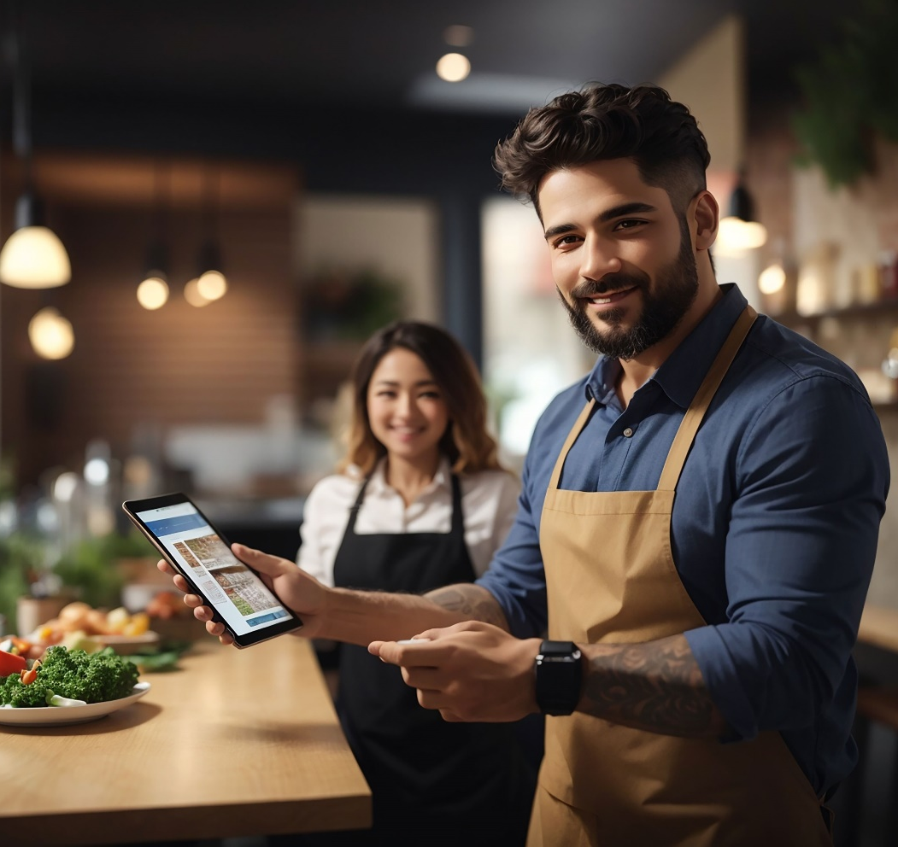
Jagdai Foods
MULTI BRAND CLOUD KITCHEN
One Kitchen which offers multiple Quick Service Restaurant (QSR), Internet Restaurants (IR) & Food Trolley (FT) chains, where the luxury of five-star dining meets unbeatable convenience and satisfaction of a QSR, IR & FT. Our QSR, IR & FT offers culinary journey filled with flavor, convenience, and craftmanship for those seeking quality food on the go.
With a menu that reinvents classics with a modern twist, each bite promises satisfaction and rejuvenation. Whether it's a quick lunch break, a pre-work energy boost, or a leisurely meal with family and friends, our food ensures efficient service without compromising on excellence.
Join us at JAGDAI FOOD PVT LTD’s for a fast, flavorful experience like no other and other franchise opportunities.

Slide 3
Why Jagdai Foods?
Our Franchise is not Just a Normal One Food Outlet, It's full Food Business
24+ Brands Available in all
QSR
TROLLY
INTERNET KITCHEN
Biggest Cloud Kitchen
Approx. 10000SqrFt
Highly Trained Staff with
Experienced Master Chef
Only franchise that lets you start your own brand
Own 1 Franchise, but take orders for other 24 + brands + Zomato + Swiggy + Bulk Orders
Additional Revenue by
managing Food Supply for
FT and IR Franchise
You will represent Jagdai Foods and can sell its franchise and earn too. Sell franchises and get 3% royalty and 25% upfront franchise fee
Full operational Support and Training along with uniform food taste
Exquisite taste and hygiene of five-star cuisine seamlessly blended with the chataka flavors, availability and affordability of street food!
We use only stainless steel equipment in the kitchen because aluminum can react with acidic or alkaline foods, altering the flavor and leaving a metallic taste.
Fresh food QSR Chain (Most of the QSR provides frozen food but we make fresh food in out QSR)
Hygiene standards are maintained in our central kitchen.
We have top-of-the-line kitchen equipment in our central kitchen.
Centralized Chef
(A five-star restaurant chef who brings the flavors of street food to life)

Slide 4
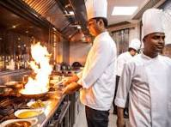
USP of our Franchise
The unique selling point of our franchise lies in offering the following revenue opportunities:
Additional Revenue by managing Food Supply for Food Trolley and Internet Restaurant Franchise
10% royalty on Billing of trolleys, 10% royalty on Billing of Internet Restaurant
10% royalty on Tiffin service bookings
10% royalty on selling of Spices and gravy base
Free CashAqua water bottle SIS franchise

Slide 5
Investment opportunity at Jagdai Foods?
3 different franchise formats to choose from: White label | FOFO | FOCO
FREE UPOS to sell 20 Crores+ Products & Services and Free Micro ATM
Full operational Support and Training along with uniform food taste
We use only stainless steel equipment in the kitchen because aluminum can react with acidic or alkaline foods, altering the flavor and leaving a metallic taste
24+ Brands Available in all forms QSR | TROLLEY | INTERNET RESTAURANT
Kitchen equipment like Kitchen Crockery, Tandoor, Bhatti, BBQ, Griller, Fridge, Exhaust etc needed for QSR will be set-up and provided by us.
Loan for QSR Franchises are also available, including options for government-subsidized financing
Revenue Booster: Tapri Ki Tafri (chai) Franchise with all QSR Franchise Complimentary at just 1 Lakh Extra (optional)

Slide 6












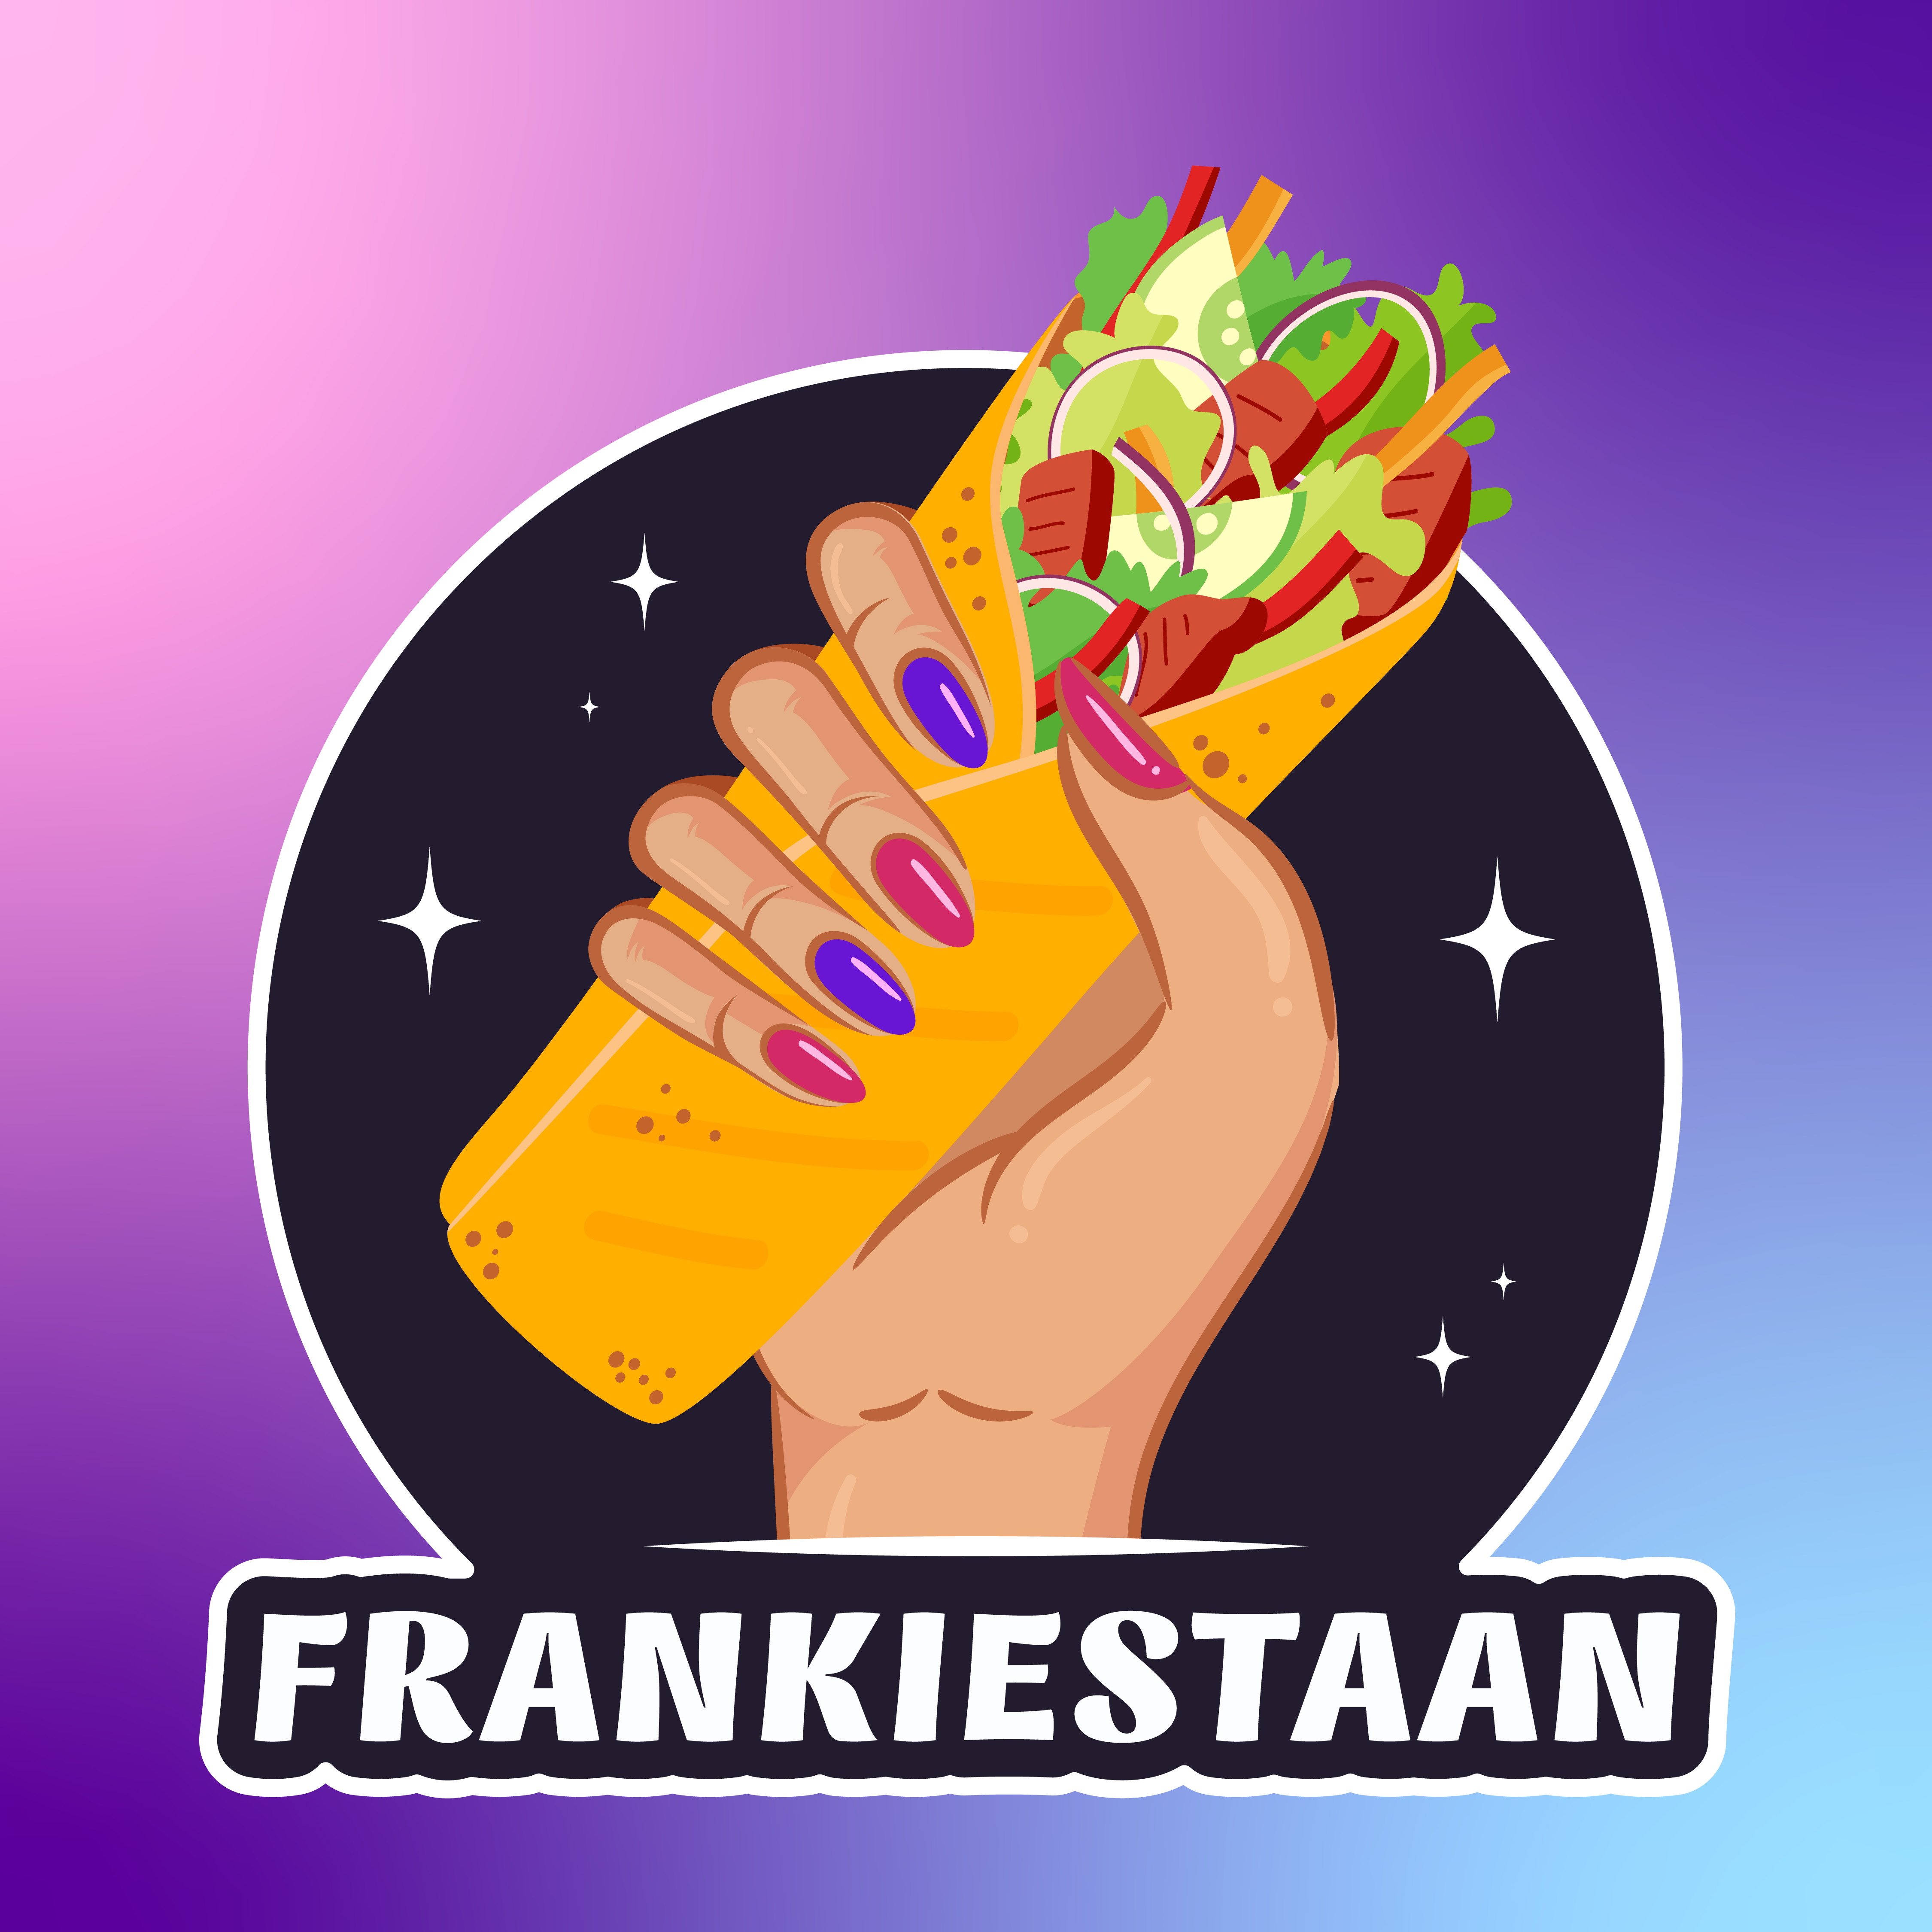



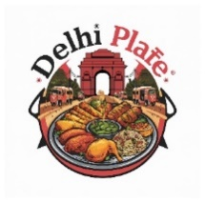


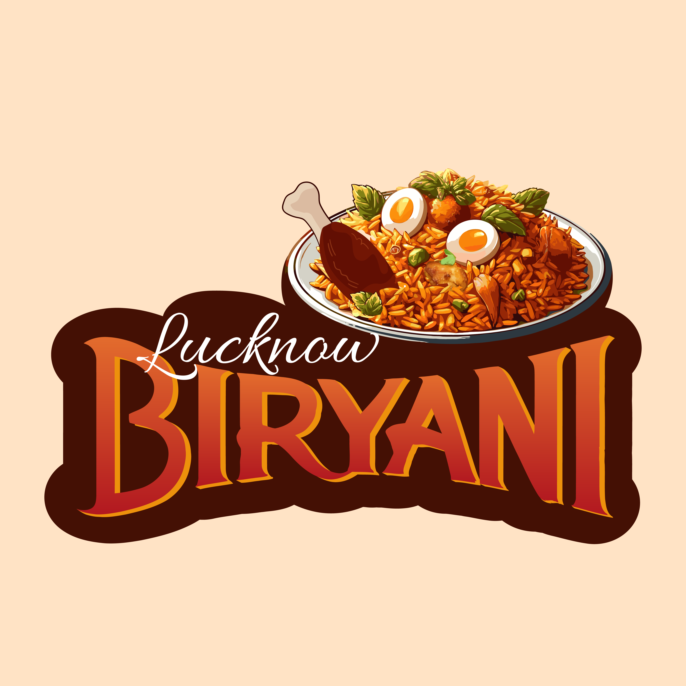
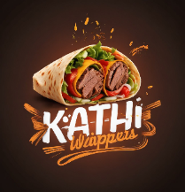
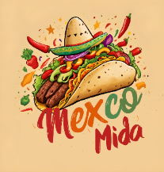
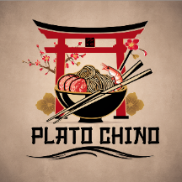

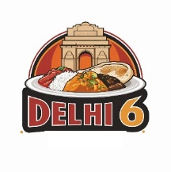

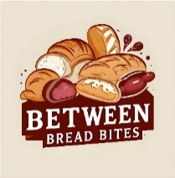


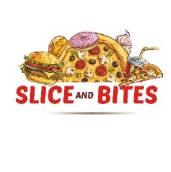








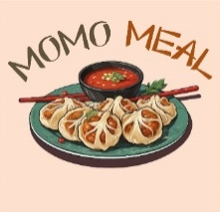
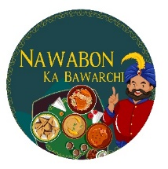

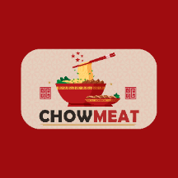

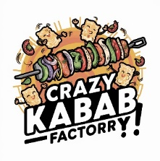
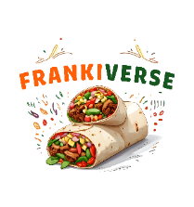

OUR BRANDS
Choose Yours!
FOFO, FOCO or Whitelisting Model

Slide 7

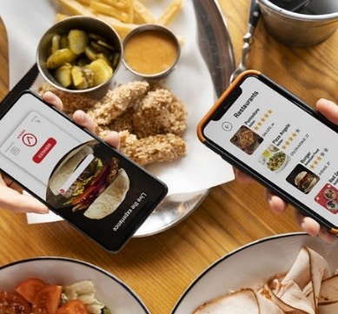
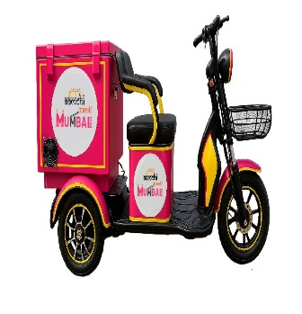
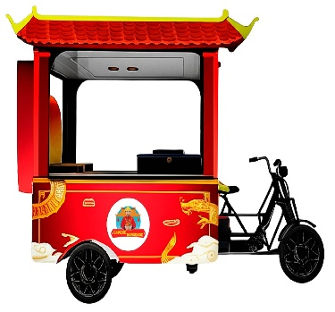

To meet growing demand,
We offer 5 Franchise Options
Quick Service Restaurant
(QSR) Franchise
Internet Restaurants
(IR)Franchise
Bike kart
Franchise
Food Trolley
(FT) Franchise
Food Court
Franchise
QSR stands for Quick Service Restaurant. It's a type of eatery known for fast service and convenience, with a limited menu and quick food preparation.
An internet restaurant is a food establishment that operates primarily online, offering delivery or pickup services through websites or mobile apps, without a physical dining space.
A Bike Kart Trolley is a compact and stylish mobile food unit, designed for easy mobility and serving fresh food directly to customers on the go.
A food trolley is a fancy mobile eatery used for transporting and serving food to the customers
Food Court is a dynamic food court that features a wide range of food stalls, offering both vegetarian and non-vegetarian options.
With 3 different franchise formats
White labeling of brand (Create your own brand & No Royalty)
FOCO :- Franchise-Owned, Company-Operated
FOFO :- Franchisee-Owned, Franchisee-Operated
Whitelisting
FOCO
FOFO

Slide 8
QSR Franchise
You will be representing Jagdai Foods and can sell its franchise too.
You can also create your own brand.
Kitchen equipment like Kitchen Crockery, Tandoor, Bhatti, BBQ, Griller, Fridge, Exhaust needed for QSR are provided.
Loan for QSR Franchise is also available.
Additionally, the unique selling proposition (USP) of our franchise offers the following revenue opportunities :-
The opportunity to sell franchises with a 3% royalty and 25% franchise fee.
Billing of trolleys with a 10% royalty.
Billing of internet kitchens with a 10% royalty.
Self-QSR billing online and in-store.
One CashAqua water bottle SIS franchise with UPOS
Tiffin services booking with a 10% royalty.
Spices and gravy base selling with 10% royalty.

Slide 9


QSR Franchise
YEILD
Investment
ROI
Breakeven
Gross Profit
*T&C Applied, Actuals may vary
₹16 lac
12 to 15
Months*
After
35%
6 Month
₹6 lac (Franchise Fees)
+ ₹10 lac (10 Lac or actual whichever is higher)
Of opening an outlet*
+
UPOS – The Digital Mall
Tapri Ki Tafri (chai)
With 20 Crores + Products & Services
with all QSR Franchise Complimentary
at just 1 Lakh Extra (optional)

Slide 10
Monthly Potential Earning of QSR
Assuming that a minimum of 300 orders are placed daily, including walk-ins and online orders, with a minimum ticket size of ₹150 per order, resulting in a total of 30 (Days) x 300 = 9000 orders in a month, generating a total
monthly revenue of = 9000 x ₹150 = (a) ₹13,50,000
Considering the food margin to be 50% , the approximate food cost expense will be (b) ₹6,75,000
Thus, the monthly gross margin will be (a) ₹13,50,000 - (b) ₹6,75,000 = (c) ₹6,75,000
Additional operating expenses amount to | (d) ₹2,23,500
Salaries & Wages | ₹60,000
Rent (Fixed)/ Management/Office Expense | ₹25,000
Energy & Utilities/Wood | ₹50,000
Operating Cost/Packaging etc | ₹25,000
Marketing Cost/ Finance Cost/ Maintenance | ₹50,000
Marketing expenses (1% of the billing amount) | ₹13,500
Therefore, the net profit from the QSR operation alone is
(c)₹6,75,000 – (d)₹2,23,500 = (i)₹4,51,500/- (Approx)
This figure is only for illustration purpose actuals may vary

Slide 11
Extra Potential Earning of QSR
Keep in mind that there may be other sources of income as well
Other Income to QSR by Our Other Products
Heads | Monthly | Details
10% Royalty from Trolley on Actual sales | ₹30000/- | On Expected Sale 3 Lac pm
10% Royalty from Internet Kitchen on Actual sales | ₹60,000/- | On Expected Sale 6 Lac pm
10% Royalty from Tiffin Box on Actual sales | ₹15,000/- | On Expected Sale 1.5 Lac pm
10% Royalty from Gravy Mix on Actual sales | ₹4500/- | On Expected Sale 0.45 Lac pm
Total | (ii) ₹1,09,500/-
Expected Net Monthly Profit (i) ₹4,51,500 + Other Income (ii) ₹1,09,500 = ₹5,61,000/- pm
This figure is only for illustration purpose actuals may vary

Slide 12












Multiple Brands:
QSR & Trolley (VEG)
Choose Yours!
FOFO, FOCO or Whitelisting Model

Slide 13




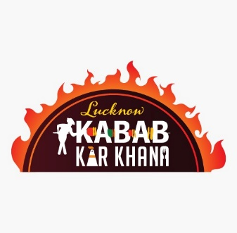
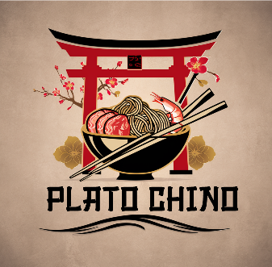


Multiple Brands:
QSR & Trolley (NON-VEG)
Choose Yours!
FOFO, FOCO or Whitelisting Model

Slide 14


CHAAT
Samosa, Tikki, Batashe, Bhalle, Basket Chaat & many more…
Lakhnavi Chatpati Chaat brings the vibrant flavors of Lucknow to Gujarat, with our Founders and chefs from Lucknow crafting each dish with hand-prepared chutneys and ingredients. Experience the essence of Lucknow right here, as we use fresh, premium-quality ingredients cooked in pure ghee to ensure a rich and flavorful indulgence in every bite.
Our USP
Our chefs hail from Lucknow, ensuring an authentic Lakhnavi experience
All preparations made in PURE DESI GHEE
Handcrafted Chaat and Chutneys with original authentic zaika
Enjoy the essence of Lucknow streets in Gujarat

Slide 15
CHAAT MENU
Pani Puri
Aloo Tikki Chole Chaat
Lakhnawi Special Samosa
Papdi Chaat
Green Chutney wale Aloo
Palak Patta Chaat
Crispy Fried Aloo (Spicy)
Raj Kachori
Crispy Cut Aloo Chaat
Kachori with Aloo Sabzi
Mumbai Bhel
Dahi Bhalle
Samosa Ragda Chaat (White peas)
Dahi Bhalla Papdi Chaat
Samosa Chole Chaat (Boiled Chickpeas)
Lakhnawi Special Chaat (Mutter Chaat)
Aloo Tikki Chaat
Lakhnawi Special Chaat (Basket Chaat)

Slide 16


Starters
Spring Roll & Cheese Croquettes, Stuffed Mushroom & many more…
Crispy Crazy Starters has a wide variety of starters suitable for any size gathering, whether it's a small get-together or a large event. Whether you're hosting a house party, a kitty party, or any other event at your home, we're your go-to source for a diverse range of starters all in one convenient place.
Our USP
Catering to diverse tastes from traditional to innovative.
Exclusive starter selection not found elsewhere.
Go-to destination for every meal and occasion.
Fusion of Indian, Chinese, and Continental flavors.

Slide 17
STARTERS MENU
Crispy Crazy Corn
Veg spring roll Chinese spring roll
Onion Rings Cheese Spinach & Corn Ball
Jalapeno cheese poppers Honey chilli potato
Hara bhara kabab Mozzarella Cheese Croquette
Veg Fried Wonton
Stuffed Mush Potato Corn Cheese Kabab
Paneer 65 Paneer Chilli
Tandoori Aloo
Paneer Tikka
Paneer Malai Tikka
Paneer Lahsuni Tikki
Crispy Veg
Dragon Paneer
Cajun Potato
Dry Manchurian
French Fries
Mushroom Chilli Dry
Paneer Pakora
Mexican Fries

Slide 18

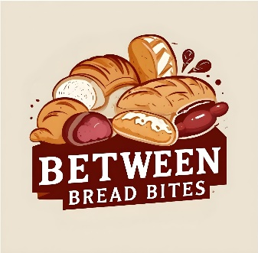
Bread/Sandwich
Mumbai Sandwich, Ahmedabad Ghughra Sandwich & many more…
Mingling Breads invites you to experience the ultimate sandwich journey in the city. With our in-house freshly baked assortment of breads, we promise to deliver the best sandwich experience, catering to all your desi and Italian sandwich cravings.
Our USP
Fresh in-house baked handcrafted breads
Diverse sandwich menu catering to all tastes, from Desi to Italian cravings
Personalized sandwiches with our customizable options
Made in Original Amul butter and cheese

Slide 19
SANDWICH MENU
Bread Butter Sandwich Maggi Sandwich Aloo Matar Sandwich Cheese Chutney Sandwich Palak Corn Cheese Sandwich
Chilli Cheese Onion Club Mumbai Ahmedabad Ghughra Sandwich Jumbo veg Sandwich
Tex-mex Focaccia Sandwich Peri Peri Paneer Focaccia Sandwich Veg Pesto focaccia Sandwich
Veg Carlos Club Sandwich Double Loaded Maharaja Cheese Sandwich Ahmedabad Ghughra Sandwich Jumbo veg Sandwich

Slide 20



Momos
Momos, Water Chestnut, Lotus Root & many more…
Experience the magic of momos with the luxury of five-star dumplings, where gourmet delights are prepared to perfection and served with meticulous attention to detail. From classic momos to innovative creations, our menu offers a delightful array of options to tantalize your taste buds. Discover the fusion of elegance and efficiency at our QSR.
Our USP
Authentic momos made with premium ingredients.
Innovative varieties ranging from classic steamed momos to fusion creations
Taste and flavors reminiscent of five-star dumplings
Exclusive innovative varieties found nowhere else.

Slide 21
MOMO MENU
Veg Momos Cheese Momos Soya Momos Paneer Momos Mashroom Momos
Cheese Sweet Corn Momos
Cheese & Spinach Momos Avacado Mushroom Momos Water Chestnut, Lotus Root & Celery Momos
Jhol Momos

Slide 22


Dilli By Heart
Chole Bhature, Rajma Chawal, Pulav & many more…
Dilli by heart brings the essence of Old Delhi to your plate with our team of chefs exclusively from the North India, particularly Delhi. Immerse yourself in the authentic flavors of street food of Delhi experience right at our place with more hygiene and freshness.
Our USP
Team of chefs exclusively from Delhi, guaranteeing authentic flavours of Old Delhi.
Immersive experience of Delhi street food, providing a taste of the city's culinary heritage.
Menu featuring exclusive and authentic dishes unique to Delhi
Unparalleled authenticity, delivering the true essence of Delhi's culinary traditions.

Slide 23
MENU
Chole and Poori Chana and poori Chana and Bhature Chana and Kulcha Chole and Bhature Chole and Kulcha
Shaadi style aloo gobi and poori Bedmi poori aur aloo ki sabji
Rajma/Kadhi Chawal Dal Makhni and Rice
Chole Rice
Jeera Rice
Veg Pulao
Kadi Chawal
Punjabi Thali
Mini Punjabi Thali
Paneer Butter Masala
Paneer Lababdar
Paneer Kadhai
Paneer Tikka Masala
Malai Tikka Masala
Mushroom Masala
Aloo Tandoori

Slide 24


Amchi Tumchi Mumbai 1966
Vadpav, Mumbaia misal pav, Ulta Wada Pav & many more…
Amchi Tumchi Mumbai brings the vibrant flavors of Mumbai to your city! Enjoy authentic and fusion vada pav made with traditional Maharashtrian masalas, and indulge in our amazing misal. Experience the true essence of Mumbaiya street food, from spicy snacks to hearty Maharashtrian regional dishes.
Our USP
Authentic and traditional Maharashtrian masalas for a genuine taste
Vibrant and hygenic essence of Mumbai's street food in your city.
Fusion Delights with Unique twists on classic vada pav and other favorites.
Diverse Menu, from spicy street snacks to hearty regional dishes

Slide 25
MENU
Mumbai Vada Pav Amdavadi Vada Pav (Oil/Butter) Bhajiya Pav Cheese Vada Pav Dabeli (Oil/Butter) Cheese Dabeli Samosa Pav Bread Pakoda Mirchi Pakoda
Cheese Bread Pakoda Ulta Vada Pav Baked Vada Pav (Aloo Bun) Masala Pav 2 Pcs Sev Usal Misal Pav Cheese Fry Misal Pav Mumbaiya Misal Pav Pav Bhaji

Slide 26

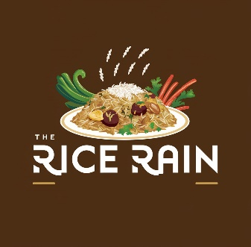
All
Rice Baby
Dal Makhni & Chawal, Chinese Rice Bowl & many more…
All Rice Baby revolutionizes mealtime by offering complete Rice meals in one bowl, meticulously crafted to fulfill your body's needs. Experience convenience and flavor with a wholesome combination of rice, salad, gravy, and other accompaniments, all served in a single bowl. Delight in a diverse array of rice dishes from around the world, ranging from North Indian to Chinese to Continental cuisine, all under one roof.
Our USP
A complete meal in one bowl, curated to meet your nutritional needs.
Enjoy global rice dishes from around the world, all under one roof
An innovative concept featuring rice as the main ingredient, offering the most diverse menu
Taste for all generations, all in one place

Slide 27
MENU
Mexican Rice Bowl
American Chop Suey
Italian Rice Bowl
Burmese Bowl
Indian Rice Bowl
Faijta Bowl
Thai Curry & Rice Bowl
Hot Pot
Jagdai Special South Indian Thali
Dal Makhni & Chawal
Dal Rice
Rajma Chawal
Chole Rice
Kadhi Rice
Dal Palak & Rice
Chinese Rice Bowl
Burrito Bowl

Slide 28

Ghee
Dosa
Masala Dosa (Butter /ghee), Gotala Dosa & many more…
Ghee Dosa invites you on a culinary journey through the flavors of South India right in your city. We specialize in crafting the perfect blend of traditional masalas and the finest ingredients to bring you the best sambhar and authentic South Indian dosas, all prepared in the purest ghee to enhance the flavors and leave you licking your fingers.
Our USP
Authentic and original South Indian taste and flavors.
Innovative dosas blending tradition with contemporary twists.
All preparations made using the finest pure ghee.
Exclusive variety of South Indian food items rarely found anywhere else other than South

Slide 29
MENU
Filter Coffee Medu Vada Plain Dosa Neer Dosa Spring Masala Dosa Butter Garlic Masala Dosa Masala Dosa (Butter /ghee) Cheese Masala Dosa Rava Coconut Dosa
Rava Onion Dosa Mysore Masala Dosa Rava Dosa Mysore Masala Uttapam Rava Masala Dosa Ghee Roast Masala Dosa Palak Corn Cheese Dosa Cheese Corn Dosa Set Dosa
Steam Idli With Sambhar Vegetable Masala Idli Ghee Tossed Podi Idli Kurkuri Idli Plain Uttapam Onion Uttapam Tomato Uttapam Onion Tomato Uttapam Mix Veg Uttapam
Gotala Dosa

Slide 30
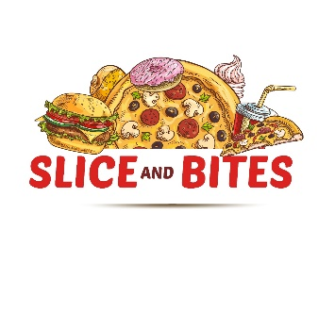
Pizza
& Burger
Double cheese margarita Pizza, Veg Pesto Pizza & many more…
Pizza and Burger redefine your culinary experience by combining the best of Italy and America under one roof. Our pizzas feature in-house, artisanal dough and wheat crusts topped with gourmet ingredients, while our burgers boast succulent, hand-pressed patties on freshly baked buns. Enjoy exclusive seasonings and signature sauces that make each bite unforgettable.
Our USP
Pizzas crafted with in-house, artisanal dough and wheat crusts.
Toppings made from the finest, gourmet ingredients
Burgers featuring succulent, hand-pressed patties
A perfect blend of Italian and American culinary traditions.

Slide 31
MENU
Garlic Bread Cheese Garlic Bread Quesadilla Veg Paneer Cheese Corn Quesadilla Mushroom Cheese Corn Quesadilla Spinich Cheese Corn Quesadilla
Indian Paneer tikka Quesadilla Red Sauce Pasta White Sauce Pasta Pink sauce Pasta Mac and cheese Pasta Pesto Pasta

Slide 32


Chinese
Paneer Chilli Dry, Manchurian Pot Rice, Kung Pao Paneer & many more…
Chinese Nonsense is where traditional Chinese flavors meet with a desi twist and modern creativity. Our playful name reflects our belief that food should be both delicious and fun. Enjoy a culinary journey through China with our innovative dishes, from spicy Sichuan delights to savory Cantonese specialties.
Our USP
Fusion of traditional Chinese flavors with a modern, playful twist
Delightful bites that blend Chinese traditions with a desi twist
Innovative dishes spanning regional specialties from Sichuan to Cantonese
culinary journey through diverse and flavorful Chinese cuisine

Slide 33
MENU
Honey Chilli Potato Veg Chinese Hakka Noodles Veg Chinese Hakka Noodles Gravy Dry Manchurian Gravy Manchurian Veg Manchurian Pot Rice Veg Spring Roll Veg Schezwan Fried Rice Veg Triple Schezwan Fried Rice
Veg Chilli Garlic Fried Rice American Chopsey with Fried Noodle/ Rice Veg Fried Rice Paneer 65 / Chilli Dry Veg Medium Wok Bowl with Fried Noodle/ Rice Veg Personal Wok Bowl with Fried Noodle/Rice Kung Pao Paneer Dry Manchurian Veg Bowl Veg Schezwan Noodle Soups (Manchow / Hot & Sour / Sweet Corn / Tomato)

Slide 34


Mexico
Loaded Nachos, Quesadilla, Mexican Hot Pot & many more…
Mexico Culture Eatery is your gateway into the vibrant tapestry of Mexican cuisine. From zesty tacos to nachos, savour the rich flavors that define Mexican cultural heritage. We serve freshly made nachos, tacos, tostadas, and wraps, with all dips prepared in-house. Enjoy the freshness of our salsa and other dips with every bite. Join us for an authentic taste of Mexico right in your neighbourhood
Our USP
Mexico's rich tapestry of flavors and traditions.
Artisanal crafted nachos, tacos, tostadas, and wraps
Signature homemade dips, bursting with authentic flavors.
Quick and delicious taste of Mexico in your neighbourhood.

Slide 35
MENU
Nacho Chips With Salsa & Cheese Dip Mexican Fries With Cheese Tacos Loaded Nachos Falafal Tacos Quesadilla
Mexican Tostada Cheese & Spring Onion Toasted
Spicy Cottage Cheese & Pinto Bean Tacos
Mexican Hot Pot
Burrito Wrap (Veggies & Cheese / beans & Cottage Cheese/the Mexican)
Salted Fries
Peri Peri Fries
Cheese Balls

Slide 36

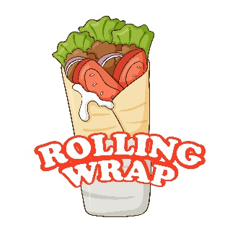
Frankie
Mad Mix Frankie, BBQ Paneer Frankie & many more…
Frankiestaan welcomes you to a paradise of flavor and variety! Indulge in our delectable selection of Frankies, made with fresh tortillas crafted from wheat flour and filled with a variety of mouthwatering ingredients, our Frankies offer a unique twist on this classic street food. From classic favorites to innovative creations, it offers a tantalizing array of options to satisfy your cravings.
Our USP
Frankies made with fresh wheat flour tortillas
Classic favourites to innovative creations, catering to every taste.
Range of dips, sauces, and fillings, tailored to every tastebud
Go-to destination for a delicious and satisfying meal on the go.

Slide 37
MENU
Mad mix Frankie Spicy Schezwan Frankie Cheesy Corn Frankie Veggie Delight Frankie Pizza Punch Frankie Noodles Frankie
Tandoori Paneer Frankie Paneer Delight Frankie Cheese Chilli Paneer Frankie Cheese Peri Peri Frankie Paneer Peri Peri Frankie Cheese Chilli Corn Frankie

Slide 38



Kabab
Karkhana
Kabab, Murg Tandoori Tikka, Chicken and Mutton Dishes & many more…
Kabab Karkhana gives you the royal flavors of Lucknow right in your neighbourhood. Specializing in succulent kababs, flavorful rolls, aromatic biryani, etc our eatery brings the authentic taste of Lucknowi cuisine to every dish. Join us and indulge in the exquisite flavors of Nawabi tradition at Kabab Karkhana.
Our USP
Authentic Non-veg and veg Lucknowi Cuisine
Specialization in Kababs, Rolls, and Biryani with the similar Lucknowi taste
Royal Flavors and the essence of Nawabi tradition, offer a taste of royalty in every bite.
Finest Mughlayi ingredients with authentic flavors.
easy access to Lucknowi delicacies whenever you crave them

Slide 39
MENU
Mutton Galouti Kabab Mutton Shami Kabab Mutton Seekh Kabab Murgh Kabab Murgh Seekh Kabab Roasted Chicken
Fried Chicken
Murgh Tandoori Tikka
Desi Chicken Gravy Butter Chicken Chicken Bhuna Masala Chicken Kali Mirch Chicken Korma Mutton Rogan Josh
Nalli Nihari
Fish Fry
Murgh Malai Tikka Mutton Boti Kabab Chicken Boti Kabab Lucknow Special Dum Chicken Biryani Lucknow Special Dum Mutton Biryani Muradabadi Special Chicken Dum Biryani
Kolkata Special Chicken Biryani Anda Dum Biryani

Slide 40

Sweetoo
Jalebi, Gulab Jamuns, Cheese cake & many more…
Sweetoo presents an exquisite combination of authentic Indian sweets & Contemporary dessert, meticulously prepared using tried-and-true recipes that have been passed down through generations. Delight your taste buds with the rich, luscious gulab jamuns oozing with decadent syrup, or savor the crisp, golden jalebis that are fried to perfection. Every sweet from Sweetoo reflects our dedication to preserving traditional Indian flavors.
Our USP
Authentic and traditional sweets for a genuine taste
Delicious freshly made sweets, exquisitely crafted.
Diverse Menu of sweets
Contemporary dessert

Slide 41
MENU
Kesar Pista Srikhand Rasgulla Shahi Tukda Malai Sandwich Ras Malai Gulab Jamun
Kala Jaam Malai Rabdi Mohan Thal Jalebi Moong Dal Halwa Akhroth Badam ka Halwa

Slide 42

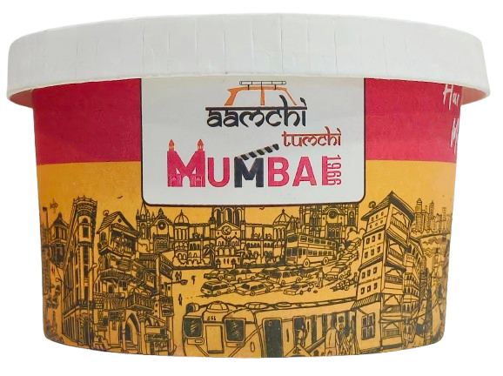

Slide 43
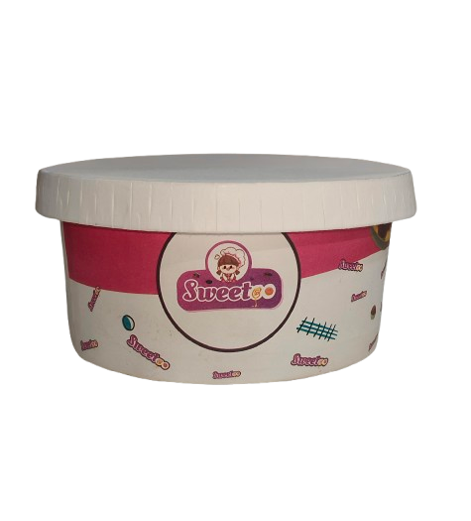
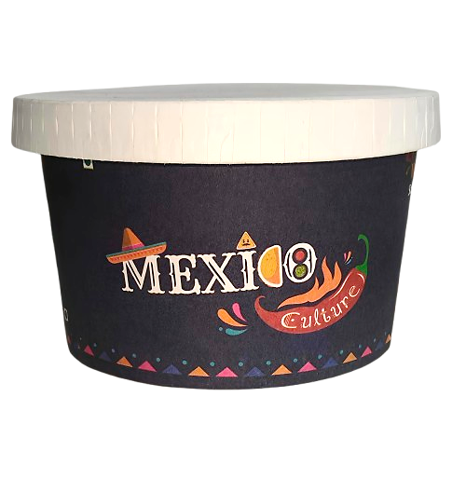

Slide 44





Food Trolley Franchise
FOCO Model
Franchise Fees : ₹2,70,000/- (+ GST)
Food
Trolley
Centralized kitchen supply
No Location Constraint
In-built
Freezer/hotpot
Ultra Modern Design
Earnings :- Earn 9% ROI or 5% of the billing amount (whichever is higher)
NON-VEG Option also available for all brands

Slide 45
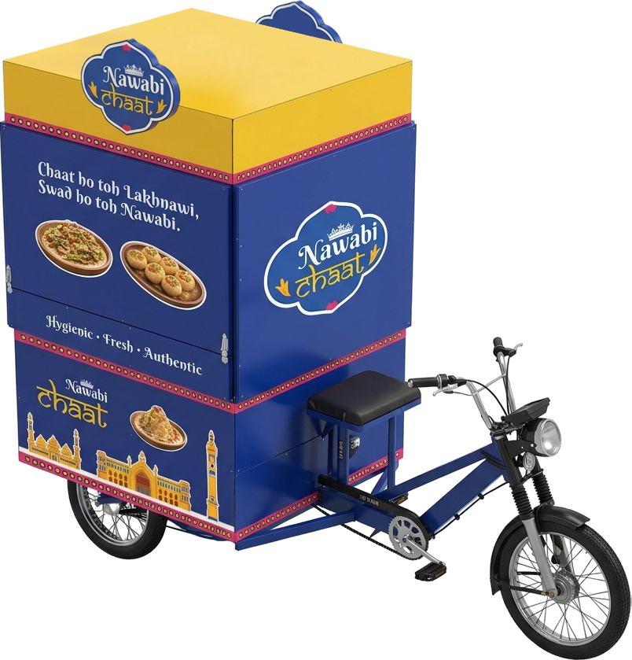
Earning Potential Food Trolley
If the daily billing is just ₹5,000,
Monthly Billing will be:
5,000×30=₹1,50,000
The annual revenue amounts to approximately:
1,50,000×12=₹18,00,000(or ₹18 lakh)
Now, if you receive a 5% share from that, it totals:
5%×₹18,00,000=₹91,000 per year
Just think about it — on an investment of ₹2.7 lakh, you're getting a return of over 30%.

Slide 46
Food Tempo Franchise
Franchise Fees : ₹5,40,000/- (+ GST)
Food
Trolley
Centralized kitchen supply
No Location Constraint
In-built
Freezer
Ultra Modern Design
FOFO Model
Earnings :- Earn 9% ROI or 5% of the billing amount (whichever is higher)
NON-VEG Option also available for all brands

Slide 47
Monthly Potential Earning of Tempo (FOFO)
Assuming that a minimum of 100 orders are placed daily, with a minimum ticket size of ₹100 per order,
resulting in a total of 30 (Days) x 100 = 3000 orders in a month, generating a total monthly revenue of 3000 x ₹100 = (a) ₹3,00,000
Considering the food margin to be 50%, the monthly food cost expense will be (b) ₹1,50,000
Thus, the monthly gross profit will be (a) ₹3,00,000 – (b) ₹1,50,000 = (c) ₹1,50,000
Additional operating expenses amount to | (d) ₹60,000
Salaries & Wages | ₹20,000
Management/Office Expense | ₹5000
Energy & Utilities/Wood | ₹10,000
Operating Cost/Packaging etc | ₹10,000
Finance Cost/Maintenance | ₹12,000
Marketing Expenses (1% of billing amount) | ₹ 3000
Therefore, the net monthly profit from the Trolley operation alone is
(c)₹1,50,000 – (d)₹60,000 = (i)₹90,000/- pm (Approx)
This figure is only for illustration purpose actual may vary

Slide 48
Food Court Franchise
Food Court is a dynamic food court featuring a wide range of food stalls, offering both vegetarian and non-vegetarian options.
With over 24 food brands under one umbrella, it brings diverse culinary experiences to its customers.
A high-end food stall is run by a skilled chef and trained staff, ensuring consistent quality.
The recipes for every dish are standardized, guaranteeing a uniform taste and experience at all Food Court outlets.
5-star cuisine, prepared by a 5-star chef, is served on a street-style trolley at affordable rates.
24+ Brands under 1 roof
Food prepared by 5 star chef best utilization of vacant space at commercial spaces
5 Start taste at street food rate
The most hygienic food on a trolley, with quality at par with a five-star menu.
Increased walk-ins in the mall due to Food court
Best utilization of vacant space at commercial spaces

Slide 49
Franchise (Food Court)
Other Investment
Fees
Breakeven
Gross Profit
*T&C Applied, Actuals may vary
₹20 lac + GST
After
35%
₹30 lac (approx) (Food court setup)
12 Month
On opening of food court*
+
UPOS – The Digital Mall
With 20 Crore + Products & Services

Slide 50
Multiple Brands:
Food Court Franchise
Choose Yours!
FOFO, FOCO or Whitelisting Model

Slide 51
Multiple Brands:
Food Court Franchise
Choose Yours!
FOFO, FOCO or Whitelisting Model

Slide 52




Internet Restaurant
FOCO Model
3L + GST | 3L + GST + 50K (Marketing Expenses for 3 Months)
Marketing Charges
Franchisee has to pays minimum 50,000 per month for first 3 months as marketing fund there after it will be optional. It is an essential part to get the visibility of the new restaurant as this fund will be used for Zomato, Swiggy and Social Media Promotions.
Benefits of franchise of the Internet Restaurant
No
Rental
No
Salary
High
Margins
No
Expenses

Slide 53
Internet Restaurant
YEILD
Investment
ROI
Breakeven
Net Profit
₹3 lac
6 to 9
Months*
After
FOCO 15% &
FOFO 35%
6 Month
with franchise Fee
and all setup
*T&C Applied, Actuals may vary

Slide 54
Monthly Earning Potential of Internet Restaurants
FOCO Model
Assuming that a minimum of 100 orders are placed daily, with a minimum ticket size of ₹200 per order,
resulting in a total of 30 x 100 = 3000 orders in a month, generating a total revenue of 3000 x ₹200= ₹6,00,000
NO operating expenses
Earning = 15% of the total billing
Monthly Earning = ₹6,00,000 x 15% = ₹90,000 pm
FOFO Model
Assuming that a minimum of 100 orders are placed daily, with a minimum ticket size of ₹200 per order,
resulting in a total of 30 x 100 = 3000 orders in a month, generating a total revenue of 3000 x ₹200= ₹6,00,000
NO operating expenses
Earning = 35% of the total billing
Monthly Earning = ₹6,00,000 x 35% = ₹2,10,000 pm
This figure is only for illustration purpose actuals may vary

Slide 55



Multiple Brands:
Internet Restaurant (VEG)
FOFO, FOCO or Whitelisting Model

Slide 56

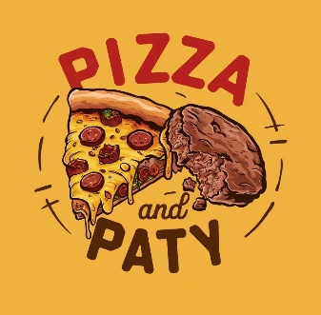
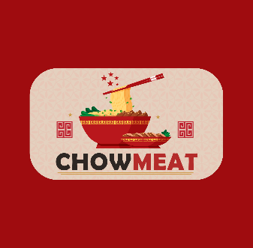

Multiple Brands:
Internet Restaurant (NON-VEG)
⁠FOFO, FOCO or Whitelisting Model

Slide 57
Influencer Franchise
Plan 1
Starter Influencer
Plan 2
Pro Influencer
Fee: ₹2,000/month
Earnings: Get 5% on total billing
Bonus: Full refund of ₹2,000 once you achieve ₹20,000/month in food business
Special Offer: Enroll now for just ₹200/month (Limited Time)
Fee: ₹5,000/month
Earnings: Get 10% on total billing
Bonus: Full refund of ₹5,000 once you achieve ₹50,000/month in food business
Zero Risk
Earn from Day One
Promote JF’s All Foods Brands along with 20Crore Product and Services, Cashback & More

Slide 58
Master Franchise
Franchise Fee :-
1 Cr
*T&C Applied, Actuals may vary
Earning from Master Franchise
70% of Franchise Fee if sold by Master Franchise
30% of Franchise Fee if sold by Jagdai Foods
7% of Billing
For more detailed calculation please refer :- Calculator

Slide 59






World’s Biggest Inter-exchange of Businesses
Generating Entrepreneurial & Employment Opportunities for all
20 Crore +
Products & Services
to Sell
Guaranteed Cashback/Rewards up to 100% to Customers
Generate new Revenue from Existing Customer Base
Best Earning Opportunity with lowest capital investment
Zero Investment
In Inventory
Large & Diversified Inventory
Zero Maintenance
Cost

Slide 60

THANK YOU
8866373077
jagdai.ggconsultancy.services

