Slide 1
Cloudera Cyclehire (an example)
Graham Gear, Director of Systems Engineering, APJ

Slide 2
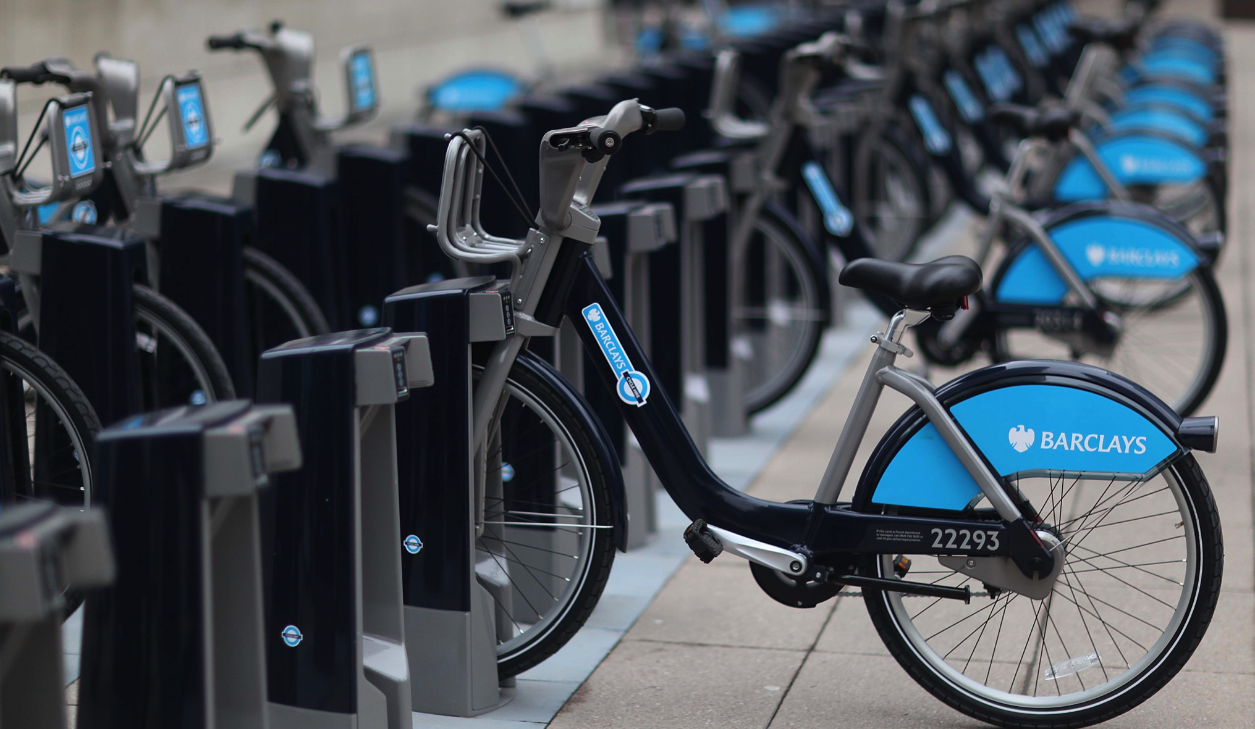
Provide a current-time XML feed disclosing cycle hire docking station status?
Provide real-time and historical analytic view of the complete cycle hire system?
Notes:
Big questions:
What is the quality of the data?
Is the snapshot updated every 2 min?
What is the availability of the service?
What does a time lapse heat map look like?
What does the usage model by time, time/day, day/year, station, locale look like?
How do we redistribute the bikes most effectively based on historic usage?
How much does weather/strike/events strike etc influence usage?
What is the pricing elasticity?
Are different tariffs required?
What is the availability now for this location?
How many journeys are their currently being made?
Do we need more bikes/stations?
Where to put new bike stations?
How can we optimise the bike redistribution?
How many journeys will there be at this time?
What bikes/slots will be available on a given time/station?

Slide 3
Logical Architecture
TFL IT
Flume
Kafka
Flume
HBase
HBase
Web Server
Poll Source
Broker
HBase Sink
Region Server
Indexer
Local FS
Flume
Flume
Flume
Solr
Tarball XML
HDFS Sink
HDFS Sink
Spark Sink
Solr Server
HDFS Client
HDFS
HDFS
Spark
Jetty
TFL User
TFL Data Sci
Java Client
XML
Seq XML
Spark Stream
Web App
Browser
Browser
Hue
HDFS
MR
HDFS
HDFS
MR
HDFS
Visualization
Partition
Seq XML +
Seq XML
SQL
Tarball XML
Cleanse
Avro
Spark
Hive
HDFS
Impala
MR
Rewrite
Parquet
Impalad
HBase

Slide 4
Physical Architecture
Worker
Worker
Gateway
TFL Data Sci
Worker
Gateway
Browser
Master1
Master2
Master3
DataNode
TFL IT
Gateway
NodeMgr
Hue
NameNode
NameNode
MetaStore
Web Server
Kafka
RegionServer
Visualization
JournalNode
JournalNode
JournalNode
ZooKeeper
Flume
SQL
TFL User
ZooKeeoer
ZooKeeoer
ZooKeeoer
Flume
SolrServer
Spark
Browser
ResourceMgr
ResourceMgr
CatalogServer
Jetty
SparkWorker
MR
SentryService
HBaseMaster
SparkMaster
HBase
Impalad

Slide 5
Physical Architecture
Master1
Master2
Master3
TFL IT
Gateway
NameNode
NameNode
MetaStore
Web Server
Kafka
JournalNode
JournalNode
JournalNode
ZooKeeper
TFL User
ZooKeeoer
ZooKeeoer
ZooKeeoer
Flume
Browser
ResourceMgr
ResourceMgr
CatalogServer
Jetty
SentryService
HBaseMaster
SparkMaster
TFL Data Sci
Worker
Worker
Worker
Worker
Browser
DataNode
DataNode
DataNode
DataNode
Hue
NodeMgr
NodeMgr
NodeMgr
NodeMgr
Visualization
Gateway
RegionServer
RegionServer
RegionServer
RegionServer
SQL
Kafka
Flume
Flume
Flume
Flume
Spark
ZooKeeper
SolrServer
SolrServer
SolrServer
SolrServer
MR
Flume
SparkWorker
SparkWorker
SparkWorker
SparkWorker
HBase
Jetty
Impalad
Impalad
Impalad
Impalad

Slide 6
Questions?
graham@cloudera.com

