Slide 1
Torrey Pine Abundance Over Time
Torrey Pines State Natural Reserve — ~3,000-year record
Pollen-based estimates (Cole & Wahl 2000) through modern surveys

Slide 2
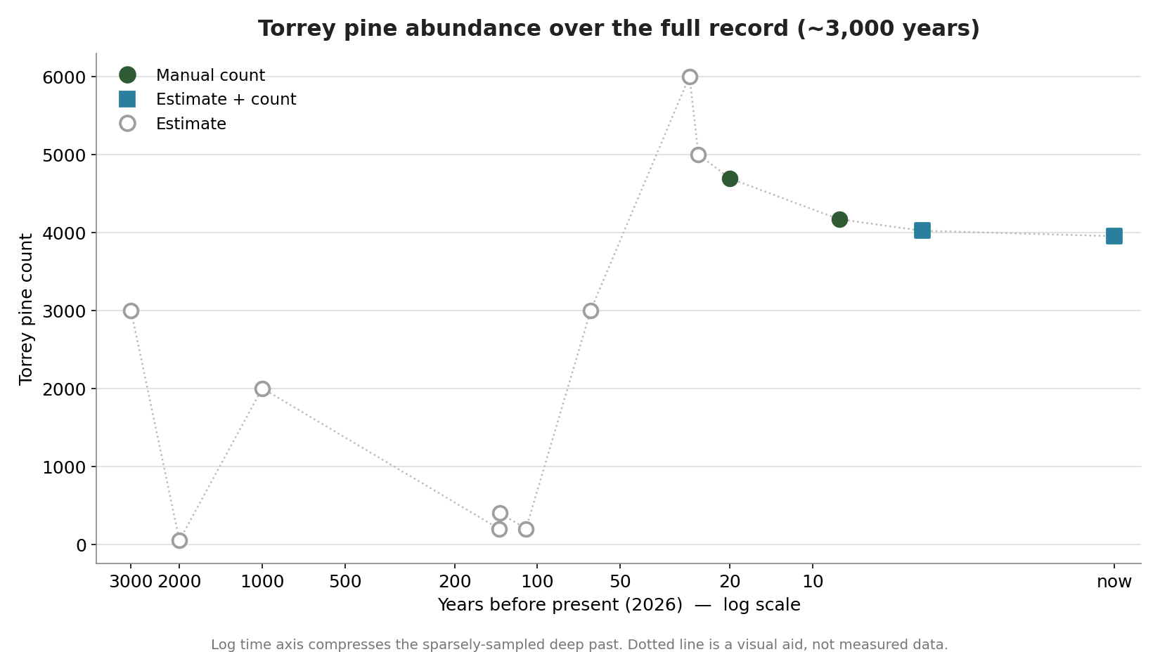
The full record
Present on the right. Ancient points are pollen-derived estimates with real uncertainty; modern points are surveys. Story: present throughout, far less numerous in the deep past.

Slide 3
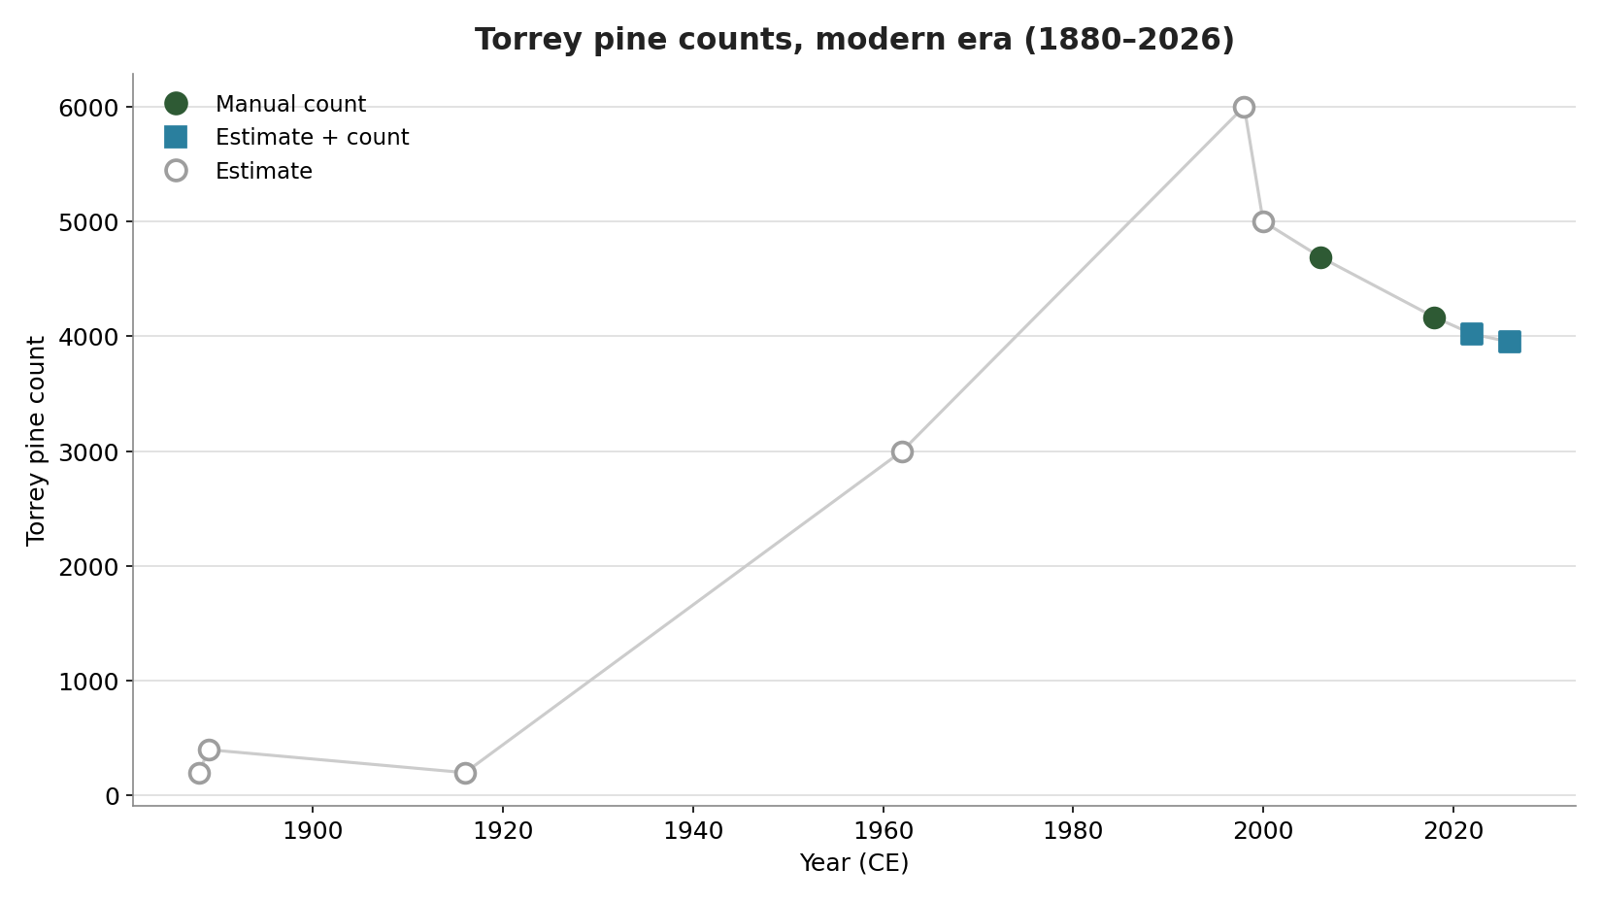
Modern era (1880–2026)
The documented era. A late-1800s low of a few hundred trees recovers to several thousand by the 2000s. Open markers are estimates; filled are hard counts.

Slide 4

Estimate vs. hard count
Which numbers are measured vs. estimated. Only the 2006 and 2018 points are full manual counts; recent totals blend counts with planting/fire estimates.

Slide 5
The data
Year | Yrs ago | Count | Type | Source
2026 CE | 0 | 3,950 | Estimate + count | Estimate post fire
2022 CE | 4 | 4,020 | Estimate + count | Ball park with plantings
2018 CE | 8 | 4,167 | Manual count | Tierra Data
2006 CE | 20 | 4,691 | Manual count | Santos and Franklin
2000 CE | 26 | 5,000 | Estimate | cole and wahl most
1998 CE | 28 | 6,000 | Estimate | ledig
1962 CE | 64 | 3,000 | Estimate
1916 CE | 110 | 200 | Estimate | fleming
1889 CE | 137 | 400 | Estimate | Belle Angiers
1888 CE | 138 | 200 | Estimate | lemmon
1026 CE | 1,000 | 2,000 | Estimate
26 CE | 2,000 | 50 | Estimate | cole and wahl
~974 BCE | 3,000 | 3,000 | Estimate | cole and wahl

Slide 6
Methods & sources
• Deep-time points (≈2,000–3,000 yrs ago) are ESTIMATES derived from pollen abundance in Los Peñasquitos Lagoon sediment cores — not tree counts.
• Source: Cole, K.L. & Wahl, E. (2000), Quaternary Research 53(3):341–351. The record shows Torrey pine present throughout but less numerous before ~2,100 years ago.
• Historical points (1888–1962) are early naturalists' estimates (Lemmon, Belle Angier, Fleming, Ledig).
• Modern points: 2006 (Santos & Franklin) and 2018 (Tierra Data) are manual counts; 2022 and 2026 blend counts with planting / post-fire estimates.
• Years-before-present computed from 2026. Estimates carry real uncertainty — shown as open markers, not precise values.
• Generated from TPSNR_treecount_version1.xlsx by build.py — re-run after editing the spreadsheet.

