Slide 1

Torrey Pine Abundance Over Time
Torrey Pines State Natural Reserve — a ~3,000-year record
Pollen-based estimates through modern surveys

Slide 2

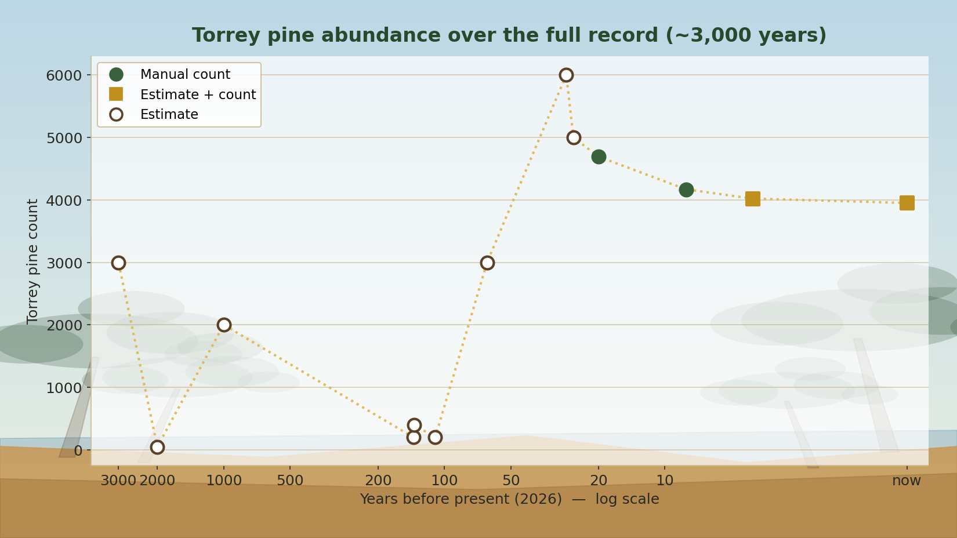
The full record
Present on the right (log time axis). Ancient points are pollen estimates with real uncertainty; modern points are surveys.

Slide 3
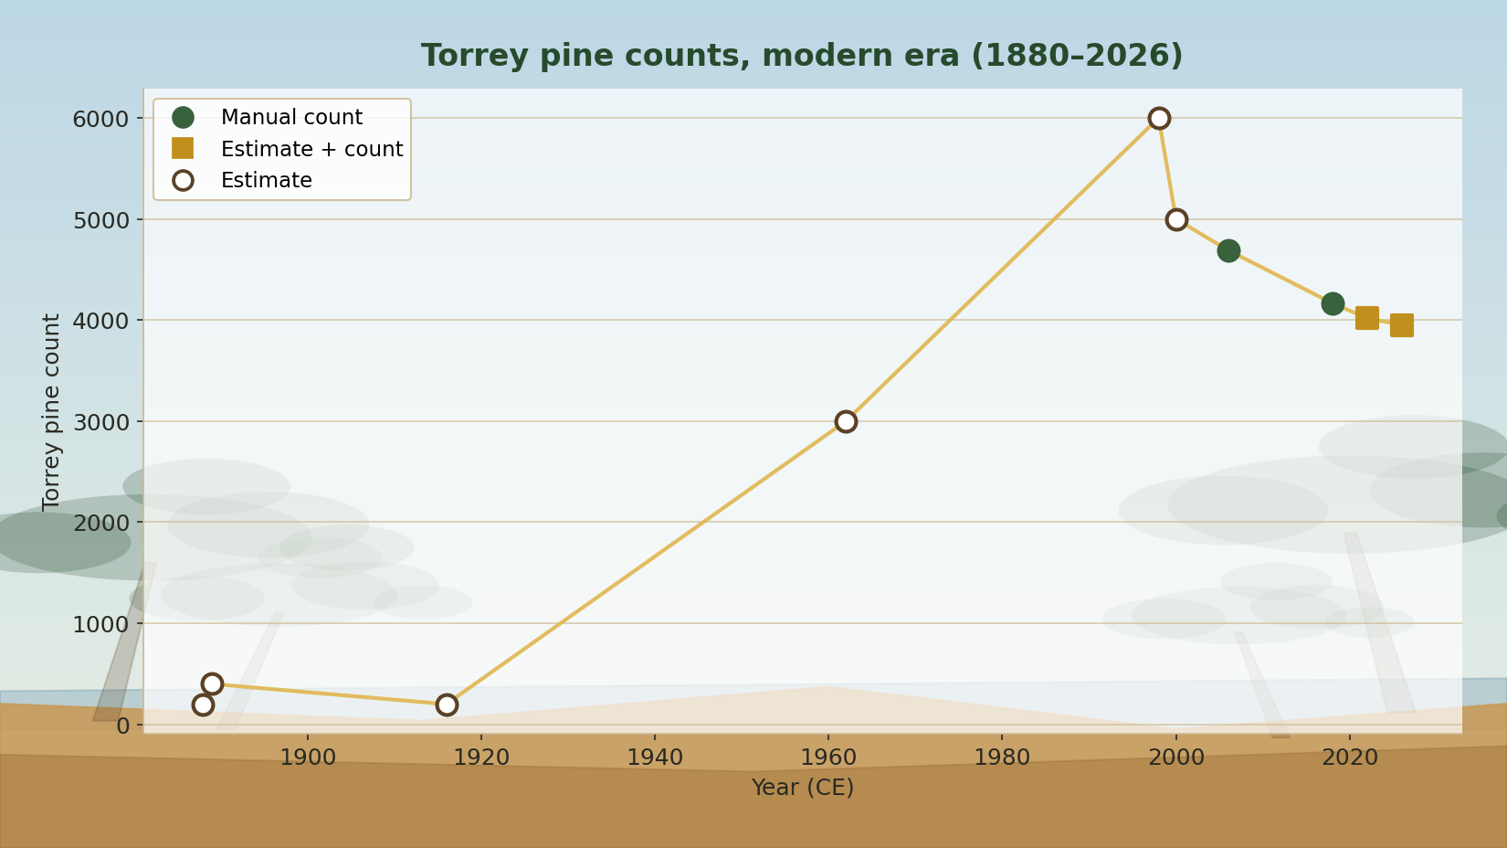
Modern era (1880–2026)
A late-1800s low of a few hundred trees recovers to several thousand. Open markers are estimates; filled are hard counts.

Slide 4
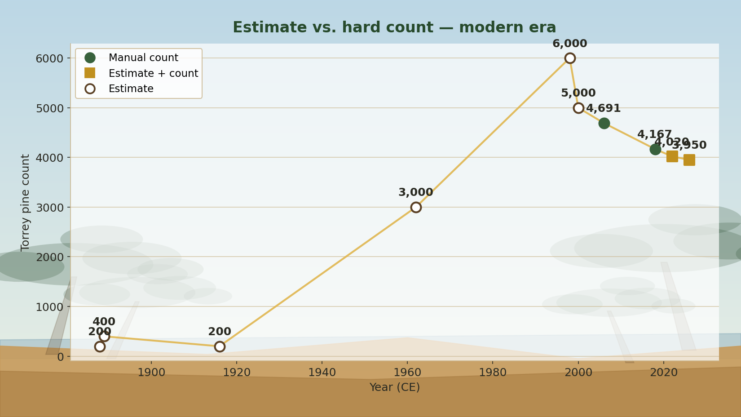
Estimate vs. hard count
Only 2006 and 2018 are full manual counts; recent totals blend counts with planting and post-fire estimates.

Slide 5
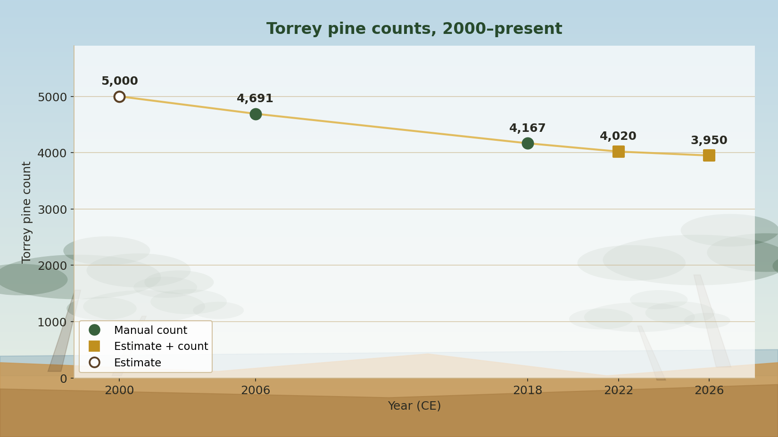
2000 to present
The last ~25 years, labeled. A gentle decline from the 2000 estimate (5,000) to the 2026 post-fire figure (3,950).

Slide 6
Methods & sources
• Deep-time points (~1,000–3,000 yrs ago) are ESTIMATES from pollen abundance in Los Peñasquitos Lagoon sediment cores — not tree counts.
• Source: Cole, K.L. & Wahl, E. (2000), Quaternary Research 53(3):341–351. Torrey pine present throughout but less numerous before ~2,100 years ago.
• Historical points (1888–1962): early naturalists (Lemmon, Belle Angier, Fleming, Ledig).
• Modern: 2006 (Santos & Franklin) and 2018 (Tierra Data) are manual counts; 2022/2026 blend counts with planting / post-fire estimates.
• Years-before-present computed from 2026. Estimates shown as open markers to signal uncertainty.
• Generated from TPSNR_treecount_version1.xlsx by build_fancy.py.

