Slide 1
Improving Model Performance using Cross Validation
By… Sakeeb sheikh

Slide 2
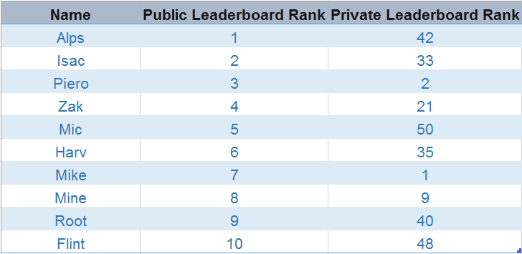
Example to address the issue ?

Slide 3
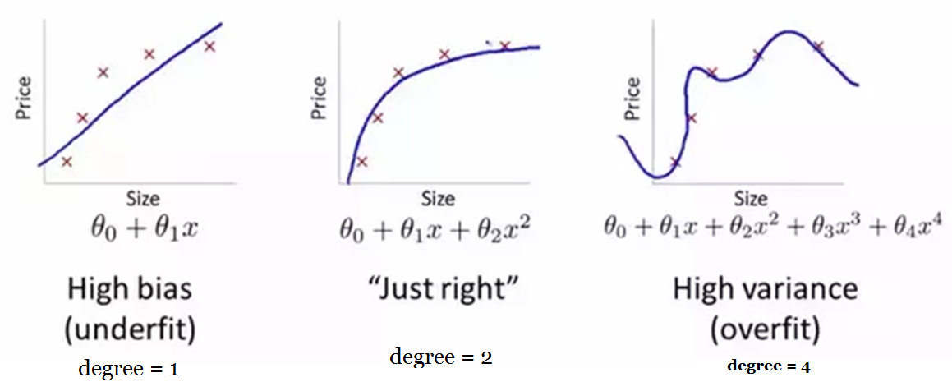
Why do models lose stability?

Slide 4
Why to use Validation Technique ?
When tuning the model to get the higher accuracy score it becomes difficult to distinguish whether this improvement in score is coming because we are capturing the relationship better, or we are just over-fitting the data. To find the right answer for this question, we use validation techniques.

Slide 5
What is Cross Validation?
Cross Validation is a technique which involves reserving a particular sample of a dataset on which you do not train the model. Later, you test your model on this sample before finalizing it.
This reserved set is called TEST set or VALIDATION set.
The set on which we try to fit the model is called TRAINING sample.

Slide 6
Cross Validation Techniques
The Validation set Approach
Leave out one cross validation (LOOCV)
k-fold cross validation
Stratified k-fold cross validation
Adversarial validation
Cross validation for time series
Custom cross validation techniques

Slide 7
The Validation set Approach
we reserve 50% of the dataset for validation and the remaining 50% for model training.
huge possibility that we might miss out on some interesting information.
will lead to a higher bias.
train, validation = train_test_split(data, test_size=0.50, random_state = 5)

Slide 8
Leave one out cross validation (LOOCV)
we reserve only one data point from the available dataset
To train model we make use of all data points, hence the bias will be low.
We repeat the cross validation process n times.
which results in a higher execution time.
This approach leads to higher variation in testing model.
If the data point turns out to be an outlier, it can lead to a higher variation

Slide 9
Python Code
from sklearn.model_selection import LeaveOneOut
X = np.array([[1, 2], [3, 4]])
y = np.array([1, 2])
loo = LeaveOneOut()
loo.get_n_splits(X)
for train_index, test_index in loo.split(X):
print("train:", train_index, "validation:", test_index)
X_train, X_test = X[train_index], X[test_index]
y_train, y_test = y[train_index], y[test_index]

Slide 10
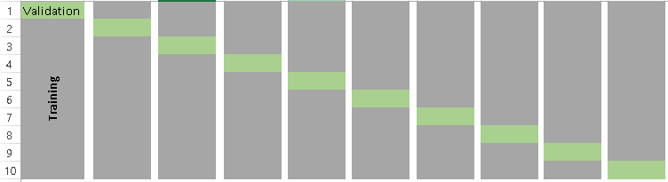
k-fold cross validation

Slide 11
K-Fold Continue…
Randomly split your entire dataset into k”folds”
For each k-fold in your dataset, build your model on k – 1 folds of the dataset. Then, test the model to check the effectiveness for kth fold
Record the error you see on each of the predictions
Repeat this until each of the k-folds has served as the test set
The average of your k recorded errors is called the cross-validation error and will serve as your performance metric for the model

Slide 12
Python code for K-Fold CV
from sklearn.model_selection import KFold
kf = RepeatedKFold(n_splits=5, n_repeats=10, random_state=None)
for train_index, test_index in kf.split(X):
print("Train:", train_index, "Validation:",test_index)
X_train, X_test = X[train_index], X[test_index]
y_train, y_test = y[train_index], y[test_index]

Slide 13
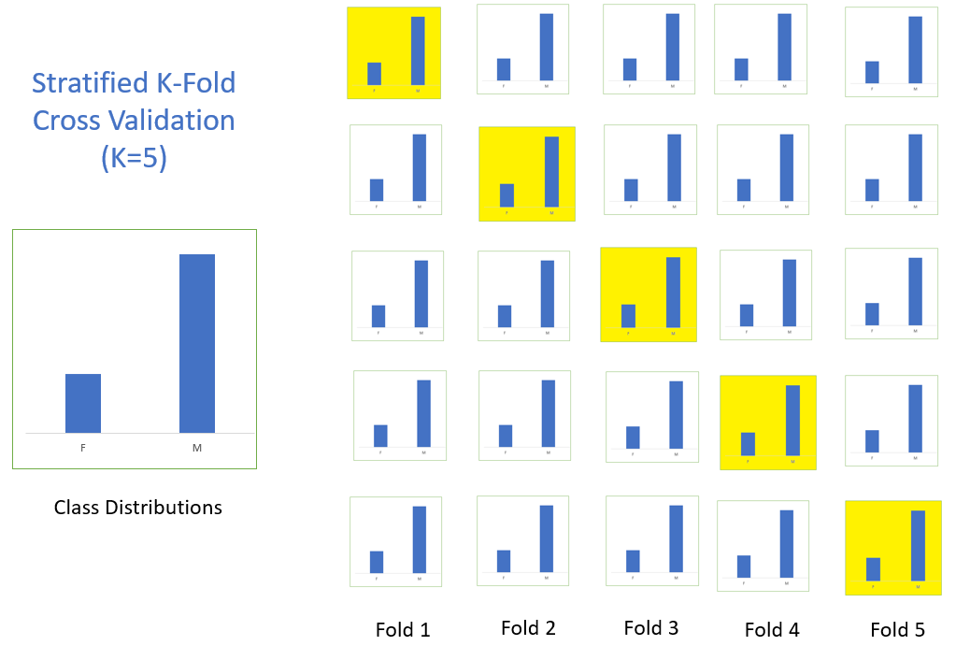
Stratified k-fold cross validation

Slide 14
Python for Stratified K-Fold CV
from sklearn.model_selection import StratifiedKFold
skf = StratifiedKFold(n_splits=5, random_state=None)
# X is the feature set and y is the target
for train_index, test_index in skf.split(X,y):
print("Train:", train_index, "Validation:", val_index)
X_train, X_test = X[train_index], X[val_index]
y_train, y_test = y[train_index], y[val_index]

Slide 15
Adversarial Validation
There are often cases where the test and train sets are very different.
The general idea is to check the degree of similarity between training and tests in terms of feature distribution.
Combining train and test sets, assigning 0/1 labels (0 – train, 1-test) and evaluating a binary classification task

Slide 16
Cross Validation for time series
Folds for time series cross valdiation are created in a forward chaining fashion
Suppose we have a time series for yearly consumer demand for a product during a period of n years. The folds would be created like:
fold 1: training [1], test [2]
fold 2: training [1 2], test [3]
fold 3: training [1 2 3], test [4]
fold 4: training [1 2 3 4], test [5]
fold 5: training [1 2 3 4 5], test [6]
. . .
fold n: training [1 2 3 ….. n-1], test [n]

Slide 17
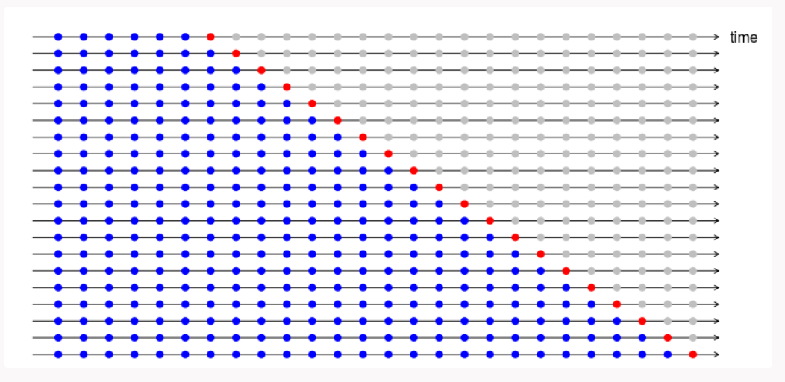
CV For Time Series Data Analysis

Slide 18
from sklearn.model_selection import TimeSeriesSplit
X = np.array([[1, 2], [3, 4], [1, 2], [3, 4]])
y = np.array([1, 2, 3, 4])
tscv = TimeSeriesSplit(n_splits=3)
for train_index, test_index in tscv.split(X):
print("Train:", train_index, "Validation:", val_index)
X_train, X_test = X[train_index], X[val_index]
y_train, y_test = y[train_index], y[val_index]

Slide 19
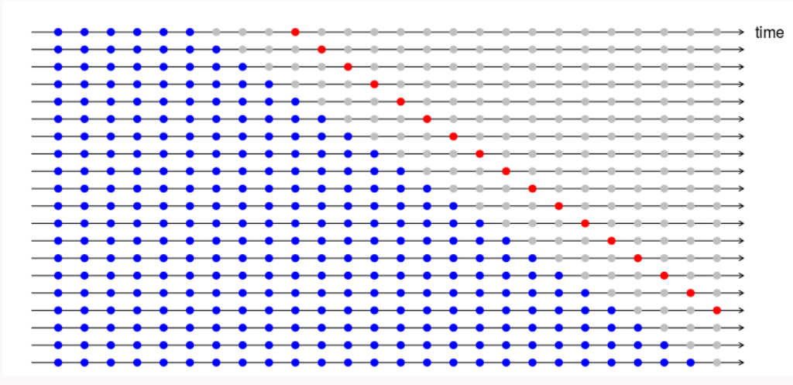
4-step ahead forecast error is depicted in the below diagram.

