Slide 1
Model Fitting and Assessment
By……. Sakeeb Sheikh

Slide 2
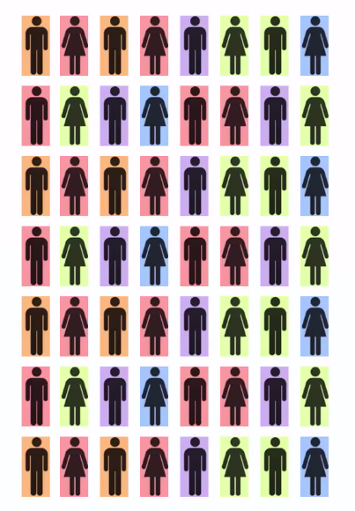
Assume, this is a dataset

Slide 3
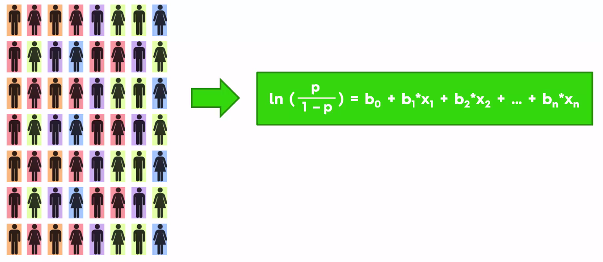
We decided to apply model,
so called logistic regression

Slide 4

We need to divide dataset into
train and test dataset
So big part will be train and small
part will be test dataset

Slide 5
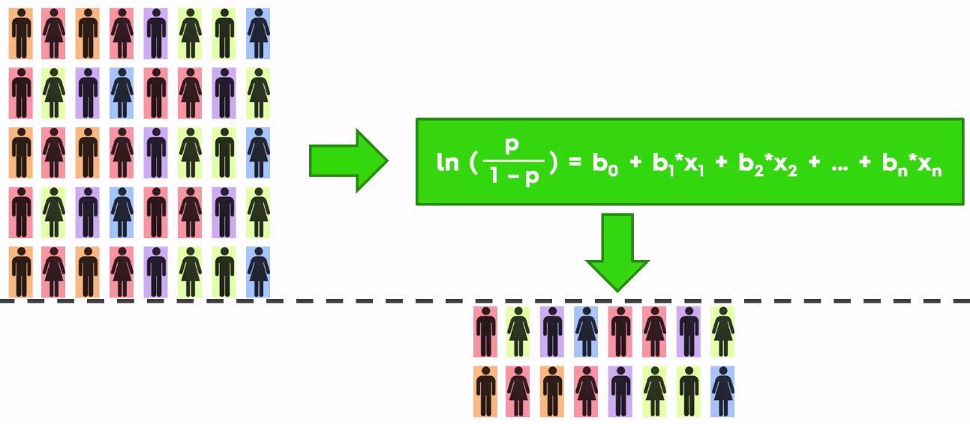
Apply training and then test the
model on test data
Train
Test

Slide 6
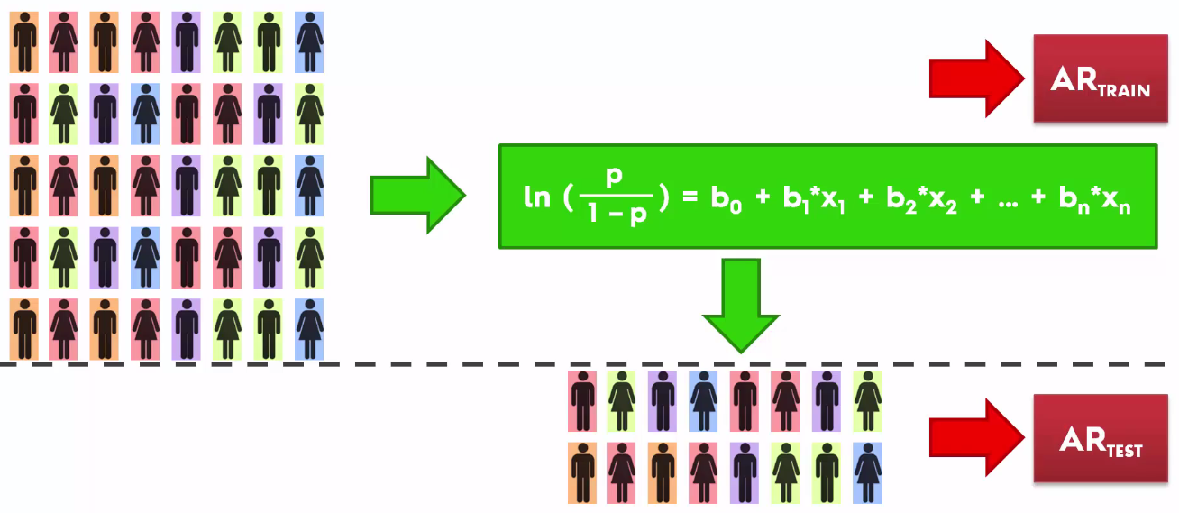
Accuracy Ratio of train
Accuracy Ratio of test

Slide 7
Underfitting, Overfitting, Accurate Model
Underfitting – high bias – consistent – inaccurate - AR train < AR test
Overfitting – high variance - accurate – inconsistent-AR train > AR test
Accurate – low bias low variance- best fit - AR train ~ AR test

Slide 8
What is bias?
Bias is the difference between the average prediction of our model and the correct value which we are trying to predict.
Model with high bias pays very little attention to the training data and oversimplifies the model.
It always leads to high error on training and test data.

Slide 9
What is variance?
Variance is the variability of model prediction for a given data point or a value which tells us spread of our data.
Model with high variance pays a lot of attention to training data and does not generalize on the data which it hasn’t seen before.
As a result, such models perform very well on training data but has high error rates on test data.

Slide 10
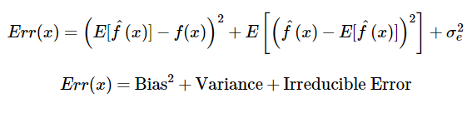
Error calculations

Slide 11
Irreducible Error
Irreducible error is the error that can’t be reduced by creating good models. It is a measure of the amount of noise in our data.
Here it is important to understand that no matter how good we make our model, our data will have certain amount of noise or irreducible error that can not be removed.

Slide 12
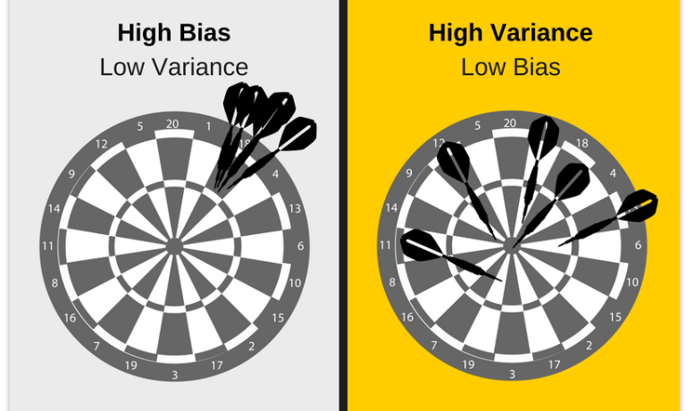

Slide 13
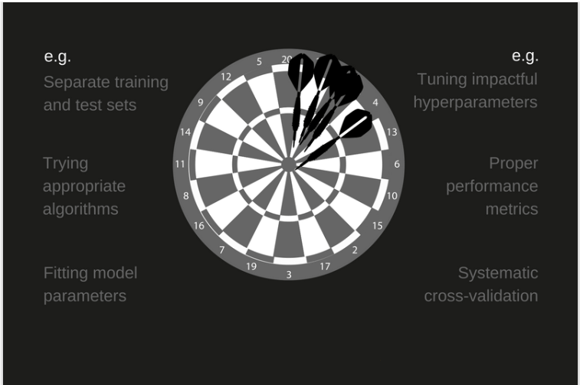
`

Slide 14
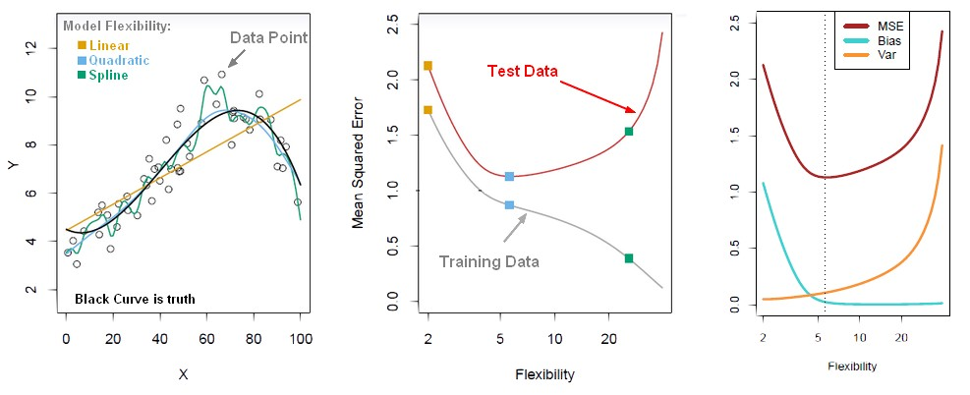

Slide 15
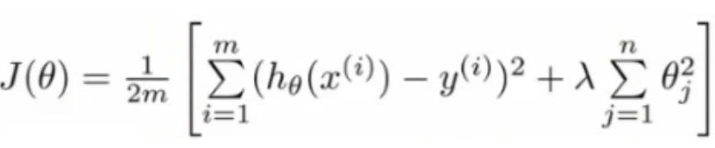
Ex: Cost function

Slide 16
Performance Metrics
Performance Metrics are the measure which can assess the performance of the model
For Regression: Three statistics are used in Ordinary Least Squares (OLS) regression to evaluate model fit:
R-squared
The Root Mean Square Error (RMSE).

Slide 17
Performance Metrics
All three are based on two sums of squares: Sum of Squares Total (SST) and Sum of Squares Error (SSE).
SST measures how far the data are from the mean, and SSE measures how far the data are from the model’s predicted values.

Slide 18
Assessing Regression Performance
R-squared is a statistical measure that represents the proportion of the variance for a dependent variable that's explained by an independent variable.
R-Squared = 1 - (Total Variation of Line/ Total Variation in ¯y)

Slide 19
Remember this dataset?
x | y
1 | 2
2 | 4
3 | 5
4 | 4
5 | 5

Slide 20
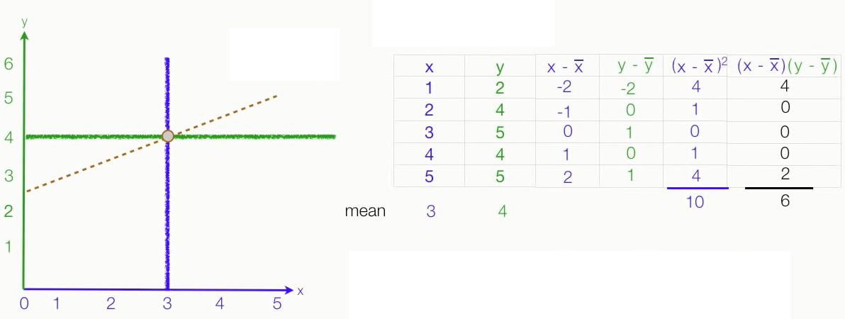

Slide 21
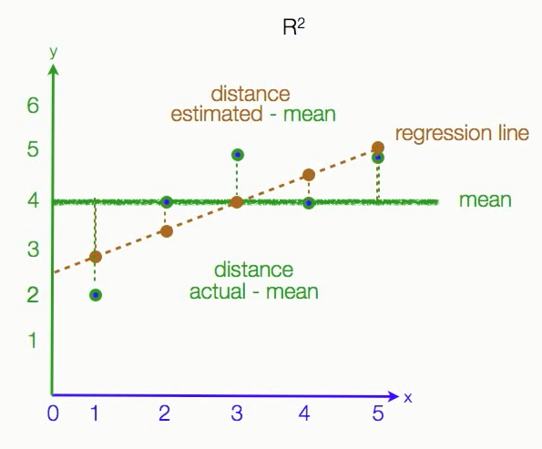
R squared also called
coefficient of determination
Total Variation of Line
---------------------------
Total Variation in ¯y
R-Squared = 1 -

Slide 22
Note:
If we want to maximize R², we note that we cannot influence the denominator in this formula.
Thus, maximizing R² is equivalent to minimizing the sum of squared errors (or the Mean Squared Error).

Slide 23
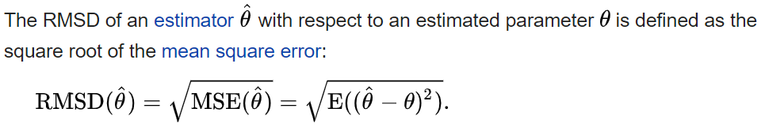
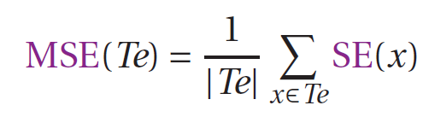
RMSE or RMSD
Root Mean Squared Error or Root Mean Squared Deviation
Where,

Slide 24
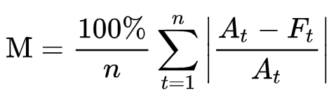
Mean Absolute Percentage Error (MAPE)
MAPE is, The mean absolute percentage error (MAPE), also known as mean absolute percentage deviation (MAPD), is a measure of prediction accuracy of a forecasting method in statistics.
It usually expresses accuracy as a percentage, and is defined by the formula:

Slide 25
Mean Absolute Percentage Error (MAPE)
Week | Sales | 3MA | Error | |Error| | Error 2 | |%Error|
1 | 39
2 | 44
3 | 40
4 | 45 | 41 | 4 | 4 | 16 | 8.89%
5 | 38 | 43 | -5 | 5 | 25 | 13.16%
6 | 43 | 41 | 2 | 2 | 4 | 4.65%
7 | 39 | 42 | -3 | 3 | 9 | 7.69%
 |  | 40 | Total | 14 MAD 3.5 | 54 MSE 13.5 | 34.39/4 MAPE 8.60%
+
+

Slide 26
Mean Absolute Percentage Error (MAPE)
Week | Sales | 3MA | Error | |Error| | Error 2 | |%Error|
1 | 39
2 | 44
3 | 40
4 | 45 | 41 | 4 | 4 | 16 | 8.89%
5 | 38 | 43 | -5 | 5 | 25 | 13.16%
6 | 43 | 41 | 2 | 2 | 4 | 4.65%
7 | 39 | 42 | -3 | 3 | 9 | 7.69%
 |  | 40 | Total | 14 MAD 3.5 | 54 MSE 13.5 | 34.39/4 MAPE 8.60%

Slide 27
MSE vs MAPE
MSE is scale-dependent, MAPE is not. So if you are comparing accuracy across time series with different scales, you can't use MSE.
For business use, MAPE is often preferred because apparently managers understand percentages better than squared errors.
MAPE can't be used when percentages make no sense. For example, the Fahrenheit and Celsius temperature scales have relatively arbitrary zero points, and it makes no sense to talk about percentages. MAPE also cannot be used when the time series can take zero values.
MAPE is intended to be both independent of scale and usable on all scales.

Slide 28
Assessing Classification Performance
Confusion Matrix
Accuracy
Error rate
Area under ROC Curve (AUC) and Receiver operating characteristic (ROC)
Precision
Recall

Slide 29
Confusion Matrix
A confusion matrix is a table that is often used to describe the performance of a classification model (or "classifier") on a set of test data for which the true values are known.
The confusion matrix itself is relatively simple to understand, but the related terminology can be confusing.

Slide 30
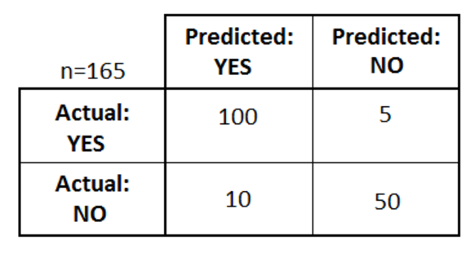
Ex:
Healthcare dataset
165 Observations
2 classes “Yes” and “No”

Slide 31
Out of those 165 cases, the classifier predicted "yes" 110 times, and "no" 55 times.
In reality, 105 patients in the sample have the disease, and 60 patients do not.

Slide 32
some basic terms
true positives (TP): These are cases in which we predicted yes (they have the disease), and actually they do have the disease.
true negatives (TN): We predicted no, and they don't have the disease.

Slide 33
false positives (FP): We predicted yes, but they don't actually have the disease. (Also known as a "Type I error.")
false negatives (FN): We predicted no, but they actually do have the disease. (Also known as a "Type II error.")

Slide 34
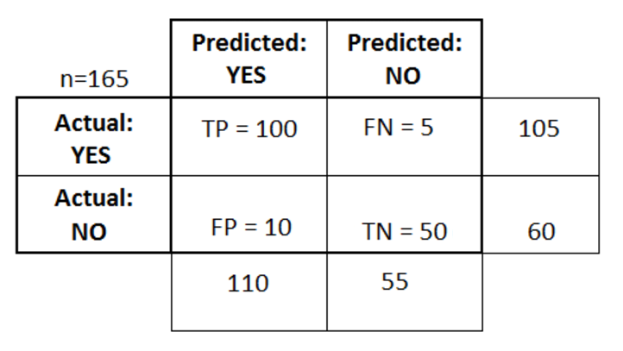
confusion matrix

Slide 35
Accuracy: Overall, how often is the classifier correct?
(TP+TN)/total = (100+50)/165 = 0.91
Misclassification Rate: Overall, how often is it wrong?
(FP+FN)/total = (10+5)/165 = 0.09
equivalent to 1 minus Accuracy
also known as "Error Rate“
Note: Total is nothing but a addition of TP, TN, FP, FN

Slide 36
True Positive Rate(TPR): When it's actually yes, how often does it predict yes?
TP/actual YES = 100/105 = 0.95
also known as "Sensitivity" or "Recall"
False Positive Rate(FPR): When it's actually no, how often does it predict yes?
FP/actual NO = 10/60 = 0.17
Class Ratio (clr) =Pos/Neg

Slide 37
Specificity: When it's actually no, how often does it predict no?
TN/actual NO = 50/60 = 0.83
equivalent to 1 minus False Positive Rate
Precision: When it predicts yes, how often is it correct?
TP/predicted YES = 100/110 = 0.91
Prevalence: How often does the yes condition actually occur in our sample?
actual YES/total = 105/165 = 0.64

Slide 38
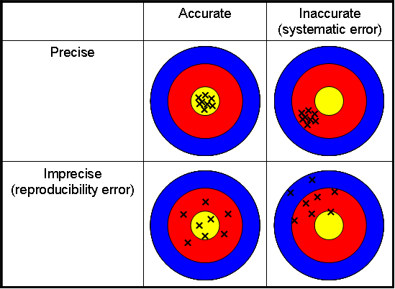

Slide 39
ROC Curve
An ROC curve is a commonly used way to visualize the performance of a binary classifier, meaning a classifier with two possible output classes.
For example, let's pretend you built a classifier to predict whether a research paper will be admitted to a journal, based on a variety of factors.
The features might be the length of the paper, the number of authors, the number of papers those authors have previously submitted to the journal, et cetera.

Slide 40
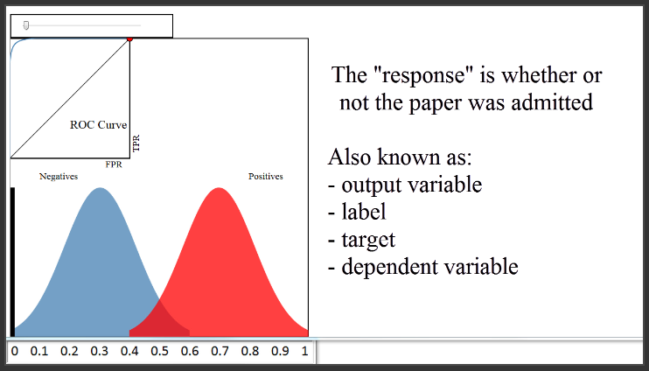
every blue and red pixel represents a paper for which you want to predict the admission status.

Slide 41
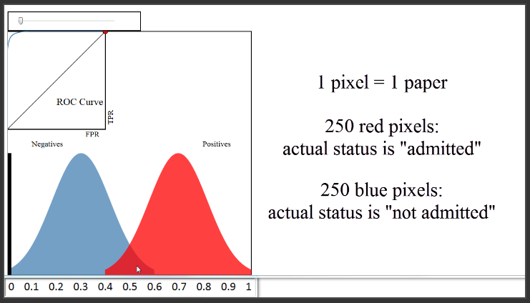

Slide 42
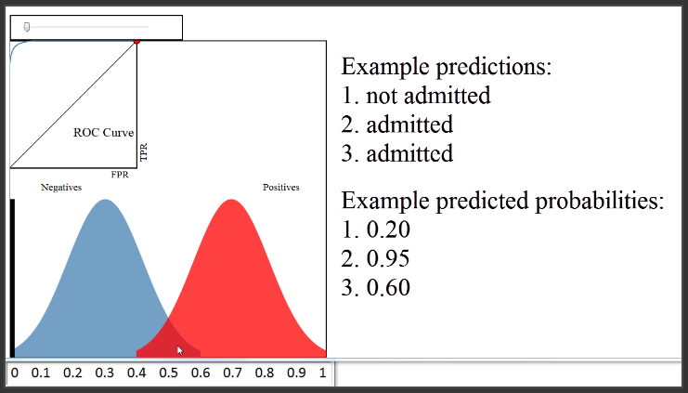

Slide 43
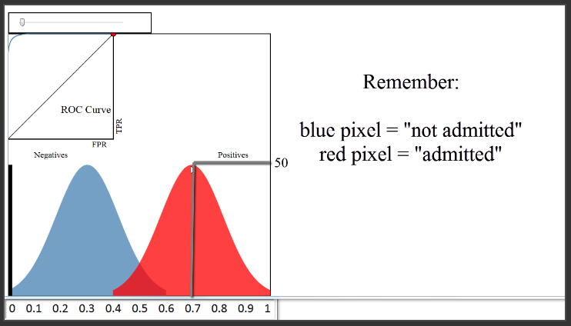

Slide 44
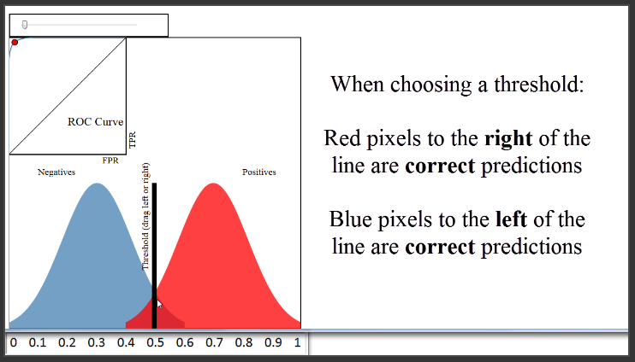

Slide 45
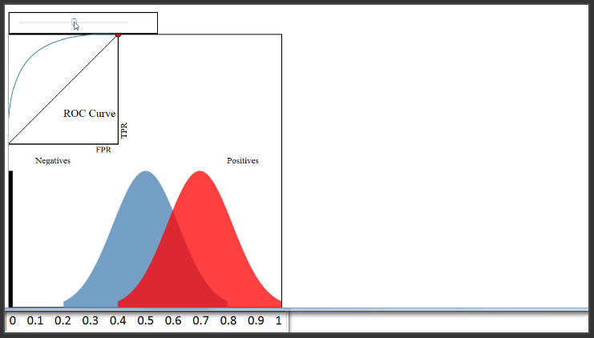

Slide 46
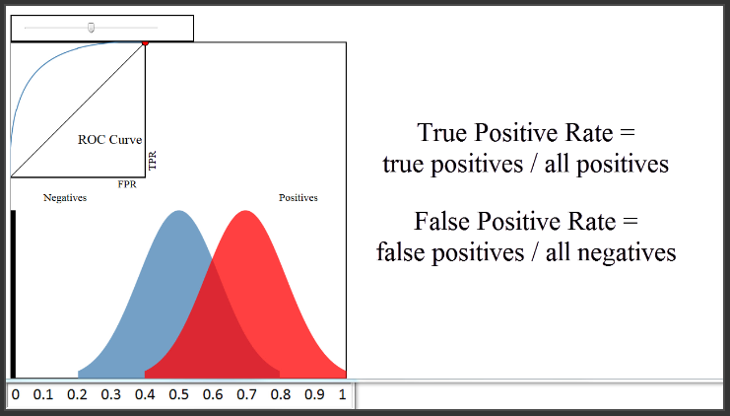

Slide 47
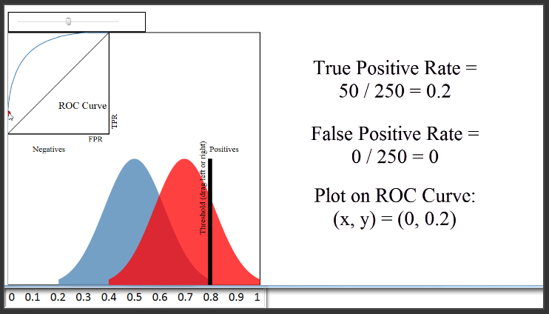

Slide 48
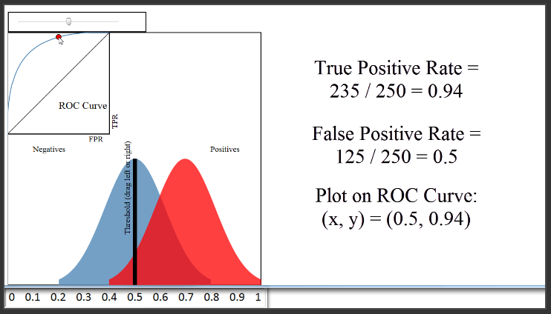

Slide 49
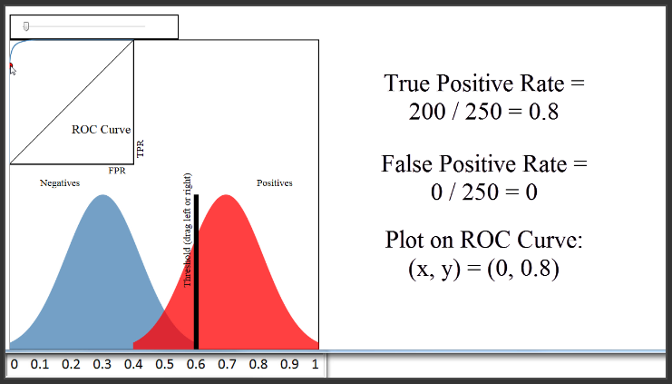

Slide 50
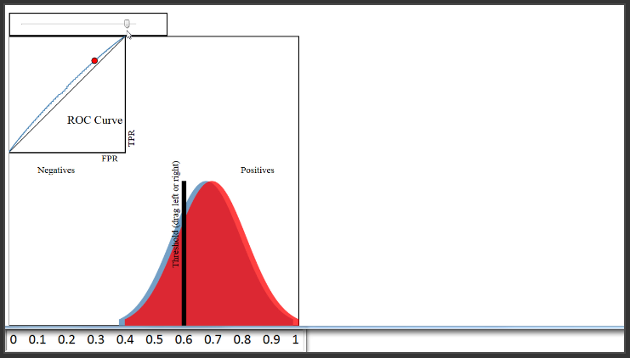

Slide 51
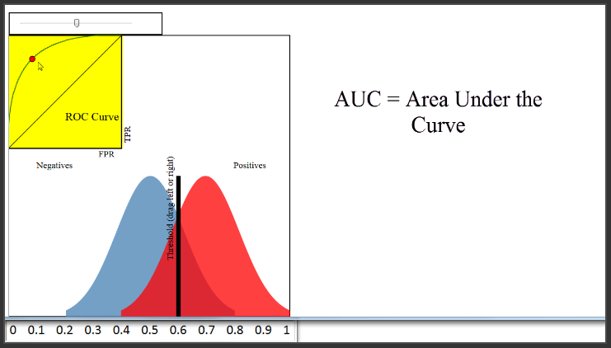

Slide 52
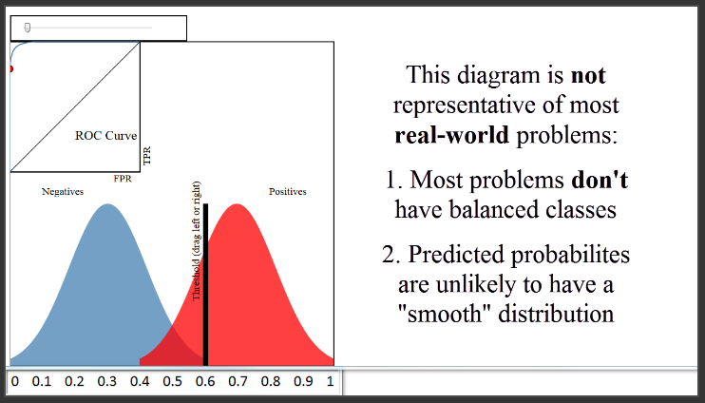

Slide 53
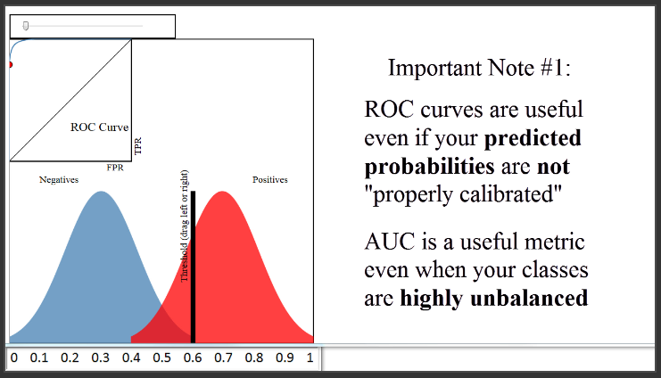

Slide 55
