Slide 1
Clustering Using K-mean
By… Sakeeb Sheikh

Slide 2
Cluster Analysis
Cluster analysis or clustering is the task of grouping a set of objects in such a way that objects in the same group (called a cluster) are more similar (in some sense) to each other than to those in other groups (clusters).
It is a main task of exploratory data mining, and a common technique for statistical data analysis, used in many fields, including machine learning, pattern recognition, image analysis, information retrieval, bioinformatics, data compression, and computer graphics.

Slide 3
How does K-Mean algorithm works to Cluster Data into Different Groups? Mathematically……..

Slide 4
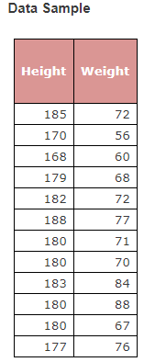
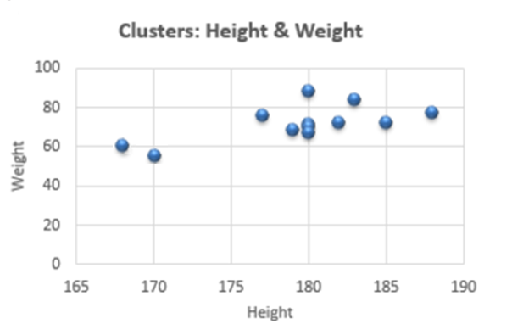
K Means Clustering Algorithm
Data sample
Plot of data sample

Slide 5
Step 1: Input

Slide 6
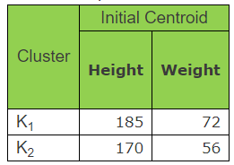
Randomly Select Some Data Rows as cluster Centroids.
Step 2: Initialize cluster centroid
here k = 2
1. We Selected two rows because we are considering the value of k as 2.
2. Selecting First two rows just for easily understanding the problem.

Slide 7
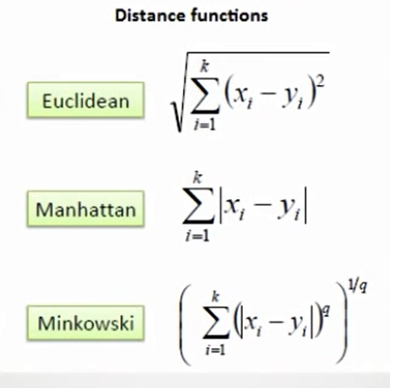
Distance Metrics
Euclidean distance
Manhattan distance
Minkowski distance

Slide 8
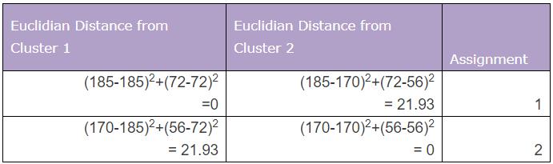
Using Euclidean Distance Formula
Step 3: Calculate Euclidean Distance

Slide 9
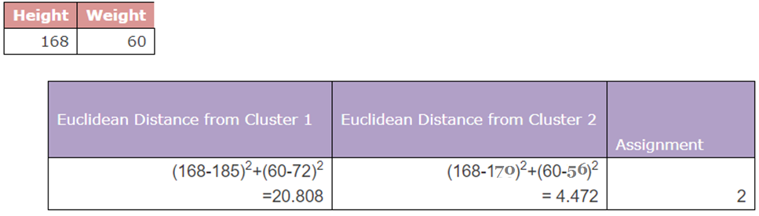
Step 4: Move on to next observation and calculate Euclidean Distance

Slide 10
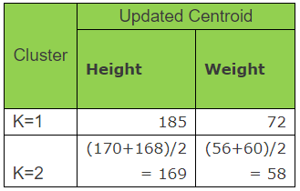
Since distance is minimum from cluster 2, so the observation is assigned to cluster 2. Now revise Cluster Centroid – mean value Height and Weight as Custer Centroids. Addition is only to cluster 2, so centroid of cluster 2 will be updated
Updated cluster centroids

Slide 11

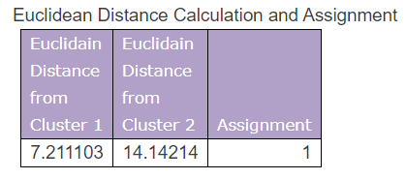
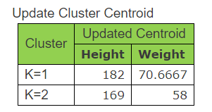
Step 5: Calculate Euclidean Distance for the next observation, assign next observation based on minimum euclidean distance and update the cluster centroids.

Slide 12
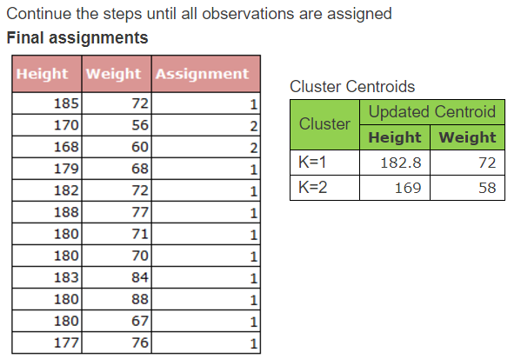

Slide 13
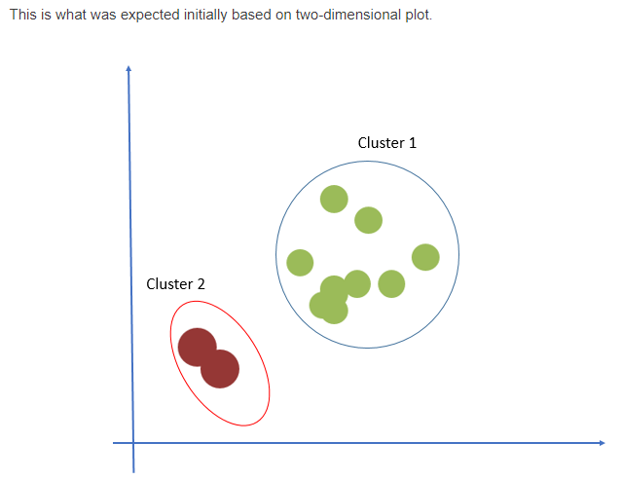

Slide 14
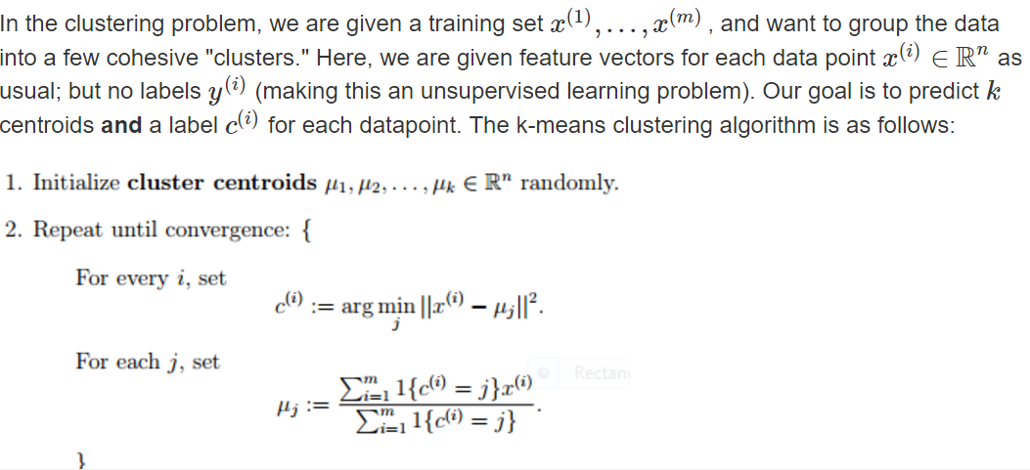
K-means cluster-Algorithm

Slide 15
Our Example Final Outcome

