Slide 1
kNN
By… Sakeeb Sheikh

Slide 2
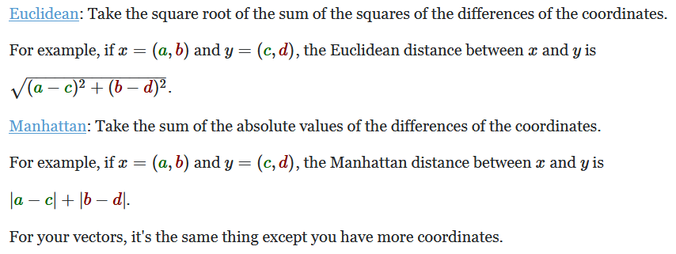
We know how to calculate the Distance ?

Slide 3
k-Nearest Neighbour
The kNN algorithm belongs to the family of instance-based, competitive learning and lazy learning algorithms.
Instance-based algorithms are those algorithms that model the problem using data instances (or rows) in order to make predictive decisions.
The kNN algorithm is an extreme form of instance-based methods because all training observations are retained as part of the model.

Slide 4
k-Nearest Neighbour
It is a competitive learning algorithm, because it internally uses competition between model elements (data instances) in order to make a predictive decision.
The objective similarity measure between data instances causes each data instance to compete to “win” or be most similar to a given unseen data instance and contribute to a prediction.

Slide 5
k-Nearest Neighbour
Lazy learning refers to the fact that the algorithm does not build a model until the time that a prediction is required.
It is lazy because it only does work at the last second. This has the benefit of only including data relevant to the unseen data, called a localized model.
A disadvantage is that it can be computationally expensive to repeat the same or similar searches over larger training datasets.

Slide 6
k-Nearest Neighbour
Finally, kNN is powerful because it does not assume anything about the data, other than a distance measure can be calculated consistently between any two instances.
As such, it is called non-parametric or non-linear as it does not assume a functional form.

Slide 7
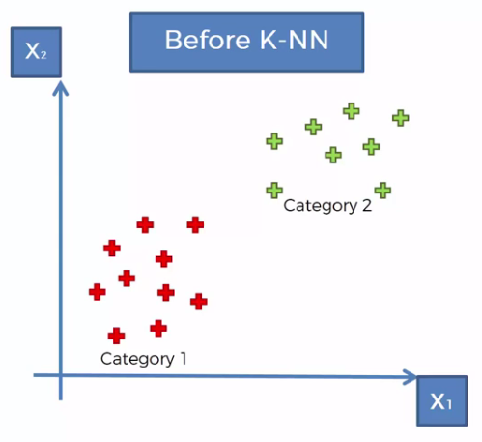
Ex:

Slide 8
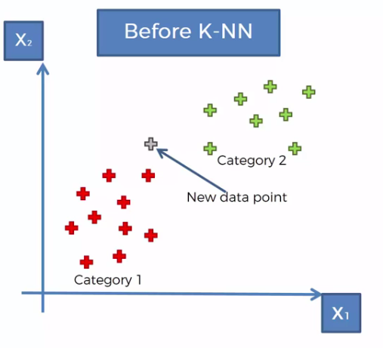

Slide 9
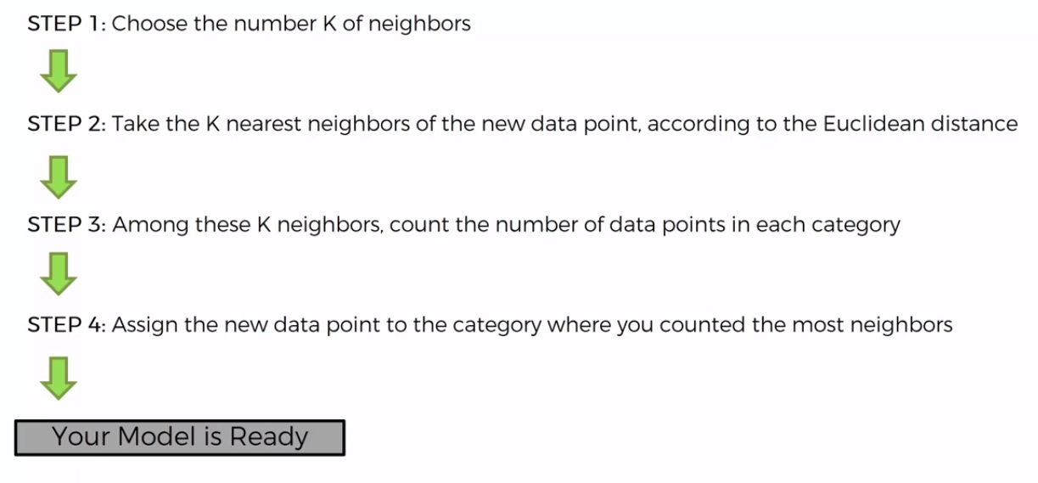

Slide 10
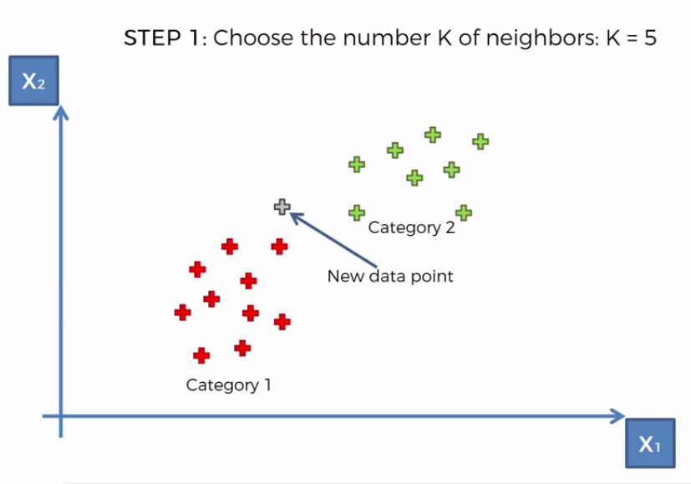

Slide 11
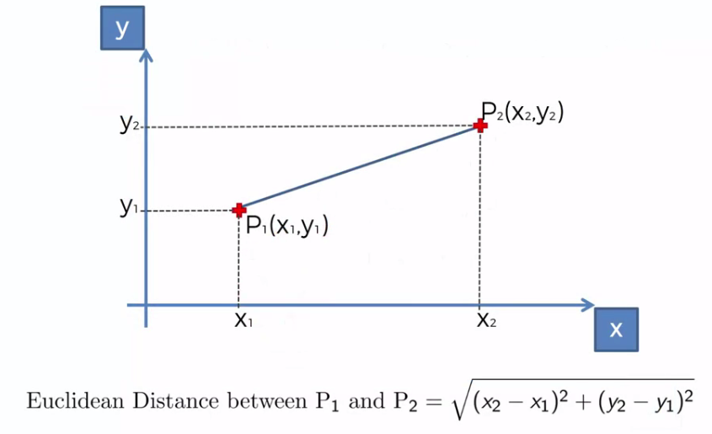

Slide 12
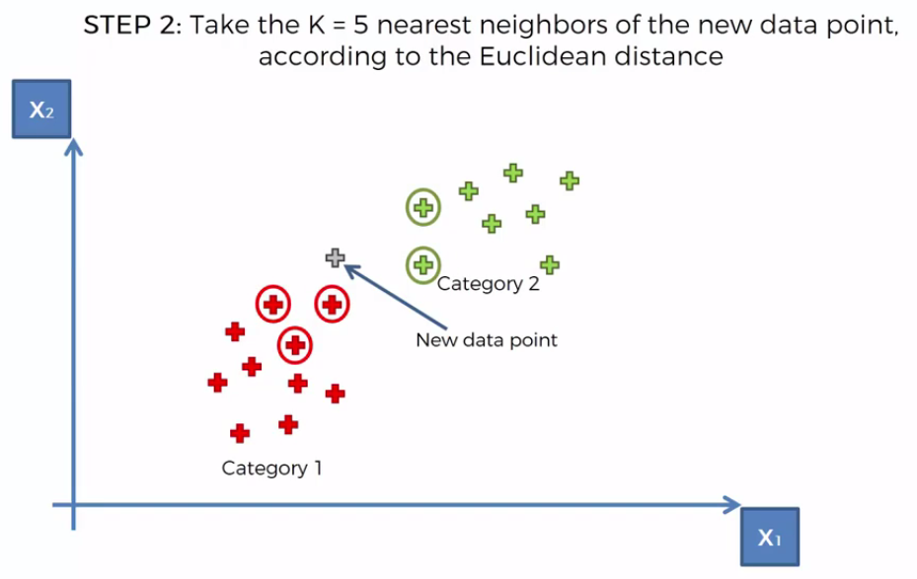

Slide 13
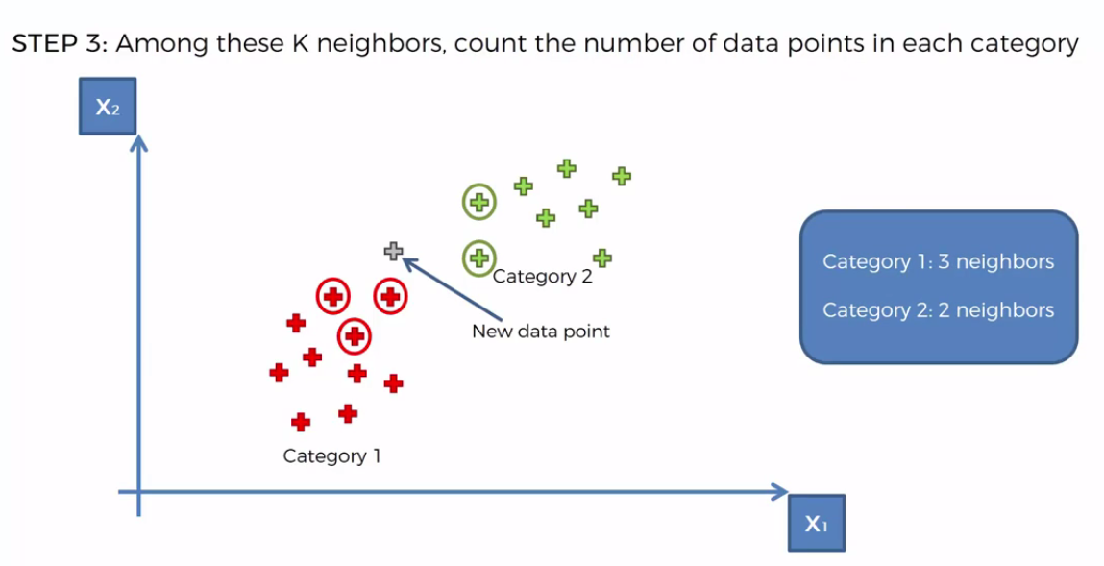

Slide 14
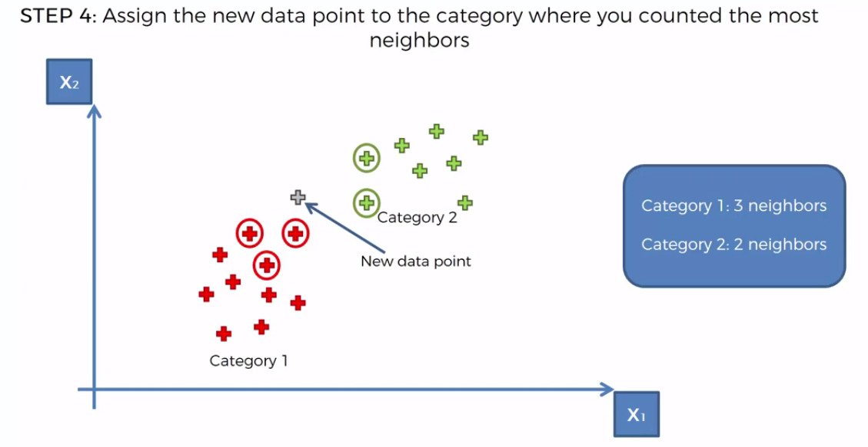

Slide 15
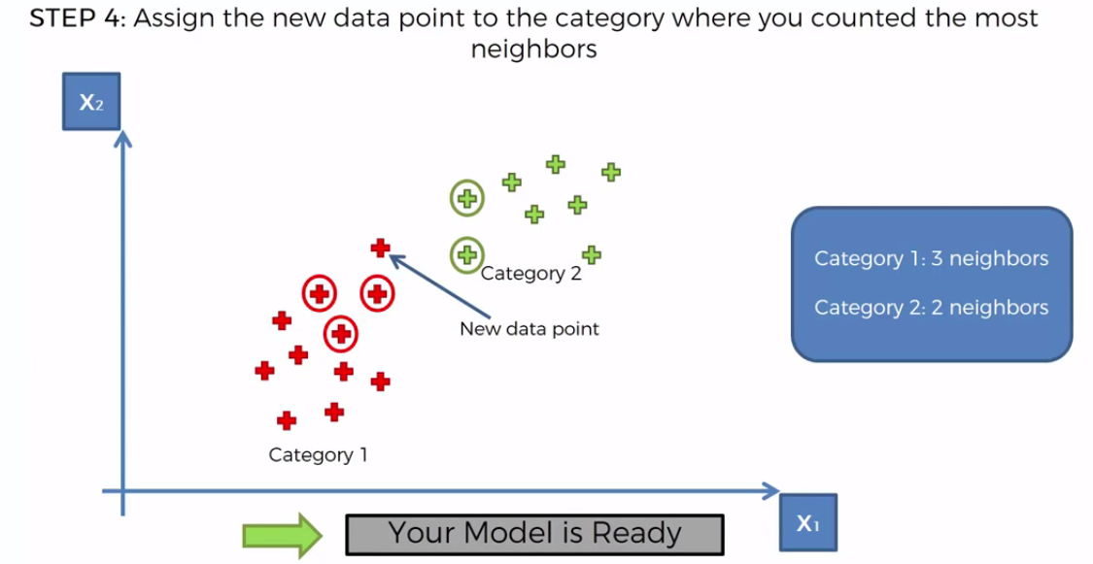

Slide 16
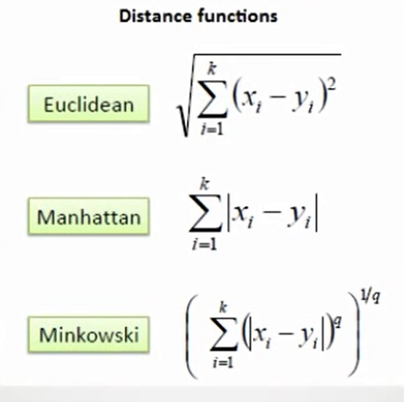
Distance Metrics
Euclidean distance
Manhattan distance
Minkowski distance

Slide 17
K- nearest neighbour (knn)
Student | Internal (xi1) | External (xi2) | Result (y)
S1 | 7 | 7 | Pass
S2 | 7 | 4 | Pass
S3 | 3 | 4 | Fail
S4 | 1 | 4 | Fail
S_{NEW} | 3 | 7 | ?
X₀ = (p₁, p₂) = (3,7)

Slide 18



Let k=3
Euclidian distance
where n is number of features in input vector =2
= $\sqrt{\left(7−3\right)2+\left(7−7\right)2}$
(d₁)² = 16
d₁ = 4

Slide 19
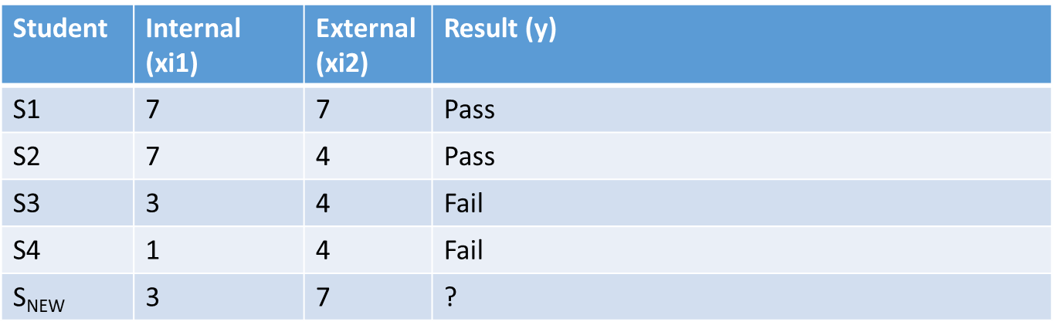
Similarly
d2=5, d3=3, d4=3.6

Slide 20
In increasing order w.r.t. evaluated distances
(d₃, d₄, d₁, d₂) = (3, 3.6, 4, 5)
K=3 , ∴ first 3 distances are (3, 3.6, 4)
Nearest neighbour are 3rd, 4th, 1st
(3,4, fail) , (1,4,fail), (7,7, pass)
Decide based on majority class ie fail > pass
So new student will be fail

