Slide 1
Naïve Bayes Classification
By Sakeeb Sheikh

Slide 2
Things We’d Like to Do
Spam Classification
Given an email, predict whether it is spam or not
Medical Diagnosis
Given a list of symptoms, predict whether a patient has disease X or not
Weather
Based on temperature, humidity, etc… predict if it will rain tomorrow

Slide 3
Bayesian Classification
Problem statement:
Given features X₁,X₂,…,X_{n}
Predict a label Y

Slide 4
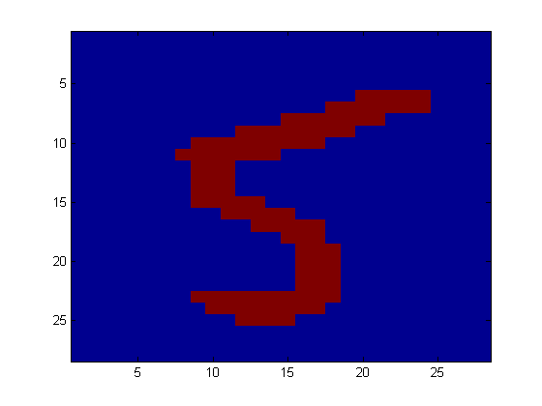
Another Application
Digit Recognition
X₁,…,X_{n} ∈ {0,1} (Black vs. White pixels)
Y ∈ {5,6} (predict whether a digit is a 5 or a 6)
Classifier
5

Slide 5

The Bayes Classifier
A good strategy is to predict:
(for example: what is the probability that the image represents a 5 given its pixels?)
So … How do we compute that?

Slide 6
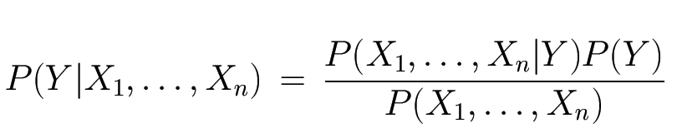
The Bayes Classifier
Use Bayes Rule!
Why did this help? Well, we think that we might be able to specify how features are “generated” by the class label
Likelihood
Prior
Normalization Constant

Slide 7
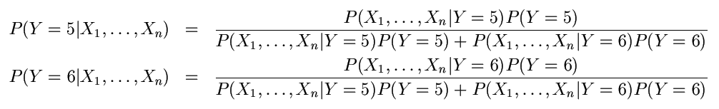
The Bayes Classifier
Let’s expand this for our digit recognition task:
To classify, we’ll simply compute these two probabilities and predict based on which one is greater

Slide 8
Model Parameters
For the Bayes classifier, we need to “learn” two functions, the likelihood and the prior
How many parameters are required to specify the prior for our digit recognition example?

Slide 9
Model Parameters
How many parameters are required to specify the likelihood?
(Supposing that each image is 30x30 pixels)
?

Slide 10
Model Parameters
The problem with explicitly modeling P(X₁,…,X_{n}|Y) is that there are usually way too many parameters:
We’ll run out of space
We’ll run out of time
And we’ll need tons of training data (which is usually not available)

Slide 11
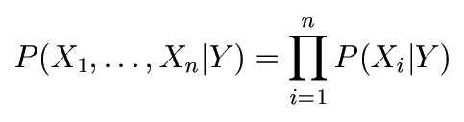
The Naïve Bayes Model
The Naïve Bayes Assumption: Assume that all features are independent given the class label Y
Equationally speaking:
(We will discuss the validity of this assumption later)

Slide 12
Why is this useful?
# of parameters for modeling P(X₁,…,X_{n}|Y):
2(2^{n}-1)
# of parameters for modeling P(X₁|Y),…,P(X_{n}|Y)
2n

Slide 13
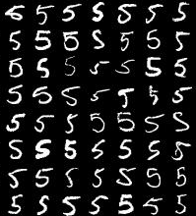
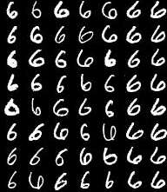
Naïve Bayes Training
Now that we’ve decided to use a Naïve Bayes classifier, we need to train it with some data:
MNIST Training Data

Slide 14
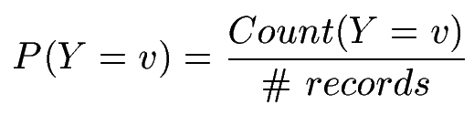

Naïve Bayes Training
Training in Naïve Bayes is easy:
Estimate P(Y=v) as the fraction of records with Y=v
Estimate P(X_{i}=u|Y=v) as the fraction of records with Y=v for which X_{i}=u
(This corresponds to Maximum Likelihood estimation of model parameters)

Slide 15
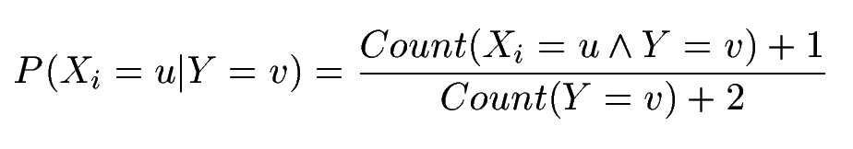
Naïve Bayes Training
In practice, some of these counts can be zero
Fix this by adding “virtual” counts:
(This is like putting a prior on parameters and doing MAP estimation instead of MLE)
This is called Smoothing

Slide 16
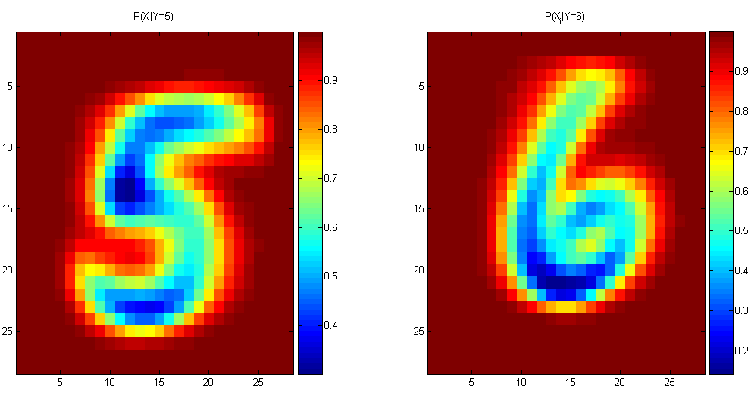
Naïve Bayes Training
For binary digits, training amounts to averaging all of the training fives together and all of the training sixes together.

Slide 17
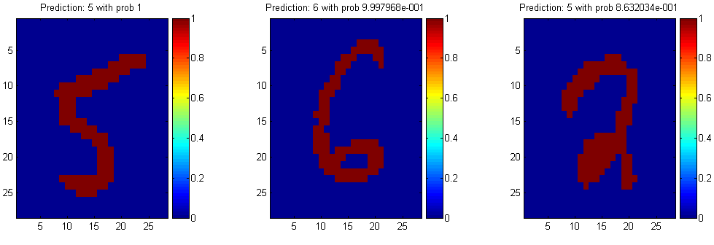
Naïve Bayes Classification

Slide 18
Another Example of the Naïve Bayes Classifier
The weather data, with counts and probabilities
outlook |  |  | temperature |  |  | humidity |  |  | windy |  |  | play
 | yes | no |  | yes | no |  | yes | no |  | yes | no | yes | no
sunny | 2 | 3 | hot | 2 | 2 | high | 3 | 4 | false | 6 | 2 | 9 | 5
overcast | 4 | 0 | mild | 4 | 2 | normal | 6 | 1 | true | 3 | 3
rainy | 3 | 2 | cool | 3 | 1
sunny | 2/9 | 3/5 | hot | 2/9 | 2/5 | high | 3/9 | 4/5 | false | 6/9 | 2/5 | 9/14 | 5/14
overcast | 4/9 | 0/5 | mild | 4/9 | 2/5 | normal | 6/9 | 1/5 | true | 3/9 | 3/5
rainy | 3/9 | 2/5 | cool | 3/9 | 1/5
A new day
outlook | temperature | humidity | windy | play
sunny | cool | high | true | ?

Slide 19
Likelihood of yes
Likelihood of no
Therefore, the prediction is No

