Slide 1
Model Optimization Using Gradient Descent
By… Sakeeb Sheikh

Slide 2
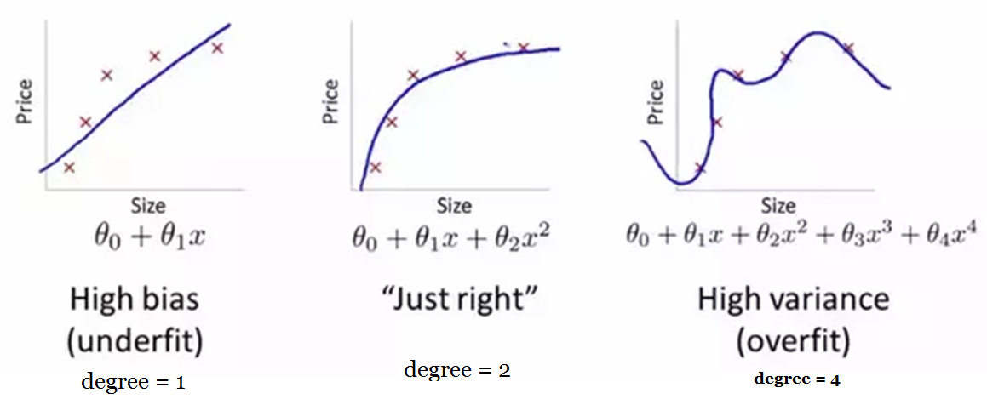
Overfitting, Underfitting, Just right

Slide 3
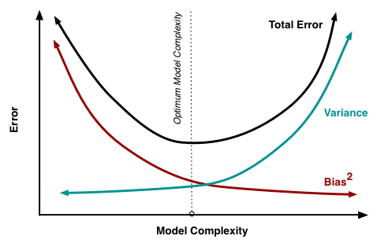
Bias Variance Trade Off

Slide 4
Now Let us try to understand what is Gradient Descent ? And Why we use Gradient Descent Algorithm ?

Slide 5
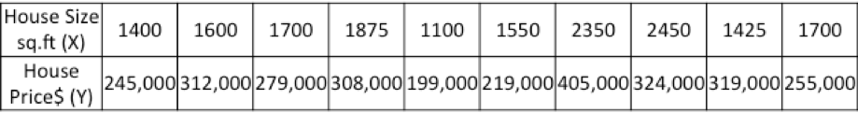
Example
Given historical housing data,the task is to create a model that predicts the price of a new house given the house size.
The task → for a new house, given its size (X), what will its price (Y) be?

Slide 6
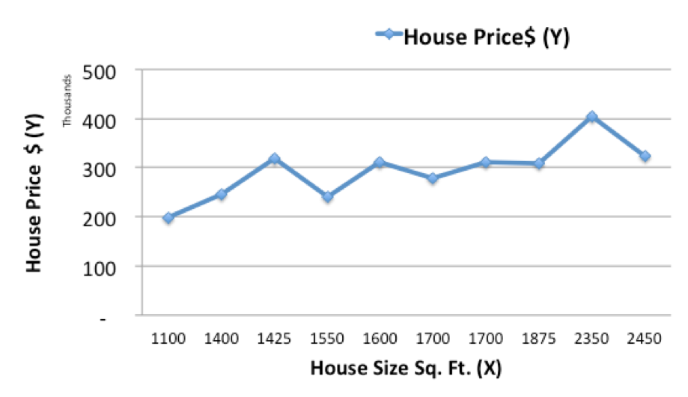
Lets start off by plotting the historical housing data:

Slide 7
Now, we will use a simple linear model, where we fit a line on the historical data, to predict the price of a new house (Ypred) given its size (X)

Slide 8
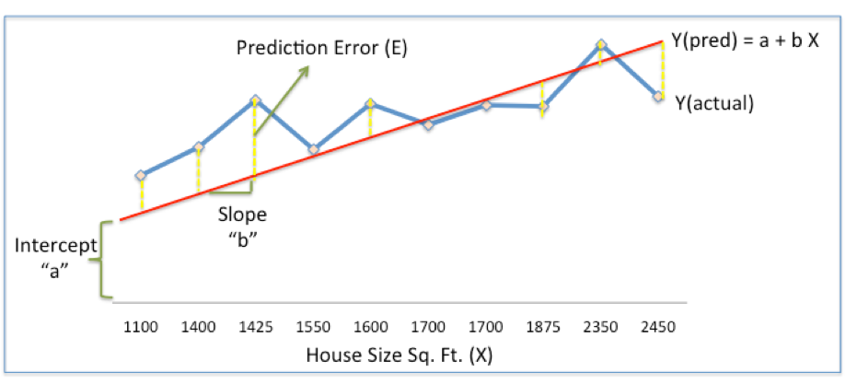
Fitting a Linear Model On the Training Data

Slide 9
We can see from above
In the above chart, the red line gives the predicted house price (Ypred) given house size (X)
Ypred = a+bX = θ0 + θ1.x
The blue line gives the actual house prices from historical data (Yactual)
The difference between Yactual and Ypred is the prediction error (E)

Slide 10
And We also Know That
Sum of Squared Errors (SSE)
= ½ Sum (Actual House Price – Predicted House Price)²
= ½ Sum(Y – Ypred)²
And our aim is to optimize the model performance which means we want to Minimize the ERROR rate.
Please Note there are other measures of Error also like MAD, MSE, MAPE.

Slide 11
Gradient Descent for Optimizing Model
Used for tuning model for the Least SSE(Sum Squared Error).
Gradient Means → Slope
Descent Means → Moving Downward Along the Slope.
Gradient descent is an optimization algorithm that finds the optimal weights (a,b) / (θ0,θ1) that reduces prediction error.

Slide 12
Gradient Descent Step By Step
Step 1: Initialize the weights(a & b) with random values and calculate Error (SSE).
Step 2: Calculate the gradient i.e. change in SSE when the weights (a & b) are changed by a very small value from their original randomly initialized value. This helps us move the values of a & b in the direction in which SSE is minimized.
Step 3: Adjust the weights with the gradients to reach the optimal values where SSE is minimized
Step 4: Use the new weights for prediction and to calculate the new SSE
Step 5: Repeat steps 2 and 3 till further adjustments to weights doesn’t significantly reduce the Error

Slide 13
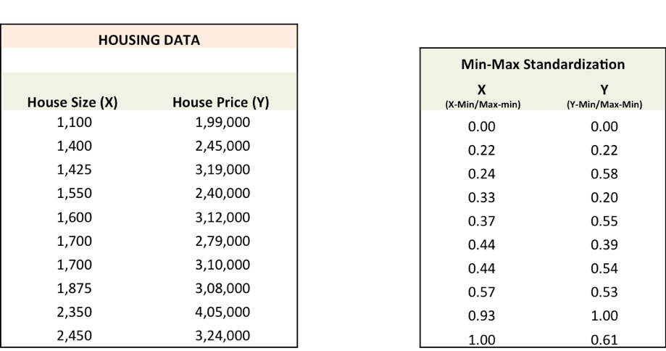
Min-Max Standardization

Slide 14
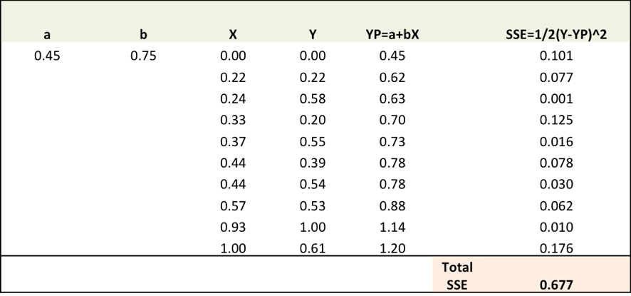
Step 1: To fit a line Ypred = a + b X, start off with random values of a and b and calculate prediction error (SSE)

Slide 15
Step 2: Calculate the error gradient w.r.t the weights
∂SSE/∂a = – (Y-YP)
∂SSE/∂b = – (Y-YP)X
Here, SSE=½ (Y-YP)² = ½(Y-(a+bX))²
You need to know a bit of calculus, but that’s about it!!
∂SSE/∂a and ∂SSE/∂b are the gradients and they give the direction of the movement of a,b w.r.t to SSE.

Slide 16
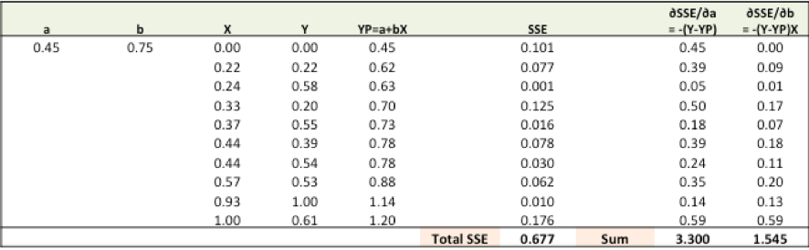
Doing Calculations

Slide 17
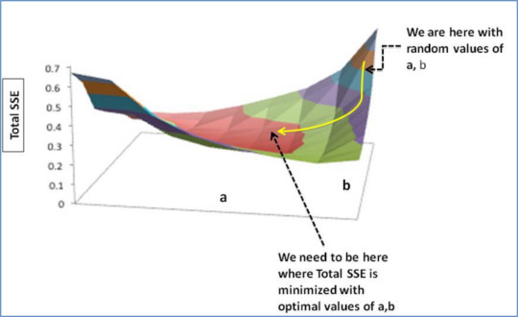
Step 3:Adjust the weights with the gradients to reach the optimal values where SSE is minimized

Slide 18
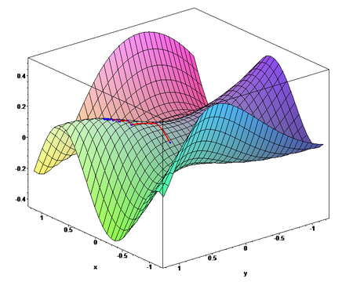

Slide 19
Updating The Values of (a,b) / (θ0 , θ1)
We need to update the random values of a,b so that we move in the direction of optimal a, b.
Update rules:
a – ∂SSE/∂a
b – ∂SSE/∂b
So, update rules:
New a = a – r * ∂SSE/∂a = 0.45-0.01*3.300 = 0.42
New b = b – r * ∂SSE/∂b= 0.75-0.01*1.545 = 0.73
here, r is the learning rate = 0.01, which is the pace of adjustment to the weights.

Slide 20
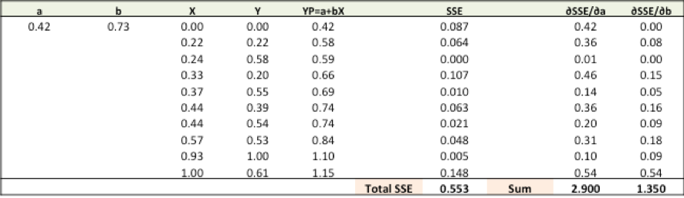
Step 4:Use new a and b for prediction and to calculate new Total SSE

Slide 21
Doing Calculations

