Slide 1
Ensemble Learning
By Sakeeb Sheikh

Slide 2
Ensemble
Ensembles can give you a boost in accuracy on your dataset.
We will discover how you can create some of the most powerful types of ensembles in Python using scikit-learn.
This session will step you through Bagging, Boosting and Majority Voting and show you how you can continue to ratchet up the accuracy of the models on your own datasets.

Slide 3
Combine Model Predictions Into Ensemble Predictions
Bagging: Building multiple models (typically of the same type) from different subsamples of the training dataset.
Boosting: Building multiple models (typically of the same type) each of which learns to fix the prediction errors of a prior model in the chain.
Voting: Building multiple models (typically of differing types) and simple statistics (like calculating the mean) are used to combine predictions.

Slide 4
Bagging Algorithms
Bootstrap Aggregation or bagging involves taking multiple samples from your training dataset (with replacement) and training a model for each sample.
The final output prediction is averaged across the predictions of all of the sub-models.

Slide 5
Bagging Algorithms
The three bagging models covered in this section are as follows:
Bagged Decision Trees
Random Forest
Extra Trees

Slide 6
1. Bagged Decision Trees
Bagging performs best with algorithms that have high variance.
A popular example are decision trees, often constructed without pruning.
In the example next, see an example of using the Bagging Classifier with the Classification and Regression Trees algorithm (DecisionTreeClassifier). A total of 100 trees are created.

Slide 7
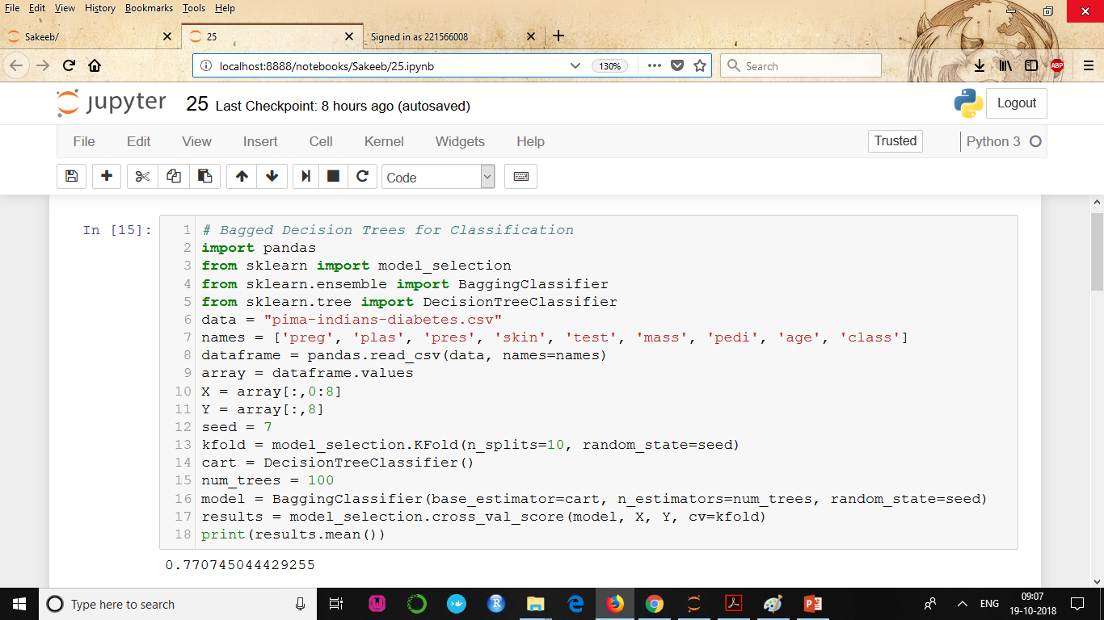
Decision Tree

Slide 8
Random Forest
Random forest is an extension of bagged decision trees.
Samples of the training dataset are taken with replacement, but the trees are constructed in a way that reduces the correlation between individual classifiers.
Specifically, rather than greedily choosing the best split point in the construction of the tree, only a random subset of features are considered for each split.

Slide 9
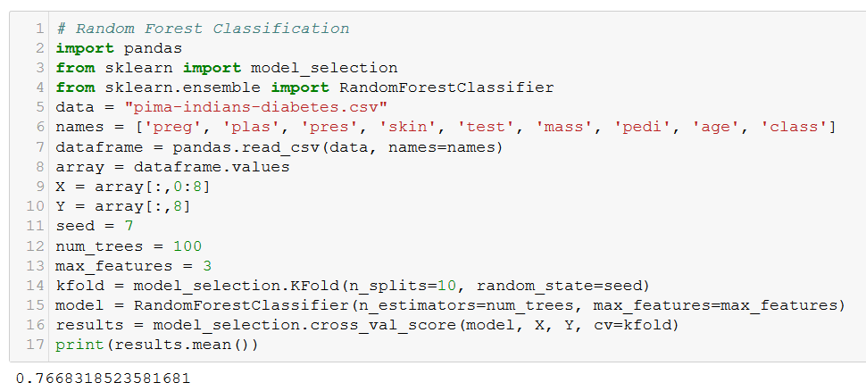
Random Forest

Slide 10
Extra Trees
Extra Trees are another modification of bagging where random trees are constructed from samples of the training dataset.
You can construct an Extra Trees model for classification using the Extra Trees Classifier class.
The example next provides a demonstration of extra trees with the number of trees set to 100 and splits chosen from 7 random features.

Slide 11
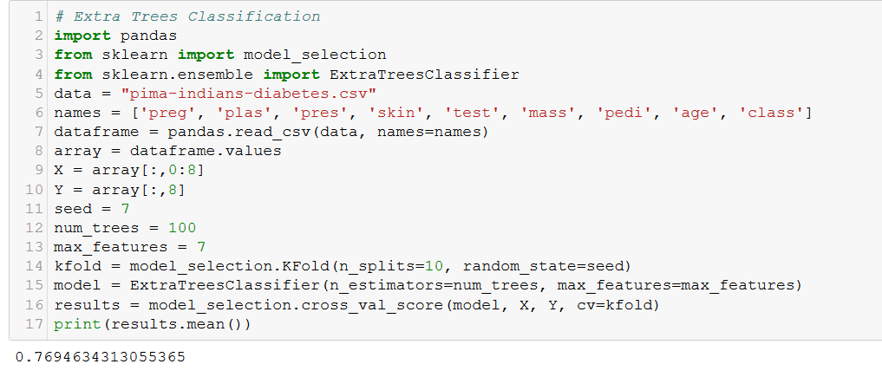
Extra Trees

Slide 12
Boosting Algorithms
Boosting ensemble algorithms creates a sequence of models that attempt to correct the mistakes of the models before them in the sequence.
Once created, the models make predictions which may be weighted by their demonstrated accuracy and the results are combined to create a final output prediction.

Slide 13
Boosting Algorithms
The two most common boosting ensemble machine learning algorithms are:
AdaBoost
Stochastic Gradient Boosting

Slide 14
AdaBoost
AdaBoost was perhaps the first successful boosting ensemble algorithm.
It generally works by weighting instances in the dataset by how easy or difficult they are to classify, allowing the algorithm to pay or less attention to them in the construction of subsequent models.
The example next demonstrates the construction of 30 decision trees in sequence using the AdaBoost algorithm.

Slide 15
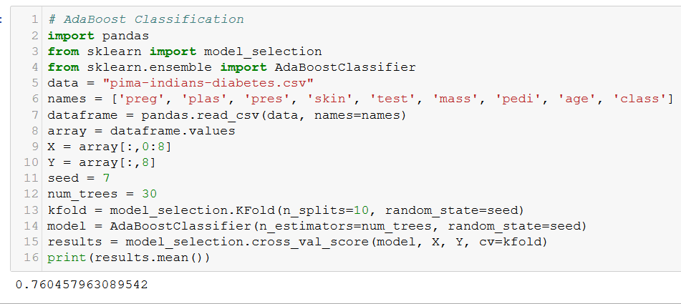
AdaBoost

Slide 16
Stochastic Gradient Boosting
Stochastic Gradient Boosting (also called Gradient Boosting Machines) are one of the most sophisticated ensemble techniques.
You can construct a Gradient Boosting model for classification using the Gradient Boosting Classifier class.
The example below demonstrates Stochastic Gradient Boosting for classification with 100 trees.

Slide 17
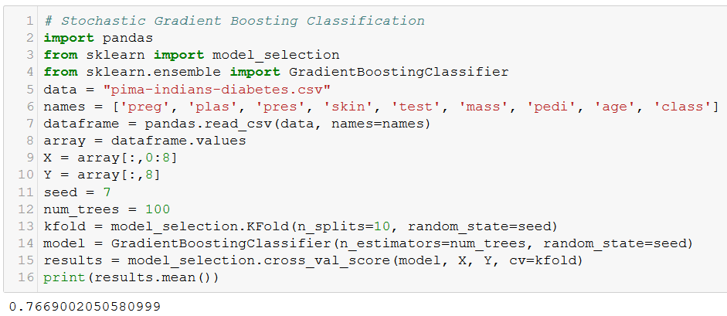
Stochastic Gradient Boosting

Slide 18
Voting Ensemble
Voting is one of the simplest ways of combining the predictions from multiple machine learning algorithms.
It works by first creating two or more standalone models from your training dataset.
A Voting Classifier can then be used to wrap your models and average the predictions of the sub-models when asked to make predictions for new data.

Slide 19
Voting Ensemble
The predictions of the sub-models can be weighted, but specifying the weights for classifiers manually or even heuristically is difficult.
More advanced methods can learn how to best weight the predictions from submodels, but this is called stacking (stacked aggregation) and is currently not provided in scikit-learn.
You can create a voting ensemble model for classification using the VotingClassifier class.

Slide 20
What we have seen yet ?
Bagging Ensembles including Bagged Decision Trees, Random Forest and Extra Trees.
Boosting Ensembles including AdaBoost and Stochastic Gradient Boosting.
Voting Ensembles for averaging the predictions for any arbitrary models.

