Slide 1
Database Design Principles Chapter 1 & 2
Reference(s):
Cornel and Morris, Database Systems: Design, Implementation, and Management, 12e

Slide 2
Chapter 1
Database Systems

Slide 3
Learning Objectives
The difference between data and information
What a database is, the various types of databases, and why they are valuable assets for decision making
The importance of database design
How modern databases evolved from file systems
About flaws in file system data management
The main components of the database system
The main functions of a database management system (DBMS)

Slide 4
Why Databases?
Databases solve many of the problems encountered in data management
Used in almost all modern settings involving data management:
Business
Research
Administration
Important to understand how databases work and interact with other applications

Slide 5
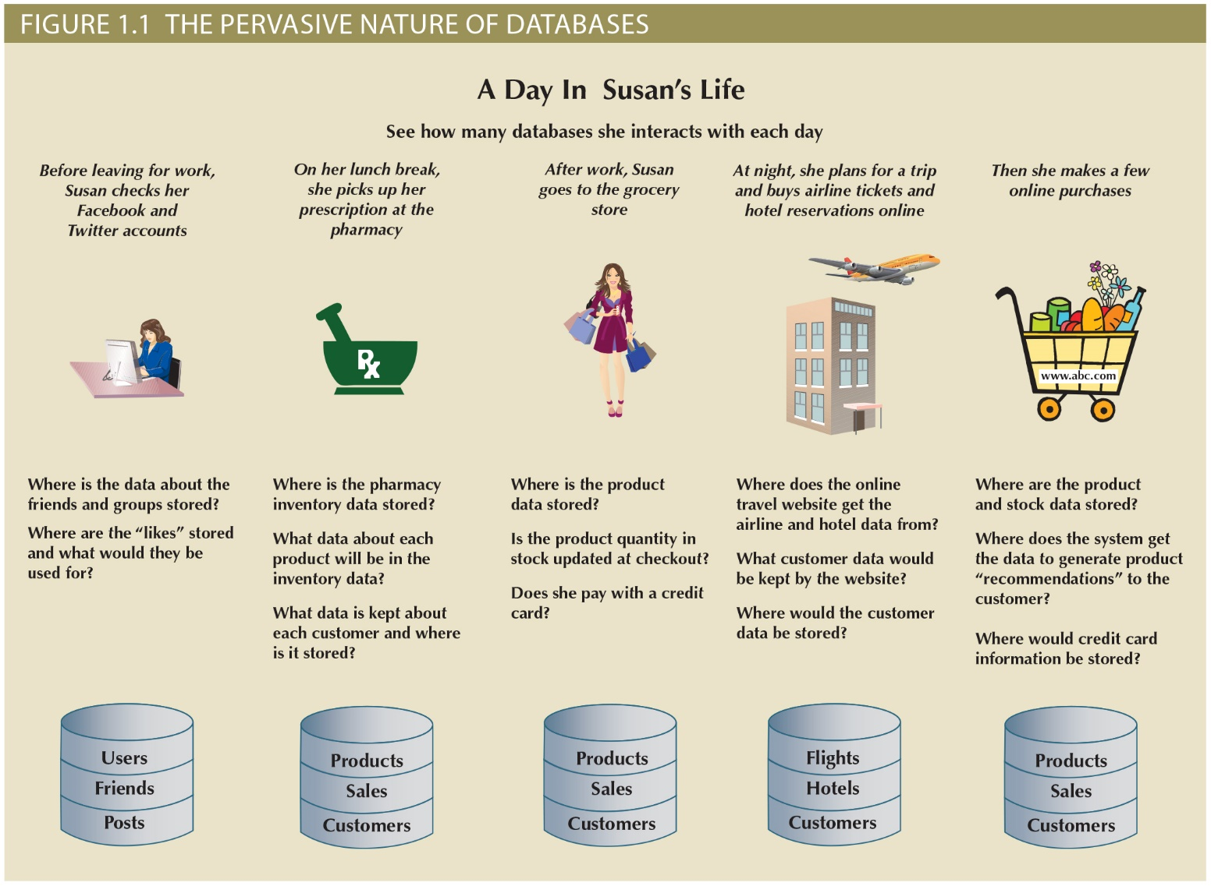

Slide 6
Data vs. Information
Data, Information, Knowledge
Data (raw facts)
Information (processed data with meaning)
Knowledge (the body of information and facts about a specific subject)
Example
I have access to data, so I can check the last name of customer with ID 10001
I have access to information: I can find the customer who has paid the most among all services in year 2015.
I work in the HR department, and I know what type of data we have in our database and the relationships and constraints.
Notes:
To reveal meaning, information requires context.

Slide 7
Data versus Information
Data
Information
Raw facts
Have not yet been processed to reveal their meaning to the end user
Building blocks of information
Data management
Generation, storage, and retrieval of data
Produced by processing raw data to reveal its meaning
Requires context
Bedrock of knowledge
Should be accurate, relevant, and timely to enable good decision making
Notes:
Raw data must be properly formatted for storage

Slide 8
Database & Management Systems (DBMS)

Slide 9
Introducing the Database
Database: shared, integrated computer structure that stores a collection of:
End-user data: raw facts of interest to end user
Metadata: data about data
Provides description of data characteristics and relationships in data
Complements and expands value of data
Database management system (DBMS): collection of programs
Manages structure and controls access to data

Slide 10
Role and Advantages of the DBMS
DBMS is the intermediary between the user and the database
DBMS enables data to be shared
DBMS integrates many users’ views of the data
Receives and translates application requests into operations required to fulfill the requests
Hides database’s internal complexity from the application programs and users

Slide 11
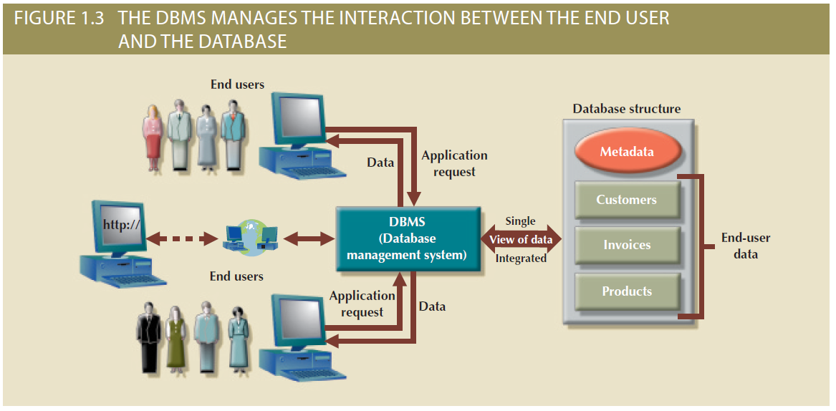
Figure 1.3 - The DBMS Manages the Interaction between the End User and the Database

Slide 12
Role and Advantages of the DBMS (cont’d.)
Advantages of a DBMS:
Improved data sharing
Improved data security
Better data integration
Minimized data inconsistency
Improved data access
Improved decision making
Increased end-user productivity

Slide 13
Types of Databases
Databases can be classified according to:
Number of users
Database location(s)
Expected type and extent of use
Single-user database supports only one user at a time
Desktop database: single-user; runs on PC
Multiuser database supports multiple users at the same time
Workgroup databases: Supports a small number of users or a specific department
Enterprise database: Supports many users across many departments

Slide 14
Types of Databases (cont’d.)
Centralized database: Data is located at a single site
Distributed database: Data is distributed across different sites
Cloud database: Created and maintained using cloud data services that provide defined performance measures for the database

Slide 15
Types of Databases (cont'd.)
Unstructured data exist in their original state
Structured data result from formatting
Structure applied based on type of processing to be performed
Semistructured data have been processed to some extent
Extensible Markup Language (XML) represents data elements in textual format
XML database supports semistructured XML data

Slide 16
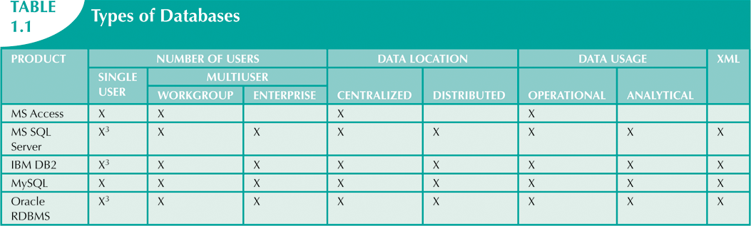

Slide 17
Before the Age of Databases? File Systems!

Slide 18
Before the Age of Databases? File Systems!
Manual File Systems
Papers and pencils
File cabinets
Keeping books and records
Computerized File Systems
Data processing (DP) specialist converted computer file structure from manual system
Wrote software that managed the data
Designed the application programs

Slide 19
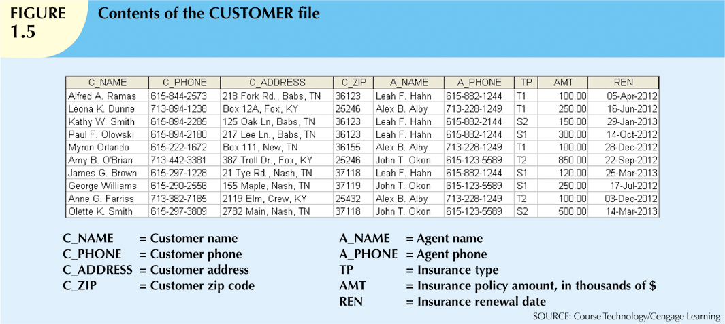
Notes:
Matching the manual file system

Slide 20
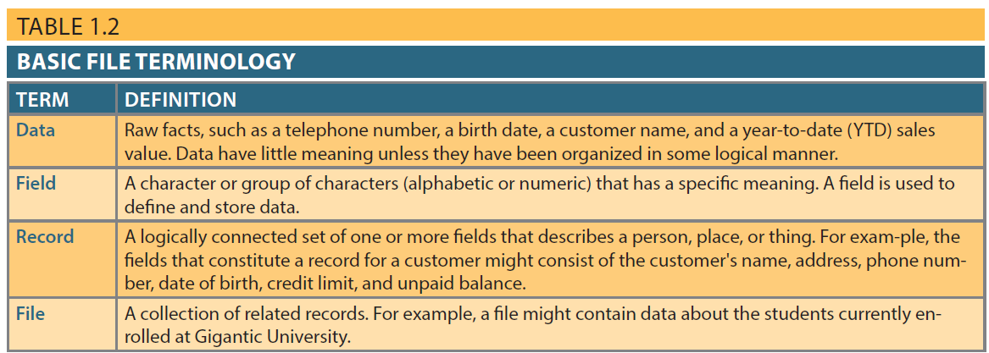
Table 1.2 - Basic File Terminology

Slide 21
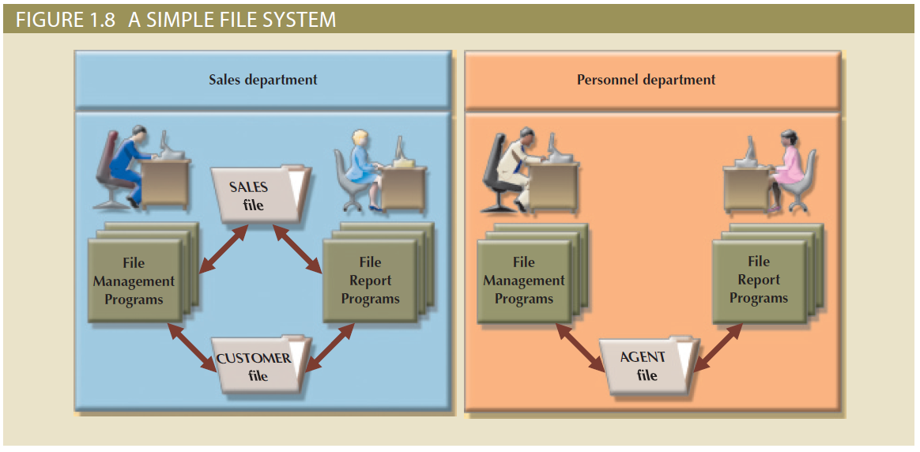
Figure 1.8 - A Simple File System

Slide 22
Before the Age of Databases? File Systems! (cont.)
File System Redux: Modern Tools
Microsoft Excel
Widely used by business users
Users have become so adept at working with spreadsheets, they tend to use them to complete tasks for which spreadsheets are not appropriate – database substitute
Notes:
Redux: means revived, brought back

Slide 23
Evolution of File System Data Processing
Manual File Systems
Accomplished through a system of file folders and filing cabinets
Computerized File Systems
Data processing (DP) specialist: Created a computer-based system that would track data and produce required reports
File System Redux: Modern End-User Productivity Tools
Includes spreadsheet programs such as Microsoft Excel

Slide 24
Problems with File System Data Processing
Lengthy development times
Difficulty of getting quick answers
Complex system administration
Lack of security and limited data sharing
Extensive programming

Slide 25
Problems with File System Data Processing
Lengthy development times
Difficulty of getting quick answers- Cannot perform ad hoc queries
System administration is complex and difficult
Security features are likely to be inadequate; limited data sharing
Requires extensive programming
Difficult to make changes to existing structures

Slide 26
More problems: (a) Structural and Data Dependence
Structural dependence: access to a file is dependent on its own structure
All file system programs must be modified to conform to a new file structure
Versus Structural Independence: change file structure without affecting data access
Data dependence: data access changes when data storage characteristics change
Versus Data Independence: data storage characteristics do not affect data access
We can achieve independence by differentiating between
The logical data format (how human views the data) and
The physical data format (how computer must work with data)

Slide 27
More problems: (b) Data Redundancy
Organizational structure promotes storage of same data in different locations
Islands of information: Scattered data locations
Data redundancy: same data stored unnecessarily in different places
Results in:
Poor data security
Data inconsistency: different and conflicting versions of same data occur at different places
Data-entry errors
Data integrity problems

Slide 28
More problems: (c) Data Anomalies
Data anomalies: abnormalities when all changes in redundant data are not made correctly
Update anomalies
Insertion anomalies
Deletion anomalies
Update Anomalies
Insertion Anomalies
Deletion Anomalies

Slide 29
Database Systems
Database system consists of logically related data stored in a single logical data repository
May be physically distributed among multiple storage facilities
DBMS eliminates most of file system’s problems
Current generation stores data structures, relationships between structures, and access paths
Also defines, stores, and manages all access paths and components

Slide 30
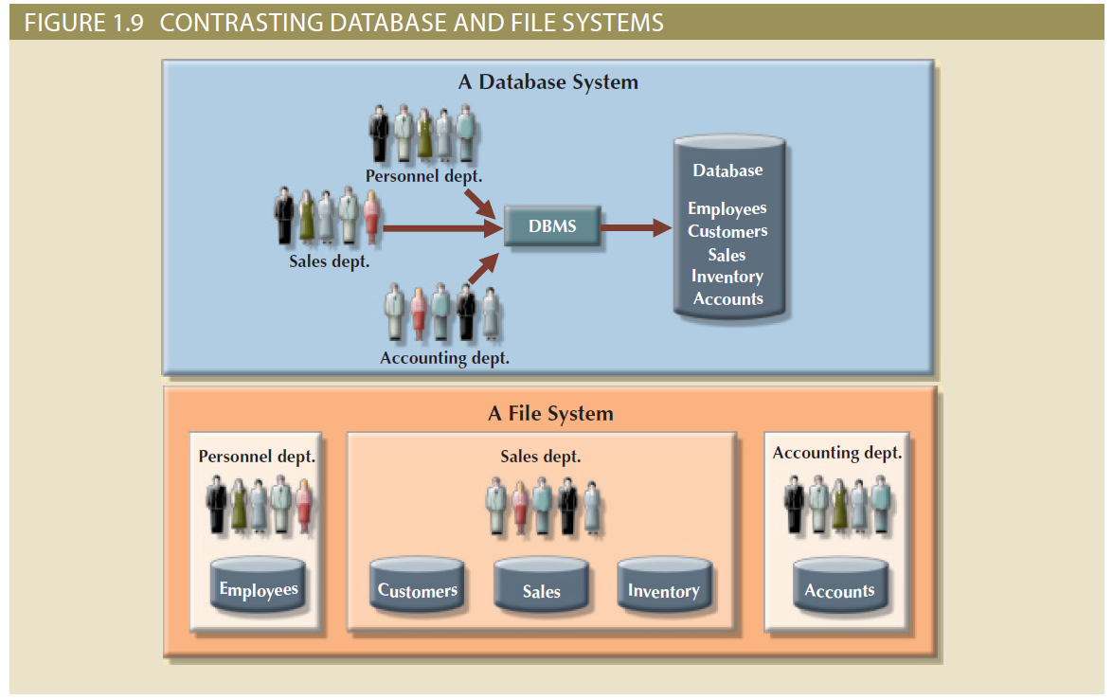
Figure 1.9 - Contrasting Database and File Systems

Slide 31
The Database System Environment
Database system: defines and regulates the collection, storage, management, use of data
Five major parts of a database system:
Hardware
Software
People
Procedures
Data

Slide 32
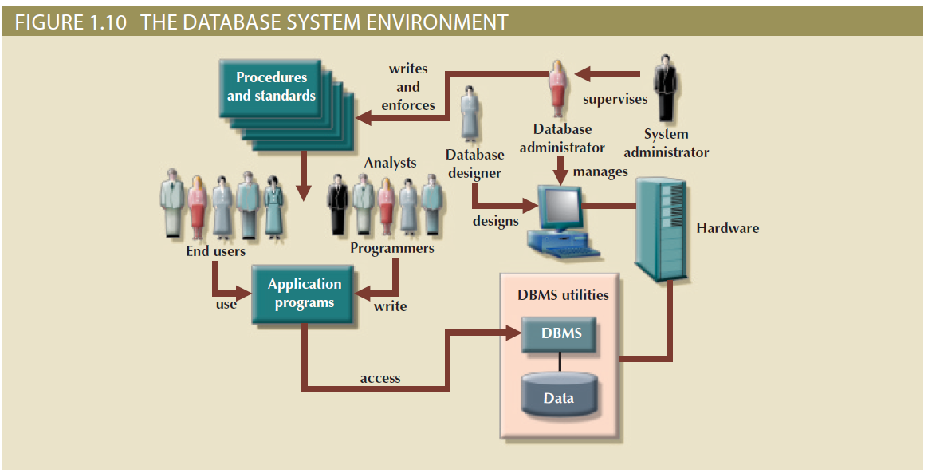
Figure 1.10 - The Database System Environment

Slide 33
The Database System Environment
Hardware: all the system’s physical devices
Software: three types of software required
Operating system software
DBMS software
Application programs and utility software
People: all users of the database system
System and database administrators
Database designers
Systems analysts and programmers
End users
Procedures: instructions and rules that govern the design and use of the database system
Data: the collection of facts stored in the database

Slide 34
DBMS Functions
Most functions are transparent to end users
Can only be achieved through the DBMS
Functions:
Data dictionary management
Data storage management
Data transformation and presentation
Security management
Multiuser access control
Backup and recovery management
Data integrity management
Database access language and application programming interfaces
Database communication interfaces

Slide 35
DBMS Functions
Data dictionary management
Data dictionary: Stores definitions of the data elements and their relationships
Data storage management
Performance tuning: Ensures efficient performance of the database in terms of storage and access speed
Data transformation and presentation
Transforms entered data to conform to required data structures
Security management
Enforces user security and data privacy

Slide 36
DBMS Functions
Multiuser access control
Sophisticated algorithms ensure that multiple users can access the database concurrently without compromising its integrity
Backup and recovery management
Enables recovery of the database after a failure
Data integrity management
Minimizes redundancy and maximizes consistency

Slide 37
DBMS Functions
Database access languages and application programming interfaces
Query language: Lets the user specify what must be done without having to specify how
Structured Query Language (SQL): De facto query language and data access standard supported by the majority of DBMS vendors
Database communication interfaces
Accept end-user requests via multiple, different network environments

Slide 38
Disadvantages of Database Systems
Increased costs
Management complexity
Maintaining currency
Vendor dependence
Frequent upgrade/replacement cycles

Slide 39
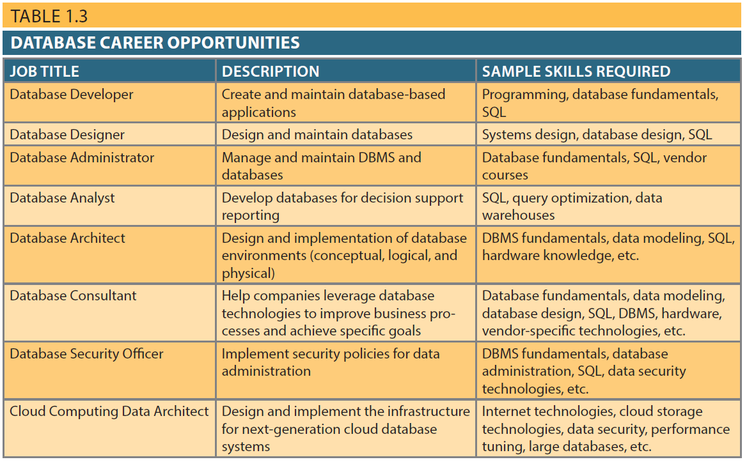
Table 1.3 - Database Career Opportunities
31

Slide 40
Chapter 2
Data Models

Slide 41
Learning Objectives
Data modeling
Data model building blocks
Entity, attribute
Relationships
Business rules
Evolution of data models
Levels of abstraction

Slide 42
A model’s main function is to help you understand the complexities of the real-world environment.
A data model is a relatively simple representation, usually graphical, of more complex real-world data structures.
Data modeling: The process of creating a specific data model for a determined problem domain.
(A problem domain is a clearly defined area within the real-world environment, with well-defined scope and boundaries.)
Database design focuses on how the database structure will be used to store and manage end-user data. The first step is data modeling.

Slide 43
Data Modeling and Data Models
Data modeling: Iterative and progressive process of creating a specific data model for a determined problem domain
Data models: Simple representations of complex real-world data structures
Useful for supporting a specific problem domain
Model - Abstraction of a real-world object or event

Slide 44
Importance of Data Models
Are a communication tool
Give an overall view of the database
Organize data for various users
Are an abstraction for the creation of good database

Slide 45
Data Model Basic Building Blocks
Entity:
A person, place, thing, concept or event about which data will be collected and stored
Example: customer
Attribute:
A characteristic of an entity
Example: last name or first name of a customer
Relationship:
Describes an association among entities
Relationship | Example
One-to-many (1:M or 1..*) | PAINTER paints PAINTING
Many-to-many (M:N, M:M or *..*) | EMPLOYEE learns SKILL
One-to-one (1:1 or 1..1) | EMPLOYEE manages STORE

Slide 46
Data Model Basic Building Blocks (cont’d.)
Constraint:
a restriction placed on the data, usually expressed in the form of rules
ensure data integrity
Examples:
An employee’s salary must have values between 6,000 and 350,000
A student’s GPA must be between 0.00 and 4.00
Each class must have one and only one teacher.

Slide 47
Business rules
A business rule is a brief, precise, and unambiguous description of a policy, procedure, or principle within a specific organization.
Examples:
A customer may generate many invoices.
An invoice is generated by only one customer.
A training session cannot be scheduled for fewer than 10 employees or for more than 30 employees.
business rules establish entities, relationships, and constraints.
Notes:
Note that those business rules establish entities, relationships, and constraints.
For example, the first two business rules establish two entities (CUSTOMER and INVOICE) and a 1:M relationship between those two entities. The third business rule establishes a constraint (no fewer than 10 people and no more than 30 people), two entities (EMPLOYEE and TRAINING), and a relationship between EMPLOYEE and TRAINING.

Slide 48
Sources of Business Rules
Company managers
Policy makers
Department managers
Written documentation
Direct interviews with end users

Slide 49
Translating Business Rules into Data Model Components
Nouns translate into entities
Verbs translate into relationships among entities
Relationships are bidirectional
Questions to identify the relationship type
How many instances of B are related to one instance of A?
How many instances of A are related to one instance of B?

Slide 50
Examples
Student and Class
In how many classes can one student enroll? Many
How many students can enroll in one class? Many
Many-to-many
Customer and Invoice
One customer may generate many invoices.
An invoice is generated by only one customer.
One-to-many

Slide 51
Evolution of Data Models

Slide 52
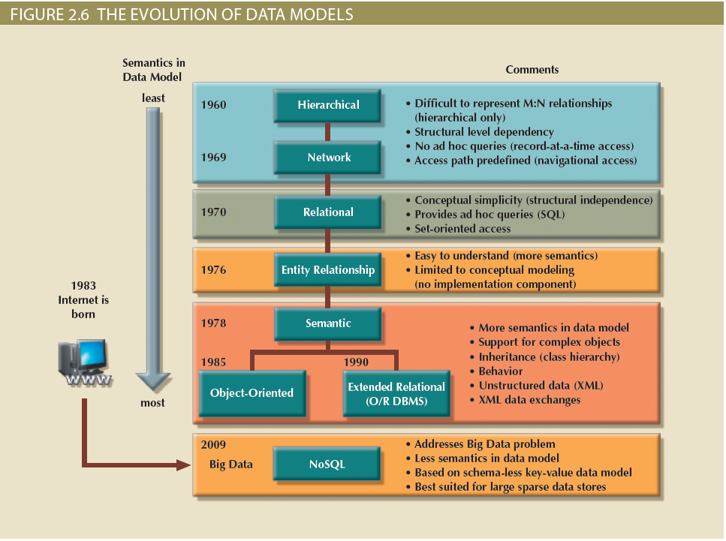
Figure 2.6 - The Evolution of Data Models

Slide 53
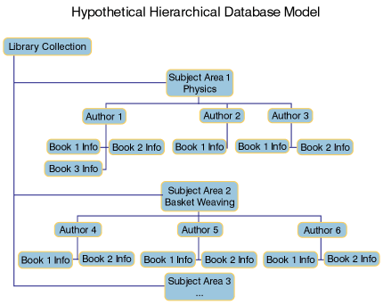
(1) Hierarchical and Network Models
The hierarchical model
Developed in the 1960s to manage large amounts of data for manufacturing projects
Basic logical structure is represented by an upside-down “tree”
Structure contains levels or segments (parent and children);
Each parent can have many children, but each child has only one parent
Set of one-to-many (1:M) relationships between a parent and its children segments

Slide 54
Hierarchical Model
Advantages
Disadvantages
Promotes data sharing
Parent/child relationship promotes conceptual simplicity and data integrity
Database security is provided and enforced by DBMS
Efficient with 1:M relationships
Requires knowledge of physical data storage characteristics
Navigational system requires knowledge of hierarchical path
Changes in structure require changes in all application programs
Implementation limitations
No data definition
Lack of standards

Slide 55
Hierarchical and Network Models (cont’d.)
Network model
Created to represent complex data relationships more effectively than the hierarchical model
Improves database performance
Imposes a database standard
Resembles hierarchical model
Record may have more than one parent

Slide 56
Network Model
Advantages
Disadvantages
Conceptual simplicity
Handles more relationship types
Data access is flexible
Data owner/member relationship promotes data integrity
Conformance to standards
Includes data definition language (DDL) and data manipulation language (DML)
System complexity limits efficiency
Navigational system yields complex implementation, application development, and management
Structural changes require changes in all application programs

Slide 57
(2) The Relational Model
Developed by E.F. Codd (IBM) in 1970
the relational data model bases data storage on relations
Table (relations)
Matrix consisting of row/column intersections
Each row in a relation is called a tuple
Tables, also called relations, are related to each other by sharing a common entity characteristic
tables are used to describe the entities they represent

Slide 58
The Relational Model
Table schema:
Book (Bid: char(2), Title: char(50), Author: char(20), Price: decimal(5,2))
Bid | Title | Author | Price
11 | Franklin forgets | Bourgeois | 7.00
22 | Arthur and the Seventh-Inning Stretcher | Krensky | 14.00
33 | Midnight Wrestlers | Morgan | 11.00
44 | Midnight Pilot | Morgan | 9.00
55 | Book of Science Activities |  | 18.00

Slide 59
Relational Model
Advantages
Disadvantages
Structural independence is promoted using independent tables
Tabular view improves conceptual simplicity
Ad hoc query capability is based on SQL
Isolates the end user from physical-level details
Improves implementation and management simplicity
Requires substantial hardware and system software overhead
Conceptual simplicity gives untrained people the tools to use a good system poorly
May promote information problems

Slide 60
(3) Entity Relationship Model (ERM) Adds a graphical tool to relational model for easier conceptual design
An entity relationship model, also known as an ERM, helps identify the database's main entities and their relationships.
Because the ERM components are graphically represented, their role is more easily understood.
Using the ER diagram, it’s easy to map the ERM to the relational database model’s tables and attributes.

Slide 61
Entity Relationship Model
Advantages
Disadvantages
Visual modeling yields conceptual simplicity
Visual representation makes it an effective communication tool
Is integrated with the dominant relational model
Limited constraint representation
Limited relationship representation
No data manipulation language
Loss of information content occurs when attributes are removed from entities to avoid crowded displays

Slide 62
(4) The Object-Oriented (OO) Model
Data and relationships are contained in a single structure known as an object
OODM (object-oriented data model) is the basis for OODBMS
Semantic data model: encompasses data (attributes) and behavior (methods)
An object:
Contains operations
Are self-contained: a basic building-block for autonomous structures
Is an abstraction of a real-world entity

Slide 63
The Object-Oriented (OO) Model (cont’d.)
Attributes describe the properties of an object
Objects that share similar characteristics are grouped in classes
Classes are organized in a class hierarchy
Inheritance: object inherits methods and attributes of parent class
UML (Unified Modeling Language) based on OO concepts that describe diagrams and symbols
Used to graphically model a system

Slide 64
Object-Oriented Model
Advantages
Disadvantages
Semantic content is added
Visual representation includes semantic content
Inheritance promotes data integrity
Slow development of standards caused vendors to supply their own enhancements
Compromised widely accepted standard
Complex navigational system
Learning curve is steep
High system overhead slows transactions

Slide 65
Other Models
(5) Extended relational data model (ERDM)
Extensible Markup Language (XML)
(6) Big Data and NoSQL
The 3 Vs of Big Data
Volume
Velocity
Variety
New Big Data Technologies
Hadoop, HDFS, MapReduce, NoSQL

Slide 66
NoSQL
Advantages
Disadvantages
High scalability, availability, and fault tolerance are provided
Uses low-cost commodity hardware
Supports Big Data
Key-value model improves storage efficiency
Complex programming is required
There is no relationship support
There is no transaction integrity support
In terms of data consistency, it provides an eventually consistent model

Slide 67
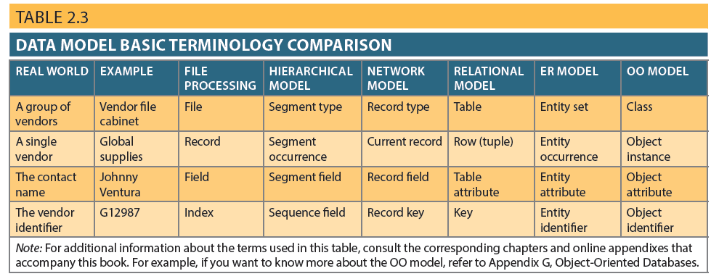
Table 2.3 - Data Model Basic Terminology Comparison

Slide 68
Standard Database Concepts
Schema
Conceptual organization of the entire database as viewed by the database administrator
Subschema
Portion of the database seen by the application programs that produce the desired information from the data within the database

Slide 69
Standard Database Concepts
Data manipulation language (DML)
Environment in which data can be managed and is used to work with the data in the database
Schema data definition language (DDL)
Enables the database administrator to define the schema components

Slide 70
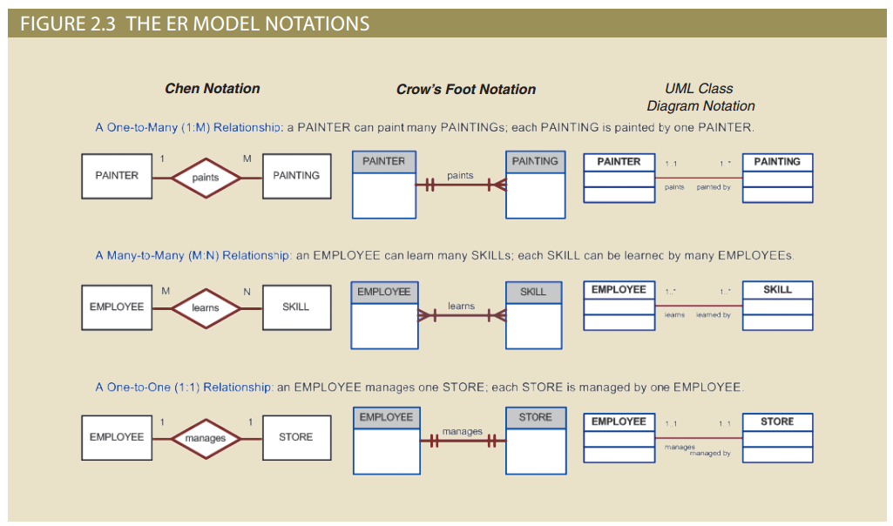
Figure 2.3 - The ER Model Notations

Slide 71
Data Abstraction Levels

Slide 72
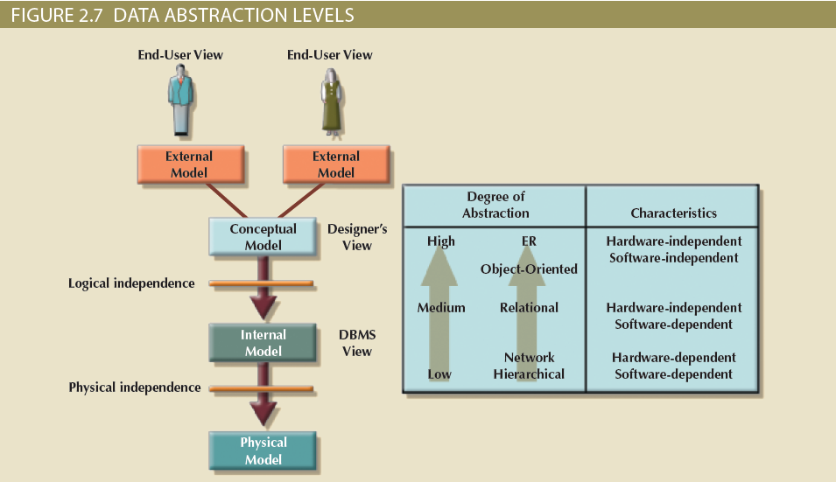
Figure 2.7 - Data Abstraction Levels

Slide 73
The External Model
End users’ view of the data environment
ER diagrams are used to represent the external views
External schema: Specific representation of an external view

Slide 74
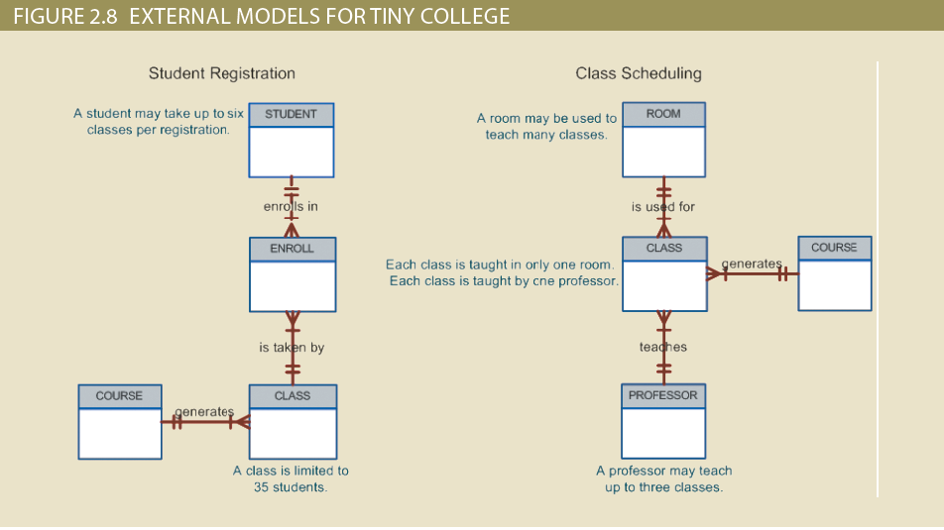
Figure 2.8 - External Models For Tiny College

Slide 75
The Conceptual Model
Represents a global view of the entire database by the entire organization
Conceptual schema: Basis for the identification and high-level description of the main data objects
Has a macro-level view of data environment
Is software and hardware independent
Logical design: Task of creating a conceptual data model

Slide 76
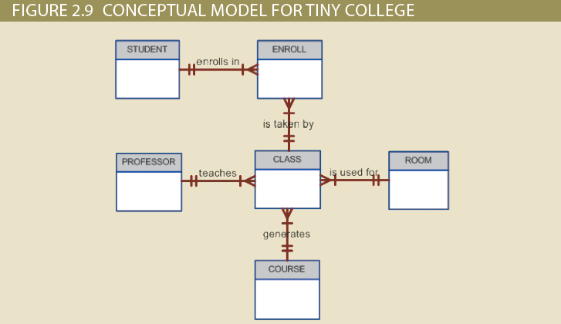
Figure 2.9 - Conceptual Model For Tiny College

Slide 77
The Internal Model
Representing database as seen by the DBMS mapping conceptual model to the DBMS
Internal schema: Specific representation of an internal model
Uses the database constructs supported by the chosen database
Is software dependent and hardware independent
Logical independence: Changing internal model without affecting the conceptual model

Slide 78
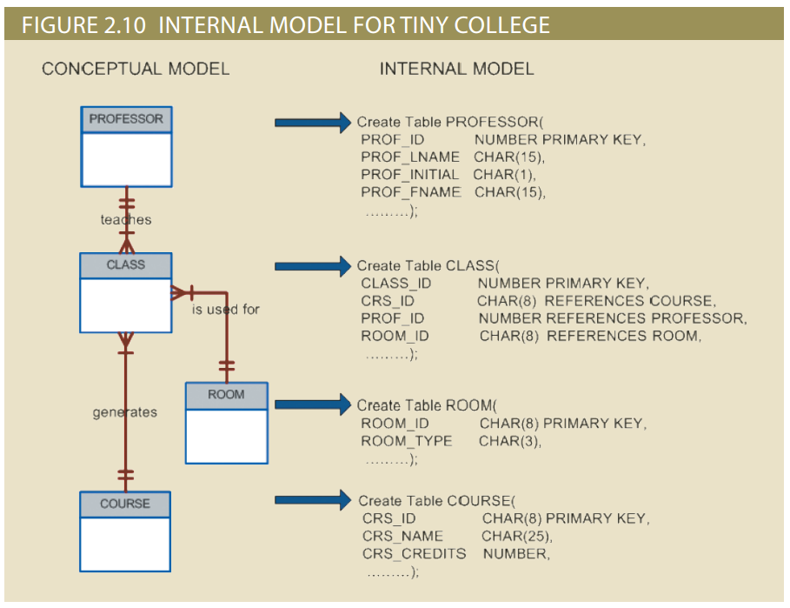
Figure 2.10 - Internal Model for Tiny College

Slide 79
The Physical Model
Operates at lowest level of abstraction
Describes the way data are saved on storage media such as disks or tapes
Requires the definition of physical storage and data access methods
Relational model aimed at logical level
Does not require physical-level details
Physical independence: Changes in physical model do not affect internal model

Slide 80
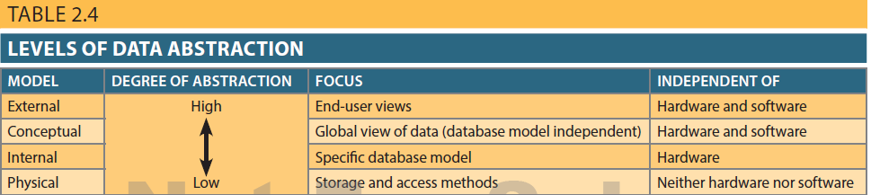
Table 2.4 - Levels of Data Abstraction

