Slide 1
Chapter 6
Normalization of Database Tables

Slide 2
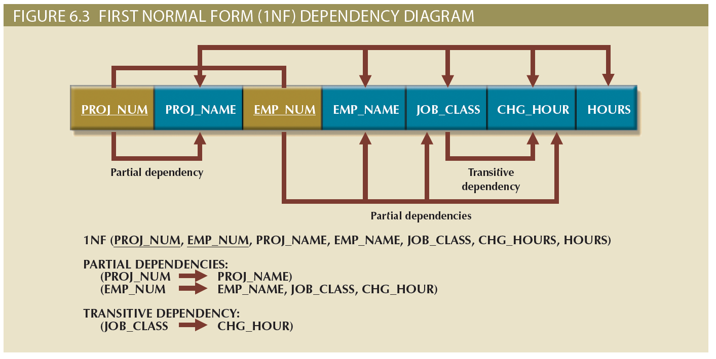
Figure 6.3 - First Normal Form (1NF) Dependency Diagram

Slide 3
Conversion to Second Normal Form
Steps
Make new tables to eliminate partial dependencies
Reassign corresponding dependent attributes
Table is in 2NF when it:
Is in 1NF
Includes no partial dependencies

Slide 4
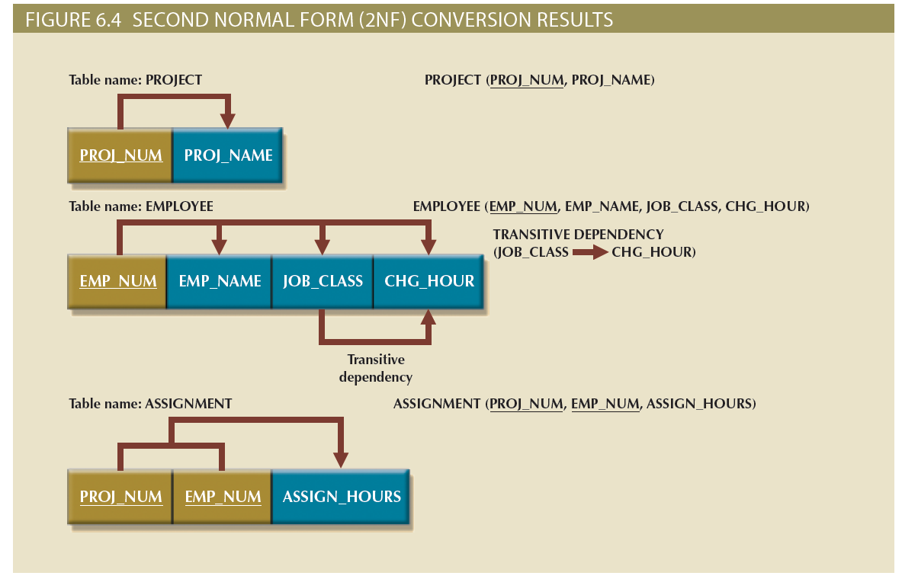
Figure 6.4 - Second Normal Form (2NF) Conversion Results

Slide 5
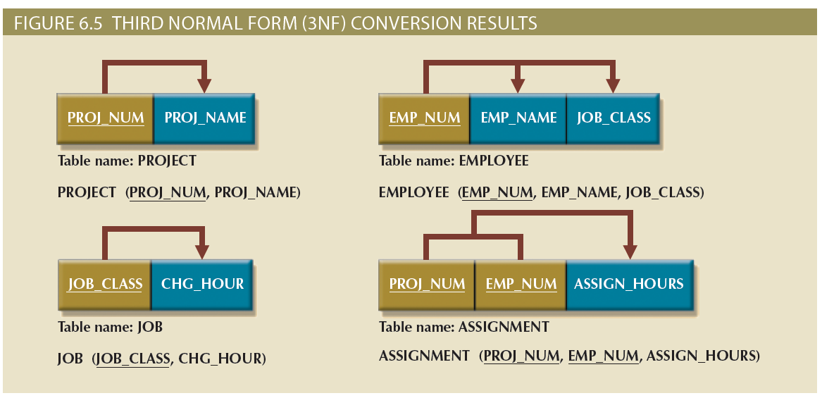
Figure 6.5 - Third Normal Form (3NF) Conversion Results

Slide 6
Conversion to Third Normal Form
Steps
Make new tables to eliminate transitive dependencies
Determinant: Any attribute whose value determines other values within a row
Reassign corresponding dependent attributes
Table is in 3NF when it:
Is in 2NF
Contains no transitive dependencies

Slide 7
Improving the Design
Evaluate PK assignments and naming conventions
Refine attribute atomicity
Atomic attribute: Cannot be further subdivided
Atomicity: Characteristic of an atomic attribute
Identify new attributes and new relationships
Refine primary keys as required for data granularity
Granularity: Level of detail represented by the values stored in a table’s row
Maintain historical accuracy and evaluate using derived attributes

Slide 8
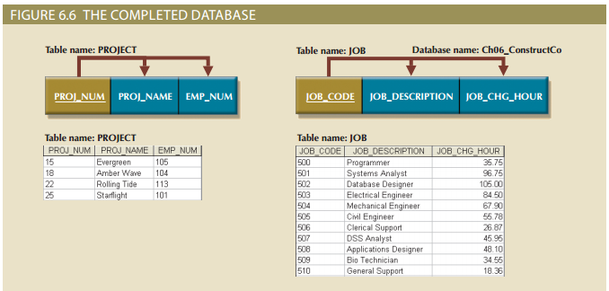
Figure 6.6 - The Completed Database

Slide 9
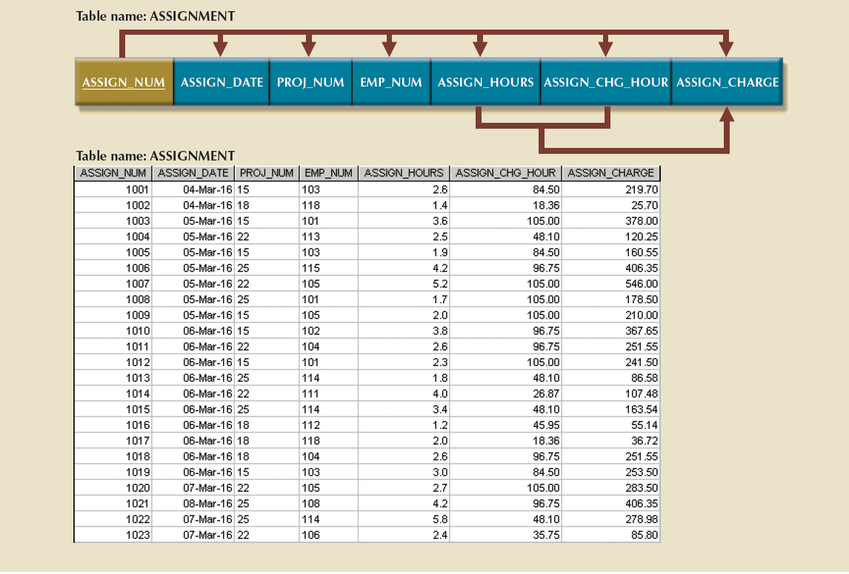
Figure 6.6 - The Completed Database (cont’d.)

Slide 10
Surrogate Key Considerations
Used by designers when the primary key is considered to be unsuitable
System-defined attribute
Created an managed via the DBMS
Have a numeric value which is automatically incremented for each new row

