Slide 1
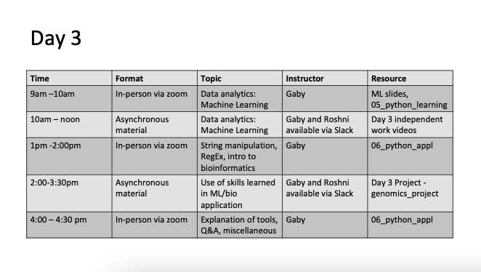

Slide 2

Machine Learning Introduction

Slide 3
What is Machine Learning?

Slide 4
What is Machine Learning?
Easy part: Machine
Harder: learning
Short answer: Methods that can help generalize information from the observed data so that it can be used to make better decisions in the future

Slide 5
What is machine learning?
DATA
Learning Algorithms
Knowledge
Notes:
Make some joke about it being a black box

Slide 6
What is machine learning?
DATA
Learning Algorithms
Knowledge
Algorithms that improve their knowledge towards some task with data
What is the relationship with AI, Data Science, Data Mining?
Notes:
Make some joke about it being a black box

Slide 7
Can differentiate fields by their goals
Machine Learning: Learn from one dataset and be applicable to more in the future
Statistics: understanding the data at hand
AI: build an intelligent agent
Data Mining: extract patterns from large-scale data
Data Science: the science encompassing collection, analysis and interpretation of data

Slide 8

Machine learning in action
The spam filters in your email
Self driving cars
Google translate
Determining which part of a genome sequence encodes a gene
And….
Natural language processing
Computer vision
Medical outcomes analysis
Protein sequence -> protein structure

Slide 9
There are two very broad categories
Supervised learning
Unsupervised learning
Both are valuable and are applied at different times to different data sets

Slide 10
There are two very broad categories
Supervised learning
Unsupervised learning
Both are valuable and are applied at different times to different data sets
What do you think makes something Supervised?

Slide 11
Supervised learning
One of the variables is labeled, so we know the “truth”
Class labels –categorical - (high risk/ low risk, normal/tumor
Continuous labels (income, age)
Objective: predict the label from other variables – called features
Ex. Given a person’s age, weight, height, gender can you predict if they play football

Slide 12
Supervised learning
If labels are discrete -> classification
If labels are continuous -> regression

Slide 13
Unsupervised learning
Learning without a teacher
There is no labeled data
The computer is supposed to learn general patterns in the data
Typically some form of cluster analysis
Goal: identify homogeneous subgroups

Slide 14
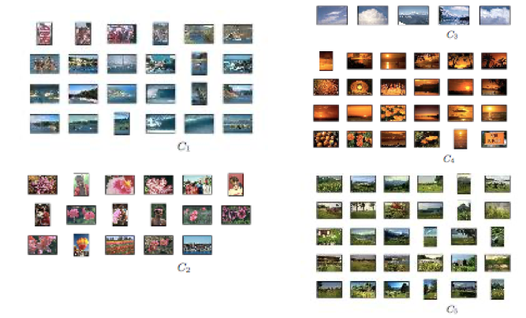
Unsupervised learning examples – Clustering
Group similar things:

Slide 15
Clustering methods
K-means clustering
Hierarchical clustering
Mixture models
There are a lot of these …

Slide 16
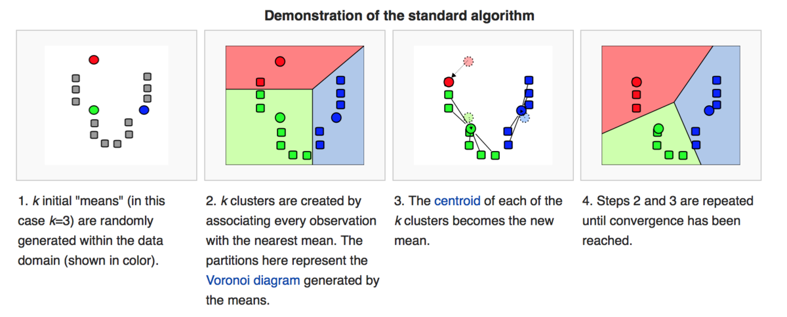
K-means very briefly
brilliant.org

Slide 17
Do we know if our clusters will be applicable to future data?

Slide 18
Something different: Reserve a test set
Standard method:
Split your data set into training set and test set
Train your data on the training set
See how well it works on the test set
Take the model that does the best on the test set

Slide 19
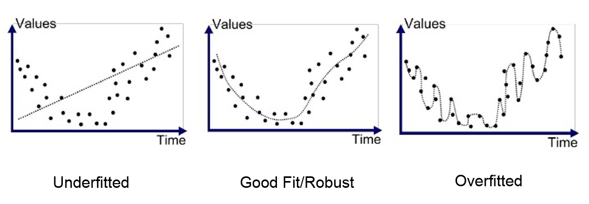
The Variance-Bias Trade-off
Some models are too simple
Under-fit the data, are not capturing all the available information
Do equally well (or bad) on training and test data
These are high-bias models

Slide 20
The Variance-Bias Trade-off
Some models are too complex
Overfit the training data
Do badly on test/new data
These are high-variance models

Slide 21
Goal: Land in the middle (low-variance, low-bias)
Variance
Bias

Slide 22
Model Performance
Metric to see how well a model works
Can’t just rely on the one test set

Slide 23
Metric of Performance depends on model
Classification:
Accuracy (misclassification)
Regression
Mean Square error

Slide 24
How can we make more test data?

Slide 25
How can we make more test data?
Take multiple random splits to generate training and test data
See overall performance across different splits
This is called: cross-validation

Slide 26
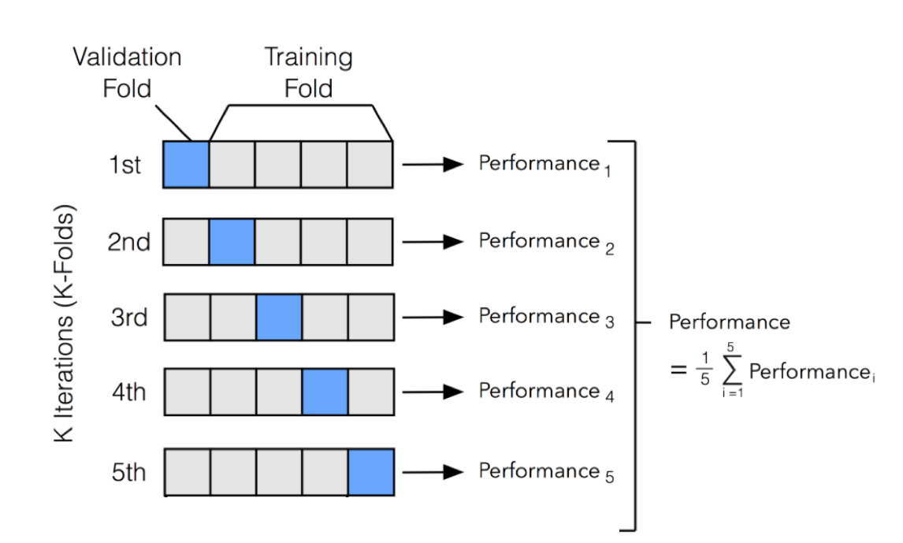
Cross validation

Slide 27
Supervised learning methods
K- nearest Neighbors
Decision trees
Ensemble methods
Random forests
Boosted trees
Support Vector Machines

Slide 28
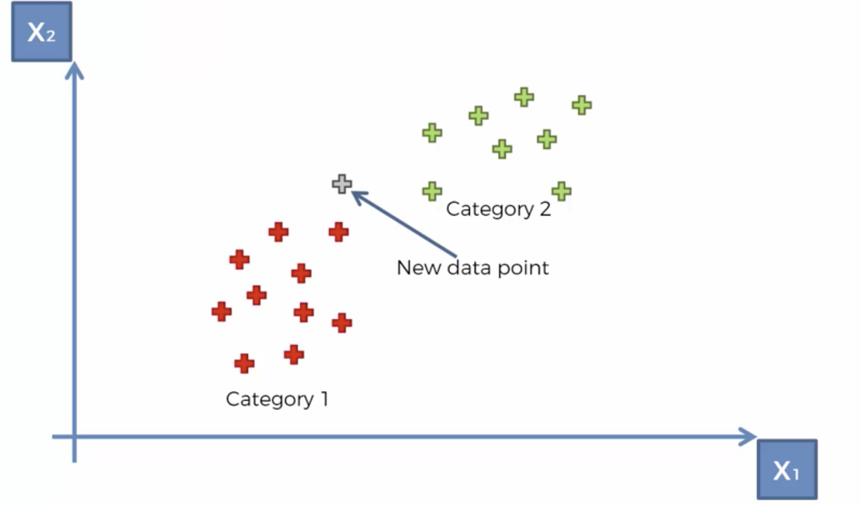
K-nearest neighbor
towardsdatascience.com

Slide 29
K-nearest neighbor
For each data point, find its k nearest neighbors in the predictor space
Decide on a distance metric
Prediction of that data point is the
Average of the labels (regression)
The most prevalent of the labels (classification)
Observed in those neighbors

Slide 30
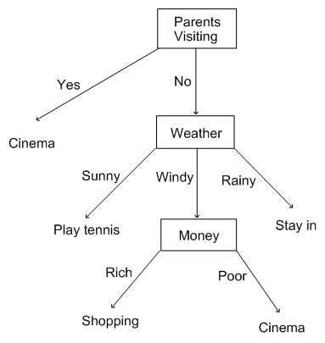
Decision Trees
quora.com

Slide 31
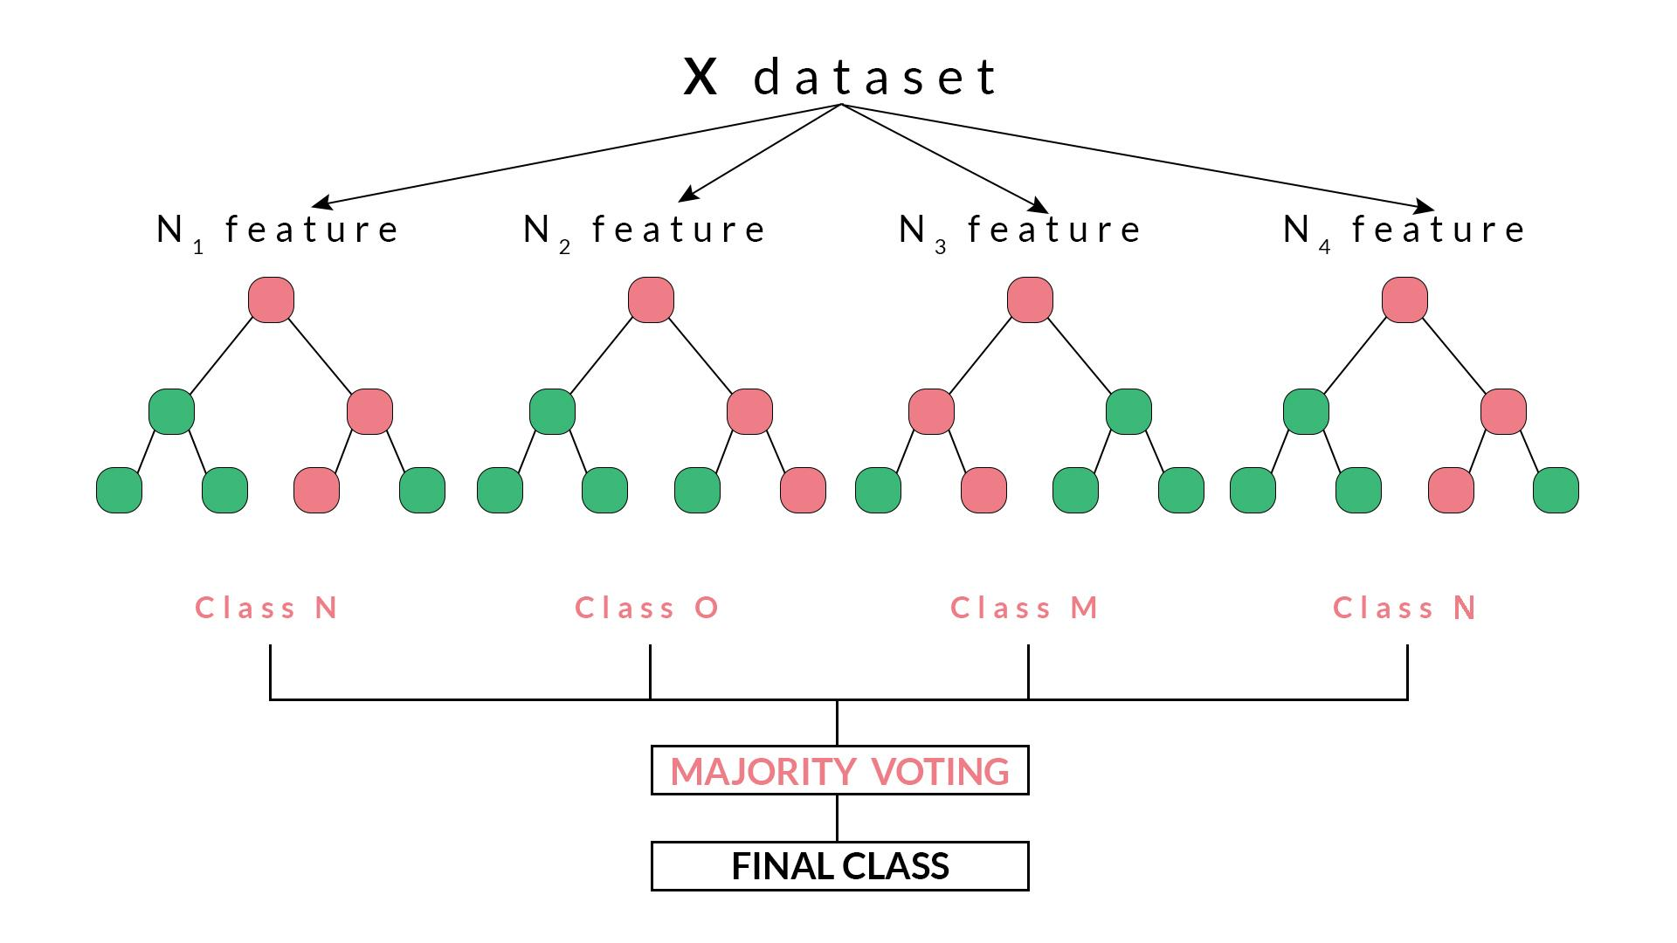
Random Forest
blog.quantinsti.com

Slide 32
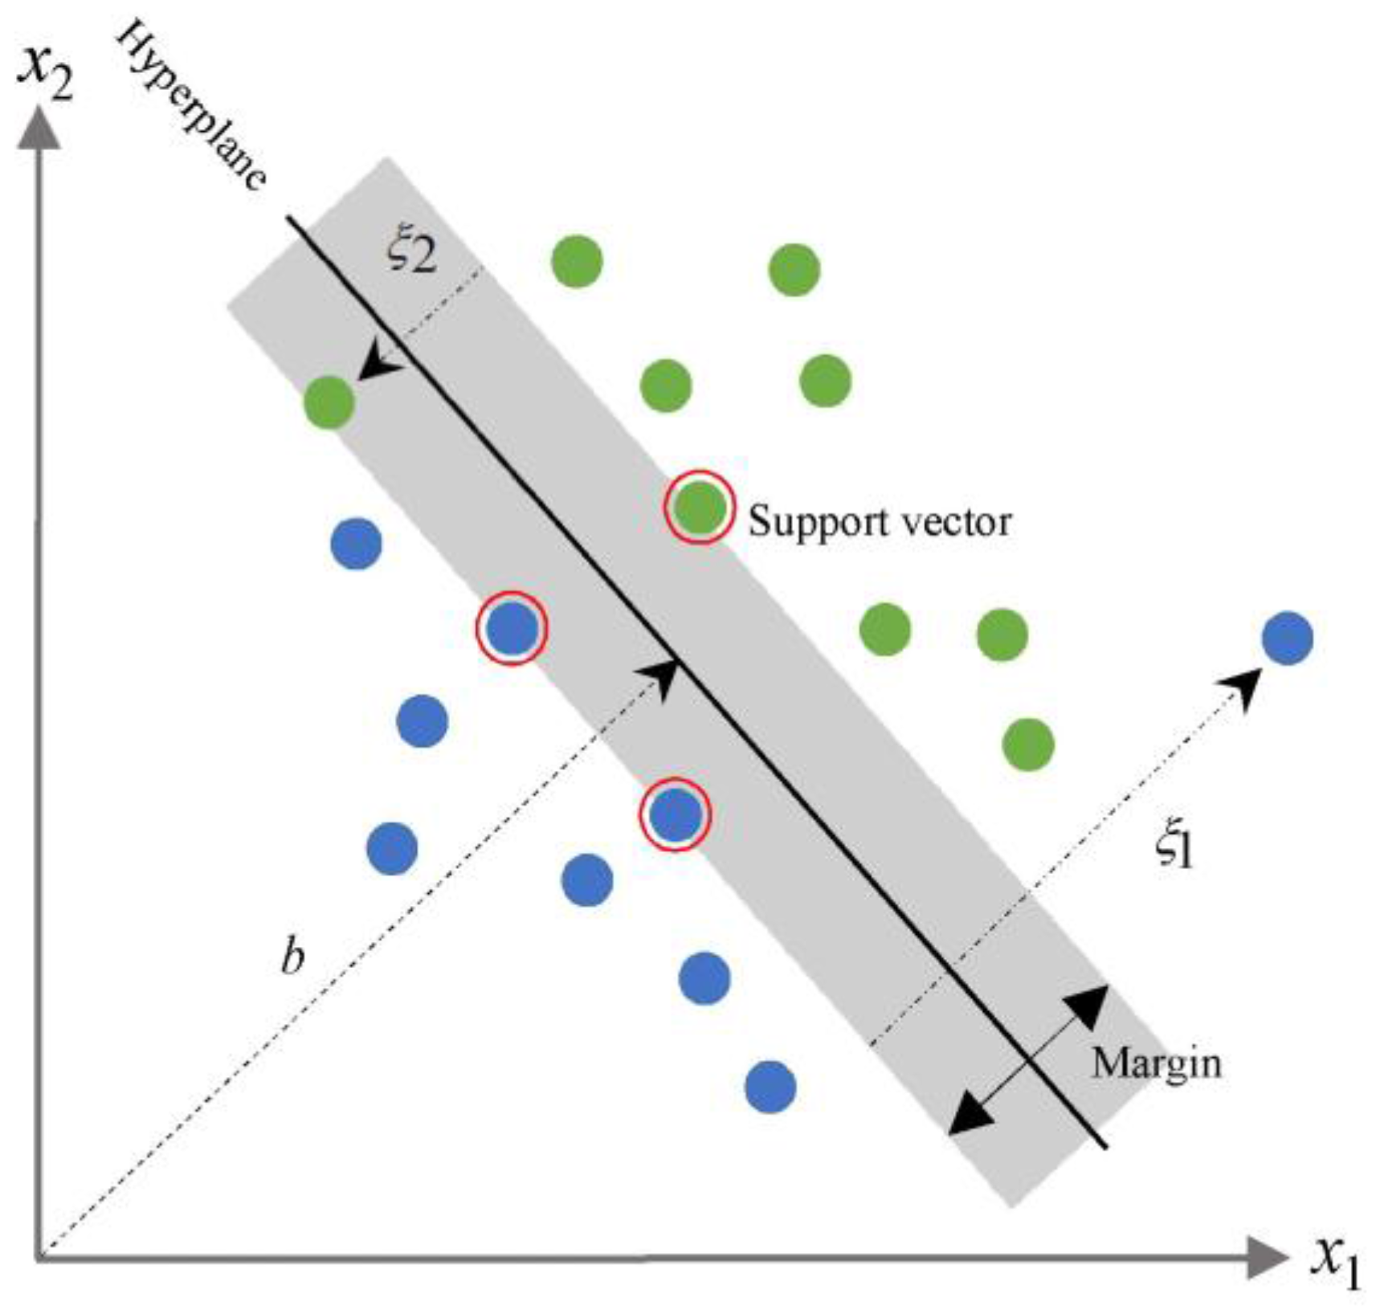
Support Vector Machines
Give higher importance to the points near the boundary
mdpi.com

Slide 33
Supervised Learning Methods
Tend to focus on local solution
We will be focusing on decision trees

Slide 34
The Scikit-learn Package
Does lots of the python machine learning
We will use this extensively in fitting machine learning models to data
General method:
Import an ML algorithm from sklearn
Define the characteristics of the model
Fit training data to the model
Predict on test fata
Compute performance metrics and cross-validation

