Slide 1
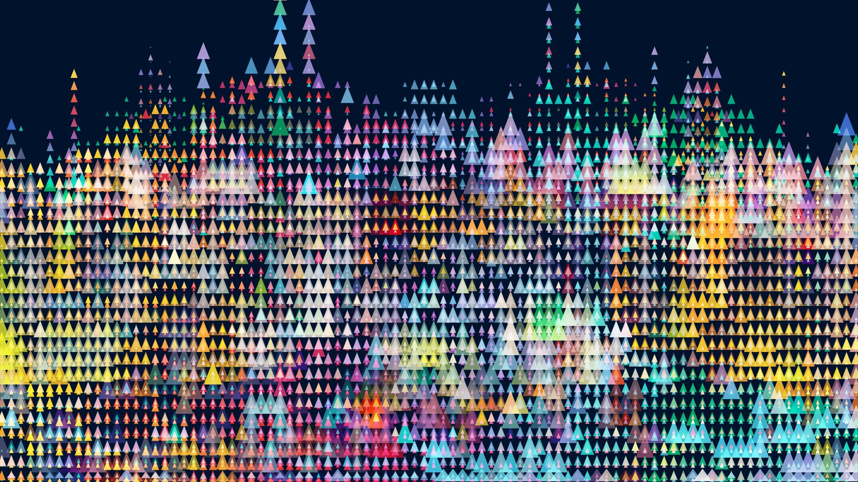
BIOF 085 Introduction
Instructors: Gaby Gerlach and Roshni Bhatt

Slide 2
Background
PhD students in CMU-Pitt program in Computational Biology (CPCB)
Use python to perform most of our analysis
Interested mostly in Structural Biology
Excited to be teaching this course!

Slide 3
Outline of Plan – Hybrid approach
Face to face (about 50% of the time via Zoom)
Lecturing and Q&A
With discussion, conversation.
Online Material (do this sequentially)
Videos of screencasts
Progress check assignments
Notes:
Go to canvas and explain the idea and outline then progress through it – explain the PDFs, Data files, Live notebooks
How long all this takes will vary
We will pose questions, please answer them either in a chat or unmute yourself – it will be much more interesting then listening to us talk for 3 days.

Slide 4
Available material
While we are live coding in either Spyder or Jupyter Notebooks
You are encouraged to follow along
PDF versions of this are on Canvas and may be helpful to have open
We will be pulling information from Jupyter Notebooks which have more explanation than we plan on saying

Slide 5
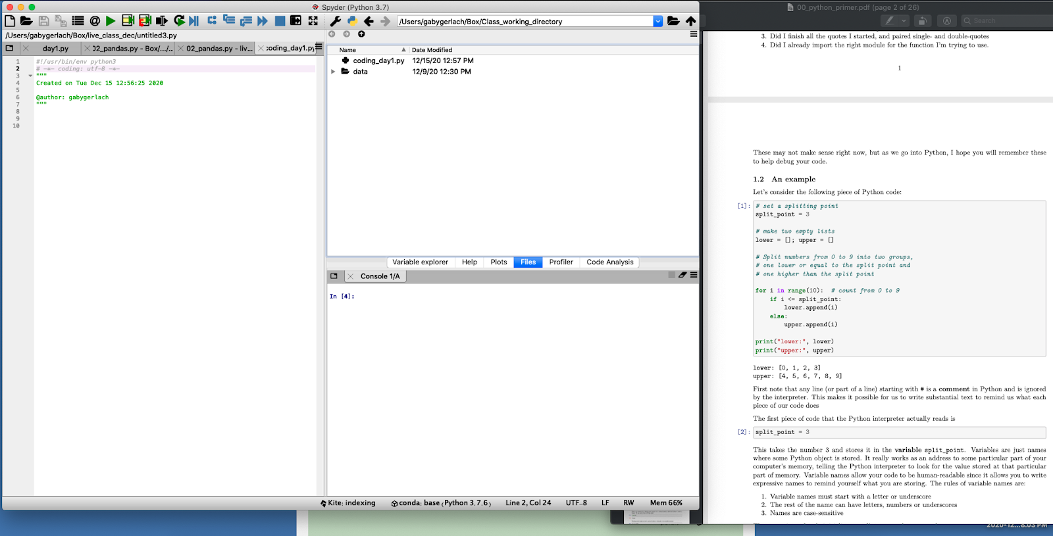
Effective work environment
Path to your working directory
Spyder Folder with data and code files PDF for section
Ideally Zoom will be on another monitor/Ipad

Slide 6
Some quick notes:
We are here to answer your questions, and provide the guidance the goal is for you to be coding in a guided manner not just listening to us talk
Feel free to interrupt us at any time
There is a lot of material in the notebooks we are not going to go through all of it – but it is all there for you too continue learning
Notes:
The notebooks note where the ”lectures” will be ending and if there are sections we will not be covering in detail. We have more content than we likely will be able to cover this is so you are able to keep learning with these materials after these three days and then are able to reference these materials for future use.

Slide 7
Day 1
Time | Format | Topic | Instructor | Resource
9am – 11am | In-person via zoom | Why python? A python primer | Gaby | Intro slides, 00_python_primer
11 am - noon | In-person via zoom | Python tools for data science | Roshni | Python_objects intro 01_python_tools
1pm-2pm | In-person via zoom | Python tools for data science Data wrangling, cleaning, summarizing | Gaby | 02_python_pandas
2pm -5pm | Asynchronous material | Data Munging | Gaby available via Slack | Day 1 independent work videos
Notes:
Asking questions in the group chat is very helpful as then people can learn from each others questions

Slide 8
Day 2
Time | Format | Topic | Instructor | Resource
9am-9:30 | Q &A | Day 1 material | Gaby and Roshni
9:30am –10:30am | In-person via zoom | Data Visualization/Stats | Roshni | Day 2 introduction
10:30am-12:30pm | Asynchronous material | Data Visualization | Roshni and Gaby available via Slack | Day 2 independent work videos
1:30pm - 2:30pm | In-person via zoom | Statistical Analysis pipeline | Roshni | 04_stat_intro
2:30pm-4:00pm | Asynchronous material | Statistical Analysis using Python | Roshni and Gaby available via Slack | stats_python_practice
4:00pm-4:30pm | In-person via zoom | Q&A | Roshni
Notes:
Asking questions in the group chat is very helpful as then people can learn from each others questions

Slide 9
Day 3
Time | Format | Topic | Instructor | Resource
9am –10am | In-person via zoom | Data analytics: Machine Learning | Gaby | ML slides, 06_python_learning
10am – noon | Asynchronous material | Data analytics: Machine Learning | Gaby and Roshni available via Slack | Day 3 independent work videos
1pm -2:00pm | In-person via zoom | String manipulation, RegEx, intro to bioinformatics | Gaby | 07_python_appl
2:00-3:30pm | Asynchronous material | Use of skills learned in ML/bio application | Gaby and Roshni available via Slack | Day 3 Project - 08_genomics_project
4:00 – 4:30 pm | In-person via zoom | Explanation of tools, Q&A, miscellaneous | Gaby | 07_python_appl

Slide 10
Adaptability
There will likely be a range of abilities in this course
It is likely there will be some people for who this is very quick and some for who it is a little slow
We are doing our best to land in the middle, but this is just the reality

Slide 11
Slack
This is the communication method will be available from ~8-6 each day
If a question is asked outside of these hours there may be a delay in response
Please use the #class-communications_mar2021 for questions during “lecture” so that everyone can benefit from your question
Also feel free to interrupt us while we are talking
During independent work you are encouraged to also use this chat, but are welcome to DM the instructors.
Notes:
DEMO – code formatting, ect.

Slide 12
Now about you!
Who are you?
Why are you here?
What is your background?
Is there anything specific you came to learn about?
What type of data are you interested in?
Notes:
How many of you use mostly excel to do analysis??

Slide 13
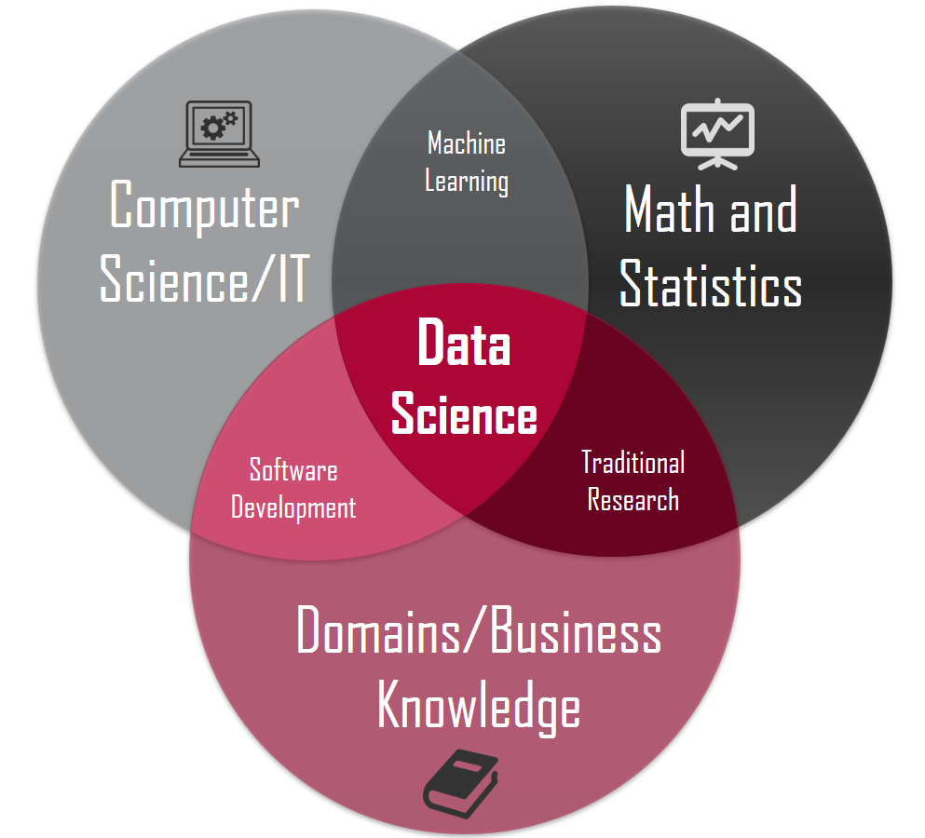
What is data science?
Notes:
Data alone is useless, it needs to be turned into something informative, actionable with context (knowledge)
Care about data science generally as a tool to learn something about a topic that you care about
Broadly applicable

Slide 14
Data scientist?
Statistician
Computer scientist
Database engineer
Software engineer
Mathematician
I know good ones who are physics and geoscientists
Notes:
Wild fire story – Charlie
Spans a huge spectrum of a

Slide 15
What data science involves
DATA
Data munging and wrangling
Computation and analyses
Reporting and visualization
Modeling and Application

Slide 16
What does it involve
Managing and cleaning data
Interest in exploring relationships between things, informed by domain knowledge
Statistical know-how
Computational skills
Tools
Notes:
Tools – programing tools

Slide 17
The goal here is the tools!
There are two major tools:
Python (https://www.python.org)
R (https://www.r-project.org)
Obviously here we are using Python.
Notes:
They are great because they are open source
Unlike matlab, Excel ect
Python runs a lot of the web
R runs a lot of bioinformatics

Slide 18
Why Python?
Popular general-purpose programming language
Strong ecosystem through packages (230K+)
Succinct, readable syntax
Good balance between computational time and developer time
Self-documenting
Easier to integrate into production pipelines that already use python
Increasingly strong Data science stack
Notes:
Python – you can do more than just data science
Natural language like
Faster than R slower than C/C++ but it is pretty easy to write in
Works well with other languages
Data science stack -> goal to create a free version of matlab started in the 90s

Slide 19
Cons of Python
Some places where the ecosystem is not rich enough
More computer science-y, less statistical
Version compatibility issues
Poorer frameworks for display and dissemination of information
R tends to shine here
Notes:
This is getting better though

Slide 20
Python Data Science Stack
To emulate Matlab
Numpy
Scipy
Matplotlib
To emulate Maple
Sympy
To add statistics/data science
Pandas
Various visualization packages
Seaborn
plotly
Notes:
Talk about the pandas guy
And a little bit more about the other packages

Slide 21
Python Data Science Stack
Philosophy has been to concentrate on a few large comprehensive packages
Statsmodels (statistics)
Scikit-learn (machine learning)
Pillow (image analysis)
Nltk (natural language processing)
Tensorflow & PyTorch (Deep learning)
PyMC3 (Bayesian learning)
Notes:
Going to talk about some of these not all of them
Nltk – really good
Tensorflow- google
Pytorch –python
Bayesain MCMC

Slide 22
Outline of Content
Python primer to get the basics of the language (day 1)
Pandas for data I/O, manipulation, cleaning and munging (day 1)
Using matplotlib and seaborn for data visualization (day 2)
Using pandas, scipy and statsmodels for statistics (day 2)
Using scikit-learn for basic machine learning (day 3)
Applications (day3)
General examples
High-level bioinformatics
High-level string manipulation

