Slide 1

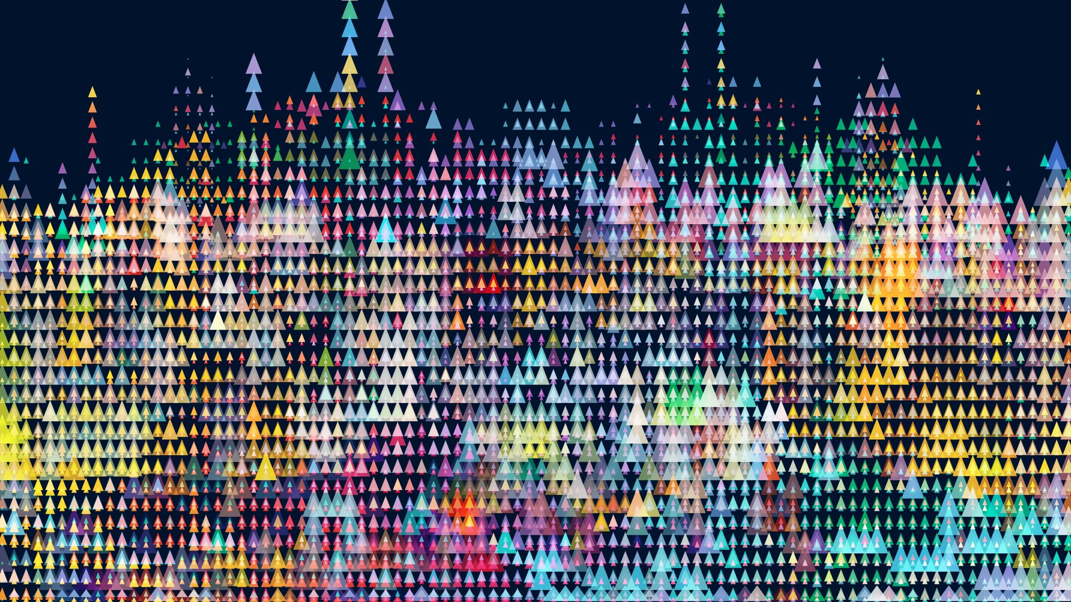
BIOF 085 Introduction: Day 0
Instructors: Gaby Gerlach and Roshni Bhatt

Slide 2

Goals for this evening session
Everyone has anaconda installed and working
Creation of a working directory containing the required data
Installation of packages (will discuss what these are, why we need them tomorrow)
Location of available resources and communication

Slide 3
Goals for this evening session
Difference between Python 3.7 and 3.8
Set up of effective working environment
Demo the two Interactive Development Environments (IDE) we are going to use (Spyder, Jupyter notebooks)

Slide 4
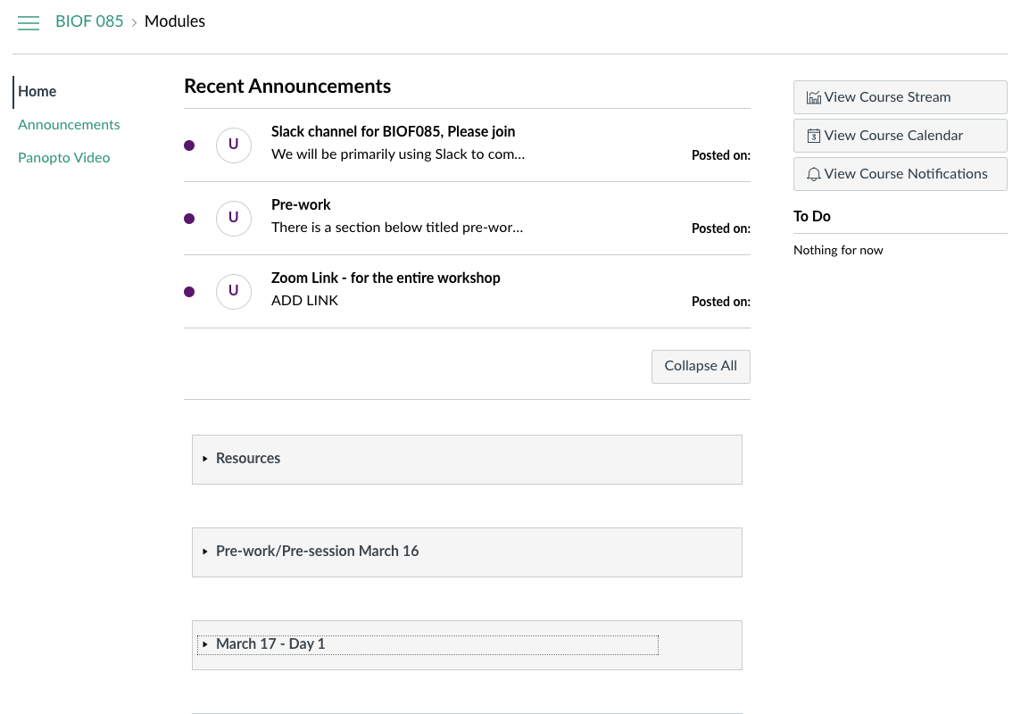
Location of resources: Canvas and Slack
Recordings will go here for your future use
Zoom, slack, into announcement
Data, slides, jupyter notebooks, schedule
Days have sections with info and assignments

Slide 5
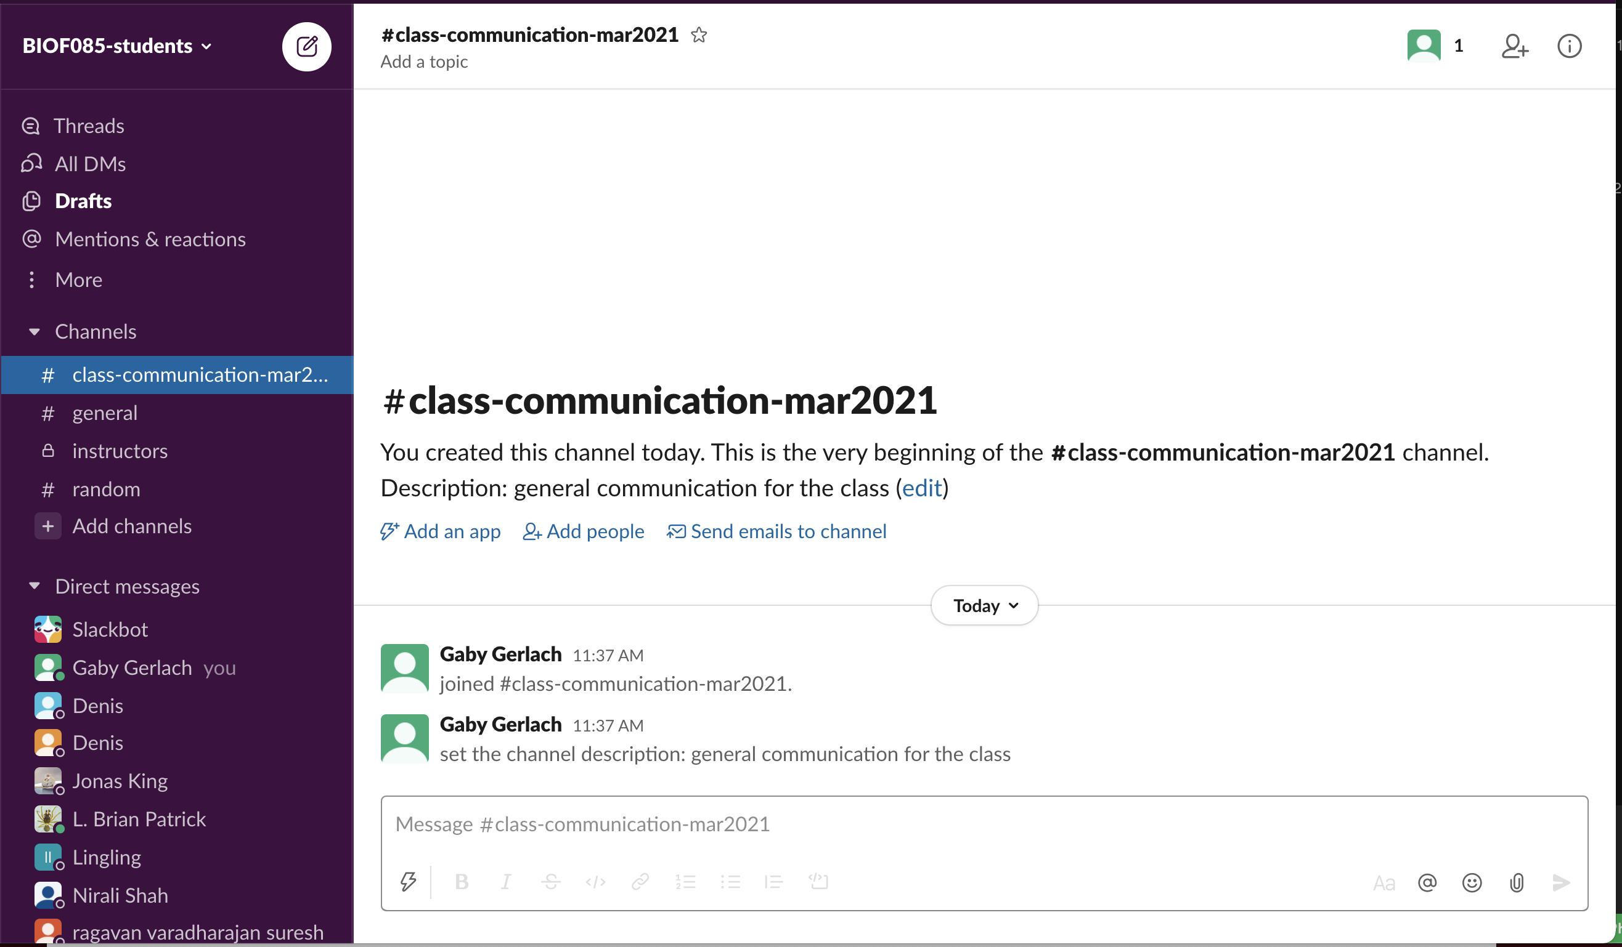

Location of resources: Canvas and Slack
Questions during independent work or lecture
Do not use the zoom chat, no one will answer your question.
direct message instructors/ other students

Slide 6
Anaconda Installation?
Let us know if anyone has had issues so we can individually help you!

Slide 7
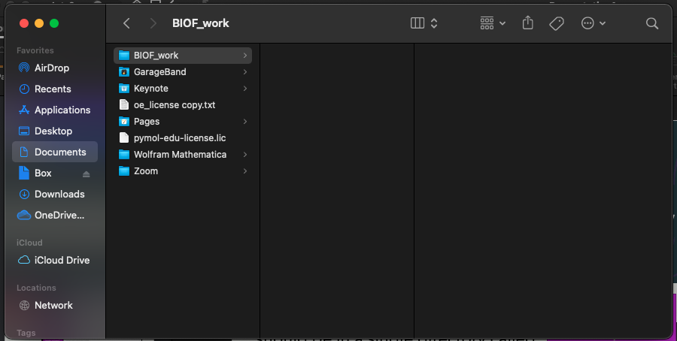
Working Directory
All the materials and work for the course should be in a single directory called something like BIOF_work
Can save it somewhere convenient this example is in my Documents folder, but what ever works for you
Documents/BIOF_work/ is the way you type the path that you click through in finder
Path: Documents/BIOF_work/
Finder/
File Explorer
Your code, other materials goes here

Slide 8
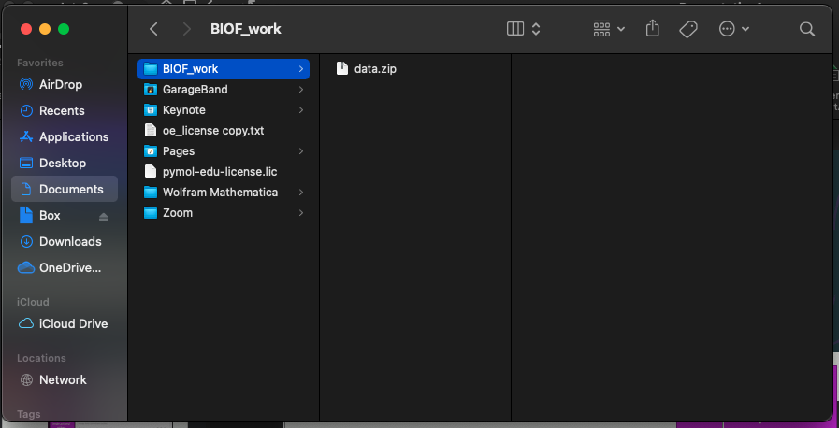
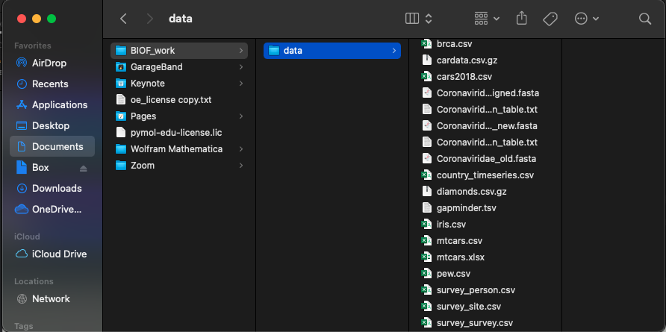
Data download
Finder/
File Explorer
Path: Documents/BIOF_work/
You will download a compressed file called data.zip from canvas
It then needs to be decompressed
Mac: Double click
Windows: right click select decompress
If you are using a computer owned by the NIH you may have issues, let us know if this doesn’t work
Your code, other materials goes here

Slide 9
Data download
Finder/
File Explorer
Path: Documents/BIOF_work/data
You will download a compressed file called data.zip from canvas
It then needs to be decompressed
Mac: Double click
Windows: right click select decompress
If you are using a computer owned by the NIH you may have issues, let us know if this doesn’t work
Should look like this when completed.
Your code, other materials goes here
Data downloaded from Canvas is here

Slide 10
Installation of packages
Packages are like extras to make python more powerful and specific; we will talk more about how they work and what they are tomorrow
There are a couple of options to do this part
(1) Use the anaconda navigator GUI to download necessary packages (I will demo this)
(2) If you are comfortable with Bash (and using Mac or Linux) there is a script on Canvas called “create_env.bash” that you can run on the command line which will download the packages we need and create a python environment for the course (it only has the required modules)
Both methods will accomplish the same goal, we will talk about python environments a little bit – but its like creating a bag with all the tools you need for a specific project

Slide 11
Packages to Install
Required:
Optional for plotting:
numpy
pandas
matplotlib
biopython
scikit-learn
seaborn
scipy
To run the 03_python_vis notebook you will need these, but not for any of the independent work
Plotnine
Plotly.
Bokeh
Altair
graphviz

Slide 12
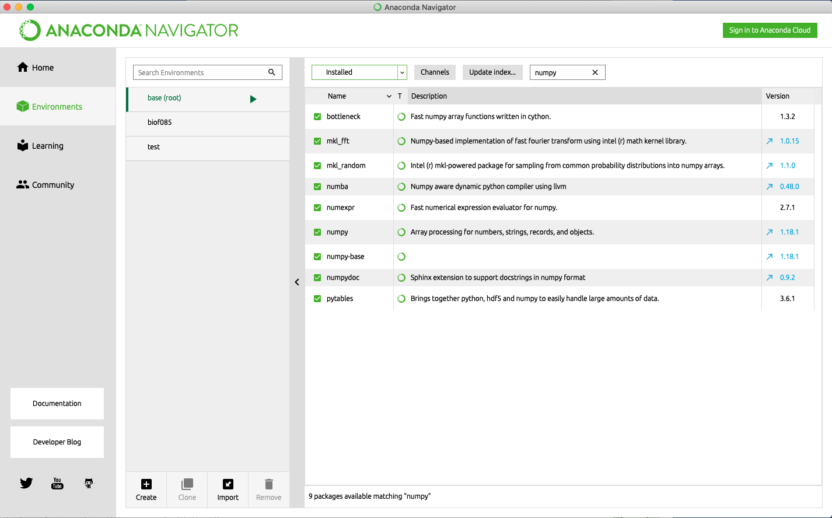
Installation of packages: Through the GUI
Dropdown
Search
anaconda navigator->environments->base(root)
Search each name if they come up when the dropdown menu says ‘Installed` - you are good
If they come up with `not installed` click the box on the left and press apply It will appear green box bottom right
If they still dont come up press “update index” try again
If that still doesn’t work talk to the instructors

Slide 13
Python 3.7 and 3.8
One major downfall of python is compatibility issues
There is one location in this workshop on day 2 relating to seaborn that it makes a difference if you have 3.7 or 3.8 (it will be noted then as well)
If you used the bash script to use an environment, you have 3.8 otherwise it is the version you downloaded
Either is totally fine just make a note of it to avoid future confusion

Slide 14
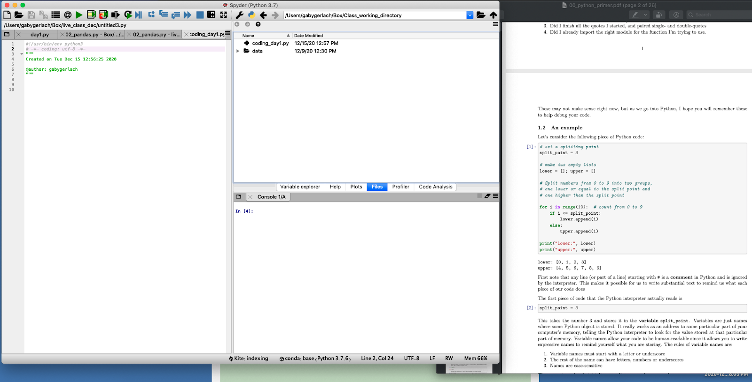
Effective work environment
Path to your working directory
Spyder Folder with data and code files PDF for section
Ideally Zoom will be on another monitor/Ipad

Slide 15
Quick Demo of Spyder and Jupyter

