Slide 1
Variational AutoEncoders
Dong-Ju Kim
School of Computer Engineering
Kwangwoon University
Notes:
I’m donju Kim from CINe Lab.
_발표용

Slide 2
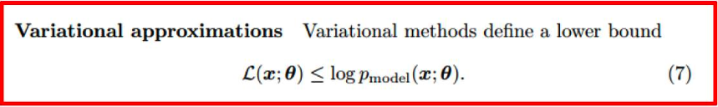
Variational Autoencoder
Variational Autoencoder(VAE)
Kingma et al., “Auto-Encoding Variational Bayes,” 2013
Generative Model + Stacked Autoencoder
Based on Variational approximation
Notes:
Variational Autoencoder was written by Kingma
It is generative model and also stacked autoencoder
It based on variational approximation.
Variational approximation term is like below.
variational methods define a lower bound

Slide 3
Unsupervised Learning
Unsupervised Learning
No label and thus self learning
More challenging than supervised learning
Unsupervised Neural Network Models
Boltzmann machine
Auto-encoder or variational inference
Generative adversarial network
Notes:
Unsupervised learning does not have label and thus self learning
It is more challenging than supervised learning

Slide 4
Contents
Background : Autoencoders
VAE : intuition & notions
VAE : how to train the model
VAE : likelihood derivation
VAE : training process
VAE : dissecting the objective
Reparameterization trick
VAE : generating DATA
VAE : conclusion
review

Slide 5
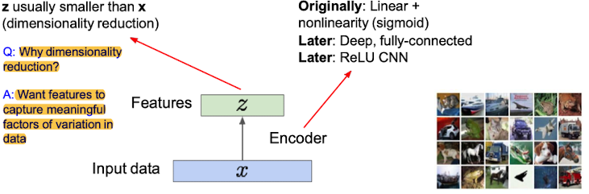
Background : Autoencoder
Purpose of Autoencoder : Encoder to make dimension lower from unlabeled training data
Unlabeled
Input
Encode
Input
Reconstruct
Input
Notes:
The autoencoder receives the data and creates a latent vector much smaller than that.
The reason why dimensionality reduction is needed. That we want features to capture meaningful factors of variation in data.
오토인코더는 데이터를 받아서 그것보다 훨씬 작은 차원의 latent vector 를 만들어준다.
낮은 차원의 레이턴트 벡터가 필요한 이유는, 피쳐들이 조금 더 의미 있는 요소들을 잡기를 원해서 이다.

Slide 6
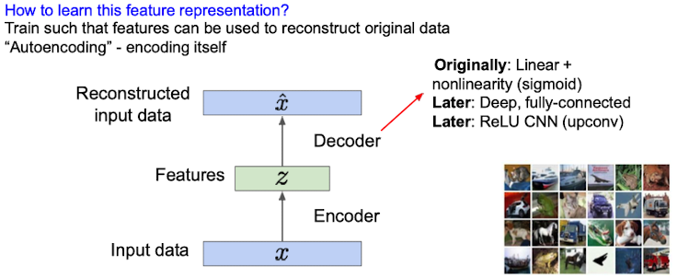
Background : Autoencoder
Purpose of Autoencoder : Encoder to make dimension lower from unlabeled training data
Unlabeled
Input
Encode
Input
Reconstruct
Input
Notes:
In order to reconstruct X and X-hat as similar as possible,
reconstruction is possible only if you have essential information for reconstruction of x in z.
Because z has less dimension than x.
A 와 B 를 최대한 비슷하게 reconstruction 하기 위해서는, z 에 x 를 reconstruction 하기 위한, 필수적인 정보만 갖고 있어야, reconstruction 이 가능하다. 왜냐하면, z 는 x 보다 dimension 이 작기 때문이다.

Slide 7
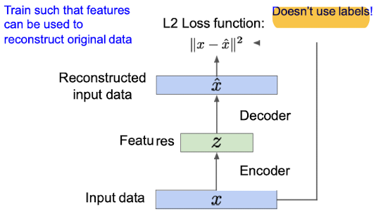
Background : Autoencoder
Purpose of Autoencoder : Encoder to make dimension lower from unlabeled training data
Unlabeled
Input
Encode
Input
Reconstruct
Input
Notes:
Auto encoder Train such that features can be used to reconstruct original data
Also It doesn’t use labels

Slide 8
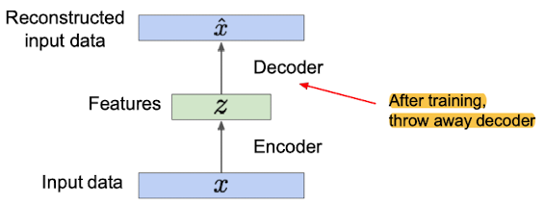
Background : Autoencoder
Purpose of Autoencoder : Encoder to make dimension lower from unlabeled training data
Unlabeled
Input
Encode
Input
Reconstruct
Input
Notes:
Auto encdoer use encoder part

Slide 9
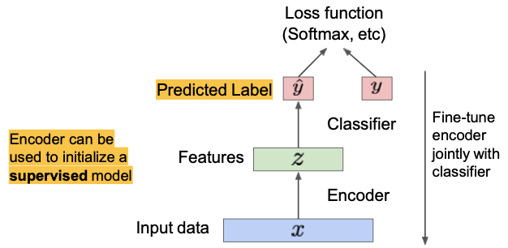
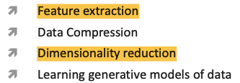
Background : Autoencoder
Purpose of Autoencoder : Encoder to make dimension lower from unlabeled training data
Unlabeled
Input
Encode
Input
Reconstruct
Input
The autoencoder excludes the decoder-part after training is completed,
and just uses the encoder part as the right fig.
Reason: Let, there are few labeled data, and there are many unlabeled data.
No matter how much you pass this data through CNN, you cannot find the main features well,
for the reason that there are few training datasets.
So, with a lot of data that is not labeled in advance, if you let the autoencoder extract the main feature Z,
and then put in a small amount of labeled data,
you can learn with a smaller amount of data much faster than you learn with random initialization.
Autoencoders can reconstruct data,
and can learn features to initialize a
supervised model
Features capture factors of variation in training data. Can we generate new images from an autoencoder?
Notes:
The autoencoder excludes the decoder-part after training is completed,
and just uses the encoder part as the fig.
Reason is.
Let, there are few labeled data, and there are many unlabeled data.
If you pass this data through CNN, you cannot find the main features well,
Because there are few training datasets.
So, with a lot of data that is not labeled in advance, if you let the autoencoder extract the main feature Z,
and then put in a small amount of labeled data,
you can learn with a smaller amount of data much faster than you learn with random initialization.
Autoencoders can reconstruct data, and can learn features to initialize a supervised model
Features capture factors of variation in training data.
then, Can we generate new images from an autoencoder?
오토 인코더는 훈련이 완료된 후 디코더 부분을 제외한다.
인코더 부분을 오른 쪽의 그림처럼 사용한다.
이유: 레이블이 지정된 데이터가 적고 레이블이 지정되지 않은 데이터가 많습니다.
CNN을 통해 이 자료를 전달하면 주요 특징을 잘 찾을 수 없다.
왜냐하면 교육 데이터 세트가 거의 없기 때문이다.
그래서, 미리 라벨링되지 않은 많은 데이터를 가지고, 자동 인코더가 주요 기능 Z를 추출하게 하면,
소량의 라벨이 붙은 데이터를 넣고
무작위 초기화를 사용하는 것보다 적은 양의 데이터로 훨씬 빠르게 학습할 수 있습니다.
자동 인코더는 데이터를 재구성할 수 있고 감독된 모델을 초기화하는 기능을 학습할 수 있다.
그렇다면. 자동 인코더에서 새 이미지를 생성할 수 있습니까?

Slide 10
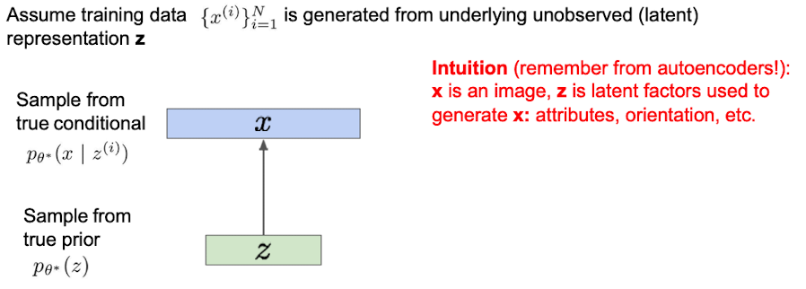
Variational Autoencoders : intuition
Probabilistic spin on autoencoders : Let us sample from the model to generate data
Let’s try to imagine an animal
Then you might think about a creature having 4 legs, one tail, feather, and so on
However, you do not come up an idea about imaginable creatures such as Haetae, Unicorn, Dragon, etc.
Our imagination could be a latent variable to create a real object or sample
VAE uses latent variables, so called an expressive model
Notes:
think Z is what we're imagining in our brain
X can be drawn with it,
from these small dimensions of z comes an image of the actual training set.
Z 는 우리가 머릿속에 상상으로 하고있는 것들이라고 생각하고
X 는 그것으로 그릴 수 있는것, 이러한 적은 차원의 z 로 부터 실제 트리이닝 셋에 대한 이미지가 나온다.
-> 우리 뇌가 이런식으로 작동하기 때무네, 즉 z는 상상 x 는 그걸 통해 이미지화 시킨 것이다.

Slide 11
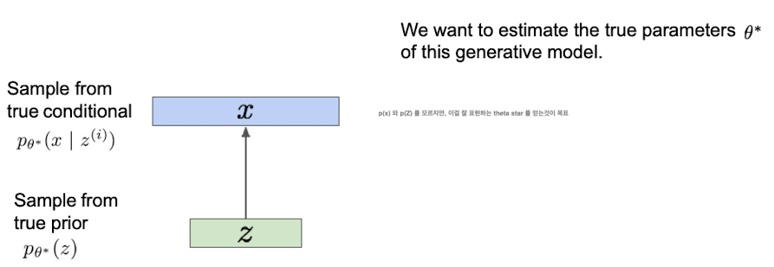

Variational Autoencoders
Notions to define VAE
X : data we want to model
z : latent variable, ex)imagination
P(X) : prob distribution of the data, ex) animal kingdom
P(z) : prob distribution of latent variable, ex) brain, a source of imagination
P(X|z) : distribution of generating data given latent variable, ex) turning imagination into real animal
Objective: model the date, finding P(X)
don't know P(x) and p(z), but the goal is to get theta star that expresses it well
Notes:
Notion to define VAE follows as below
X : data we want to model
z : latent variable, ex)imagination
P(X) : prob distribution of the data, ex) animal kingdom
P(z) : prob distribution of latent variable, ex) brain, a source of imagination
P(X|z) : distribution of generating data given latent variable, ex) turning imagination into real animal
don’t know about P(x) and P(z).
but we want to estimate the true parameters theta star of this generative model.
The goal of the VAE is finding P(X) the data likelihood function

Slide 12
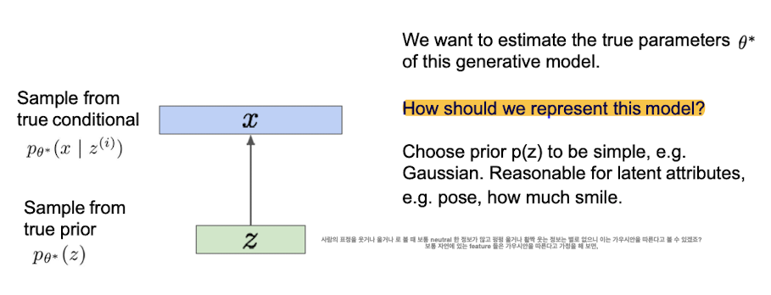
Variational Autoencoders
Notes:
for P(X), aiming to find theta star, how are we going to find it?
And, how to express this model.
For example When looking at a person's expression as smiling or crying, there is usually a lot of neutral information, and there is not much information that cries loudly or smiles broadly, so this can be seen as following Gaussian.
Like this, let’s Assume that features in real world usually follow Gaussian,
다시 돌아가서, P(X) 를 찾는것, theta star 를 찾는 것을 목표로 하였을때, 우리는 어떻게 찾을것이냐? 그리고,
그렇다면, 이 모델을 어떻게 표현을 할 것이냐.
사람의 표정을 웃거나 울거나 로 볼 때, 보통 neutral 한 정보가 많고, 펑펑 울거나 활짝 웃는 정보는 별로 없으니, 이는 가우시안을 따른다고 볼 수 있다.
보통 자연에 있는 feature 들은 가우시안을 따른다고 가정을 하면,

Slide 13
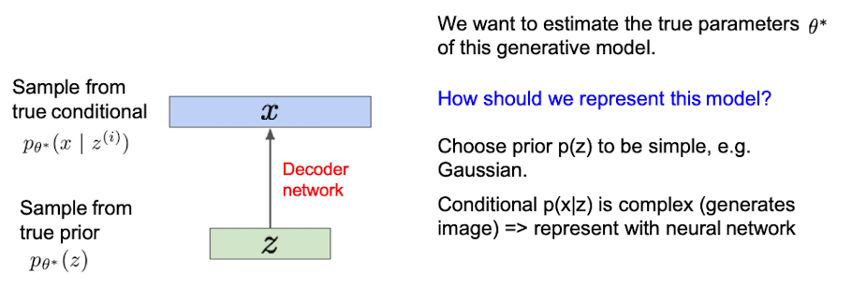
Assume that distribution is gaussian
Notes:
P(z) is a mapping p (x|z) from Gaussian to a very high dimension, so the idea of VAE is to approximate it through neural net.
P(z) 는 가우시안에서 엄청 고차원으로 가는 맵핑p(x|z) 는 엄청 복잡한 function 일 테니, 이를 neural net 을 통해 근사를 시켜보자 라는것이 아이디어이다.

Slide 14
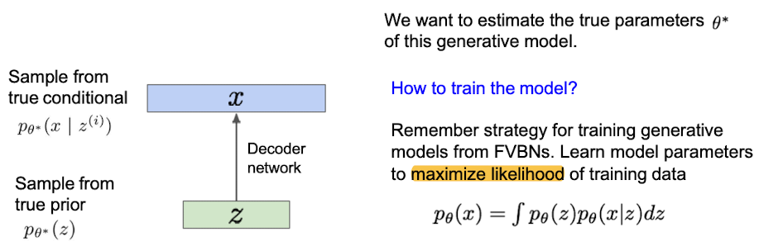
Variational Autoencoders
Notes:
Then The way to train the model is to learn model parameters to maximize likelihood of training data
Likelihood is defined by the following formula.
P(x) is a likeihood
When p(z) multiply p(x|z) is integrated with respect to the entire z-space.
Likelihood 는 다음 식과 같이 정의된다.
P(x) 는 전체 z 공간에 대해 p(z)p(x|z)의 적분을 진행 할 경우 likelihood 를 얻을 수 있다.

Slide 15
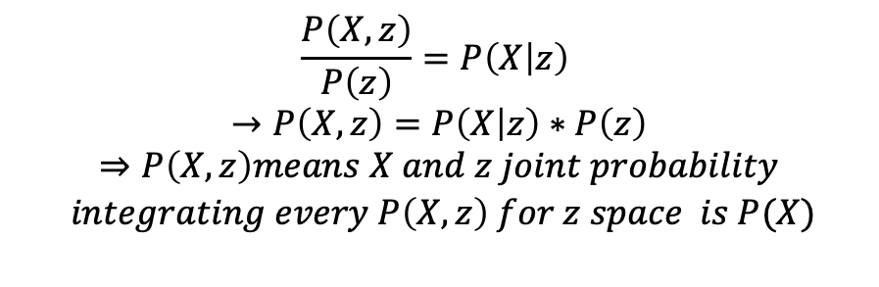
Variational Autoencoders
$$\frac{P\left(X,z\right)}{P\left(z\right)}=P\left(X | z\right)$$
$$→P\left(X,z\right)=P\left(X | z\right)∗P\left(z\right)$$
$$⇒P\left(X,z\right)means X and z joint probability$$
$$integrating every P\left(X,z\right) for z space is P(X)$$
Notes:
FVBN – fully visible belief network
But the problem is , the equation of P(X) is intractable,
Because we have to do sampling from z to know P(z) and P(X|z), we can’t do sampling for infinite times from z.
So, to solve this problem ->
To train this model, we must know how the likelihood equation is defined.

Slide 16
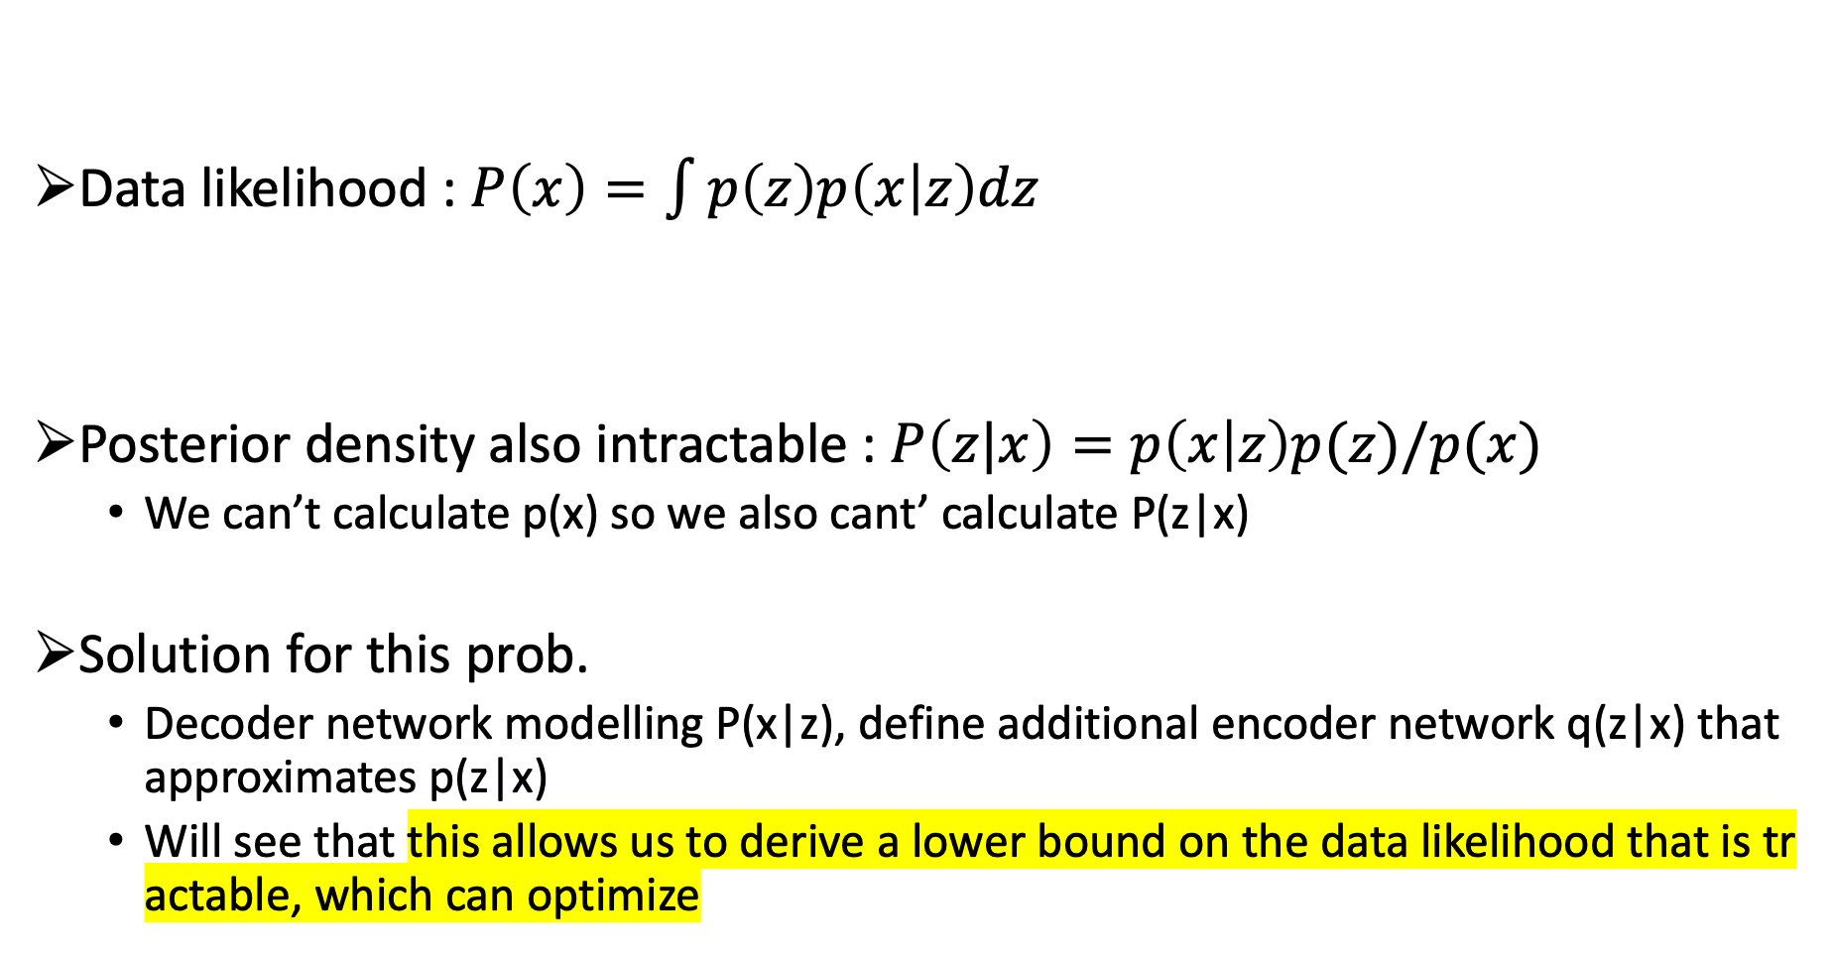

Variational Autoencoders
Data likelihood : $P\left(x\right)=\int{p\left(z\right)p\left(x | z\right)dz}$
Posterior density also intractable : $P\left(z|x\right)=p\left(x | z\right)p(z)/p(x)$
We can’t calculate p(x) so we also cant’ calculate P(z|x)
Solution for this prob.
Decoder network modelling P(x|z), define additional encoder network q(z|x) that approximates p(z|x)
Will see that this allows us to derive a lower bound on the data likelihood that is tractable, which can optimize
Intractable to compute $p\left(x | z\right)$ for every z
Simple gaussian prior
Decoder NN
Notes:
We approximate p(X|z) using a decoder. Therefore, since p(z|x) is also z when x is known, we approximate it through a neural network. And see if this likelihood can be maximized.
Since p(x|z) is the decoder and p(z|x) is the encoder
if this p(x) function has a lower bound, the p(z|x)’s likelihood can be maximized,
because if you do it in a way that raises the lower bound,
at least it won't come down below the lower bound.
If so, how can you check this lower bound.
p(X|z) 를 디코더를 이용해서 근사한다. 그러므로 p(z|x) 도 x 를 알고 있을때 z 이니깐, 이것을 뉴럴네트워크를 통해 근사를 해본다. 그리고 이 likelihood 가 맥시마이즈 될 수 있는가 를 알아본다.
p(x|z) 가 디코더 이고, p(z|x) 는 인코더 이므로
실제로 p(z|x)의 likelihood 가 맥시마이즈 될 수 있는지를 알아보자, 맥시마이즈 될 수 있다는 것을 알 수 있는 방법은 이 p(x) 함수에 lowerbound 가 있으면, lowerbound 를 높혀가는 방식으로 진행하다보면, 최소한 lowerbound 아래로는 안 내려올 것이기 때문에, 이 lower bound 를 높히다 보면, 맥시마이즈 할 수 있겠다.
그렇다면, 어떻게 이 lower bound 를 확인 할 수 있냐.

Slide 17
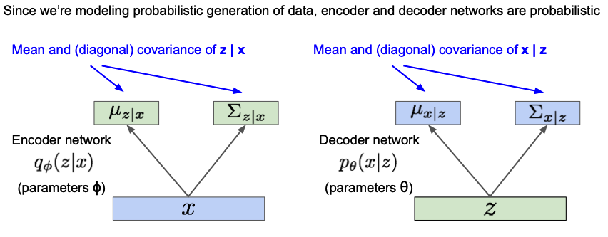
Variational Autoencoders
To make easy to read make q_pi p_theta to Q and P from now
Notes:
To know that, we need to know how the encoder network and the decoder network work.
The encoder network receives x, maps it to z, and do the process probabilistically.
Extracting the mean and covariance representing Z is how the encoder works, and the opposite is the decoder works.
There are two output values,
the mean and the variance from the encoder .
and the decoder receives as an input is a vector. These two are different.
The solution is to sampling.
the mean and variance come out as outputs ,Therefore, through this, the Gaussian is specified.
그것을 알기 위해서는, 인코더 네트워크와 디코더 네트워크가 어떻게 동작하는지를 알아야 한다.
인코더 네트워크는 x 를 받아서, z 로 맵핑을 하고 이를 probabilistic 하게 진행한다.
Z를 표현하는 평균과 공분산을 뽑아내는것이 인코더의 동작 방식이고 그 반대가 디코더가 하는일이다.
인코더에서 아웃풋으로 평균과 분산 두가지 값인데, 디코더에서 입력으로 받는 것은 벡터이다. 이 두개가 다르다.
해결 방식은, 샘플링을 통해서 진행한다. 가우시안을 가정했고, 평균과 분산이 아웃풋으로 나오므로,
그러므로, 이를 통해, 가우시안을 특정한다.

Slide 18

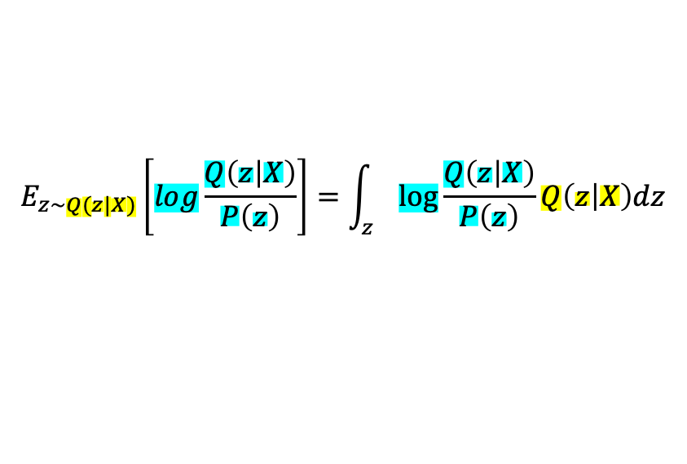
Variational Autoencoders : derivation
(Log) Data likelihood :
$$logP\left(X\right)=E_{z\sim Q(z|X)}\left[logP\left(X\right)\right] (P\left(X\right) Does not depend on z)$$
Encoder network
$$E_{z\sim Q(z|X)}\left[log\frac{Q\left(z | X\right)}{P\left(z\right)}\right]=\int_{z}{\log{\frac{Q\left(z | X\right)}{P\left(z\right)}Q\left(z | X\right)dz}}$$
Notes:
It is calculated by lowering the complexity of the calculation through log-like hood, not Likelihood. Loglikehood is also a monotonous
increasing function.
Through the Encoder network we sampled Z and we calculate the Expectation value of logP(X), 즉, the integrated value
And the reason why this is possible is that P(X) is not affected by z.
And the objective of the VAE was to maximize the datalikelihood which is P(X)
We transform the equation form to expectation form
which Z follows the encoder’s distribution Q(z|X) .
Likelihood 가 아닌 log likelihood 를 통해 계산의 복잡도를 낮추어 계산한다. Log likelihood 또한 단조 증가 함수이기 때문에 로그를 취해줘도 무방
Encoder 네트워크를 통해 sample 한 z 에 대해 logP(X) 의 Expectation 한 값, 즉, 적분한 값을 계산한다.
그리고 이것이 가능한 이유는 P(X) 가 z 의 영향을 받지 않기 때문이다.
데이터 라이클리 후드를 맥시마이즈 하고 싶기 때문에, 이 값을 로그를 씌우고,
기댓값 형태로 z 가 q(z|X) 인코더의 distribution 을 따를때, 로 식을 변환 하였다.

Slide 19


Variational Autoencoders : derivation
(Log) Data likelihood :
$$logP\left(X\right)=E_{z\sim Q(z|X)}\left[logP\left(X\right)\right] \left(P\left(X\right) Does not depend on z\right)$$
= $E_{z}\left[log\frac{P\left(X | z\right)P\left(z\right)}{P\left(z | X\right)}\right] \left(Bayes^{′}Rule\right)$
$$\left(Bayes^{′}Rule\right)$$
$$P\left(z | X\right)=\frac{P\left(X | z\right)p\left(z\right)}{P\left(X\right)}$$
$$P\left(X\right)=\frac{P\left(X | z\right)p\left(z\right)}{P\left(z|X\right)}$$
Notes:
Through the Bayesian rule, the expression on the right is transformed as below
베이시안 룰을 통해 우측의 식은 변환이 된다.

Slide 20

Variational Autoencoders : derivation
(Log) Data likelihood :
$$logP\left(X\right)=E_{z\sim Q(z|X)}\left[logP\left(X\right)\right] \left(P\left(X\right) Does not depend on z\right)$$
= $E_{z}\left[log\frac{P\left(X | z\right)P\left(z\right)}{P\left(z | X\right)}\right] \left(Bayes^{′}Rule\right)$
= $E_{z}\left[log\frac{P\left(X | z\right)P\left(z\right)}{P\left(z | X\right)} ∗\frac{Q\left(z | X\right)}{Q\left(z | X\right)}\right] \left(Multiply by constant\right)$
Notes:
Than, multiply the constant Q(z|X) at 분모와 분자 which changes nothing.

Slide 21

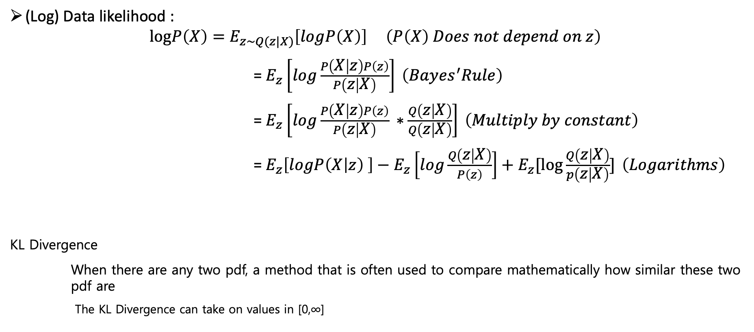
Variational Autoencoders : derivation
(Log) Data likelihood :
$$logP\left(X\right)=E_{z\sim Q(z|X)}\left[logP\left(X\right)\right] \left(P\left(X\right) Does not depend on z\right)$$
= $E_{z}\left[log\frac{P\left(X | z\right)P\left(z\right)}{P\left(z | X\right)}\right] \left(Bayes^{′}Rule\right)$
= $E_{z}\left[log\frac{P\left(X | z\right)P\left(z\right)}{P\left(z | X\right)} ∗\frac{Q\left(z | X\right)}{Q\left(z | X\right)}\right] \left(Multiply by constant\right)$
= $E_{z}\left[logP\left(X | z\right) \right]−E_{z}\left[log\frac{Q\left(z | X\right)}{P\left(z\right)}\right]+E_{z}[\log{\frac{Q\left(z | X\right)}{p\left(z | X\right)}] }\left(Logarithms\right)$
KL Divergence
When there are any two pdf, a method that is often used to compare mathematically how similar these two pdf are
The KL Divergence can take on values in [0,∞]
Notes:
Then by the logarithms the equation have changed.
For now we need KL divergence.
The KL divergence is often used to compare mathematically how similar these two distributions are
The KL divergence can take on values in 0 to infinite.
The term of KL divergence is like this.
So look at the equation again then, we notice that there is some log terms that we can transform to KL term

Slide 22
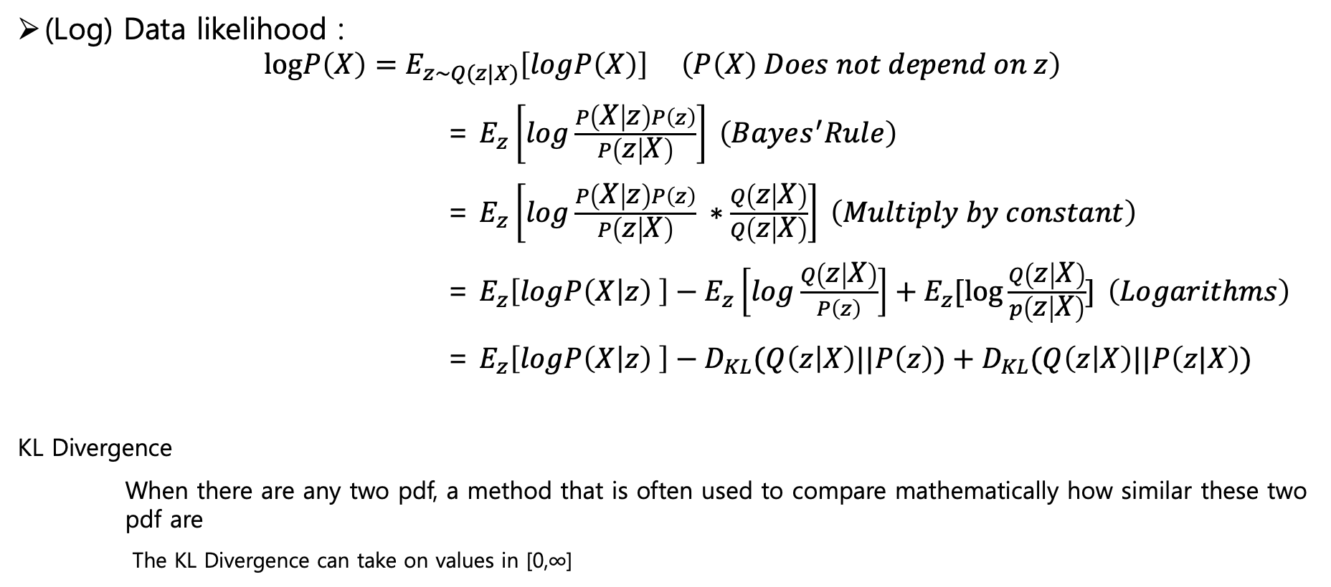
Variational Autoencoders : derivation
(Log) Data likelihood :
$$logP\left(X\right)=E_{z\sim Q(z|X)}\left[logP\left(X\right)\right] \left(P\left(X\right) Does not depend on z\right)$$
= $E_{z}\left[log\frac{P\left(X | z\right)P\left(z\right)}{P\left(z | X\right)}\right] \left(Bayes^{′}Rule\right)$
= $E_{z}\left[log\frac{P\left(X | z\right)P\left(z\right)}{P\left(z | X\right)} ∗\frac{Q\left(z | X\right)}{Q\left(z | X\right)}\right] \left(Multiply by constant\right)$
= $E_{z}\left[logP\left(X | z\right) \right]−E_{z}\left[log\frac{Q\left(z | X\right)}{P\left(z\right)}\right]+E_{z}[\log{\frac{Q\left(z | X\right)}{p\left(z | X\right)}] }\left(Logarithms\right)$
= $E_{z}\left[logP\left(X | z\right) \right]−D_{KL}(Q\left(z | X\right)||P\left(z\right))+D_{KL}(Q\left(z | X\right)||P\left(z|X\right))$
KL Divergence
When there are any two pdf, a method that is often used to compare mathematically how similar these two pdf are
The KL Divergence can take on values in [0,∞]
Notes:
changed log term to KL term

Slide 23
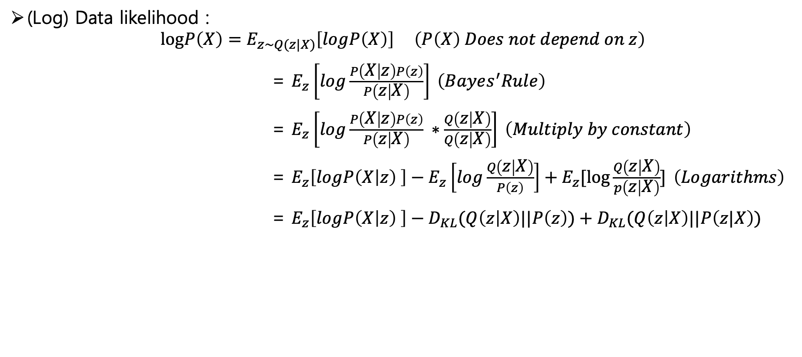
Variational Autoencoders : derivation
(Log) Data likelihood :
$$logP\left(X\right)=E_{z\sim Q(z|X)}\left[logP\left(X\right)\right] \left(P\left(X\right) Does not depend on z\right)$$
= $E_{z}\left[log\frac{P\left(X | z\right)P\left(z\right)}{P\left(z | X\right)}\right] \left(Bayes^{′}Rule\right)$
= $E_{z}\left[log\frac{P\left(X | z\right)P\left(z\right)}{P\left(z | X\right)} ∗\frac{Q\left(z | X\right)}{Q\left(z | X\right)}\right] \left(Multiply by constant\right)$
= $E_{z}\left[logP\left(X | z\right) \right]−E_{z}\left[log\frac{Q\left(z | X\right)}{P\left(z\right)}\right]+E_{z}[\log{\frac{Q\left(z | X\right)}{p\left(z | X\right)}] }\left(Logarithms\right)$
= $E_{z}\left[logP\left(X | z\right) \right]−D_{KL}(Q\left(z | X\right)||P\left(z\right))+D_{KL}(Q\left(z | X\right)||P\left(z|X\right))$
Decoder Network gives P(X|z), can compute estimate of this term through sampling. (sampling differentiable through reparam. Trick.)
P(z|X) intractable, can’t compute
this KL term: but, KL divergence
always >= 0
This KL term (between Gaussians for encoder and z prior) has nice closed-form solution
Notes:
Express how different the actual distribution of p(z) and q(z|x) is from the distribution predicted by the encoder
Assumed that p(z) is a Gaussian,
But, What the encoder predicted could not follow Gaussian.
what dKL term means is a regularize term that expresses how close the prediction is to Gaussian,
p(z) 와 q(z|x) 실제 distribution 과 인코더가 예측한 distribution 이 얼마나 다른가 를 표현
p(z) 는 가우시안 이라고, 가정을 해봤으니
인코더가 예측한것이 가우시안 일 리 없다.
그러나, dKL이 의미하는것은 예측한것이 가우시안으로 얼마나 가까워지는가 를 표현한 regularize term

Slide 24

Variational Autoencoders : derivation
(Log) Data likelihood :
$$logP\left(X\right)=E_{z\sim Q(z|X)}\left[logP\left(X\right)\right] \left(P\left(X\right) Does not depend on z\right)$$
= $E_{z}\left[log\frac{P\left(X | z\right)P\left(z\right)}{P\left(z | X\right)}\right] \left(Bayes^{′}Rule\right)$
= $E_{z}\left[log\frac{P\left(X | z\right)P\left(z\right)}{P\left(z | X\right)} ∗\frac{Q\left(z | X\right)}{Q\left(z | X\right)}\right] \left(Multiply by constant\right)$
= $E_{z}\left[logP\left(X | z\right) \right]−E_{z}\left[log\frac{Q\left(z | X\right)}{P\left(z\right)}\right]+E_{z}[\log{\frac{Q\left(z | X\right)}{p\left(z | X\right)}] }\left(Logarithms\right)$
= $E_{z}\left[logP\left(X | z\right) \right]−D_{KL}(Q\left(z | X\right)||P\left(z\right))+D_{KL}(Q\left(z | X\right)||P\left(z|X\right))$
$$≥0$$
Since dKL is larger when it is negative and different, maximizing logP(X) means minimizing
this equation, and minimizing it means that Q(z|X) and P(z) become similar.
This will cause the encoder to make approximate posterior distribution close to prior
Notes:
Since dKL term is larger when it is different,
maximizing logP(X) means
minimizing this blue circled equation,
and minimizing it means
that Q(z|X) and P(z) become similar.
This will cause the encoder to make approximate posterior distribution close to prior
-가 붙어있고, 다르면 다를수록 dKL 이 큰 값이므로, logp(x^i) 를 맥시마ㄹ이즈 한다는 것은 이 수식을 미니마이즈 한다는 것이고 얘를 미니마이즈 한다는 것은, q(z|x) 와 p(z) 가 비슷하게 되어간다. 라는 의미다. 이는 , prior 로 p(z) prior 로 인코더가 z distribution 을 예측하도록 될 것이다.

Slide 25
Variational Autoencoders : derivation
(Log) Data likelihood :
$$logP\left(X\right)=E_{z\sim Q(z|X)}\left[logP\left(X\right)\right] \left(P\left(X\right) Does not depend on z\right)$$
= $E_{z}\left[log\frac{P\left(X | z\right)P\left(z\right)}{P\left(z | X\right)}\right] \left(Bayes^{′}Rule\right)$
= $E_{z}\left[log\frac{P\left(X | z\right)P\left(z\right)}{P\left(z | X\right)} ∗\frac{Q\left(z | X\right)}{Q\left(z | X\right)}\right] \left(Multiply by constant\right)$
= $E_{z}\left[logP\left(X | z\right) \right]−E_{z}\left[log\frac{Q\left(z | X\right)}{P\left(z\right)}\right]+E_{z}[\log{\frac{Q\left(z | X\right)}{p\left(z | X\right)}] }\left(Logarithms\right)$
= $E_{z}\left[logP\left(X | z\right) \right]−D_{KL}(Q\left(z | X\right)||P\left(z\right))+D_{KL}(Q\left(z | X\right)||P\left(z|X\right))$
$$≥0$$
this term means, Reconstruct the input data, and it shows how likely it is to be from z
Notes:
this term means, Reconstruct the input data, and it shows how likely it is to be from z
Decoder network gives P(X|z), can compute estimate of this term through sampling.

Slide 26
Variational Autoencoders : derivation
(Log) Data likelihood :
$$logP\left(X\right)=E_{z\sim Q(z|X)}\left[logP\left(X\right)\right] \left(P\left(X\right) Does not depend on z\right)$$
= $E_{z}\left[log\frac{P\left(X | z\right)P\left(z\right)}{P\left(z | X\right)}\right] \left(Bayes^{′}Rule\right)$
= $E_{z}\left[log\frac{P\left(X | z\right)P\left(z\right)}{P\left(z | X\right)} ∗\frac{Q\left(z | X\right)}{Q\left(z | X\right)}\right] \left(Multiply by constant\right)$
= $E_{z}\left[logP\left(X | z\right) \right]−E_{z}\left[log\frac{Q\left(z | X\right)}{P\left(z\right)}\right]+E_{z}[\log{\frac{Q\left(z | X\right)}{p\left(z | X\right)}] }\left(Logarithms\right)$
= $E_{z}\left[logP\left(X | z\right) \right]−D_{KL}(Q\left(z | X\right)||P\left(z\right))+D_{KL}(Q\left(z | X\right)||P\left(z|X\right))$
$$≥0$$
Tractable Lower Bound
Which can take gradient of and optimize
Notes:
Since dKL is always greater than or equal to 0,, the front blue box becomes lower bound.
So, maximizing logP in a mathematical sense is maximizing the lower bound
The Maximum Likely Hood process becomes the process of maximizing the lower bound.
but dKL 은 항상 0 이상 그러므로 앞의 푸른 박스가 로우어 바운드가 된다.
그렇다면, 수학적 의미 상으로 logp 를 맥시마이즈 하는 것은 로우어 바운드를 맥시마이즈 하는 것으로
Maximum Likely Hood 공정은 하한값을 최대화하는 공정이 됩니다.

Slide 27
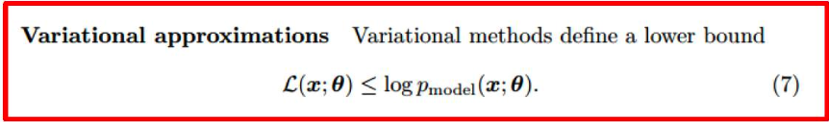

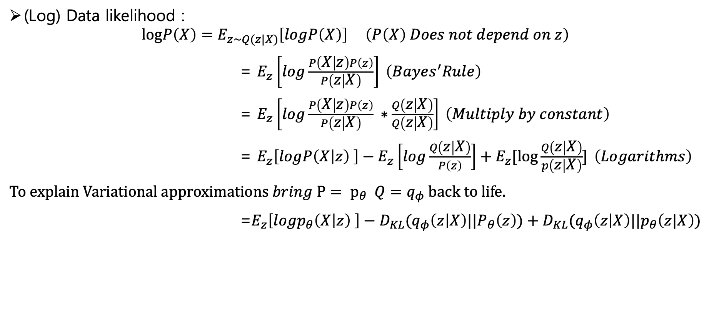
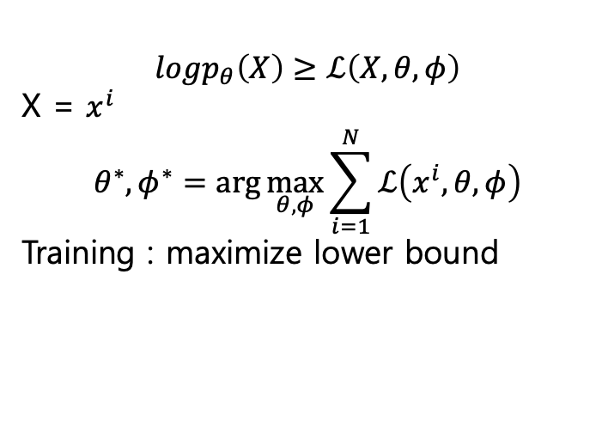

Variational Autoencoders : derivation
(Log) Data likelihood :
$$logP\left(X\right)=E_{z\sim Q(z|X)}\left[logP\left(X\right)\right] \left(P\left(X\right) Does not depend on z\right)$$
= $E_{z}\left[log\frac{P\left(X | z\right)P\left(z\right)}{P\left(z | X\right)}\right] \left(Bayes^{′}Rule\right)$
= $E_{z}\left[log\frac{P\left(X | z\right)P\left(z\right)}{P\left(z | X\right)} ∗\frac{Q\left(z | X\right)}{Q\left(z | X\right)}\right] \left(Multiply by constant\right)$
= $E_{z}\left[logP\left(X | z\right) \right]−E_{z}\left[log\frac{Q\left(z | X\right)}{P\left(z\right)}\right]+E_{z}[\log{\frac{Q\left(z | X\right)}{p\left(z | X\right)}] }\left(Logarithms\right)$
$To explain Variational approximations bring {P= p}_{θ} Q=q_{φ} back to life.$
=$E_{z}\left[logp_{θ}\left(X | z\right) \right]−D_{KL}(q_{φ}\left(z | X\right)||P_{θ}\left(z\right))+D_{KL}(q_{φ}\left(z | X\right)||p_{θ}\left(z|X\right))$
$$logp_{θ}\left(X\right)≥ℒ\left(X,θ, φ\right)$$
X = $x^{i}$
$$θ^{∗}, φ^{∗}=\arg{\max_{θ,φ}\sum_{i=1}^{N}{ℒ\left(x^{i},θ, φ\right)}}$$
Training : maximize lower bound
$$≥0$$
$$ℒ(X,θ, φ)$$
Notes:
로어 바운드를 증가시키는 방식으로 학습을 시킨다.
For explanation of Variational approximation bring P_theta and Q_pi back to life.
The L term means a lower bound
logP(X) is larger than the L term.
And, training of VAE is Maximizing the lower bound by theta and pi

Slide 28
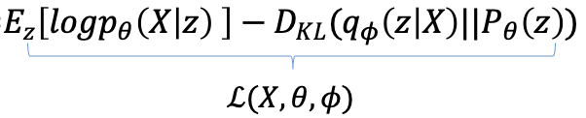
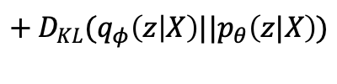
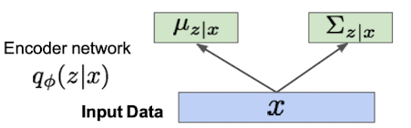
Variational Autoencoders : training process
Maximizing the lower bound. We can’t calculate this
part now so just ignore them.
Notes:
Training through maximizing the lower bound is make the L term maximize.
The right side of the L term can’t be calculated so just ignore them now.
The encoder network get x data and then output two values to determine the Gaussian, two value is mu and sigma that best fit the Gaussian assumption P(z). Which is mean and variance
인코더 네트워크는 x 를 받아서 가우시안이라고 가정한 P(z) 에 최대한 잘 맞는 두개의 값, 가우시안을 결정하기 위한 두 값을 뽑는일을 한다.

Slide 29
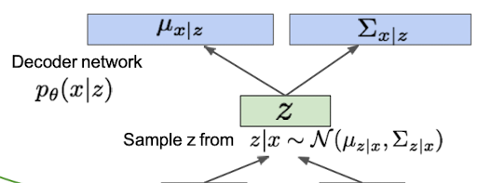
Variational Autoencoders : training process
By maximizing this term
maximizing log likelihood lower bound
Make approximate posterior distribution close to prior
Notes:
What the decoder network takes a latent vector z,
Since z is assumed to be a Gaussian, you can get mu and covariance from it, and if do sampling from there, you can get an image called x hat.
디코더 네트워크가 하는 일은 레이턴트 벡터 제트를 받아서,
가우시안이라고 가정하고 있으니 그에 대한 뮤와 코배리언스를 얻어내고, 거기서 샘플을 하면 x 햇 이라는 이미지를 얻을 수 있다.

Slide 30
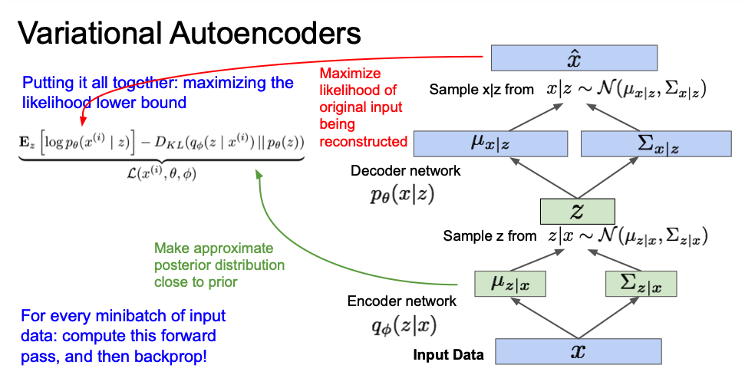
Variational Autoencoders : training process
Notes:
Through Continueing this sampling process.
we can calculate what the log-like hood is.
If backpropagate it and maximizing the lower bound, Seta and Pi, will change.
This is the training course
Reconstruntion error term is the red pointed term
인코더를 통해 나온 Z 에 대해 x 가 나올 확률 이 reconstruction error
Regularization term is green pointed term
계속 이 샘플링 과정을 진행 한다. 이를 통해,
쭉 통과시키면 로그 라이클리 후드가 어떤 값이다 라는것을 계산 할 수있고,
그걸 미분해서 백프로퍼게이션하여 미분해서 그레디언트 어센트를 하면, 하고자 하는 역할을 잘 할 수 있는 세타와 파이가 스텝을 밟아 나갈 것이다. 라고 알 수 있다.
여기까지가 트레이닝 과정

Slide 31
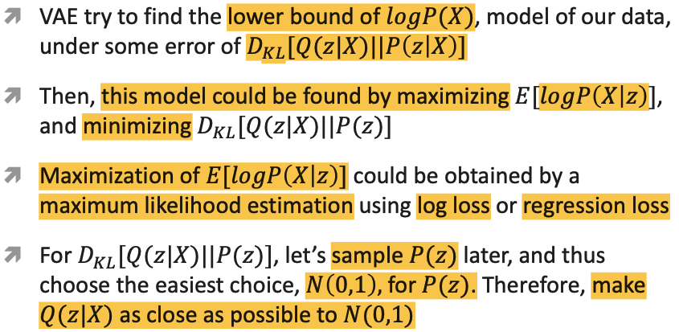

VAE : Dissecting the objective
$$logP\left(X\right)=\text{= }E_{z}\left[logP\left(X | z\right) \right]−D_{KL}(Q\left(z | X\right)||P\left(z\right))+D_{KL}(Q\left(z | X\right)||P\left(z|X\right))$$
Notes:
Dissecting the objective
VAE try to find the lower bound of logP(X), model of our data, Under some error of the KL divergence term of q(z|X) and P(z|X)
Then, this model could be found by maximizing Expectation of log P(X|z), and minimizing the KL divergence term of Q(z|X) and P(z)
For this term, let’s sample P(z) later, and thus choose the easiest choice, standard Normal distribution that is N(0,1), for P(z). Therefore, make Q(z|X) as close as possible to normal distribution.

Slide 32






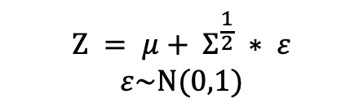
Reparameterization trick
$$μ, Σ$$
$$μ, Σ$$
encoder
decoder
encoder
decoder
$$Z$$
Z : N($μ, Σ$)
Z : N($0, 1$)
Sampling
Process
$$Z = μ+ Σ^{\frac{1}{2}} ∗ ε$$
$$ε\sim N(0,1)$$
$Z \sim N(μ, Σ$)
Notes:
There is something called Reparameterization trick. What this is.
If you pass through the encoder, you make mu and sigma, and you make a normal distribution with it, and do sampling from there.
This process can not do the backpropagation later on.
Because the sampling process cannot be differentiated
So we have to express it in a differentiable way
In a standard normal distribution with a mean of 0 and a standard deviation of 1, if you sample Epsilon, and multiply it by the deviation from encoder, and add it to Mue, it becomes a new sampling value.
As in the left figure, make normal distribution and do sampling through this method.
and the value is sampled from the standard normal distribution as in the right method, multiplied by sigma, and added to mu, resulting in the same effect as the actual sample.
This allows us to obtain an expression for Z, which makes it differentiable for both mu and sigma.
인코더를 통과하면 뮤랑 시그마를 만들고 그걸 가지고 노말 디스트리뷰션을 만들고 거기서 샘플링을 한다 라고 되어있었는데,
이것 자체가 나중에 백프로퍼게이션이 안된다. 왜냐면 샘플링 프로세스가 미분이 불가함
그러므로 미분 가능한 식으로 표현해야 하는데
평균이 0 이고 표준편차가 1 인 표준 정규분포에서 입실론을 샘플링을 하고 표준편차에 곱해주고 뮤에다가 더해주면, 그게 새로운 샘플링 값이 된다.
좌측 방식처럼 이러한 방식을 통해서 노말 디스트리뷰션을 만들고, 샘플링을 진행하는것과, 우측 방식처럼 표준 정규분포에서 값을 샘플링 한 후에 시그마에 곱해주고, 뮤에 더해주는 방법으로 , 실제 샘플링 한 것과 동일한 효과를 가져오게 된다.
이를 통해 Z 에 대한 식을 얻을 수 있어지고, 그렇기 때문에 이 식은 뮤에대해서도 시그마에대해서도 미분 가능한 식이 된다.

Slide 33
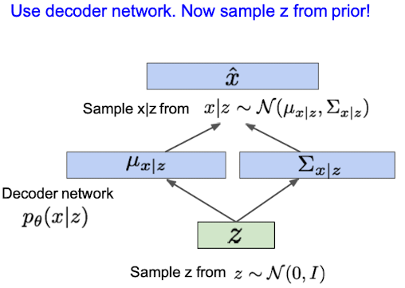
VAE : Generating Data
Notes:
Than for generating data that doesn’t exist in real
We assumed the z follows gaussian distribution,
So, we just sample anything from the z and put them into the decoder network
실제로 없는 이미지를 만들기 위해서는 어떻게 해야하냐,
z 를 가우시안으로 가정을 했으니, 그냥 거기서 뽑는다.아무거나 샘플링을 하고, 그것을 decoder network 에 넣어준다.

Slide 34
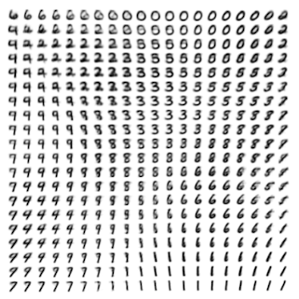
VAE : Generating Data
Notes:
The image on the right is a result of applying the VAE to the mnist data.
우측의 이미지는 mnist data 에 대해, VAE 를 적용한 결과이다.

Slide 35
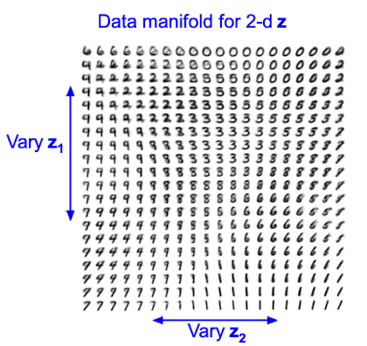
VAE : Generating Data
Notes:
Since Z1 and z2 are significant features, these results can be seen.
It looks similar to original data
Z1 과 z2 가 유의미한 feature 이기 때문에, 이러한 결과를 볼 수 있다.

Slide 36
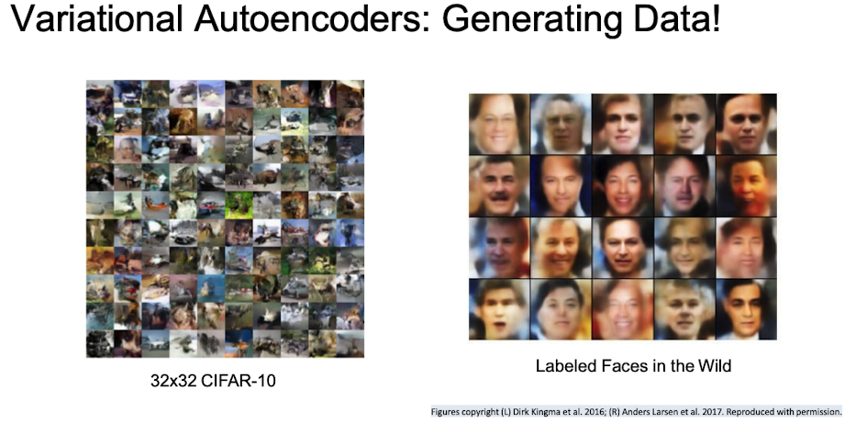
Notes:
These are results of Vae on cifar-10 and labeled faces in the wild.
The result is blurry

Slide 37






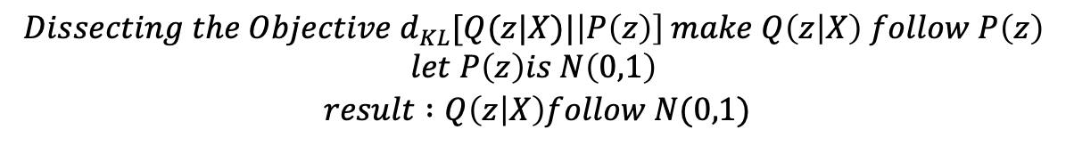




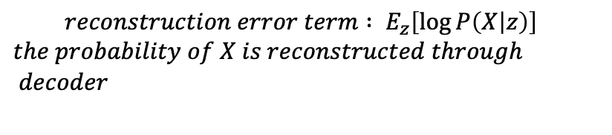
Review
$${logP\left(X\right)= E}_{z}\left[logp_{θ}\left(X | z\right) \right]−D_{KL}(q_{φ}\left(z | X\right)||P_{θ}\left(z\right))+D_{KL}(q_{φ}\left(z | X\right)||p_{θ}\left(z|X\right))$$
$$can^{′}t calculate this \text{⬆} term$$
Encoder
Input : data
output : mu and sigma
Z
training : needed to make as similar as normal distribution
Gen : from Z we do sampling to generate
Decoder
Input : sampled result from Z
Output : new data
$$μ$$
$$+$$
$$Z$$
$$X$$
$$\hat{X}$$
encoder
decoder
$$Σ$$
$$×$$
Sample from Z and put into decoder -> it makes new image!
Reparameterization
Trick
$$reconstruction error term : E_{z}\left[\log{P\left(X | z\right)}\right]$$
$$the probability of X is reconstructed through decoder$$
$$ε$$
N($0, 1$)
$$Dissecting the Objective d_{KL}[Q(z|X)|\left|P\left(z\right)\right] make Q\left(z | X\right) follow P\left(z\right)$$
$$let P\left(z\right)is N\left(0,1\right)$$
$$result :Q\left(z | X\right)follow N(0,1)$$
Notes:
Encoder 를 통해 Mu 값과 sigma 값이 나온다.
이 나온 값을 통해서 normal distribution 을 만든다.
Normal distribution 에서 z 를 샘플링을 한다.
Encoder 를 지나 바로 z 로 가는것이 아니라, 평균과 표준편차를 뽑고, 이를 활용한 정규분포를 만들고 거기서 샘플링을 통해 z 를 만든다. 이렇게 만든 z 를 가지고, 디코더를 통과를 시키는 것이다.

Slide 38
Variational Autoencoders
Probabilistic spin to traditional autoencoders -> allows generating data
Defines an intractable density -> derive and optimize a (variational) lower bound
Pros:
Principled approach to generative models
Allows inference of q(z|x), can be useful feature representation for other tasks
Cons:
Maximizes lower bound of likelihood : okay, but not as good evaluation as PixelRNN/PixelCNN
Samples blurrier and lower quality compared to state-of-the-art (GANs)
Notes:
VAE is probabilistic spin to traditional autoencoders, it allows generating data.
Pros of VAE are
These
But as a cons,
Expression is unknown
Result is blurry. Although z is assumed to be Gaussian, there are parts that cannot be predicted properly if the Gaussian is not followed, and as a result, it comes out blurry.
Pros는 수학적으로 잘 했으며,
인코더 네트워크를 트레이닝 하기 때문에,
오토 인코더는 트레이닝을 다 시키고 디코더를 빼고, 인코더를 쓰기 때문에,
그런 역할로도 사용이 가능하다.
그러나 cons 로는
식을 알 수 없음
블러리 하다.
z 를 가우시안으로 가정을 했지만, 가우시안을 따르지 않을 경우 제대로 예측이 안되는 부분이 있고, 그 결과로 블러리 하게 나온다.
생성 모델에 대한 원칙적 접근 q(z|x)의 추론을 허용하고, 다른 작업에 유용한 기능 표현 가능 반대: 가능성의 하한을 최대화합니다. OK, 그러나 PixelRNN/PixelCNN만큼 좋은 평가는 아닙니다. 샘플은 최첨단 GAN(Gealth)에 비해 흐릿하고 품질이 낮습니다.

Slide 39
references
https://www.youtube.com/watch?v=5WoItGTWV54&t=2175s
http://cs231n.stanford.edu/slides/2019/cs231n_2019_lecture11.pdf
https://youtu.be/GbCAwVVKaHY : reparam trick
https://www.oliviergibaru.org/courses/ML_VAE.html#VAE2 :Dissecting the objective
C.Doersch, “Tutorial on Variational Autoencoder,” arXiv:1606.05908v2 [stat.ML], 13 August 2016
https://wiseodd.github.io/techblog/2016/12/10/variational-autoencoder/

Slide 40
감사합니다.

Slide 41
appendix
How to make VAE using KERAS

Slide 42
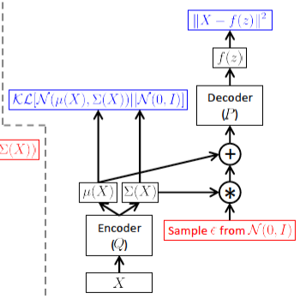
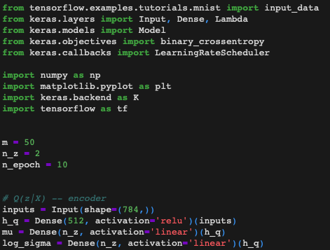
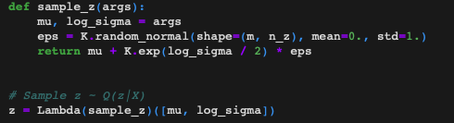
Encoder Net : Q(z|X)
Notes:
First, let’s implement the encoder net Q(z|X) , which takes input X and outputting two things: μ(X) and Σ(X) , the parameters of the Gaussian.
That is, our Q(z|X) is a neural net with one hidden layer. In this implementation, our latent variable is two dimensional, so that we could easily visualize it. In practice though, more dimension in latent variable should be better.
From the code. Blue square box is the reparameterization trick part I think

Slide 43
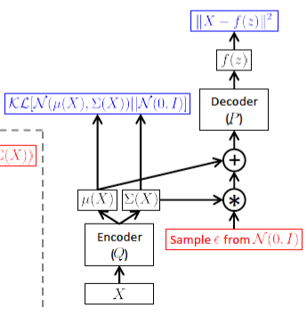

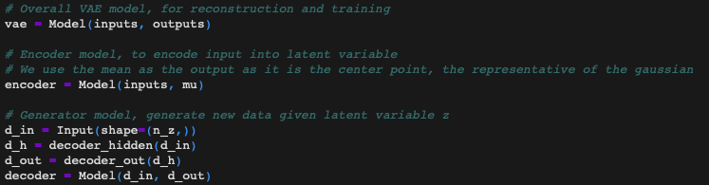
Decoder Net : P(X|z)
Final Keras Models
reconstruct inputs,
encode inputs into latent variables,
generate data from latent variable
Notes:
Final Keras Models have reconstruct inputs,
Encode inputs into latent variables
Generate data from latent variables

Slide 44
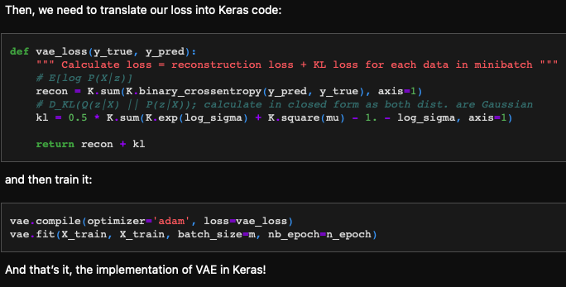
Loss and Training
Notes:
Then, we need to translate our loss into Keras code:
and then train it:
And that’s it, the implementation of VAE in Keras!

