Slide 1
CS 336 Project
Gabe Marquez and Kevin Sung

Slide 2
The location is Portland. In the past few years, many restaurants have been losing customers in droves. Troubled and bewildered, the owners of these restaurants fear that if the trend continues, they will be out of business in no time. What could be the cause of this? A closer look reveals that the troubled restaurants are suffering from:
Bad Yelp reviews!
Everybody uses Yelp to look up what restaurant to eat at next. And nobody wants to go to a restaurant that has a bad rating!

Slide 3
We have compiled data that will help you combat this scourge of bad Yelp reviews. Through our research, we have developed a way to measure how satisfied your customers are on a given day. We call this measure the Customer Satisfaction Metric (CSM). The calculation of this metric uses unique data that we have about each customer, and we have discovered that it is a good predictor of the proportion of Yelp reviews for a restaurant that are positive (Yelp factor). To demonstrate this, we calculated the CSM for 50 restaurants over a period of a month, and found that the restaurants with higher average CSM had better Yelp reviews.

Slide 4
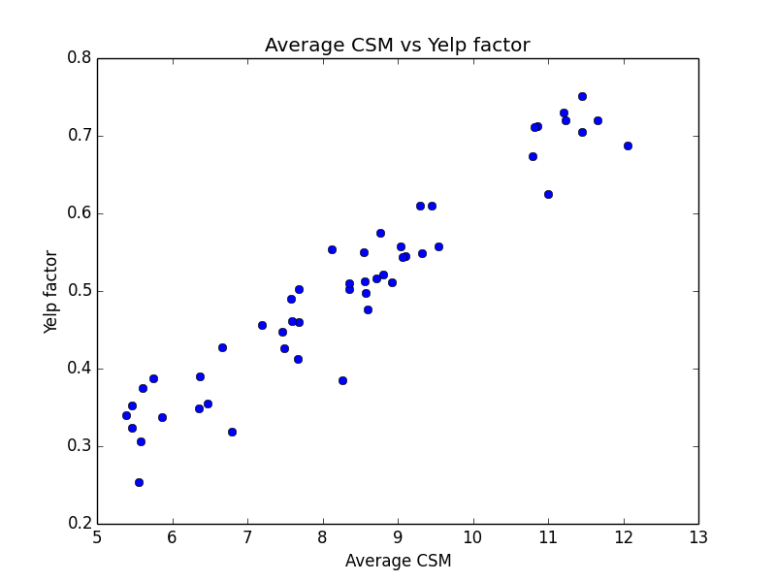
Below is a plot of CSM averaged over the month of November 2014 against Yelp factor for 50 restaurants in Portland. Each blue dot represents a restaurant.

Slide 5
What is the key ingredient that makes CSM a good metric? We know who in Portland is a vegetarian. It turns out that vegetarianism is rapidly becoming more popular (perhaps due to increasing awareness of the problem of unsustainable food production), and indeed, 25% of Portlandians are vegetarian today. This might not seem to be a big problem, but it turns out that vegetarians are twice as likely to post reviews on Yelp than meat-eaters, resulting in 40% of all Yelp reviews being written by vegetarians. This over-representation of vegetarians can be seen in the following effect. Let a restaurant's “veggie factor” be the proportion of that restaurant's menu items that are suitable for consumption by vegetarians. Then it turns out that veggie factor correlates with Yelp factor.

Slide 6
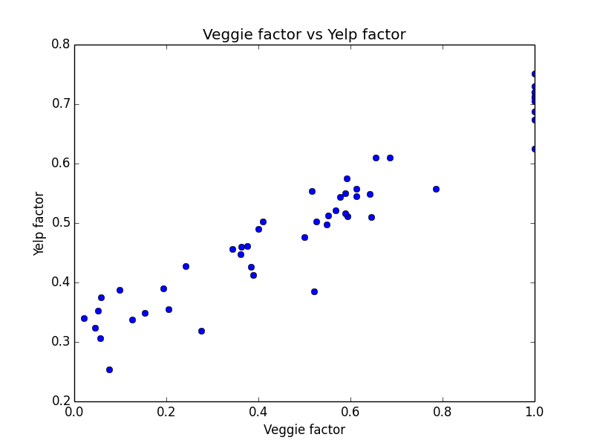
Below is a plot of veggie factor versus Yelp factor for 50 restaurants in Portland. Veggie factor of 1.0 means 100% of menu items are vegetarian.

Slide 7
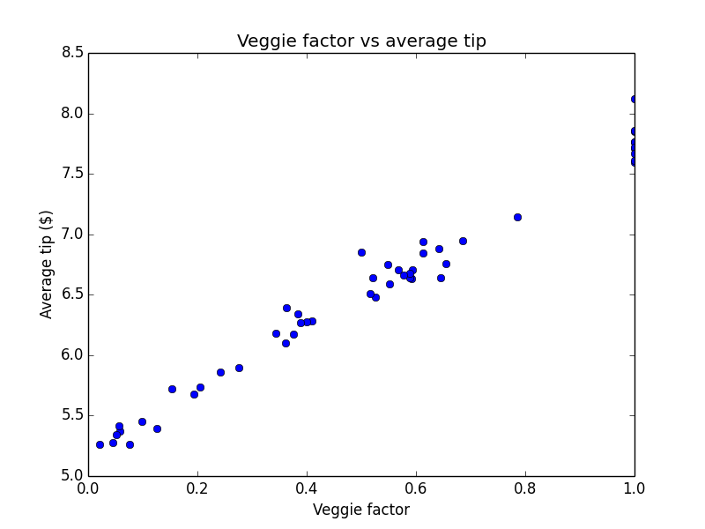
In addition, vegetarian customers leave a higher tip when a restaurant's veggie factor is higher, resulting in higher overall tips.

Slide 8
We incorporate all of these findings into CSM, which can be calculated on a day-to-day basis. The components of the CSM will tell you how you can improve your Yelp ratings. Identify and satisfy those pesky vegetarians before they ruin their business with their Yelp over-representation!

