Slide 1
ChatGPT Assignment 2
How to Guide

Slide 2
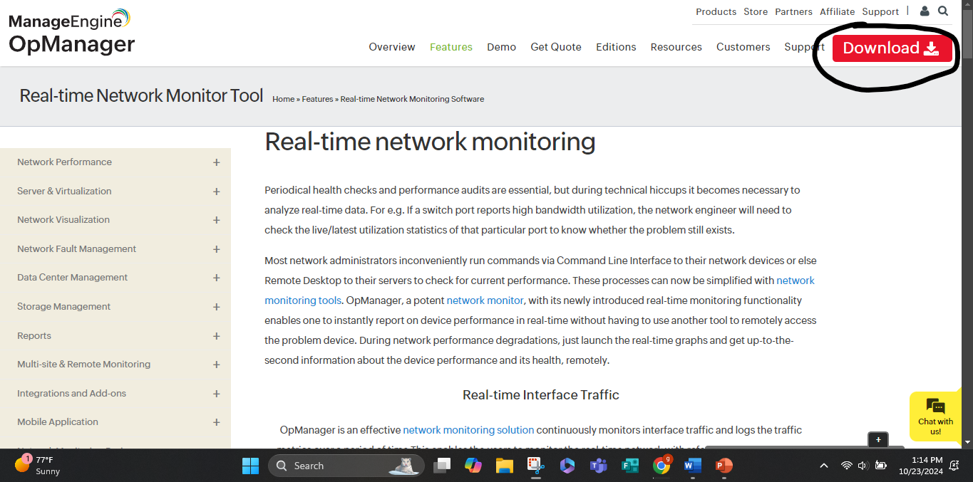
Download each software: OpManager

Slide 3
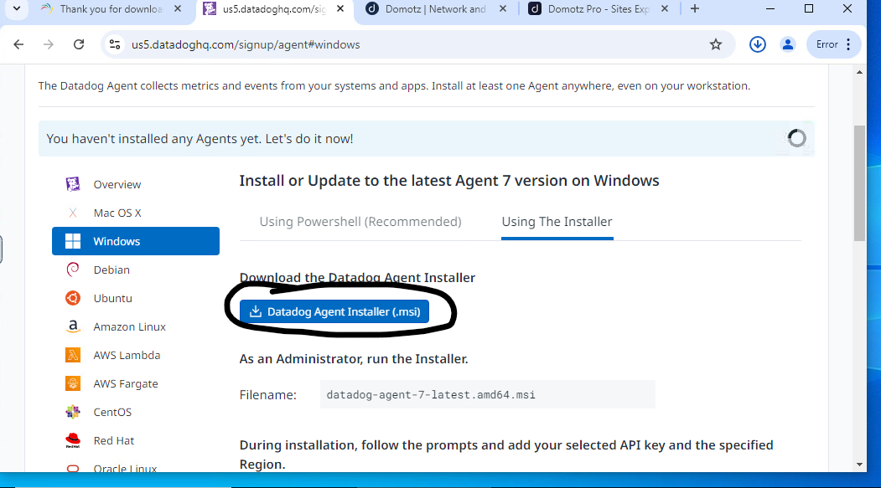
Download each software: DataDog

Slide 4
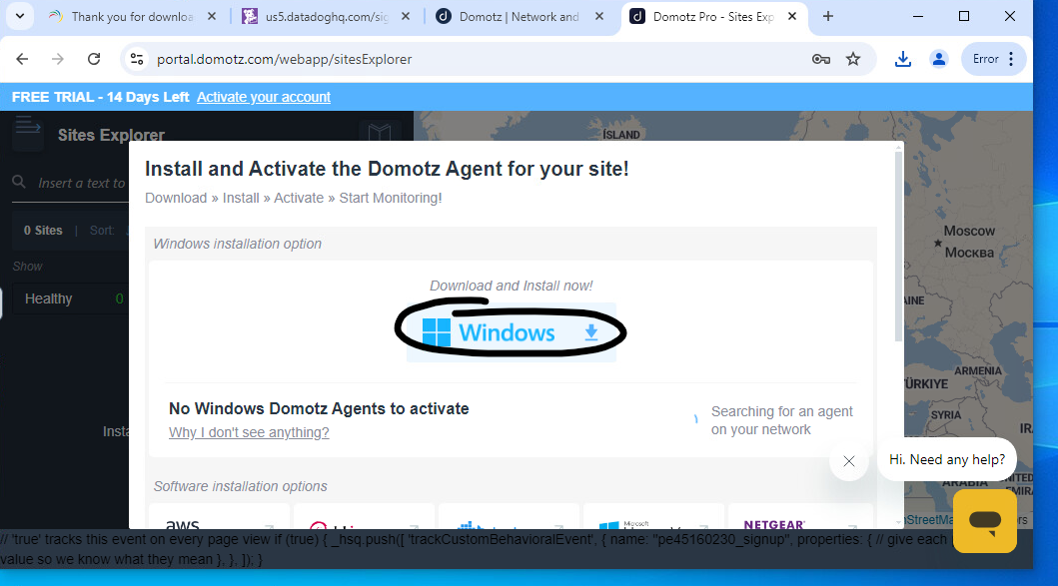
Download each software: Domotz

Slide 5
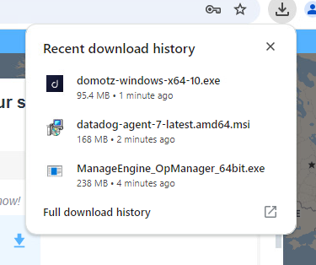
Run each software and scan your network

