Slide 1
Symbolic Computation using Big Data
Genesis Grant
CTEC 298

Slide 2
Table of Contents
Introduction
CTEC 128
CTEC 298
Data 1
Data 2
Data 3
Conclusion
References

Slide 3
Introduction
In this presentation I will discuss the topic of Structural Unemployment.
I will showcase supporting data that was wrangled using Excel (previously used in CTEC 128) as well as data visualizations prepared using Python libraries, Pandas and Matplotlib (used in CTEC 298).
I will explain reasoning behind my choice of these certain plots, walkthrough how I coded and highlight importance of these visualizations pertaining to structural unemployment.

Slide 4
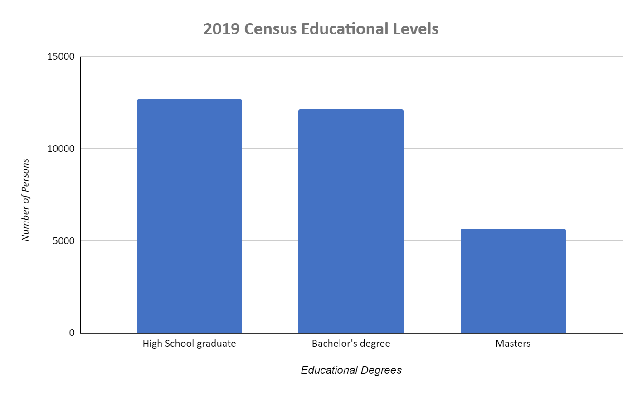
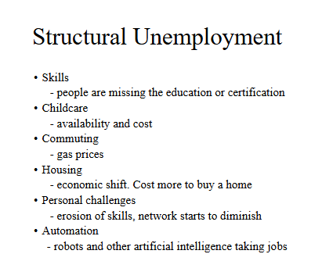
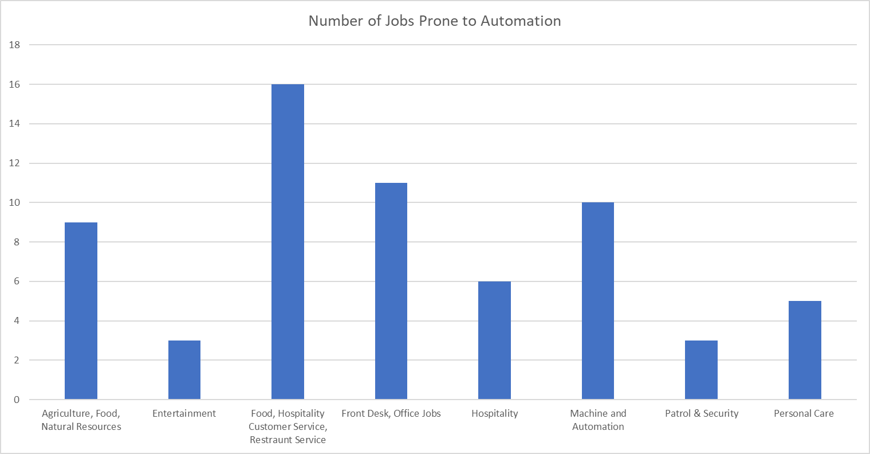
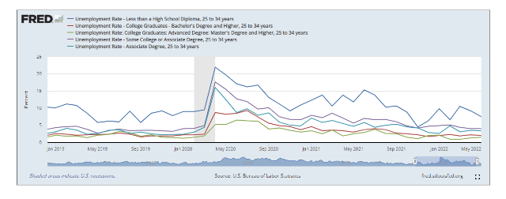
CTEC 128
Topic : Structural Unemployment
mismatch between the skills of the employee(s) and available jobs. People are not able to maintain their jobs based on their lack of skills, education and societal fluctuations.
Data wrangled using Excel
Data from U.S. Census Bureau & U.S. Bureau of Labor Statistics

Slide 5
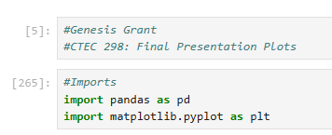
CTEC 298
Utilized same raw data sources
Pandas:
Data wrangle data
Store data into data frame
Matplotlib:
Visualize data wrangled data
Use data frame to structure visualizations

Slide 6
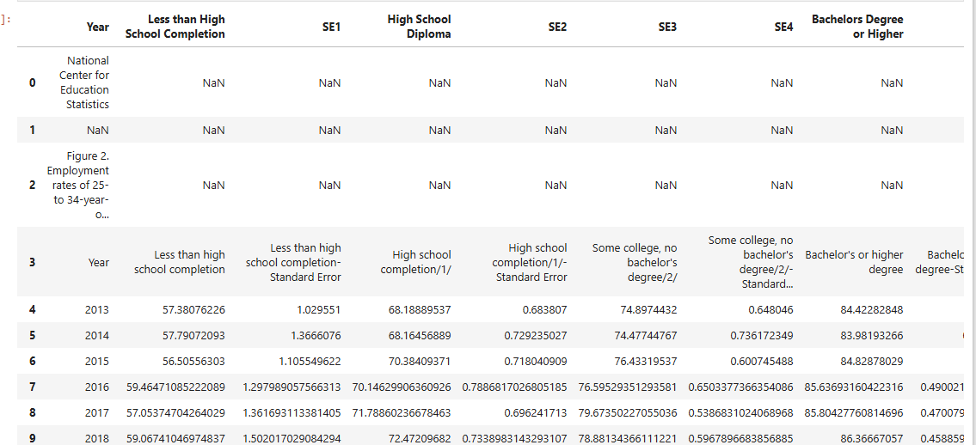
Data 1: Raw Data Bar Chart – Employment Based on Educational Attainment

Slide 7
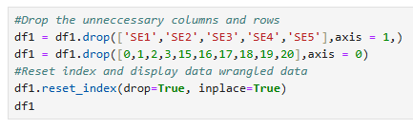
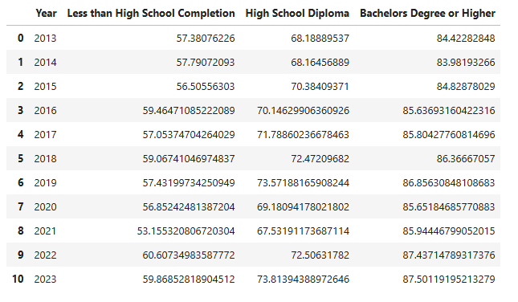
Data 1: Data Wrangling Process Bar Chart – Employment Based on Educational Attainment

Slide 8
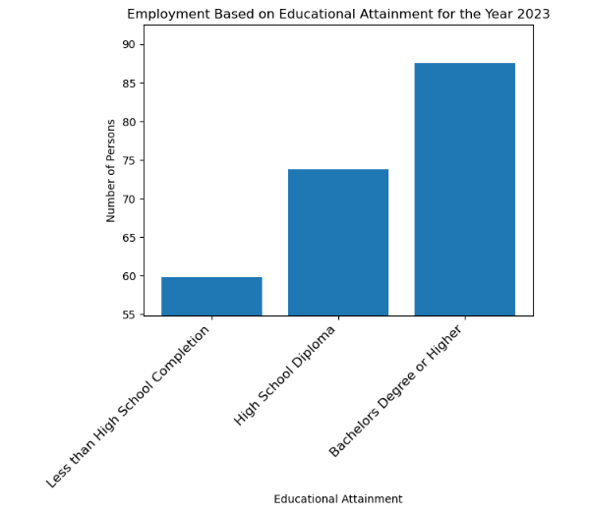
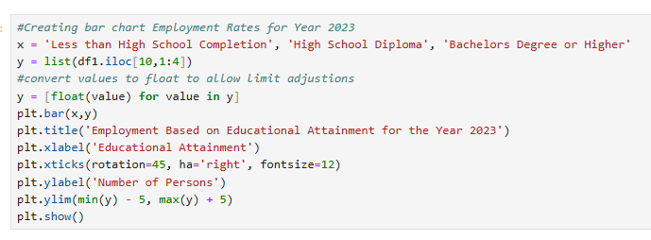
Data 1: Data Visualization Bar Chart – Employment Based on Educational Attainment

Slide 9

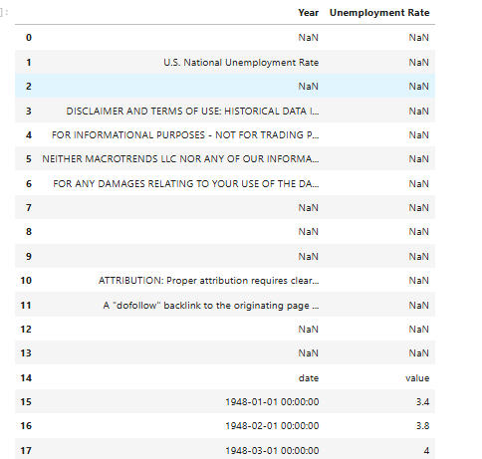
Data 2: Raw Data Line Graph – Unemployment Rates throughout Years

Slide 10
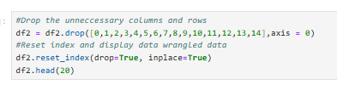
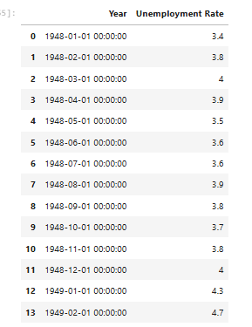
Data 2: Data Wrangling Process Line Graph – Unemployment Rates throughout Years

Slide 11
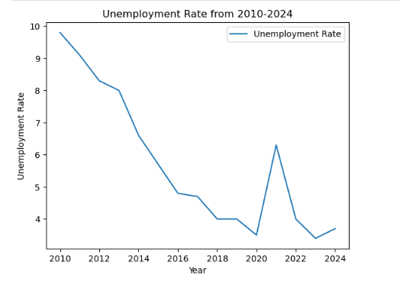
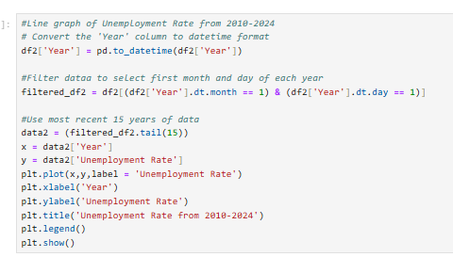
Data 2: Data Visualization Line Graph – Unemployment Rates throughout Years

Slide 12

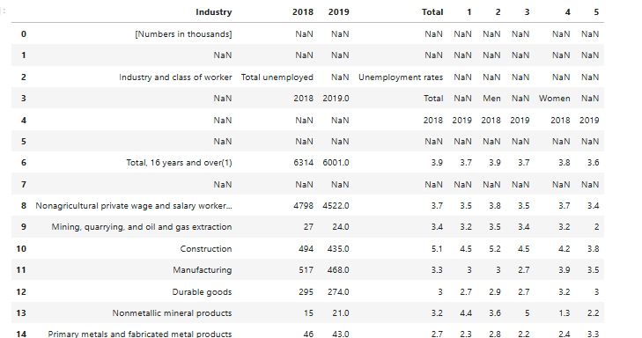
Data 3: Raw Data Bar Graph – Unemployment Based on Industry

Slide 13
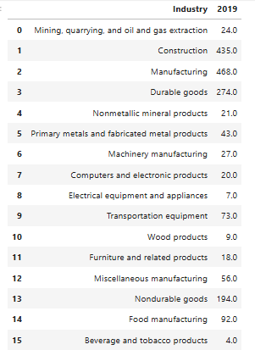
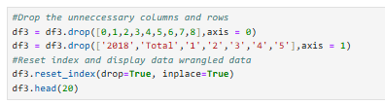
Data 3: Data Wrangling Process Bar Graph – Unemployment Based on Industry

Slide 14
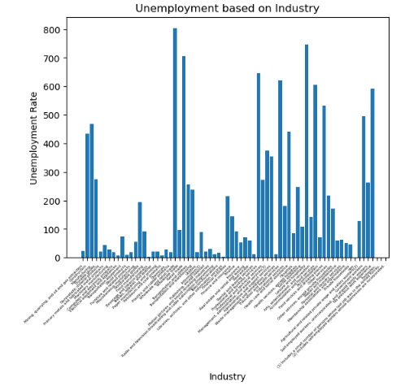
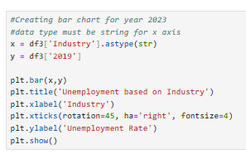
Data 3: Data Visualization Bar Graph – Unemployment Based on Industry

Slide 15
Conclusion
Enhanced skillset
Excel, Pandas, Matplotlib
Structural Unemployment Modern Factors:
Automation and Educational Attainment
As technology advances, the need for adaptive skills grows, as jobs that are easily automated or require minimal education are increasingly at risk of disappearing.
More awareness to STEM jobs; we will need people who are creating these automations and robots who do easier tasks and jobs.

Slide 16
References
Corporate Finance Institute (2021 February 15). Structural unemployment: The discrepancy between the skills of the unemployed population and the jobs available on the market. https://corporatefinanceinstitute.com/resources/knowledge/economics/structural-unemployment/
U.S Bureau of Labor Statistics (2022 January 20). Employed and unemployed full- and part-time workers by age, sex, race, and Hispanic or Latino ethnicity. https://www.bls.gov/cps/cpsaat08.htm
Federal Reserve Bank of St. Louis (2022 July 6). U.S. Bureau of Labor Statistics, Unemployment Rate - Some College or Associate Degree, 25 to 34 years [SCAD2534]. https://fred.stlouisfed.org/series/SCAD2534
National Center for Education Statistics. (2024). Employment and Unemployment Rates by Educational Attainment. Condition of Education. U.S. Department of Education, Institute of Education Sciences. https://nces.ed.gov/programs/coe/indicator/cbc.

