Slide 1

SLAM
Study:
ROS 및 SLAM Tutorial 입문기
Cheolweon Jang

Slide 2
SLAM
ROS-meiodic 환경에서 패키지 설치하기
$ sudo apt-get install ros-melodic-joy ros-melodic-teleop-twist-joy ros-melodic-teleop-twist-keyboard ros-melodic-laser-proc ros-melodic-rgbd-launch ros-melodic-depthimage-to-laserscan ros-melodic-rosserial-arduino ros-melodic-rosserial-python ros-melodic-rosserial-server ros-melodic-rosserial-client ros-melodic-rosserial-msgs ros-melodic-amcl ros-melodic-map-server ros-melodic-move-base ros-melodic-urdf ros-melodic-xacro ros-melodic-compressed-image-transport ros-melodic-rqt-image-view ros-melodic-gmapping ros-melodic-navigation
2

Slide 3
SLAM
현재 나의 환경 :
Ubuntu 18.04
ROS-melodic
CUDA setting : X
ROS-melodic 환경에서 패키지 설치하기
$ cd mkdir -p ~/catkin_ws/src
$ cd ~/catkin_ws/src/
$ git clone https://github.com/ROBOTIS-GIT/turtlebot3.git
$ git clone https://github.com/ROBOTIS-GIT/turtlebot3_msgs.git
$ git clone https://github.com/ROBOTIS-GIT/turtlebot3_simulations.git
$ cd ~/catkin_ws && catkin_make
3

Slide 4
SLAM
Gazebo 상에서 가상의 로봇을 구동
$ roscore
$ cd catkin_ws
$ source devel/setup.bash
$ export TURTLEBOT3_MODEL=waffle_pi
$ roslaunch turtlebot3_gazebo turtlebot3_world.launch
만약 실행 중 아래의 오류가 발생하면
[Err] [REST.cc:205] Error in REST request
Libcurl: (51) SSL : no alternative certificate subject name matches target host name ‘api.ignitionfuel.org’
gedit ~/.ignition/fuel/config.yaml
url: https://api.ignitionfuel.org ->
url: https://api.ignitionrobotics.org
로 수정
4

Slide 5
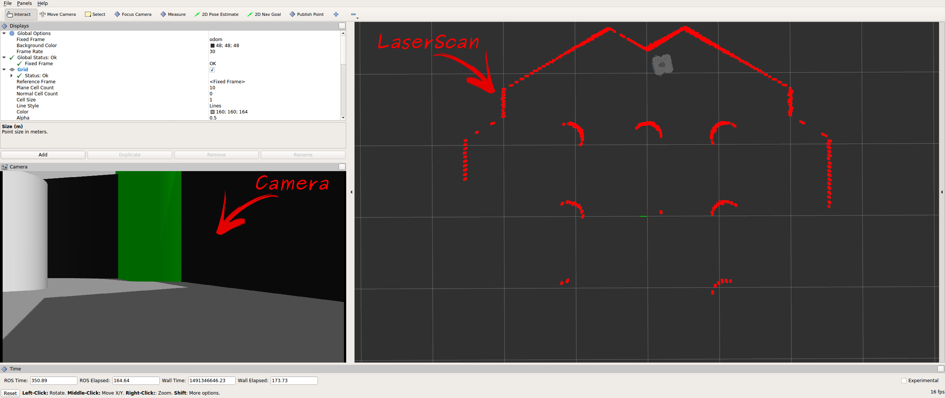
SLAM
Gazebo 상에서 가상의 로봇을 구동
$ cd catkin_ws
$ source devel/setup.bash
$ roslaunch turtlebot3_teleop turtlebot3_teleop_key.launch
$ cd catkin_ws
$ source devel/setup.bash
$ export TURTLEBOT3_MODEL=waffle_pi
$ roslaunch turtlebot3_gazebo turtlebot3_gazebo_rviz.launch
5

Slide 6
SLAM
Gazebo 상에서 SLAM 하기
Gazebo 실행
주의 ! 이전 과정을 모두 종료 후(roscore 포함) 시작할 것
$ cd catkin_ws
source devel/setup.bash
export TURTLEBOT3_MODEL=waffle_pi
roslaunch turtlebot3_gazebo turtlebot3_world.launch
SLAM 실행
$ cd catkin_ws
source devel/setup.bash
export TURTLEBOT3_MODEL=waffle_pi
roslaunch turtlebot3_slam turtlebot3_slam.launch slam_methods:=gmapping
터틀봇 원격 조종
$ cd catkin_ws
source devel/setup.bash
export TURTLEBOT3_MODEL=waffle_pi
roslaunch turtlebot3_teleop turtlebot3_teleop_key.launch
지도 출력
$ cd catkin_ws
$ source devel/setup.bash
$ rosrun map_server map_saver -f ~/map
6

Slide 7
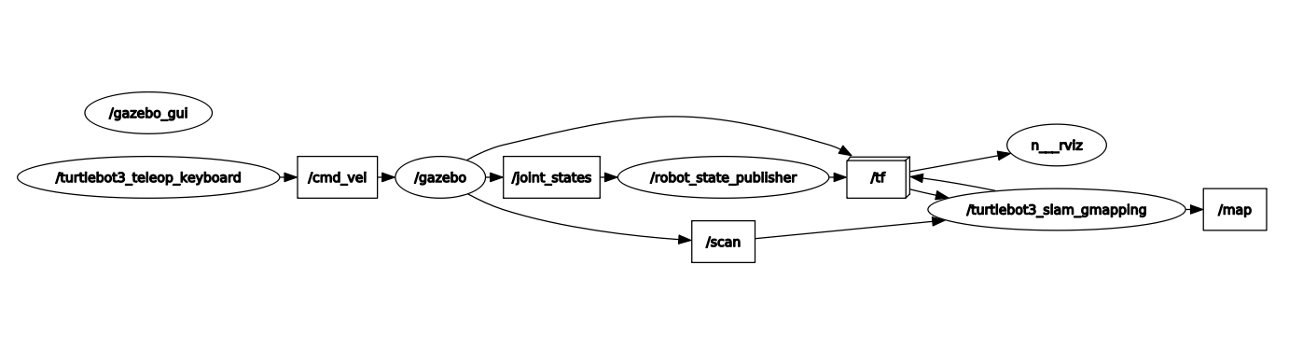
SLAM
rqt_graph
7

Slide 8
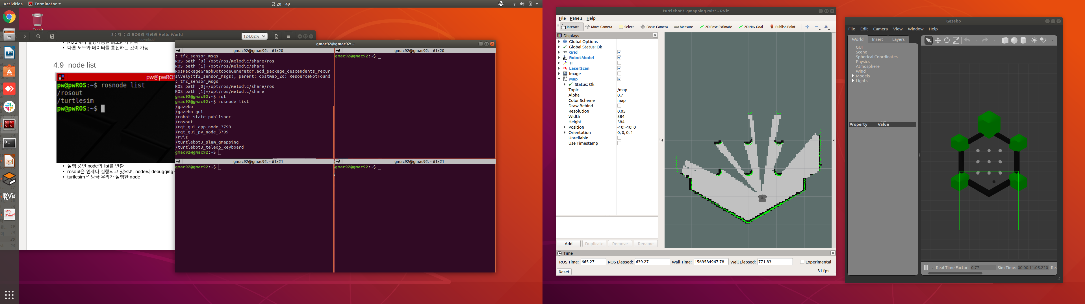
SLAM
rosnode list

Slide 9
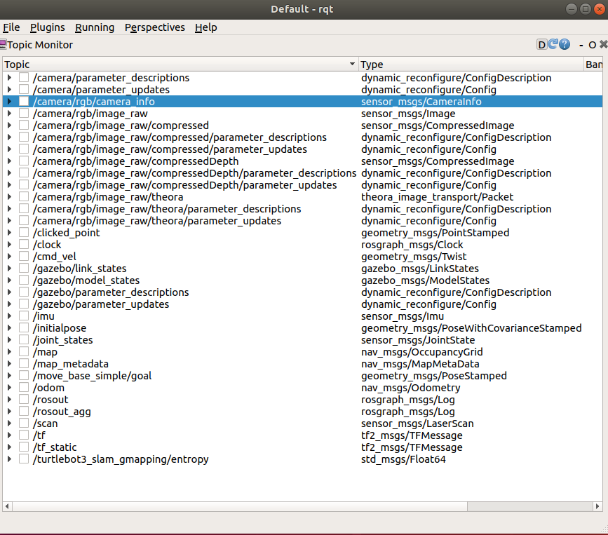
SLAM
Rqt -> Topic Monitor

Slide 10
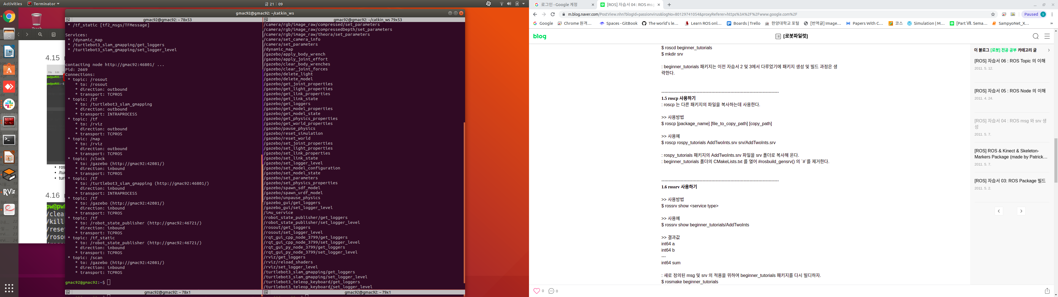
SLAM
rosservice list

Slide 11
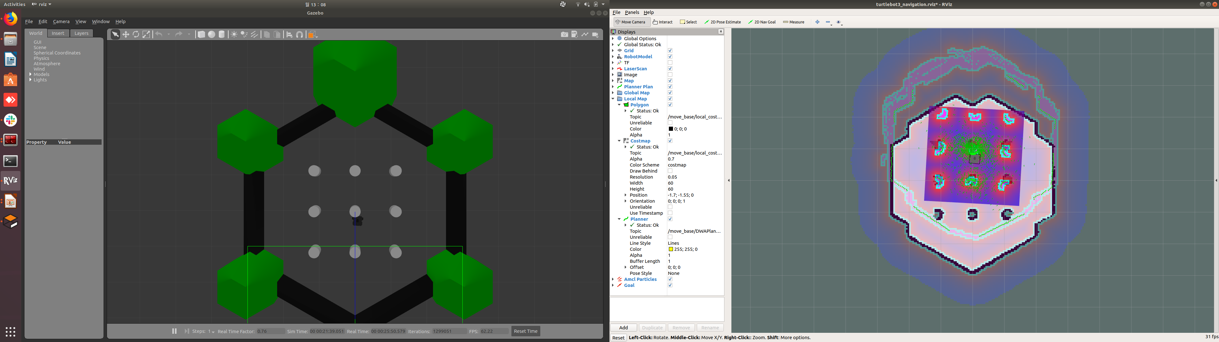
SLAM
Gazebo 상에서 Navigatinon 하기
Gazebo 실행
주의 ! 이전 과정을 모두 종료 후(roscore 포함) 시작할 것
$ cd catkin_ws
$ source devel/setup.bash
$ export TURTLEBOT3_MODEL=waffle_pi
$ roslaunch turtlebot3_gazebo turtlebot3_world.launch
$ cd catkin_ws
$ source devel/setup.bash
$ export TURTLEBOT3_MODEL=waffle_pi
$ roslaunch turtlebot3_navigation turtlebot3_navigation.launch map_file:=$HOME/map.yaml
11

