Slide 1



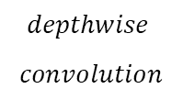



$$1×1 convolution$$
$$depthwise$$
$$convolution$$
$$pointwise convolution$$
Npar
$$gr_{int−N_{gr_{int}}}$$
Npar
Npar
$$N_{of}$$
$$N_{if}$$
Npar
Npar
$$gr_{int−0}$$
Npar
Input FM
Intermediate FM
Output FM

