Slide 1

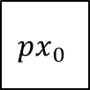

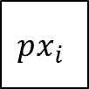

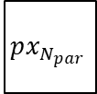
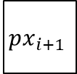

$N_{par}$ pixels
$$px_{0}$$
$$px_{i}$$
$$px_{i+1}$$
$$px_{N_{par}}$$
$$weight_{1}$$
val
pos
$N_{np}$ weight
Accumulator
$$weight_{N_{np}}$$
val
pos

Slide 2

Adder tree
ReLU 6
Multiplier array
Intermediate pixels
$$N_{par}×N_{kx}×N_{ky}$$
Depthwise weights

