Slide 1
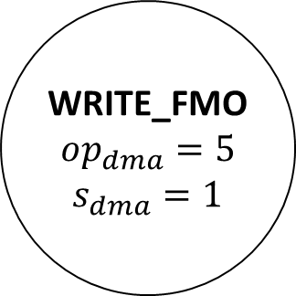



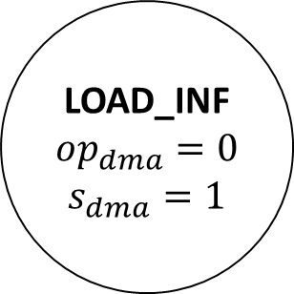


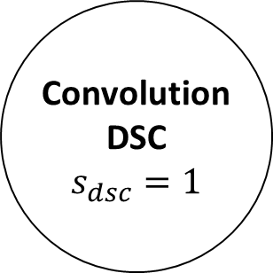
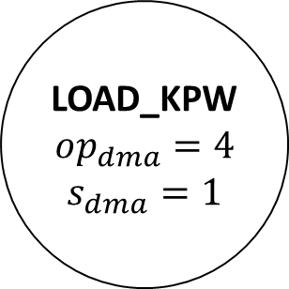


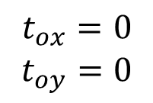



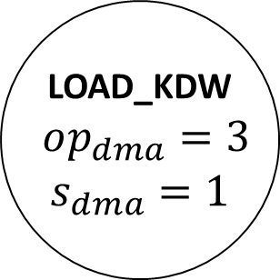
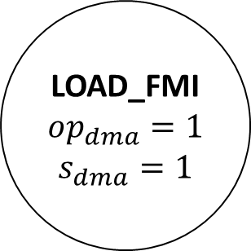

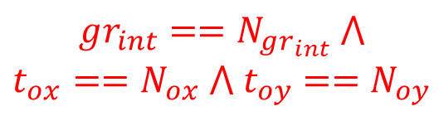
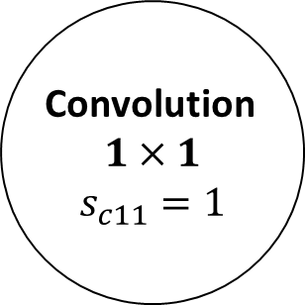





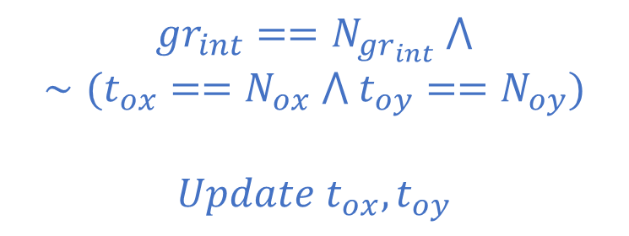
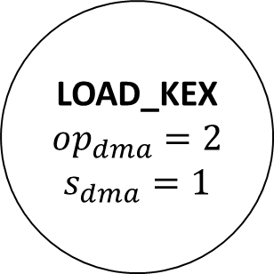
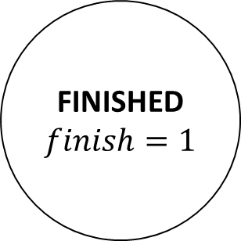



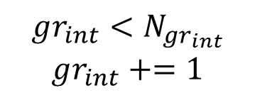
$$\overline{f_{dma}}$$
$$\overline{f_{dma}}$$
$$\overline{f_{dma}}$$
$$rst$$
$$\overline{start}$$
IDLE
$$t_{ox}=0$$
$$t_{oy}=0$$
LOAD_INF
$$op_{dma}=0$$
$$s_{dma}=1$$
LOAD_FMI
$$op_{dma}=1$$
$$s_{dma}=1$$
LOAD_KEX
$$op_{dma}=2$$
$$s_{dma}=1$$
$$start$$
$f_{dma}$
$f_{dma}$
$f_{dma}$
FINISHED
$$finish=1$$
$$gr_{int}==N_{gr_{int}} ⋀$$
$$∼(t_{ox}==N_{ox} ⋀ t_{oy}==N_{oy})$$
$$Update t_{ox}, t_{oy}$$
Convolution
$$1×1$$
$$s_{c11}=1$$
$$\overline{f_{c11}}$$
$$gr_{int}==N_{gr_{int}} ⋀$$
$$t_{ox}==N_{ox} ⋀ t_{oy}==N_{oy}$$
$$f_{c11}$$
$$gr_{int}=0$$
WRITE_FMO
$$op_{dma}=5$$
$$s_{dma}=1$$
Convolution
DSC
$$s_{dsc}=1$$
LOAD_KPW
$$op_{dma}=4$$
$$s_{dma}=1$$
LOAD_KDW
$$op_{dma}=3$$
$$s_{dma}=1$$
$$\overline{f_{dma}}$$
$$f_{dsc}$$
$f_{dma}$
$f_{dma}$
$$\overline{f_{dsc}}$$
$$\overline{f_{dma}}$$
$$\overline{f_{dma}}$$
$$gr_{int}<N_{gr_{int}}$$
$$gr_{int}+=1$$

Slide 2
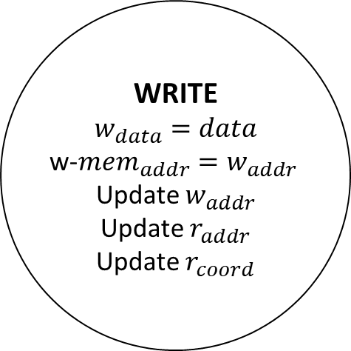





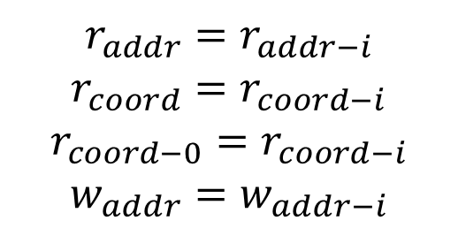

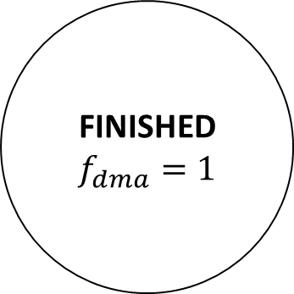
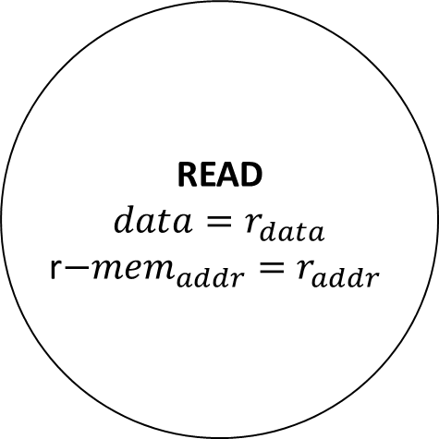

$$\overline{data−ready}$$
$$rst$$
$$\overline{s_{dma}}$$
$$r_{addr}=r_{addr−i}$$
$$r_{coord}=r_{coord−i}$$
$$r_{coord−0}=r_{coord−i}$$
$$w_{addr}=w_{addr−i}$$
READ
$$data=r_{data}$$
r$−mem_{addr}=r_{addr}$
IDLE
$$s_{dma}$$
$$r_{coord}<r_{coord−0}+Tile_{size}$$
$$data−ready$$
WRITE
$$w_{data}=data$$
w-$mem_{addr}=w_{addr}$
Update $w_{addr}$
Update $r_{addr}$
Update $r_{coord}$
FINISHED
$$f_{dma}=1$$
$$r_{coord}==r_{coord−0}+Tile_{size}$$

Slide 3

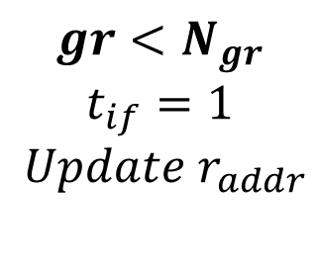
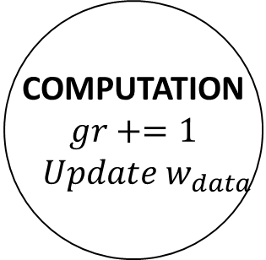

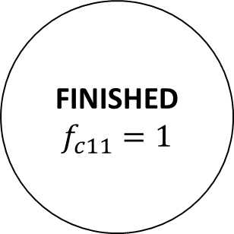

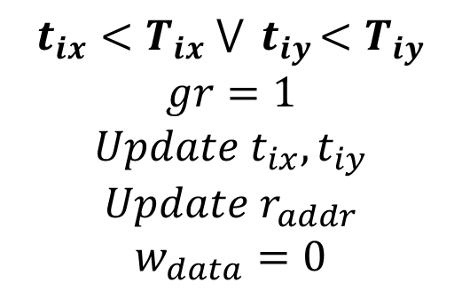
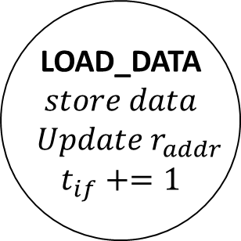



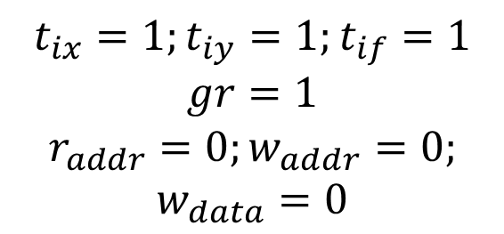

$$t_{ix}=1;t_{iy}=1;t_{if}=1$$
$$gr=1$$
$$r_{addr}=0;w_{addr}=0;$$
$$w_{data}=0$$
$$t_{if}<N_{par}$$
$$rst$$
$$\overline{s_{c11}}$$
IDLE
LOAD_DATA
$$store data$$
$$Update r_{addr}$$
$$t_{if}+=1$$
$$s_{c11}$$
$$t_{ix}<T_{ix} ⋁{ t}_{iy}<T_{iy}$$
$$gr=1$$
$$Update t_{ix}, t_{iy}$$
$$Update r_{addr}$$
$$w_{data}=0$$
$$gr<N_{gr}$$
$$t_{if}=1$$
$$Update r_{addr}$$
$$t_{if}==N_{par}$$
FINISHED
$$f_{c11}=1$$
WRITE
$$Update w_{addr}$$
$$write w_{data}$$
COMPUTATION
$$gr+=1$$
$$Update w_{data}$$
$$t_{ix}==T_{ix} ⋀{ t}_{iy}==T_{iy}$$
$$gr==N_{gr}$$

Slide 4
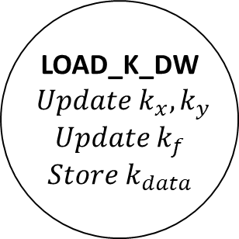
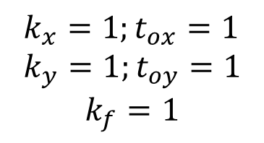



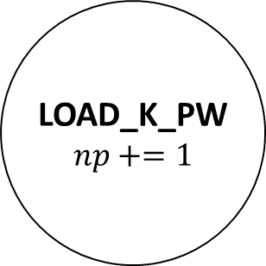
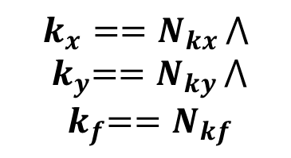
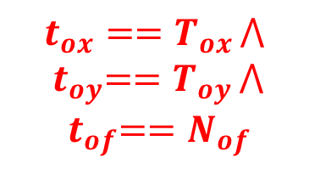

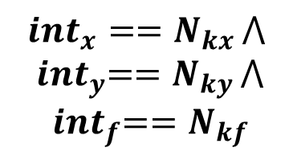

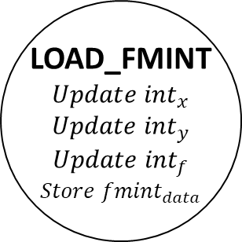

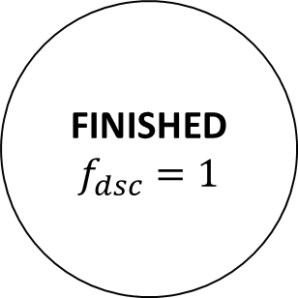


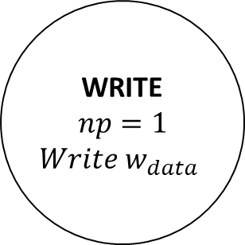


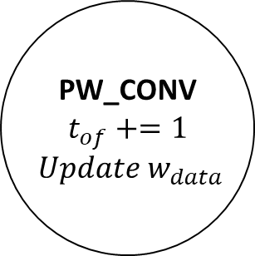
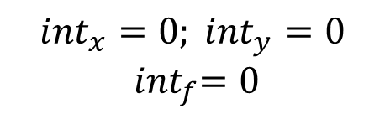
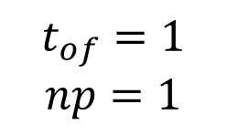
$$\overline{s_{dsc}}$$
$$k_{x}<N_{kx }⋁{ k}_{y}<N_{ky }⋁{ k}_{f}<N_{par}$$
$${int}_{x}<N_{kx }⋁{ int}_{y}<N_{ky }⋁{ int}_{f}<N_{par}$$
$$rst$$
IDLE
$$k_{x}=1;t_{ox}=1 \\ k_{y}=1;t_{oy}=1$$
$$k_{f}=1$$
LOAD_K_DW
$$Update k_{x}, k_{y}$$
$$Update k_{f}$$
$$Store k_{data}$$
LOAD_FMINT
$$Update {int}_{x}$$
$$Update {int}_{y}$$
$$Update {int}_{f}$$
$$Store {fmint}_{data}$$
$${int}_{x}==N_{kx }⋀ \\ { int}_{y}==N_{ky }⋀$$
$${ int}_{f}==N_{kf}$$
$${int}_{x}=0; {int}_{y}=0$$
$${ int}_{f}=0$$
$$s_{dsc}$$
$$k_{x}==N_{kx }⋀ \\ { k}_{y}==N_{ky }⋀$$
$${ k}_{f}==N_{kf}$$
DW_CONV_MUL
FINISHED
$$f_{dsc}=1$$
$$(t_{ox}<T_{ox }⋁{ t}_{oy}<T_{oy }) ⋀$$
$${ t}_{of}==N_{of}$$
$$Update t_{ox}, t_{oy},$$
$${int}_{x}=0; {int}_{y}=0$$
$${ int}_{f}=0$$
DW_CONV_ADD
$$t_{ox}==T_{ox }⋀ \\ { t}_{oy}==T_{oy }⋀$$
$${ t}_{of}==N_{of}$$
$$np<N_{np}$$
WRITE
$$np=1$$
$Write w_{data}$
PW_CONV
$$t_{of}+=1$$
$$Update w_{data}$$
LOAD_K_PW
$$np+=1$$
$$np==N_{np}$$
$$t_{of}=1$$
$$np=1$$
$$w_{data}=fmo_{data}$$
$${ t}_{of}<N_{of}$$

