Slide 1
Crowd counting
A model for monitoring people in public places

Slide 2
Our approach
We used a CNN based approach since Convolutional Neural Networks are reliable and we can create end-to-end regression models.
CSRNet or Congested Scene Recognition Network model was generated with 22 forward propagation layers and 11 backward propagation layers.
It was chosen because it generates density maps with the same dimensions as the original image unlike other methods that typically generate density maps 1/4th the size of original image.
VGG-16 (Visual Geometry group) or OxfordNet is used by CSRNet because of its strong transfer learning ability.

Slide 3
Our approach
In a nutshell, we first generated the density maps for all train as well as test images. (Density maps were created for test images to cross check the Mean Absolute Error, MAE.)
The model was trained on the density maps of the train images dataset.
Further, we used these trained weights to create density maps of the test images.
Then, we checked the difference between the original count of people versus the count of people obtained from the trained model.

Slide 4
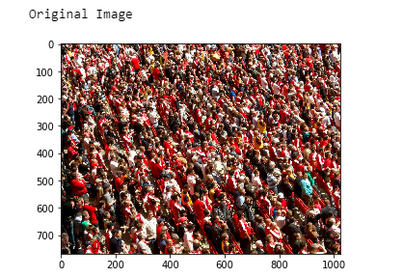
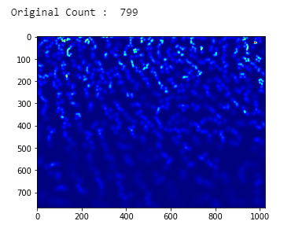
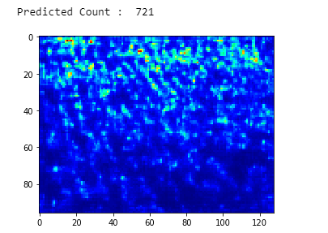
Inferences drawn from the experiment
As we can observe from the below images, the accuracy rate for densely populated images is high. (The accuracy is 0.90 for the below set of images.)
Overall, the total MAE was found to be 75.69 for the 182 images in our test dataset.

Slide 5
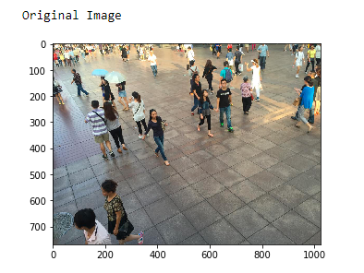
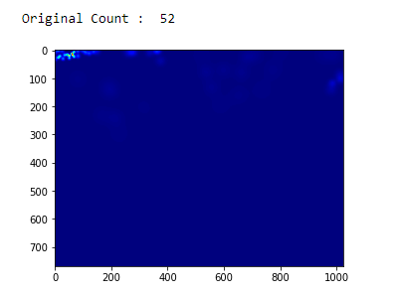
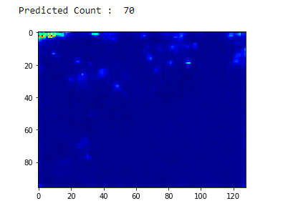
Inferences drawn from the experiment
When a sparsely populated image was passed through the model, the accuracy was dramatically decreased.
Only was 0.70 accuracy rate was achieved.

Slide 6
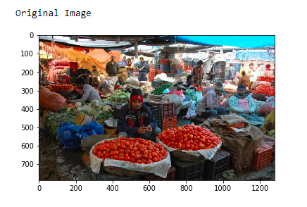
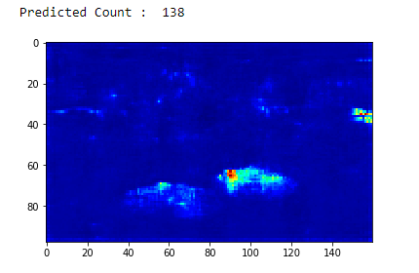
Real life examples
The previous images were still from the cumulated dataset made available by ShanghaiTech.
When the model that was trained on densely populated image was applied to real world images, the results degraded further.

Slide 7
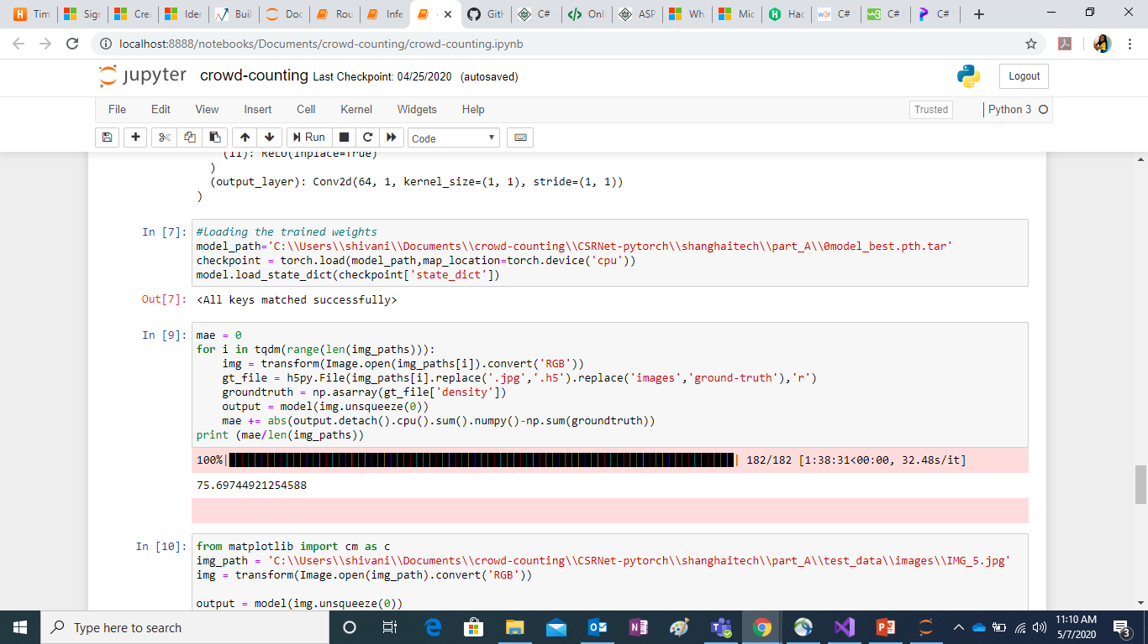
Working a way around CUDA dependencies
Due to limitations of system capabilities, installing CUDA and its integration with PyTorch was not possible.
So we used the parameters provided by PyTorch to assign the device CPU as the map_location, since GPU wasn’t configured.
We can only use CUDA when a model is trained as well as loaded on a GPU.

Slide 8
Future work
We can fine tune the model by training it on sparsely populated images that correspond to real life instances with actual obstacles.
This can be used as crowd control tech for public places making it easier to regulate the number of people allowed in a fixed area of land.

Slide 9
References
https://www.kaggle.com/bombatkarvivek/shanghaitech Dataset for dense and sparse crowds
https://www.analyticsvidhya.com/blog/2019/02/building-crowd-counting-model-python/
https://github.com/leeyeehoo/CSRNet-pytorch.git
https://medium.com/@2017csm1006/forward-and-backpropagation-in-convolutional-neural-network-4dfa96d7b37e
https://github.com/pytorch/pytorch#installation Tensors and Dynamic neural networks in Python with strong GPU acceleration

