Slide 1

GeoFare
A GIS-Based Habal-Habal Fare Computation and Management System Using Road-Network Distance in Manolo Fortich, Bukidnon
Auggie John Fred G. Manginsay
Rian S. Cat-awan
Weniel A. Raña
Bachelor of Science in Information Technology
Adviser: Cristine Joy G. Sagaosao
July 2026

Slide 2

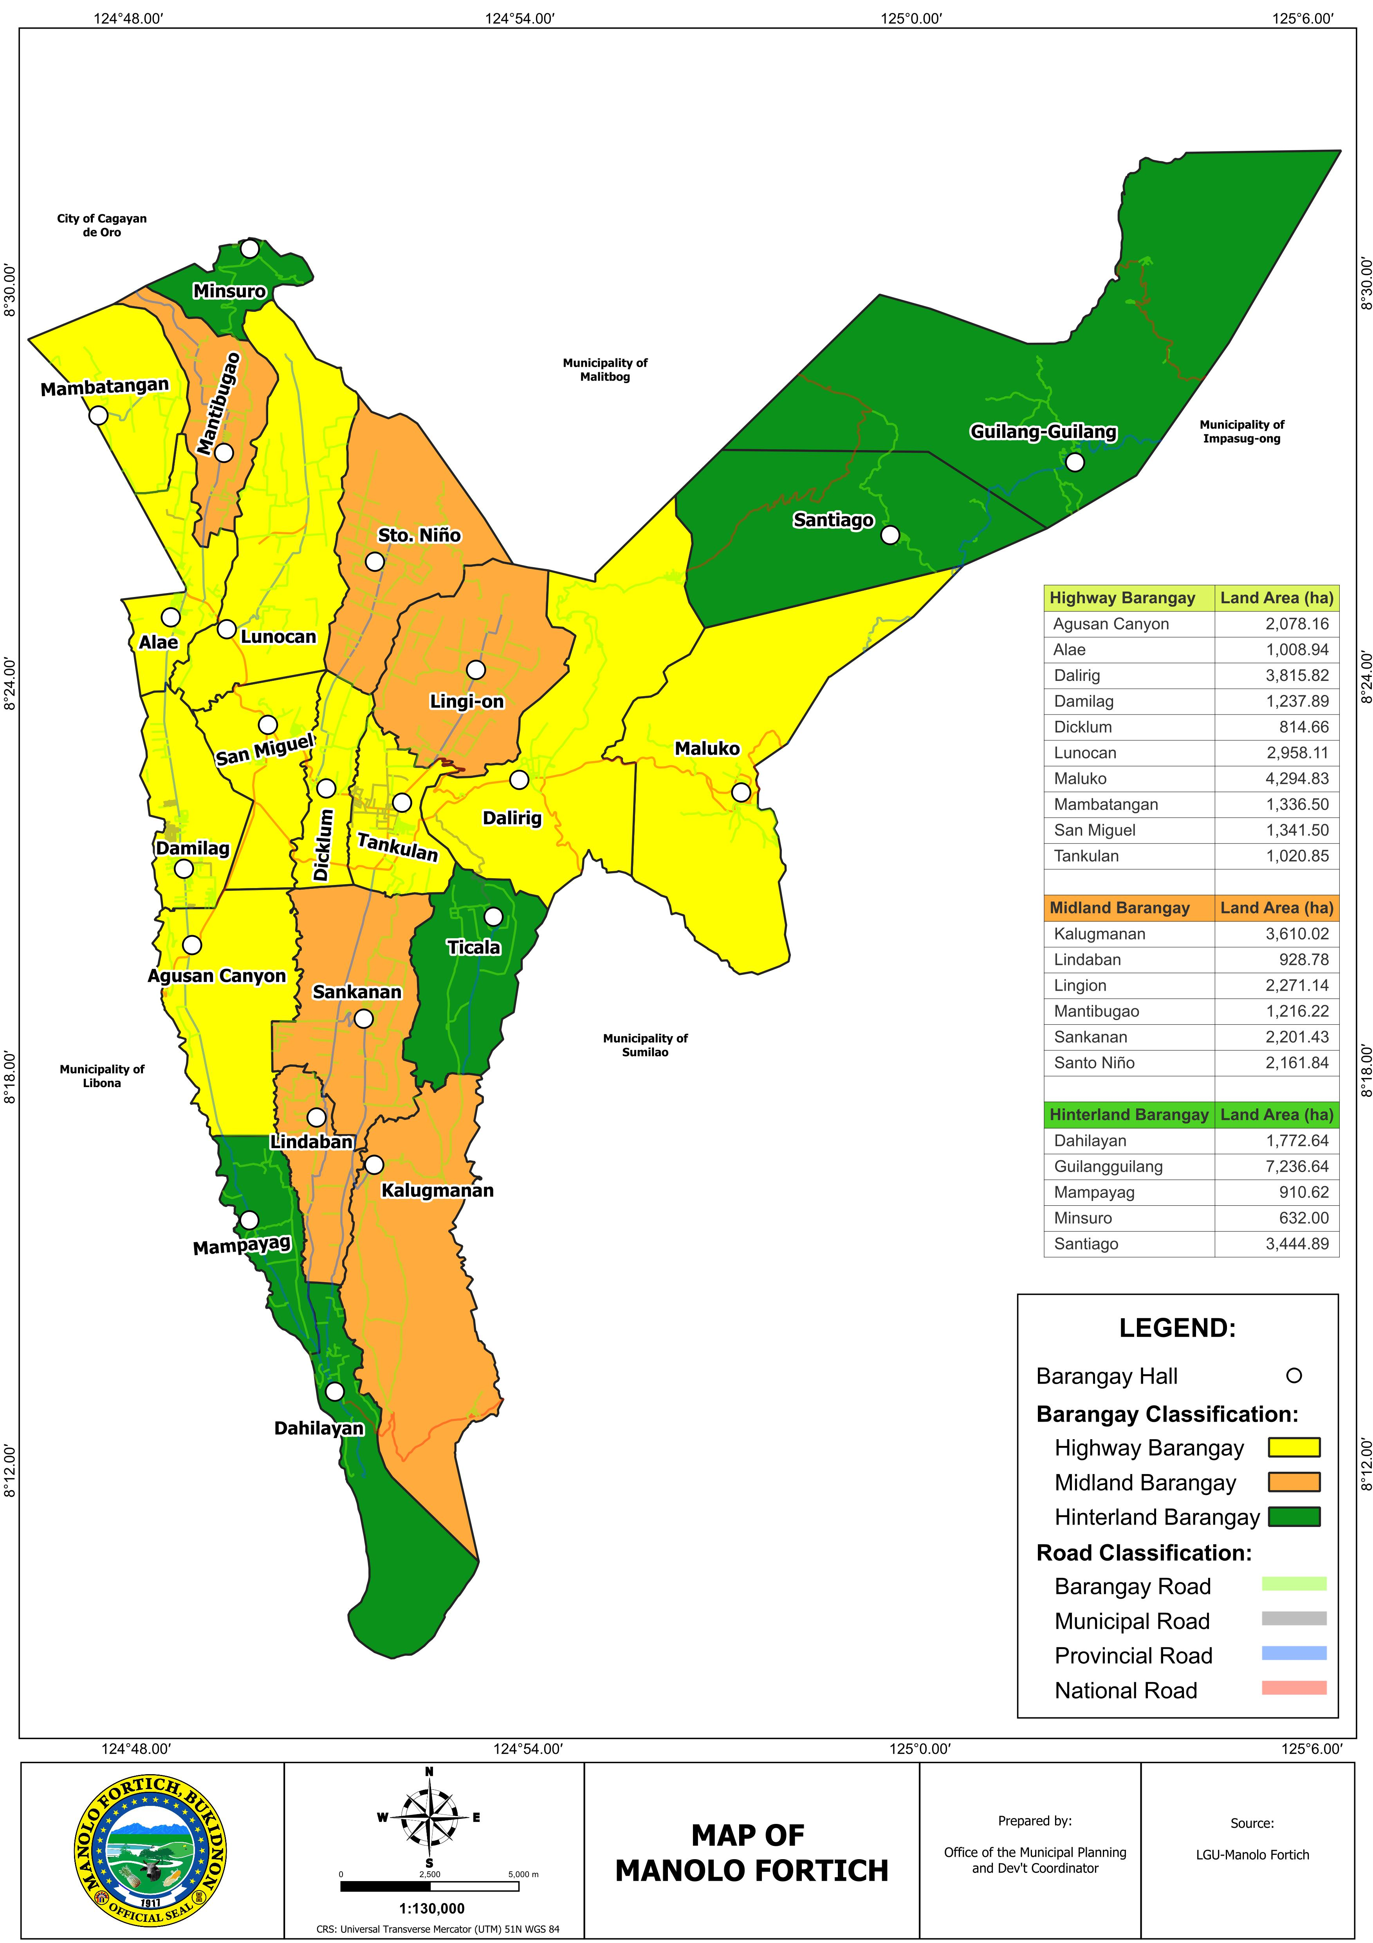
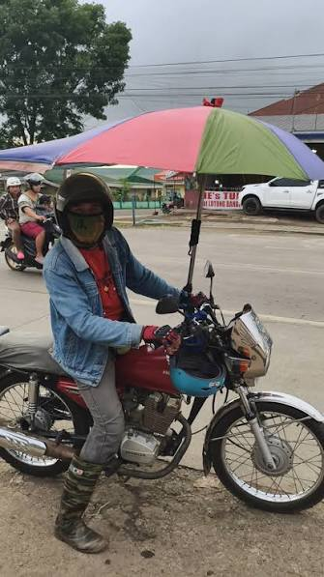

INTRODUCTION
Habal-habal is a primary mode of transportation in remote barangays of Manolo Fortich, Bukidnon (Sumilhig et al., 2021).
Existing local transportation systems lack GPS integration, mapping capabilities, and automated fare computation (Nailes & Lagmay, 2020; Tica-a et al., 2025).
The absence of a standardized digital fare computation system may lead to inconsistent fare determination and fare disputes (Sumilhig et al., 2021; Nesnia, 2026).

Slide 3
STATEMENT OF THE PROBLEM
Identified Problems
1. How can a GIS-based fare computation system be developed for habal-habal services?
2. How can fare computation be automated using road-network distance and the LGU-approved fare matrix?
3. How can the system provide a centralized fare management module for administrators?
4. How usable is the GeoFare system based on the System Usability Scale (SUS)?

Slide 4
OBJECTIVES OF THE STUDY
Design and develop a GIS-based habal-habal fare computation and management system using OpenStreetMap road-network data and the LGU-approved fare matrix to automate fare computation and route visualization.
Implement a centralized fare management module that securely manages fare information and supports accurate, transparent, and efficient fare computation.
Evaluate the developed GeoFare system in terms of functionality, accuracy, performance, and usability using the System Usability Scale (SUS).

Slide 5
SCOPE AND LIMITATION
Scope
Covers Tankulan, San Miguel, and Dicklum, Manolo Fortich.
Supports pickup and drop-off point selection with route visualization.
Uses OpenStreetMap and the LGU-approved fare matrix for automated fare computation.
Limitation
No real-time GPS tracking or Habal-habal Ally rider queueing functionality.
Depends on OpenStreetMap data and internet connectivity.

Slide 6
SIGNIFICANCE OF THE STUDY
Commuters: Accurate and transparent fare computation.
Habal-Habal Riders: Standardized fare computation.
Local Government Unit (LGU) / MFRTA: Supports fare administration, monitoring, and implementation of the approved fare matrix through a digital management platform.
Future Researchers: Reference for GIS-based transportation systems.

Slide 7
REVIEW OF RELATED LITERATURE AND STUDIES
Local Studies
Existing systems such as Transmobil Ally, TRIGO, PAYSADA, and studies by Sumilhig et al. demonstrate the continued reliance on manual fare estimation and limited GIS integration in informal transportation.
International Studies
Research by Dardas et al. (2022), Felício et al. (2022), Gungor et al. (2025), and Wang et al. (2024) confirms that GIS-based road-network analysis improves routing accuracy, transportation efficiency, and fare transparency.

Slide 8
TYPE OF RESEARCH DESIGN
Developmental Research
Focuses on the systematic design, development, and evaluation of the GeoFare system.
Quantitative Research
Utilizes statistical analysis of respondents' usability evaluations through the System Usability Scale (SUS).
Together, these research designs combine practical software development with measurable usability evaluation.

Slide 9
RESEARCH DESIGN APPROACH
Agile Software Development Methodology
Uses an iterative and incremental development approach.
Guides the development of the GeoFare system.
Covers the first three phases:
Requirements Analysis
Planning
Design

Slide 10
EXPECTED OUTPUT
Features include:
Interactive Leaflet.js map
Pickup and drop-off location selection
Automated fare computation using road-network distance
Route visualization
Accurate and transparent fare verification

Slide 11
REFERENCES
Brooke, J. (1996). System Usability Scale (SUS).
Richey, R. C. (1994). Developmental Research.
Felício, P., et al. (2022).
Dardas, A., et al. (2022).
Wang, Y., et al. (2024).
Sumilhig, J., et al. (2021).
Complete references are available in the manuscript.

Slide 12
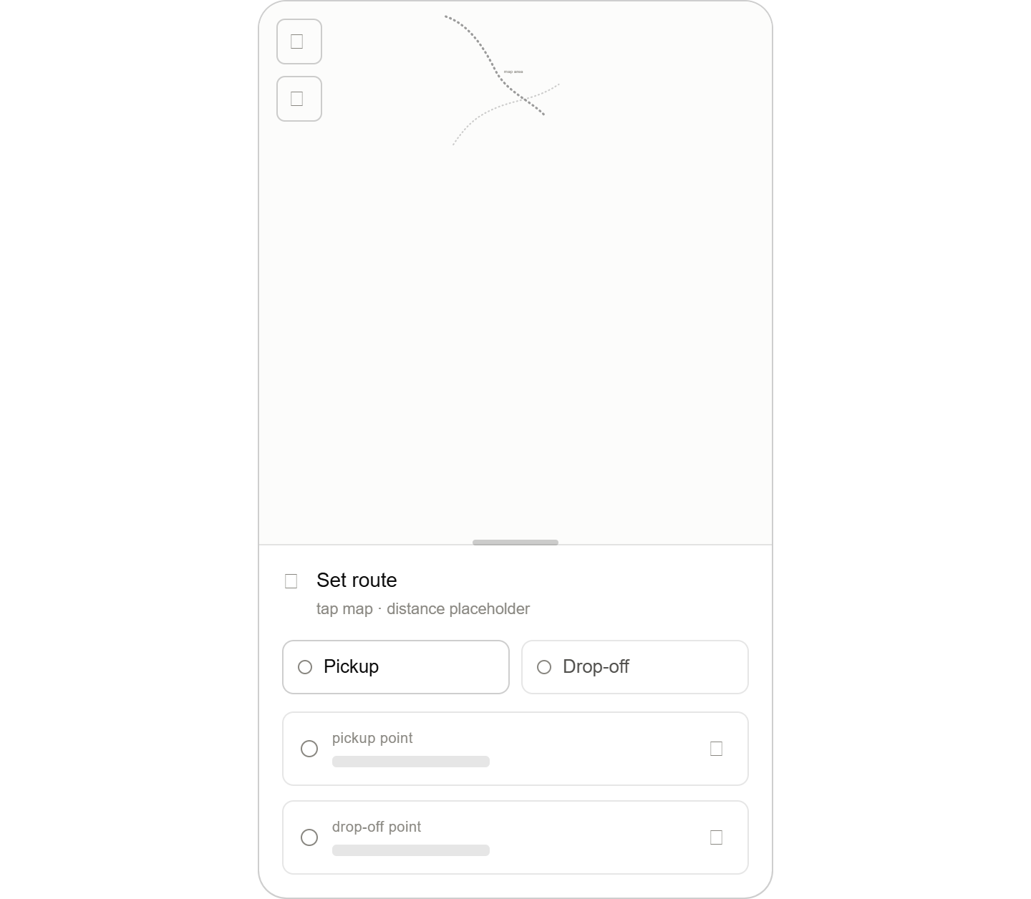
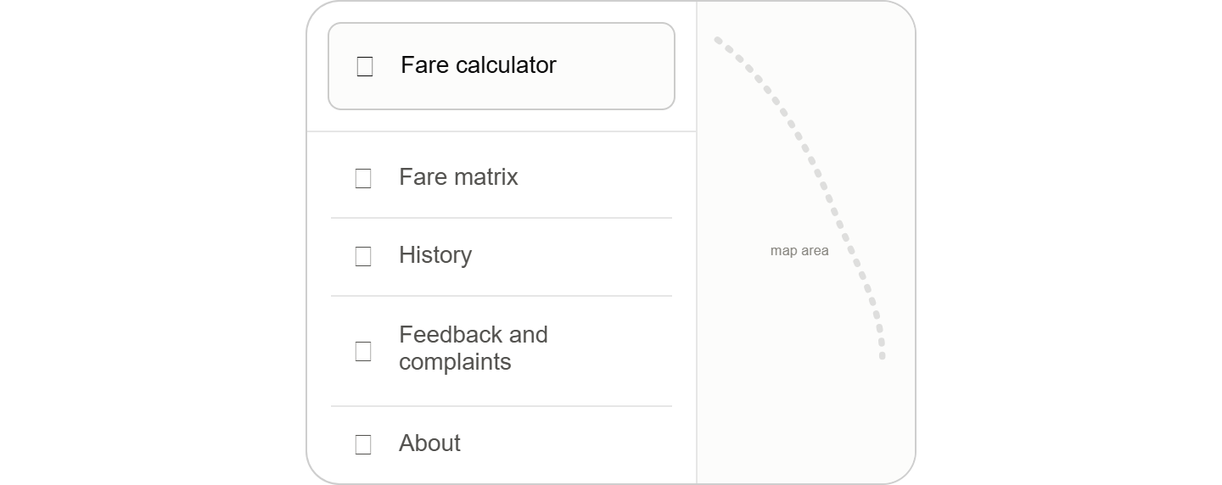
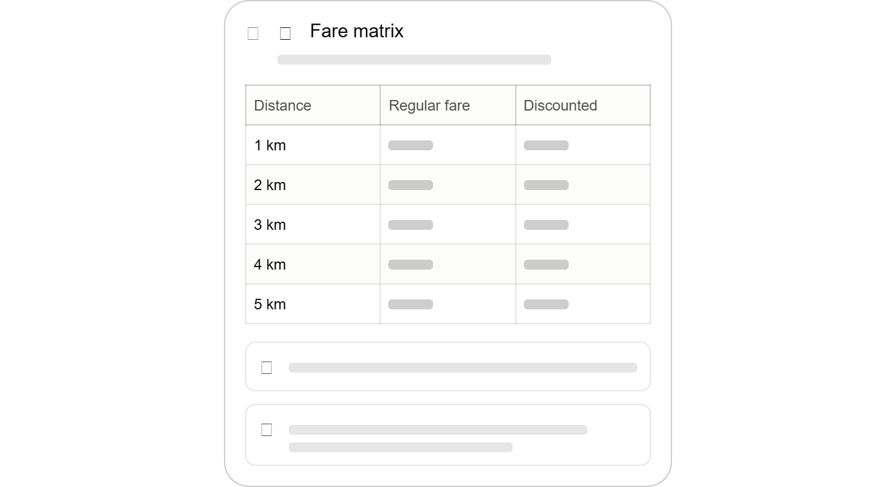
WIREFRAME
The wireframe presents the proposed layout and navigation flow of the GeoFare system before implementation. It serves as a visual blueprint that illustrates the arrangement of user interface elements, including fare computation, route visualization, and administrative functions, ensuring an intuitive user experience and proper system functionality prior to development.

Slide 13
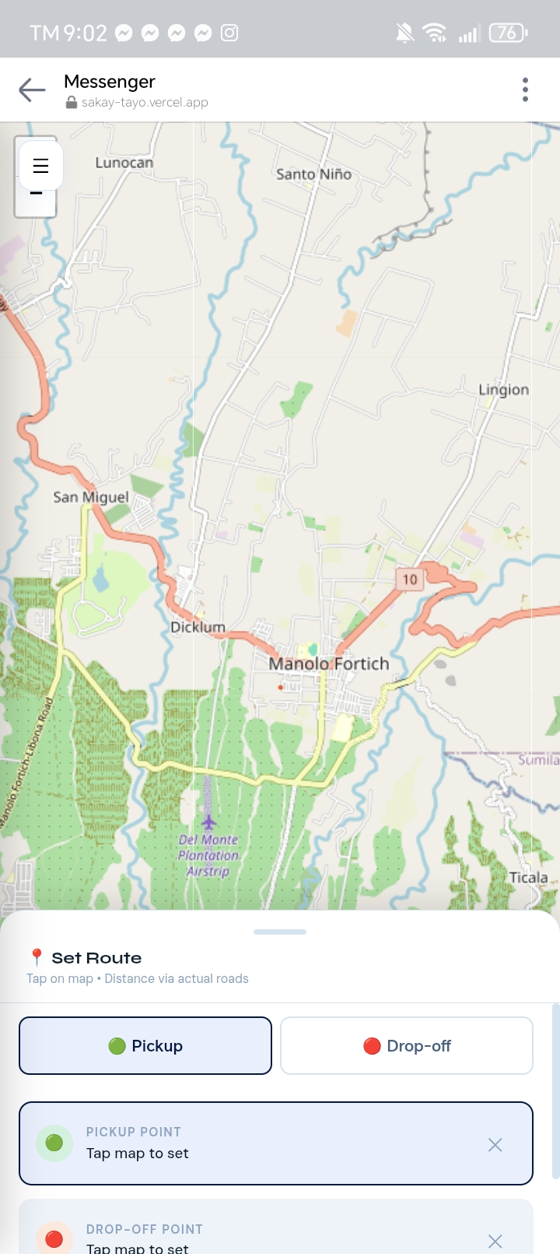
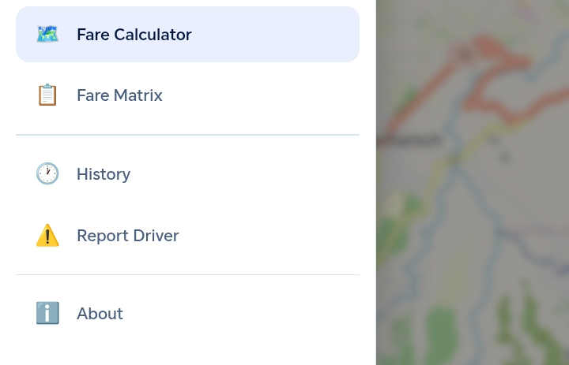
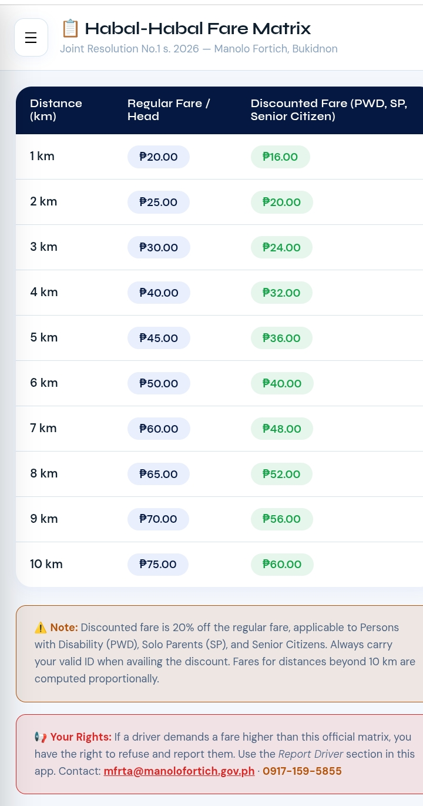
EXPECTED OUTPUT (PROTOTYPE)
GeoFare UI

Slide 14
QUESTION AND ANSWER
Thank you!
We are ready to answer your questions.

