Slide 1
Abstract
San Francisco publishes its restaurant health inspection data in monthly basis. This data set covers the past three years. Based on the violation history, we should be able to tell the future performance of a restaurant.
The 3 year period was segmented into 6 different ones, and the latest 6 months were used as target. That is, if a restaurant has one or more violations during the period, it is labeled as “True”.
This predictor is able to tell if a restaurant will pass or fail the health inspection in the next 6 months with 71.2% accuracy.

Slide 2
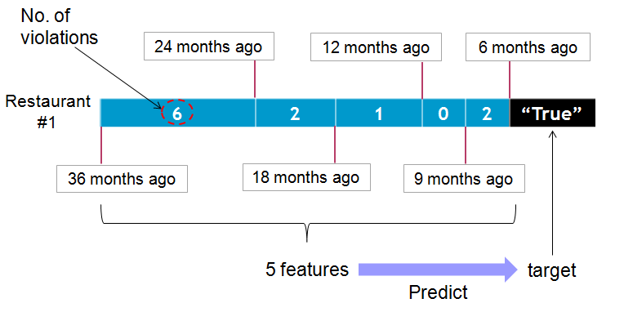
How does the predictor work?
Data: SF city health inspection (past 3 years)
The objective of data cleaning was to get the data in the following form.

Slide 3
Features considered
5 periods assigned: 7-9,10-12, 13-15, 16-24, 25-36 month ago
Zip codes
Yelp customer ratings
Yelp food price
Business geo coords
Business turnover rates
Years of restaurant in business
Sources:
Yelp ratings and prices: Web-scraping
Business geo coords: geopy
Business turnover rates and years in business: another dataset from SF city

Slide 4
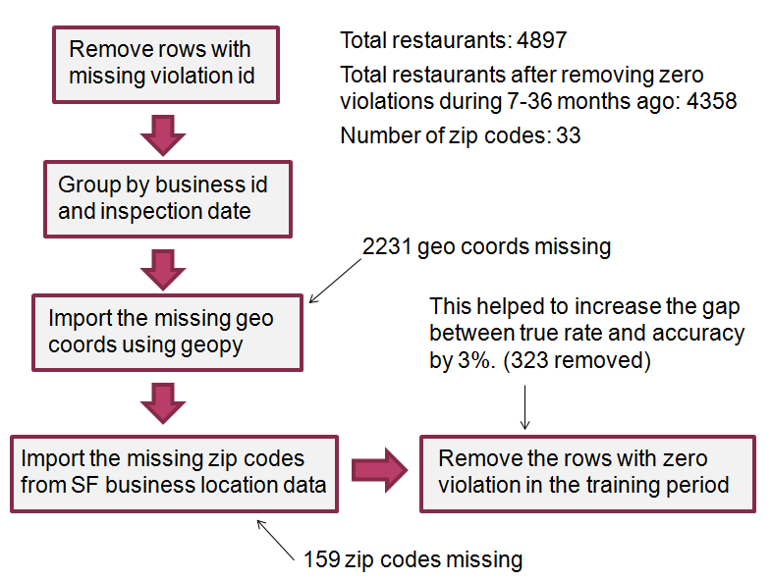
Data cleaning pipeline

Slide 5
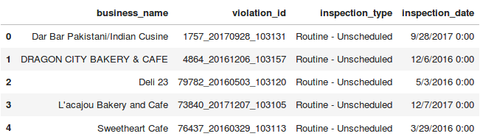
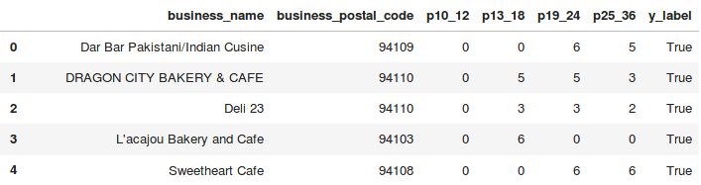
Data before and after cleaning
Before
After

Slide 6
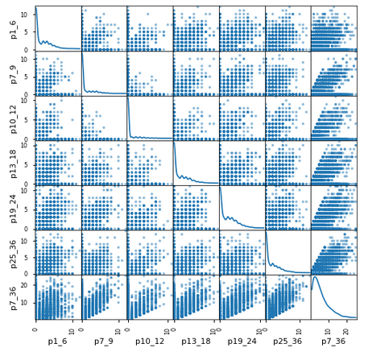
Scatter plot for different periods

Slide 7
Modeling
Algorithms considered:
1. Logistic regression
2. Gradient boosting
3. Decision tree
4. Random forest
5. Ada boost
Gradient boost was slightly better than the rest.
Accuracy: 71.2%
Precision: 71.2%
Recall: 59.1%
FP rate: 19.1%
F1: 64.6%
Class balance (overall true rate) = 44%

Slide 8
Gradient Boosting
Final modeling:
Estimator: 40
Max feature: 4
Learning rate: 0.08
Max depth: 8
Sub-sample: 0.4
. . .
Data
40 estimators

Slide 9
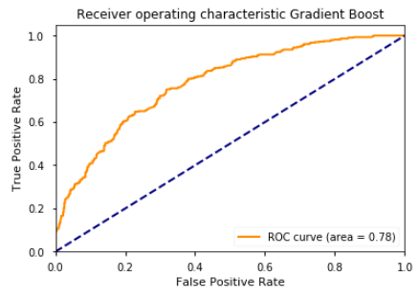
ROC Curve of Gradient Boosting
AUC = 0.78

Slide 10
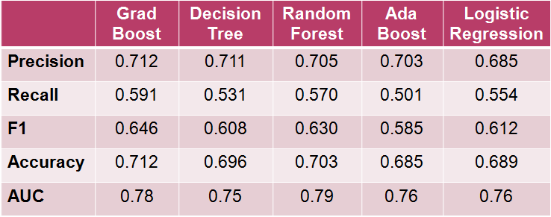
Precision, Recall, F1, Accuracy, & AUC
They perform about the same.
Gradient boost is slightly better than the rest. (best F1 value)

Slide 11
Enemble model
5 models were combined to make a prediction.
Best of 5 wins → 70.3% No effect on accuracy
( performs worse than Grad Boosting, 71.2% )

Slide 12

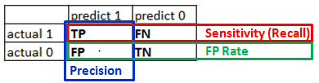
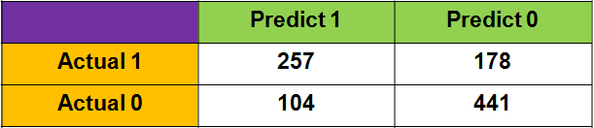
Confusion matrix
of Gradient Boost
Precision: 71.2%
Recall: 59.1%
FP rate: 19.1%
F1: 64.6%

Slide 13
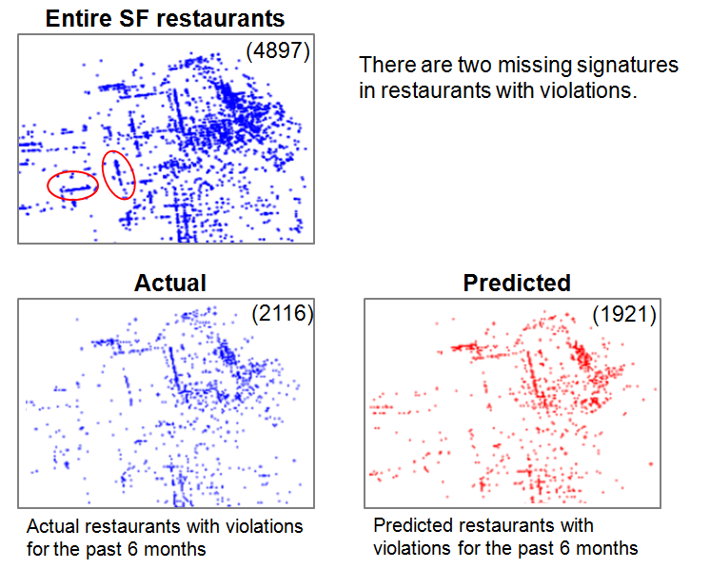
Missing signatures in violation map

Slide 14
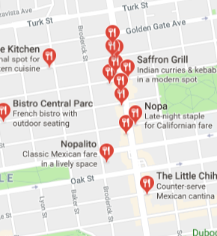
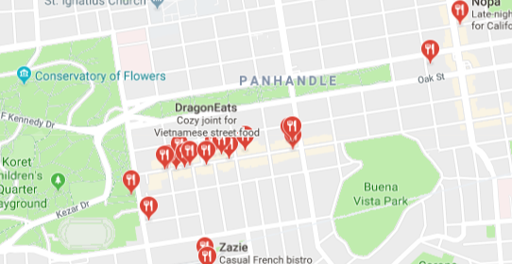
Two areas without violation signatures
Below are two areas with signatures shown at entire SF restaurant map, but missing in the violation map.
The Haight and NoPa areas (Next to Golden Gate Park)
Why?

Slide 15
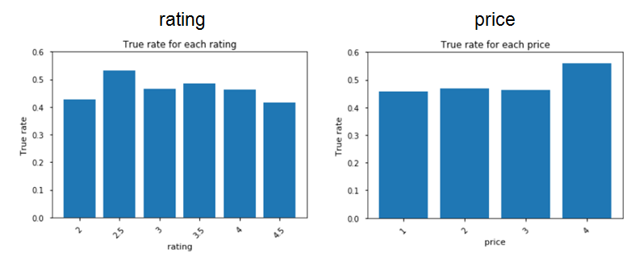
Histograms for ratings and prices
True rate: (number of restaurants with violations) / (total restaurants)
Customer ratings and food prices have no correlation with food safety.

Slide 16
Next Steps
Restaurant category information from Yelp:
Type of food: Chinese, French, Mediterranean, seafood, ramen, Southern, ...
2. Time series analysis on this data.

