Slide 1
SFeaters
Avoid Risky Restaurants
Soong Lee
github.com/ggigaev
linkedin.com/in/soonglee

Slide 2
How does the predictor work?
Data: SF city health inspection (past 3 years)
The objective of data cleaning was to get the data in the following form.
No. of violations
24 months ago
12 months ago
6 months ago
Restaurant
#1
6 | 2 | 1 | 0 | 2 | “True”
36 months ago
18 months ago
9 months ago
5 features
target
Predict

Slide 3
Features considered
5 periods assigned: 7-9,10-12, 13-15, 16-24, 25-36 month ago
Zip codes
Yelp customer ratings
Yelp food price
Business geo coords
Business turnover rates
Years of restaurant in business
Sources:
Yelp ratings and prices: Web-scraping
Business geo coords: geopy
Business turnover rates and years in business: another dataset from SF city

Slide 4
Modeling
Algorithms considered:
1. Logistic regression
2. Gradient boosting
3. Decision tree
4. Random forest
5. Ada boost
Gradient boost was slightly better than the rest.
Accuracy: 71.2%
Precision: 71.2%
Recall: 59.1%
FP rate: 19.1%
F1: 64.6%
Class balance (overall true rate) = 44%

Slide 5
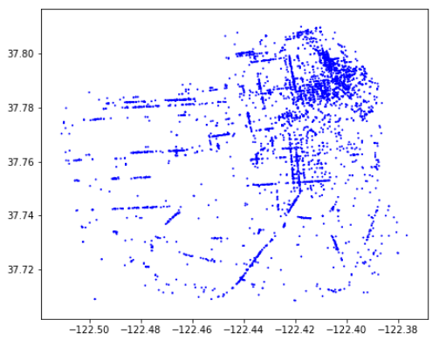
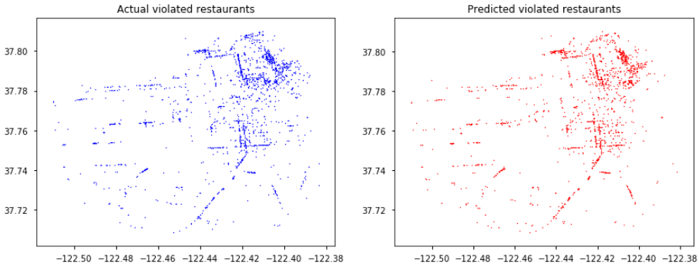
Missing signatures in violation map
Entire SF restaurants
(4897)
There are two missing signatures in restaurants with violations.
Actual
Predicted
(2116)
(1921)
Actual restaurants with violations for the past 6 months
Predicted restaurants with violations for the past 6 months

Slide 6
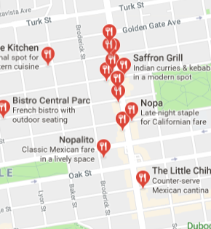
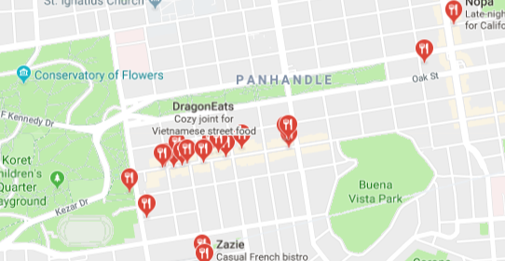
Two areas without violation signatures
Below are two areas with signatures shown at entire SF restaurant map, but missing in the violation map.
The Haight and NoPa areas (Next to Golden Gate Park)
Why?

Slide 7
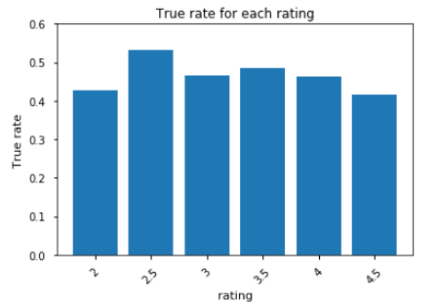
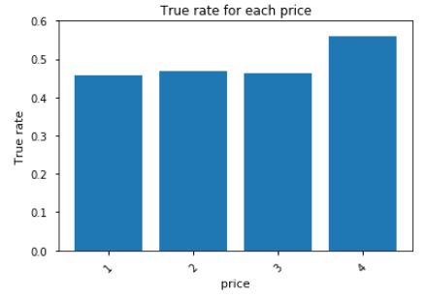
Histograms for ratings and prices
True rate: (number of restaurants with violations) / (total restaurants)
rating
price
Customer ratings and food prices have no correlation with food safety.

Slide 8
Prediction
What is your favorite restaurant in SF?

Slide 9
Next Steps
Restaurant category information from Yelp:
Type of food: Chinese, French, Mediterranean, seafood, ramen, Southern, ...
2. Time series analysis on this data.

Slide 10
Thank you.
Soong Lee
github.com/ggigaev
linkedin.com/in/soonglee

Slide 11
Appendix

Slide 12
Data cleaning pipeline
Remove rows with missing violation id
Total restaurants: 4897
Total restaurants after removing zero violations during 7-36 months ago: 4358
Number of zip codes: 33
Group by business id and inspection date
2231 geo coords missing
Import the missing geo coords using geopy
This helped to increase the gap between true rate and accuracy by 3%. (323 removed)
Import the missing zip codes from SF business location data
Remove the rows with zero violation in the training period
159 zip codes missing

Slide 13
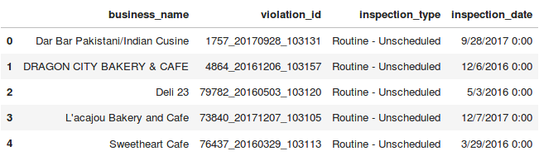
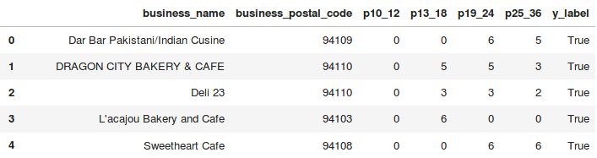
Data before and after cleaning
Before
After

Slide 14
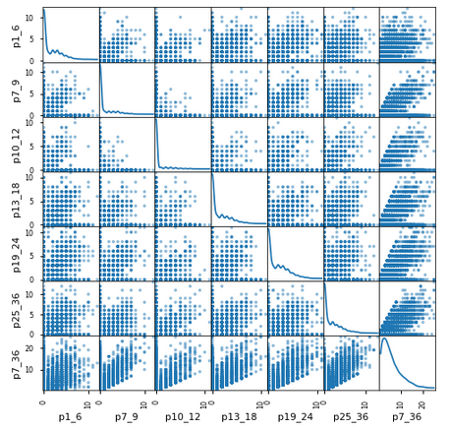
Scatter plot for different periods

Slide 15
Gradient Boosting
Final modeling:
Estimator: 40
Max feature: 4
Learning rate: 0.08
Max depth: 8
Sub-sample: 0.4
. . .
Data
40 estimators

Slide 16
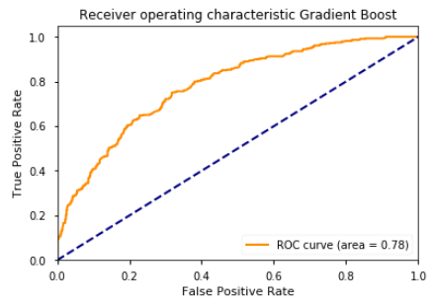
ROC Curve of Gradient Boosting
AUC = 0.78

Slide 17
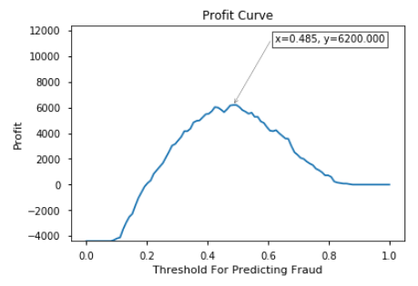
Profit curve - (1)
investment = 40 (equipment upgrade/repair, employee training, ...)
fine = 80 (penalty by the city)
FP = – investment, TP = fine – investment
The profit curve can be defined when we consider a company owns the entire SF restaurants.

Slide 18
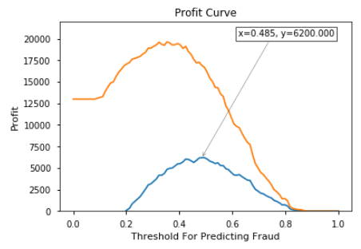
Profit curve - (2)
As penalty gets higher, the threshold peak moves toward left, which means that a restaurant would not take a chance to be caught.
fine =120
fine = 80

Slide 19
Precision, Recall, F1, Accuracy, & AUC
 | Grad Boost | Decision Tree | Random Forest | Ada Boost | Logistic Regression
Precision | 0.712 | 0.711 | 0.705 | 0.703 | 0.685
Recall | 0.591 | 0.531 | 0.570 | 0.501 | 0.554
F1 | 0.646 | 0.608 | 0.630 | 0.585 | 0.612
Accuracy | 0.712 | 0.696 | 0.703 | 0.685 | 0.689
AUC | 0.78 | 0.75 | 0.79 | 0.76 | 0.76
They perform about the same.
Gradient boost is slightly better than the rest. (best F1 value)

Slide 20

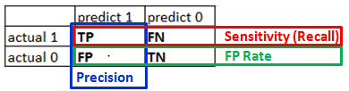
Confusion matrix
 | Predict 1 | Predict 0
Actual 1 | 257 | 178
Actual 0 | 104 | 441
Precision: 71.2%
Recall: 59.1%
FP rate: 19.1%
F1: 64.6%

Slide 21
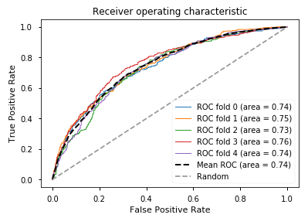
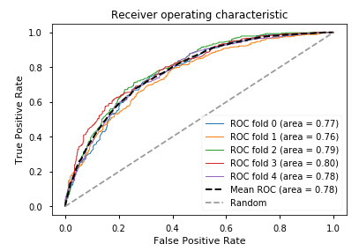
ROC curves
5-fold validation tests
Logistic regression
Gradient boosting

Slide 22
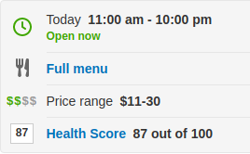
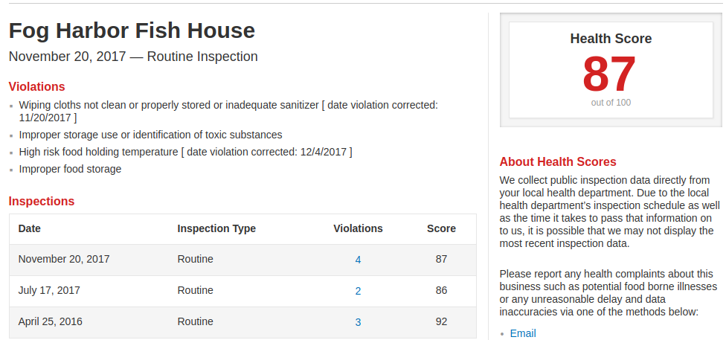
Yelp has the SF health inspection result

Slide 23
Modeling optimizaton
 | Grad Boost | Decision Tree | Random Forest | Ada Boost | Logistic Regression
N_estimators | 40 |  | 34 | 56
Max_depth | 8 | 12 | 11
Max_features | 4 | 16 | 16
Min_samples_leaf |  | 7 | 4
Min_samples_split |  | 53 | 4
Learning_rate | 0.075 |  |  | 0.17
Subsample | 0.4
Accuracy on test set | 0.704 | 0.696 | 0.703 | 0.685 | 0.689

Slide 24
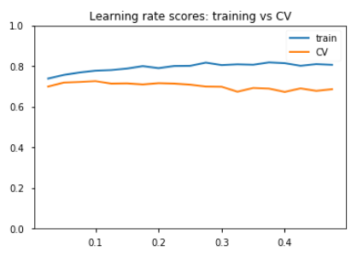
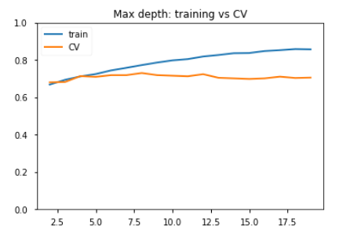
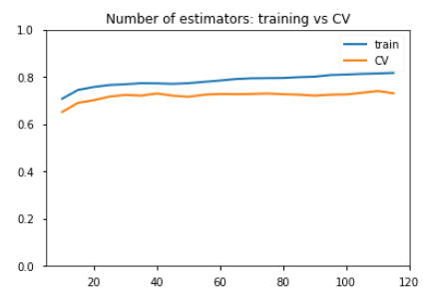
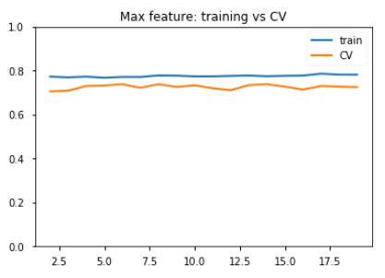
Scores: training vs CV - (1)
Learning rate
Max depth
Number of estimator
Max feature

Slide 25
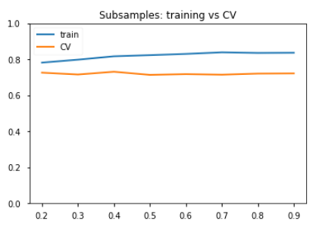
Scores: training vs CV - (2)
Subsample

Slide 26
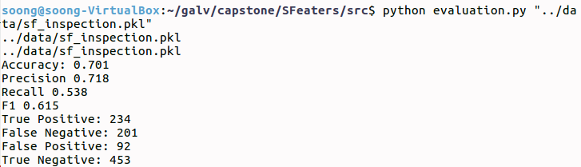
Pipeline and Modeling
Data cleaning (pipeline)
Modeling

Slide 27
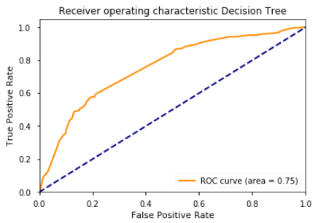
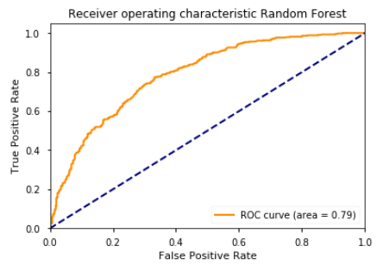
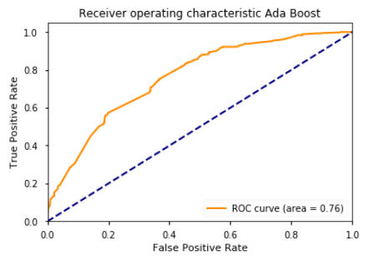
ROC curves - (1)
Grad Boosting
Decision Tree
Random Forest
Ada Boost

Slide 28
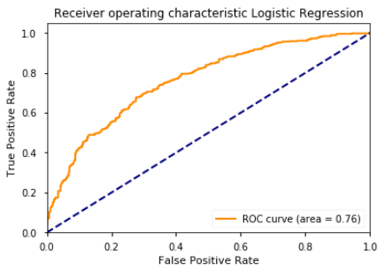
ROC curves - (2)
Logistic Regression

Slide 29
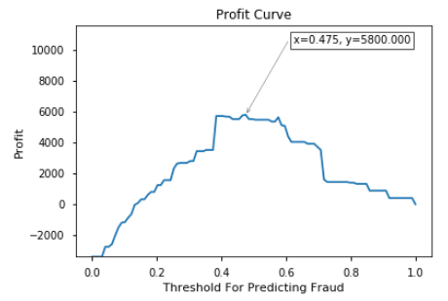
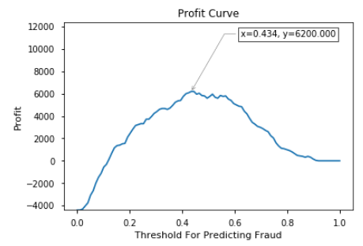
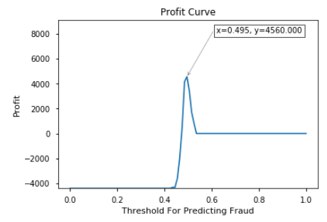
Profit curves - (1)
Grad Boosting
Decision Tree
Random Forest
Ada Boost

Slide 30
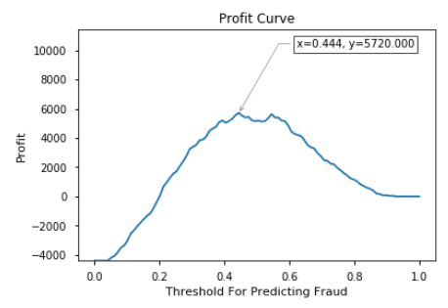
Profit curves - (2)
If you are an owner of a restaurant, you would choose Random Forest algorithm with a threshold of 0.434.

Slide 31
Enemble model
5 models were combined to make a prediction.
Best of 5 wins → 70.3% No effect on accuracy
( performs worse than Grad Boosting, 71.2% )

Slide 32
Selection of segmentation of time periods
The latest 1 – 9 months was used as a target.
True rate: 59.4%
Gradient boosting: 69.6%
target
Restaurant | 0 – 9 m | 10 – 12m | 13 -18m | 19-24m | 25 – 36m
A | 1 | 1 | 2 | 0 | 0
B | 0 | 0 | 0 | 1 | 0
C | 0 | 1 | 0 | 0 | 1
The selection of the first 6 months as a taget was to have more balanced data set and to give more immediate prediction to customers.
The accuracy did not change much from selection of segmentation; 69.6 vs. 71.2%.
The frequency of inspection does not matter in deciding the segmentation, because the modeling takes care of it. This is because modeling sees the features given and prdicts the target. If you change the segmentation, the modeling re-predicts based on the new given features and predict the new target.

Slide 33
H

