Slide 1

IAAS/PAAS: Building your own Cloud
Graeme Gillies <ggillies@redhat.com>
Cloud Architect
Red Hat
31/10/2013

Slide 2
Overview
Layers in a Software deployment Environment
SAAS/PAAS/IAAS and IAAS vs PAAS
Public Cloud vs Private Cloud
Private Cloud and Bridging the Dev/Ops Gap
Building your own Private Cloud using Openstack
The future

Slide 3
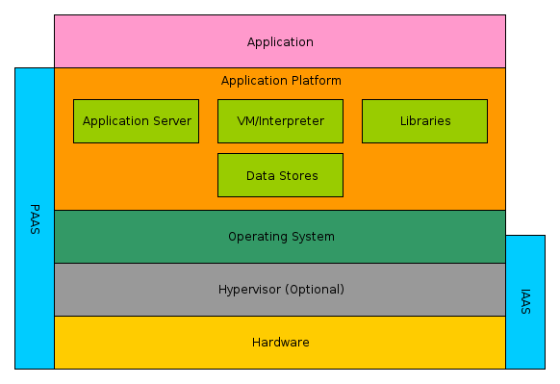
Layers in a Software Deployment Environment

Slide 4
Software as a Service (SAAS)
Functional Application provided to you, on demand
No operational or development overhead from yourself
Limited to no ability to modify the application
Public: Gmail, Salesforce, Pingdom
Private: Confluence, Jira, Zimbra

Slide 5
Platform as a Service (PAAS)
A development and deployment platform is provided to you on demand
Develop your application yourself
Provider handles deployment and operations
Public: Google App Engine, Openshift, Heroku
Private: Stackato, Openshift Enterprise

Slide 6
Infrastructure as a Service (IAAS)
Entire systems (typically virtualised) are provided to you on demand
Freedom to run whatever Operating System, Platform, Software, and anything else you want
Provider is responsible for keeping the system itself up and running and network accessible “ping and power”
Public: Amazon, Rackspace, Ninefold
Private: Openstack, Opennebula, Cloudstack, vCloud

Slide 7
IAAS vs PAAS
The tradeoff is power/control vs responsibility between you and your provider or administrator
PAAS has reduced deployment and operations overheads
PAAS fixed platform can sometimes not provide enough flexibility or features required, especially when porting existing applications
IAAS gives you maximum power, but all the responsibility

Slide 8
Public vs Private Cloud
Able to leverage existing capital expenditure to save costs
Maintain data security and privacy
No Vendor Lock in *
Private Cloud allows you to innovate and grow at your own pace (not dictated by a vendor)
Public cloud allows you to outsource large portions of operational overheads and cost

Slide 9
Private cloud and Bridging the Dev/Ops Gap
Traditional Environments often Operate around “Silos” and Process/Red Tape
Cloud taught us that computers and APIs work better than people and process
Cloud software allows us to formalise the responsibility and relationship between teams through apis, permissions, and control
As private cloud infrastructure becomes more sophisticated, we can do automated deployments that cover more scope

Slide 10
Private cloud and Bridging the Dev/Ops Gap
Private cloud can allow traditional environments to begin to adopt dev/ops easier
Ops staff can initially focus on keeping the platform up and running using traditional methods
Dev can focus on deployment on top of the platform optionally with Ops involvement
Slowly Ops can work their involvement up the stack, while Dev can work their involvement down
Single focus on an environment all teams can work in

Slide 11
Building a Private Cloud based off Openstack
Modules/cookbooks available for most configuration management systems (puppet, chef, ansible)
Number of all in one solutions designed specifically for Openstack including
  Packstack
  Mirantis Fuel
  RHOS Foreman/Astapor
  Triple O Initiative (Openstack on Openstack)

Slide 12
Building on top of Openstack
Look for a deployment/configuration management tool chain that is “cloud aware”
Examples include ansible, saltstack
Make deployment “From nothing to Everything”
Leverage Openstack projects to cover often manual or overlooked processes including
  SSL cert generation
  Load balancer configuration
  VLAN and network separation/isolation

Slide 13
Building on top of Openstack
Goal to have full automation of everything in one place, that's across all aspects of development and operation
Possible to deploy PAAS on top of IAAS, allowing you the choice and flexibility of both
Leverage Openstack automation engines like HEAT and Ceilometer to scale deployments

Slide 14
The future
The technology is here and now, but still rapidly growing and changing
The lines between IAAS and PAAS will start to blur with projects like docker/coreos and Openstack Solum
As private cloud technologies advance, the idea of “Hybrid Cloud” should become commonplace

Slide 15
Questions?

Slide 16
Links
Public/Private IAAS/PAAS Platforms
  Heroku: https://www.heroku.com/
  Openshift: https://www.openshift.com/
  Openstack: http://www.openstack.org/
  Stackato: http://www.activestate.com/stackato
  Opennebula: http://opennebula.org/
  Cloudstack: http://cloudstack.apache.org/

Slide 17
Links
Openstack Deployment Solutions
  Packstack: https://wiki.openstack.org/wiki/Packstack
  Mirantis Fuel: http://software.mirantis.com/key-related-openstack-projects/project-fuel/
  Astapor: https://github.com/jsomara/astapor
  Foreman: http://theforeman.org
  Triple-O: https://wiki.openstack.org/wiki/TripleO

Slide 18
Links
Configuration Management/Deployment Engines
  Saltstack: http://saltstack.com/community.html
  Ansible: http://www.ansibleworks.com/
Openstack Projects
  HEAT: https://wiki.openstack.org/wiki/Heat
  Ceilometer: https://wiki.openstack.org/wiki/Ceilometer
  Solum: https://wiki.openstack.org/wiki/Solum

