Slide 1
Project 5 - Application flow identification
Giuseppe Gattulli, Filippo Kubler
Network Data Analysis Laboratory
Notes:
Inizio

Slide 2
Project Introduction
Application identification problem
Network Data Analysis Laboratory

Slide 3
Background
Network or data-center operators can use different priorities for different traffic types for congestion control
It is not always possible to identify the application based on just L4 port numbers
Sequence of packets of an application (flow) can be characterized by aggregated metrics
Thus, traffic identification can be done for traffic flows rather than on per-packet basis

Slide 4
Raw data visualization/analysis
Network Data Analysis Laboratory

Slide 5
Raw data visualization/analysis Upload dataset & preprocessing (1)
Upload the dataset and delete NULL values
Select only useful columns which are not linked to the specific capture done but only correlated to the specific application
Determine the number of different application flows and the maximum number of samples for an application
Separate the features (X) and the target variable (y) by dropping the 'L7Protocol' and 'ProtocolName' columns

Slide 6
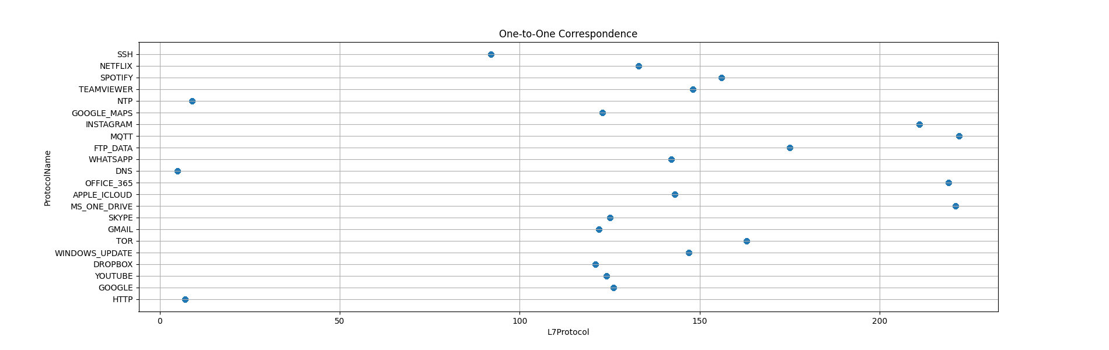
Raw data visualization/analysis Upload dataset & preprocessing (2)
Use only the column ‘ProtocolName’ as target variable given that there is a one-to-one correspondence between ‘L7Protocol’ and ‘ProtocolName’

Slide 7
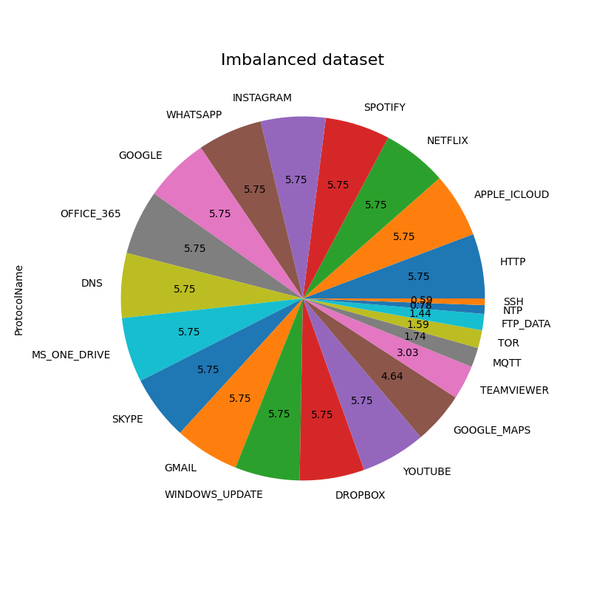
Raw data visualization/analysis Data imbalance
Once the applications with fewer samples than the maximum have been identified, a pie chart can be created to visually represent the dataset's imbalance by displaying the distribution of application flows.
Imbalanced datasets pose problems as machine learning algorithms tend to underperform when one class is over-represented.

Slide 8
Data preprocessing
Dataset augmentation
Network Data Analysis Laboratory

Slide 9
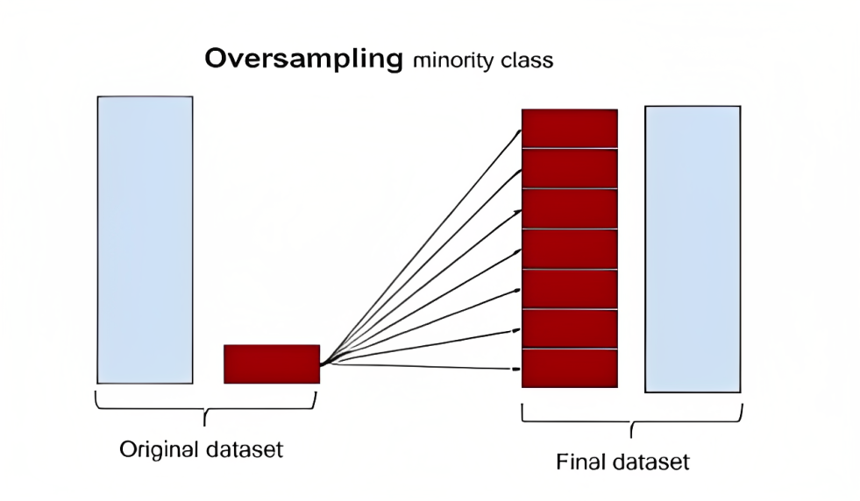
Data preprocessing Random over-sampling
In the context of random over-sampling, the minority classes (the classes with fewer instances) are over-sampled by randomly duplicating or generating new instances from the existing data.
Here's a step-by-step explanation of the random over-sampling process:
Identify minority classes
Determine the desired balance: decide on the ratio between the minority and majority classes
Randomly duplicate instances: randomly select instances from the minority classes and duplicate them until the desired balance is achieved
Combine the over-sampled data: merge the over-sampled minority class instances with the original majority class instances to form a new balanced dataset

Slide 10
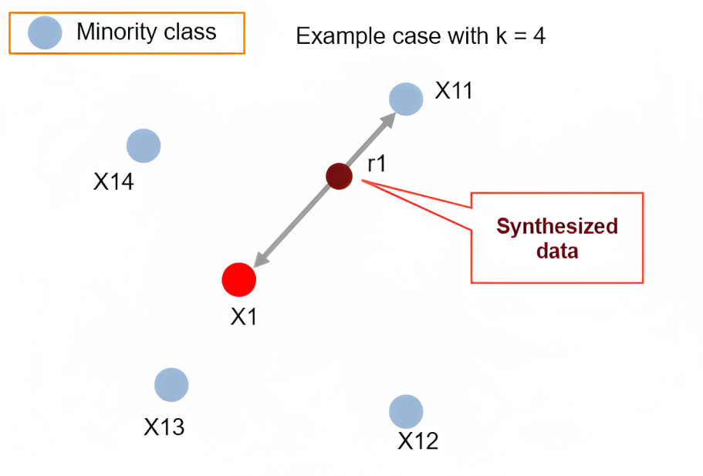
Data preprocessing SMOTE over-sampling
Synthetic Minority Over-sampling Technique (SMOTE) is a popular algorithm used for over-sampling the minority classes in imbalanced datasets. Unlike random over-sampling, which duplicates existing instances, SMOTE generates synthetic instances to increase the number of minority classes instances. This technique aims to create a more diverse and representative set of minority classes samples.
In order to discover a new sample, the process involves identifying the k-nearest neighbors by utilizing a distance metric, such as Euclidean distance. This metric is employed to locate the k closest neighbors of the chosen instance. Generally, the value of k is user-defined.

Slide 11
Data preprocessing Borderline-SMOTE over-sampling
Borderline-SMOTE is an extension of the SMOTE algorithm, it addresses the challenge of imbalanced classes by generating synthetic instances for the minority classes along their decision boundaries, thereby increasing their representation in the dataset.
For each minority class, identify the instances that are near the decision boundary. These instances are closer to the majority class samples and are more likely to be misclassified. By doing so, it helps address the under-representation of the minority classes and enables the learning algorithm to better recognize and classify instances from these classes.

Slide 12
Data preprocessing ADASYN over-sampling
The essential idea of Adaptive Synthetic Sampling (ADASYN) is to produce an appropriate number of synthetic alternatives for each observation belonging to the minority class.
The concept of “appropriate number” here depends on how hard it is to learn the original observation. In particular, an observation from the minority class is “hard to learn” if many examples from the majority class with features similar to that observation exist.
There is an automatic decision regarding the number of synthetic samples that need to be generated for each minority data example using a density distribution as a criterion.

Slide 13
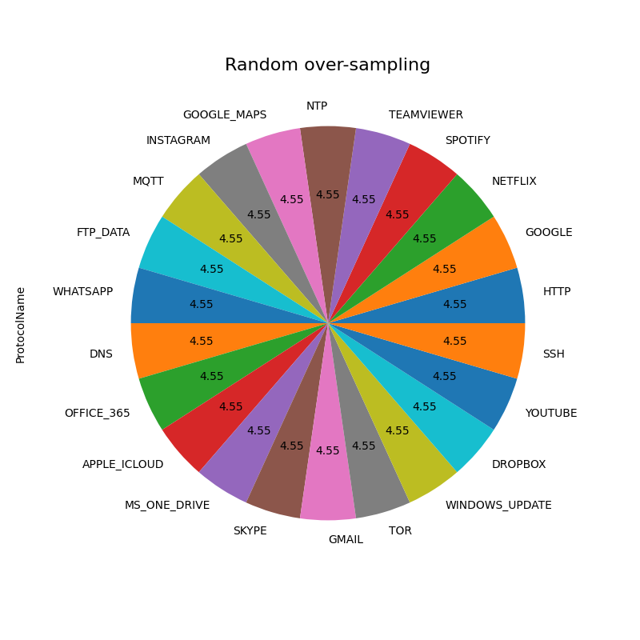
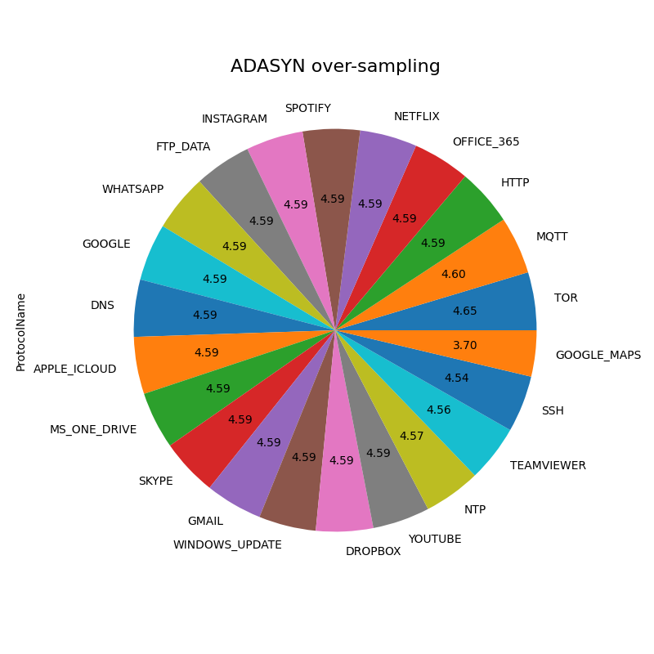
Data preprocessing Over-sampling comparison
Here it’s possible to see the difference in balance between ADASYN's algorithm compared to Random, SMOTE and B-SMOTE

Slide 14
ML models optimization and training
Hyperparameters tuning with cross-validation
Network Data Analysis Laboratory

Slide 15
ML models optimization and training Random Forest
Random Forest is a popular ensemble learning algorithm that combines multiple decision trees to make predictions. It offers various hyperparameters that can be tuned to improve its performance.
Cross-validation is a technique used to estimate how well a model will perform on unseen data.
By combining hyperparameter optimization with cross-validation, we can find the optimal set of hyperparameters for a Random Forest model.
In this scenario, the focus is on three different parameters to test:
n_estimator: number of trees in the forest
criterion: the function to measure the quality of a split
max_depth: the maximum depth of the tree

Slide 16
ML models optimization and training K-Nearest Neighbor
KNN is a non-parametric, instance-based algorithm. It doesn't explicitly build a model but stores the entire training dataset and classifies new instances based on their proximity to the k nearest neighbors in the training data.
Also in this case, by combining hyperparameter optimization with cross-validation, we can find the optimal set of hyperparameters for a KNN model.
In this scenario, the focus is on two different parameters to test:
n_neighbors: number of neighbors to use
weights: weight function used in prediction

Slide 17
Testing the performance and evaluating different scenarios
Network Data Analysis Laboratory

Slide 18
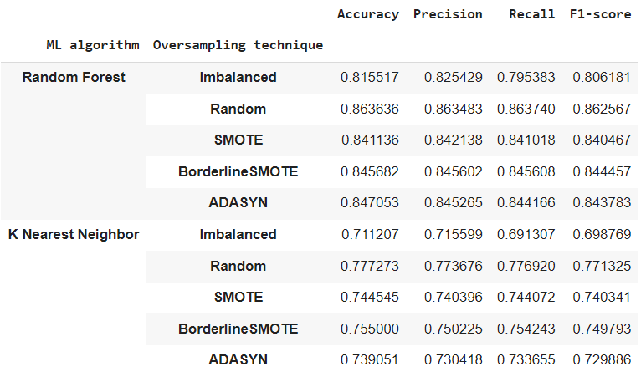
Testing the performance Comparison
KNN is suitable for small to medium-sized datasets, and it is effective when the local neighborhood information is crucial.
Random Forest is well-suited for handling larger datasets, handling high-dimensional data, and achieving robust performance.

Slide 19
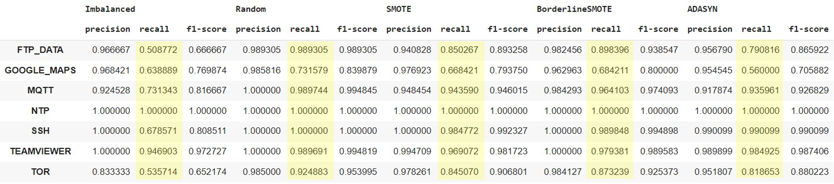
Testing the performance Per-class classification metrics
By exclusively considering the original imbalanced labels, emphasize the disparity between the initial imbalanced dataframe and the subsequent balanced dataframes generated by different sampling techniques
The biggest difference is given by the recall value and subsequently by the f1-score
The oversampling greatly reduces the number of false negatives

Slide 20
Advanced task
eXplainable Artificial Intelligence (XAI)
Network Data Analysis Laboratory

Slide 21
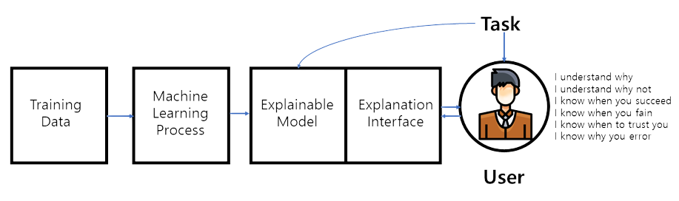

Advanced task eXplainable Artificial Intelligence (1)
Explainable artificial intelligence (XAI) is a set of processes and methods that allows human users to comprehend and trust the results and output created by machine learning algorithms.
Explainable AI is used to describe an AI model, its expected impact and potential biases. It helps characterize model accuracy, fairness, transparency and outcomes in AI-powered decision making.

Slide 22

Advanced task eXplainable Artificial Intelligence (2)
Focus on RF models (one for each method implemented)
Compute the 10 best features for each model
For each list of features recompute metrics
Compute impact of features for each class

Slide 23
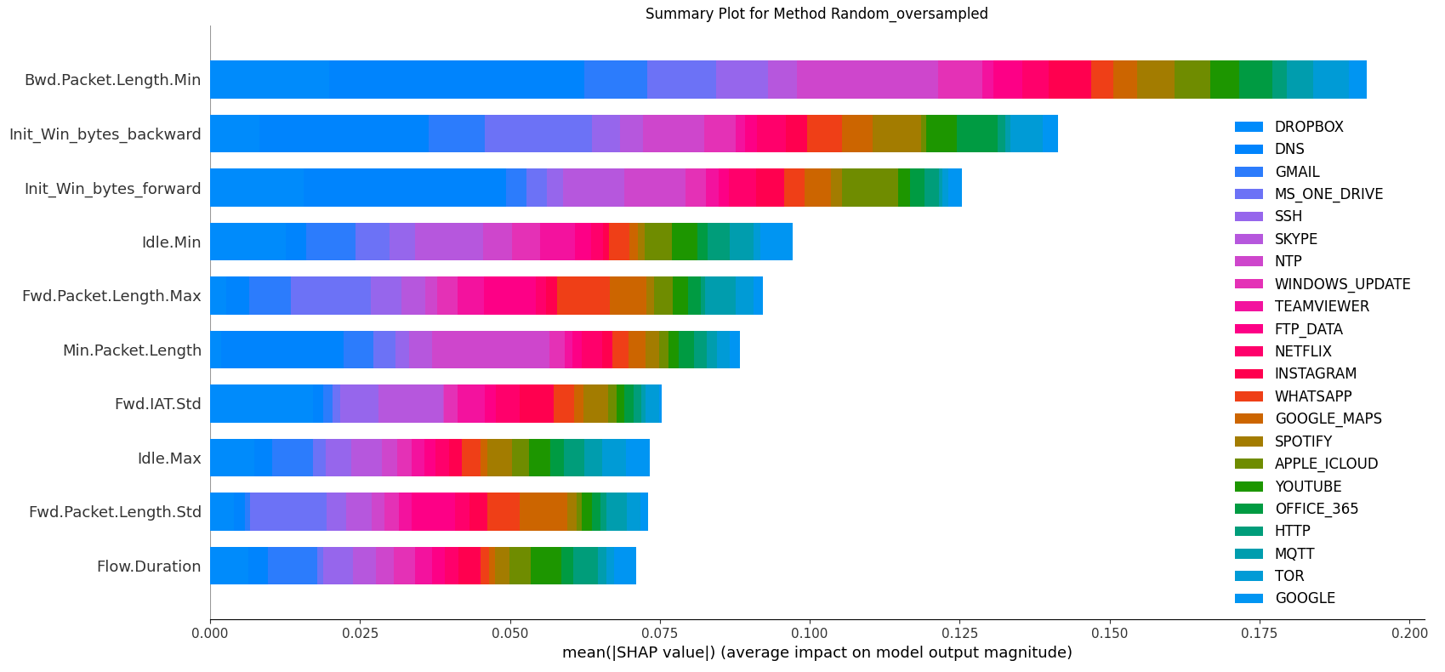
Advanced task Global per-class feature importance
Plot for Random Oversampling method

Slide 24
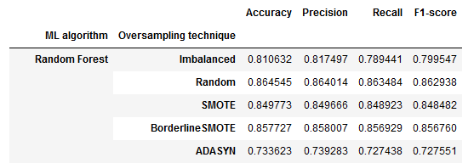
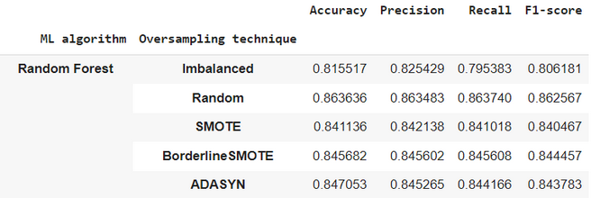
Advanced task Metrics comparison
Metrics using 10 most important features extracted for Random Oversampling
Metrics of original dataset (67 features)

Slide 25
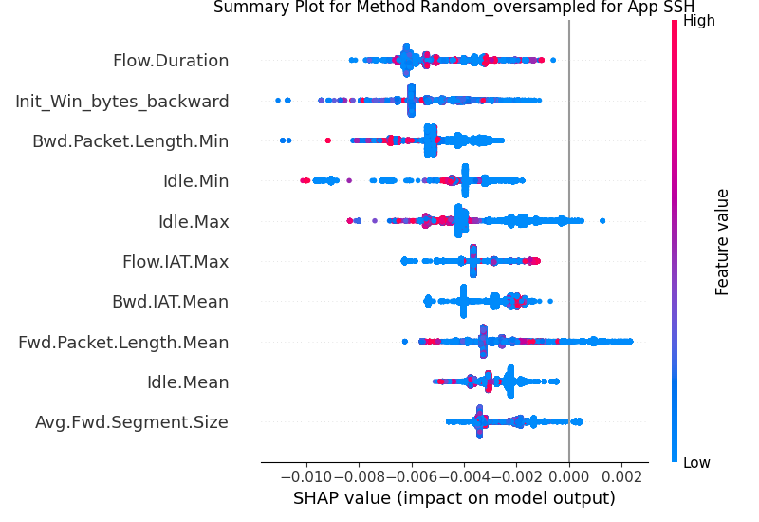
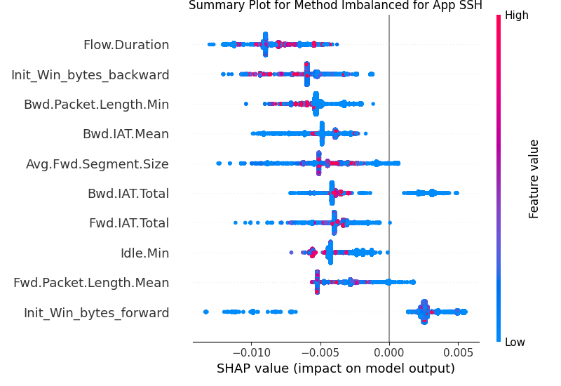
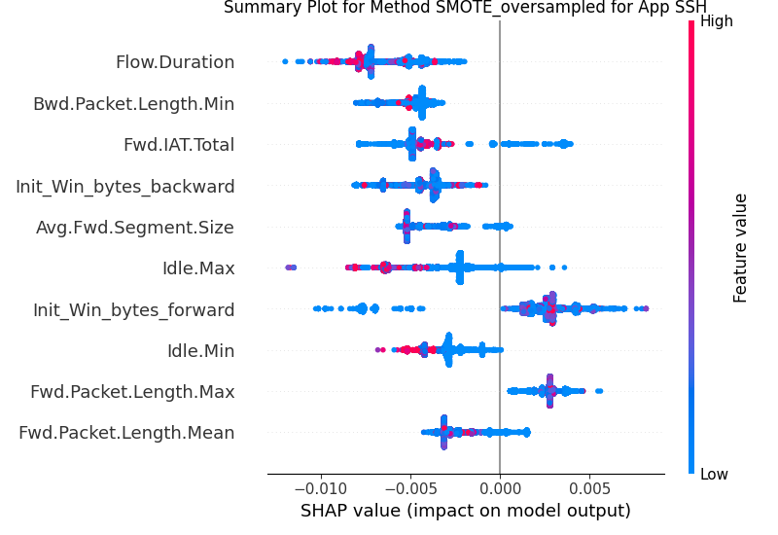
Advanced task Per-class feature importance
Random Oversampling
Imbalanced
SMOTE

Slide 26
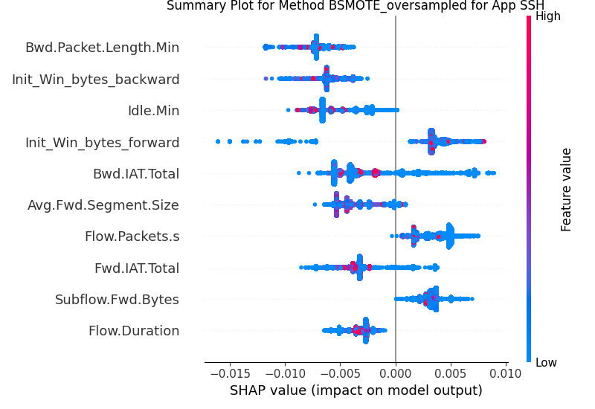
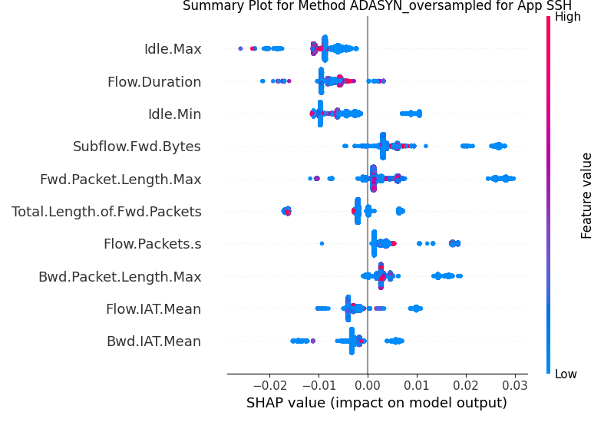
BSMOTE
ADASYN

Slide 27
THANK YOU

