Slide 1


BLE Transmission Simulation on AWGN Channel
Sistemi di Comunicazione Project
Giuseppe Gattulli Manuele Montrasio – AA 2020-2021

Slide 2
Introduction to BLE Technology
Bluetooth Low Energy is a type of wireless technology made for a short-distance type of communication. It was introduced with the specifications of Bluetooth 4.0 in 2010 and was designed as an energy-efficient solution for the control and monitoring of applications. BLE is a single-hop solution that can be used in a variety of areas including wellness, consumer electronics, smart energy and security. However, one of the main fields of application remains the Internet of Things sector.
BLE technology works in the 2.4 GHz ISM band and defines 40 channels of radio frequencies (RF) with a separation of 2 MHz between the channels, the importance of having many channels is given by the fact that many tools such as WiFi or micro waves for heating work in this band. All physical channels use a Gaussian Frequency Shift Keying (GFSK) modulation.

Slide 3
Gaussian Frequency Shift Keying (GFSK)
GFSK is a frequency modulation. It differs from FSK in that the input data signal to the modulator is filtered with a Gaussian filter. In this way, the transition between the different frequency levels is not abrupt, as is the case in FSK, but takes place gradually. One of the main benefits of Gaussian filtering is the reduction of the signal spectrum.
Below is an example that implements GFSK and FSK modulation of a 10-bit sequence, showing the differences between the waveforms obtained.

Slide 4
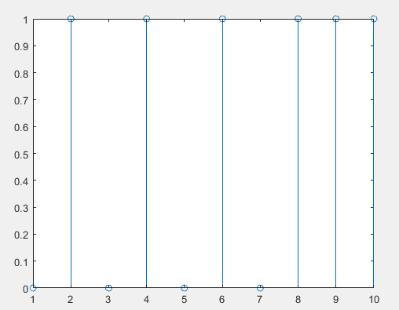
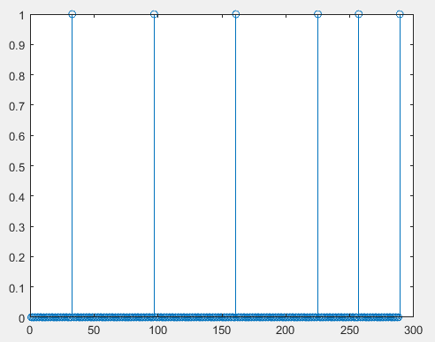
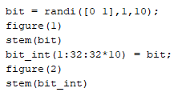
GFSK Modulation Example
Generating a Random Sequence of 10 Bits (bit)
The sequence is interspersed with the generation of 31 zeros between bits (bit_int)

Slide 5
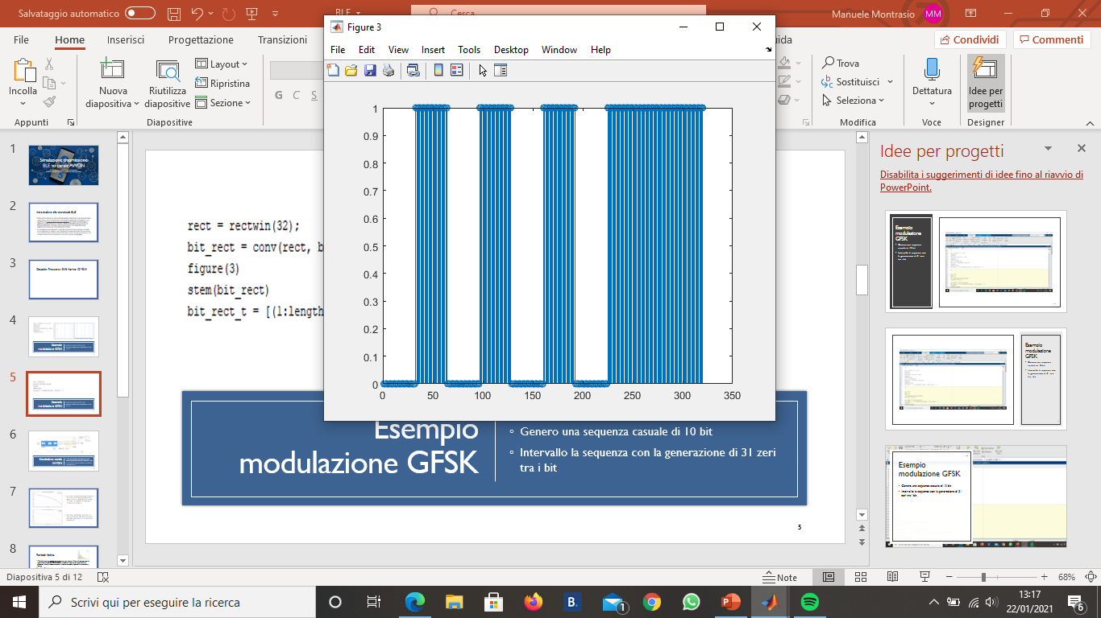
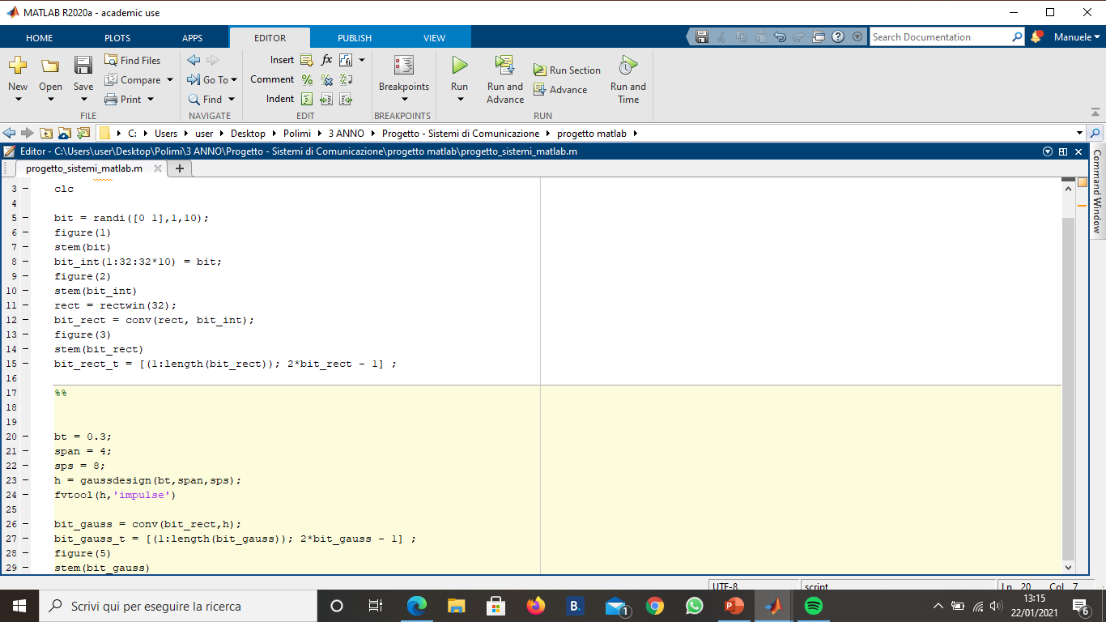
GFSK Modulation Example
Generating a 32 values long rectangular signal (rect)
Convolution (bit_rect) between the rectangle (rect) and the previously created interval bit sequence (bit_int)
This signal will then be used for FSK modulation

Slide 6
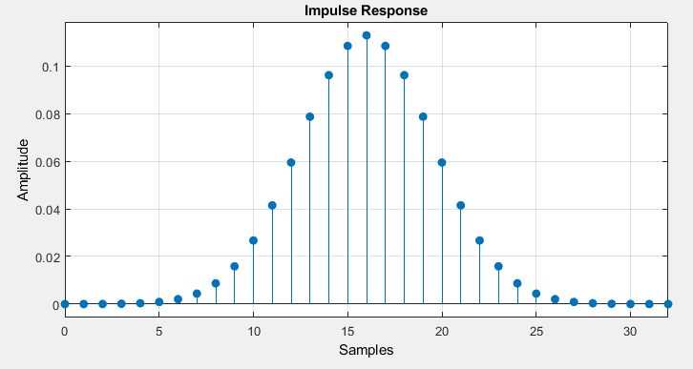
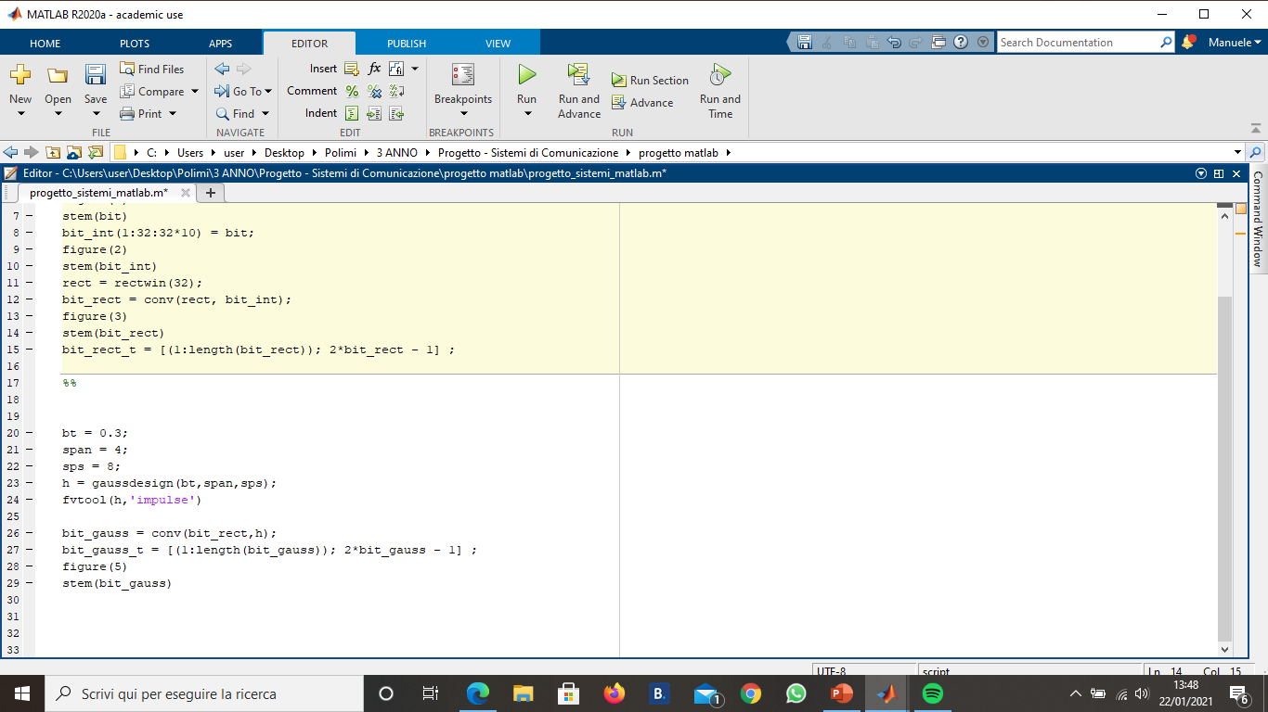
GFSK Modulation Example
Generation of a Gaussian signal with 32 non-zero values (h)

Slide 7
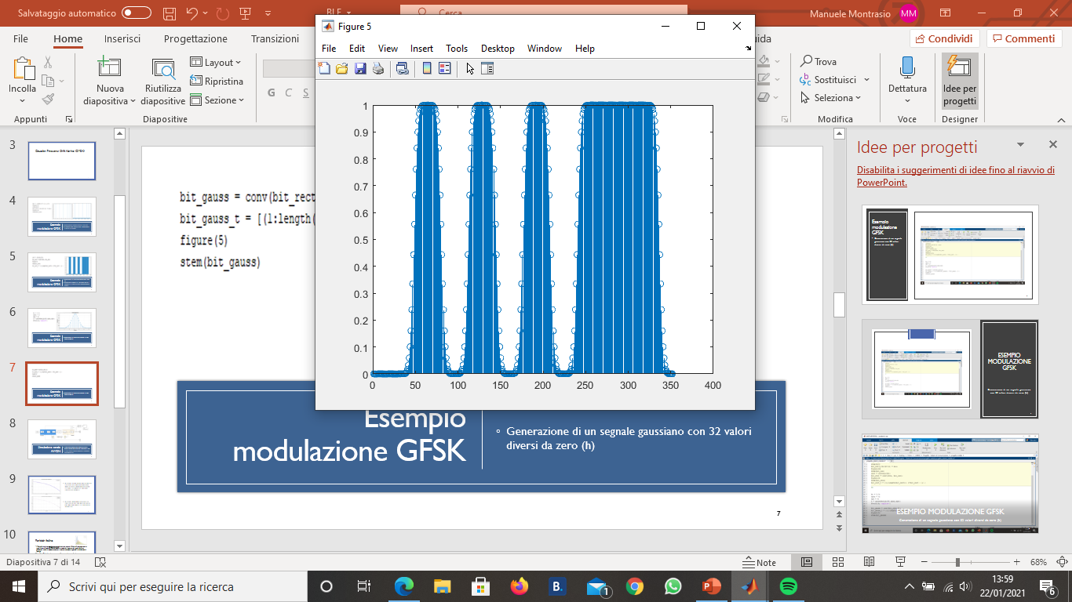

GFSK Modulation Example
Convolution (bit_gauss) between the Gaussian filter (h) and the signal obtained from the previous convolution between the interspersed bits and the rectangular filter (bit_rect)
This signal will then be used for GFSK modulation

Slide 8
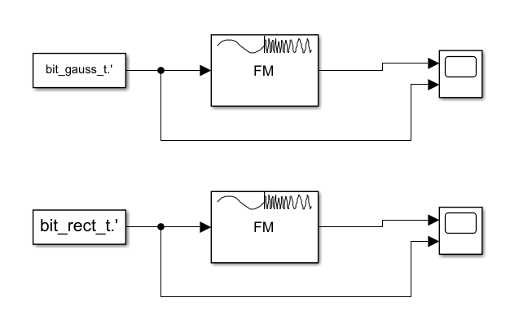
GFSK Modulation Example
By inputting the signal filtered with the rectangular filter and the one with the Gaussian filter to a frequency modulator, we can see the difference between the two results of the respective modulations

Slide 9
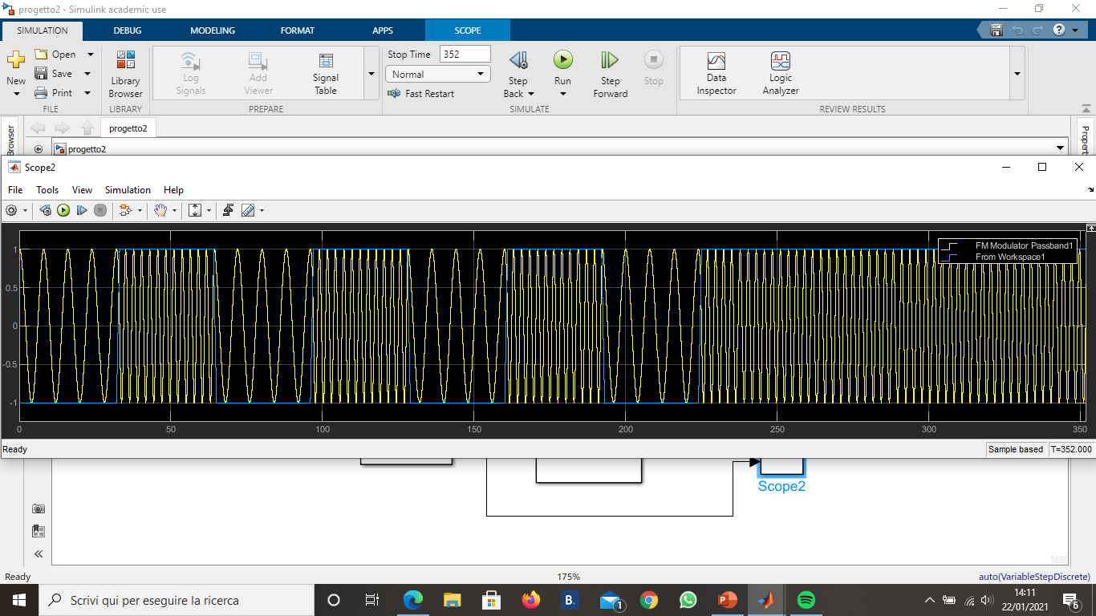
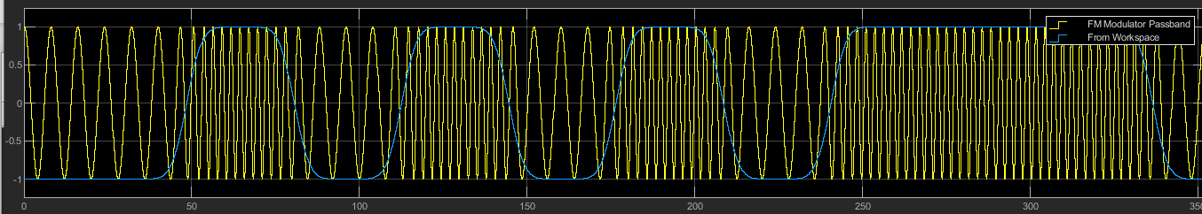
GFSK Modulation Example
The first graph shows the modulation of the signal filtered with the rectangular filter (FSK), while the second is the one of the signal filtered with the Gaussian filter (GFSK)
We can see that in the first case the transition from one frequency to the next is very abrupt, while in the second case, thanks to the previous Gaussian filtering of the signal, a gradual transition is obtained

Slide 10
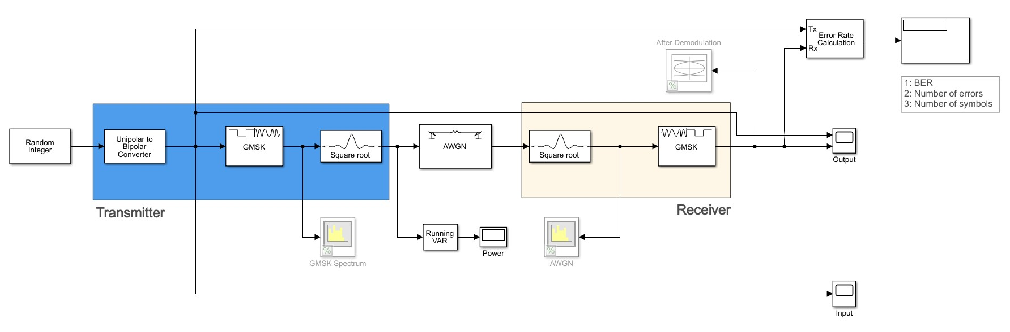
AWGN Channel Simulation
The GMSK modulator/demodulator replaces the GFSK as phase continuity is ensured
Nyquist Filter prevents Intersymbol Interference (ISI) issues

Slide 11
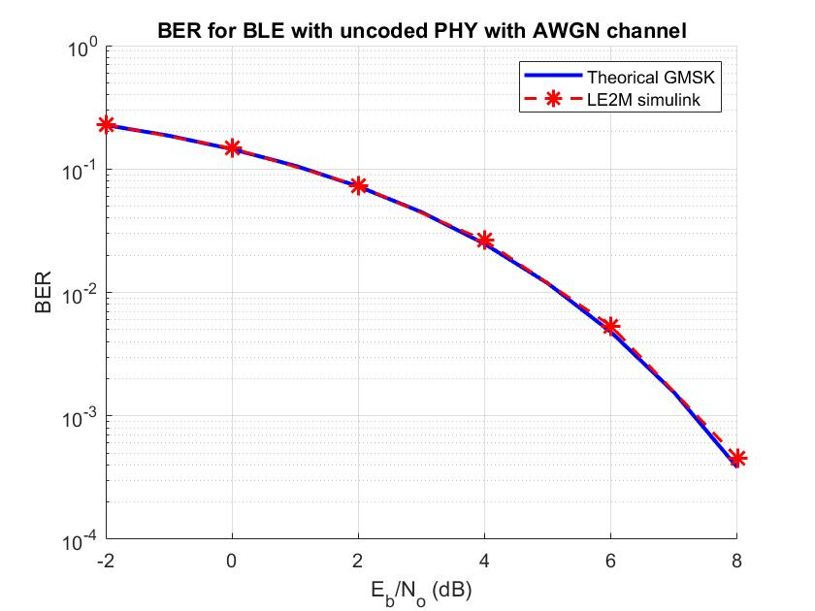
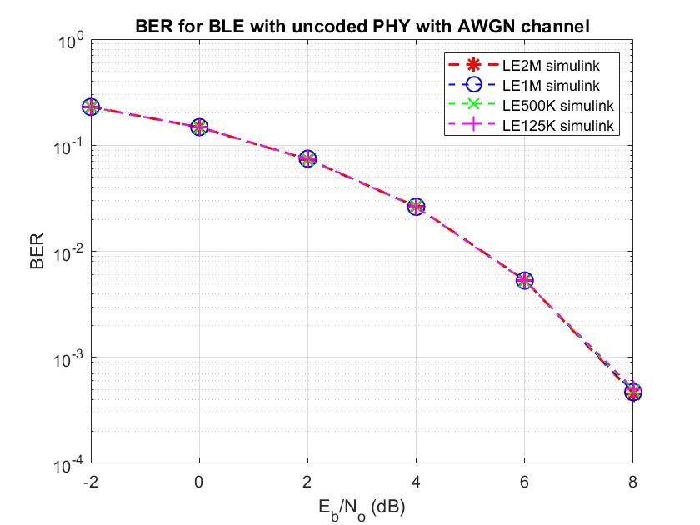
Using matlab's bertool function, it is possible to visualize the theoretical curve of GMSK modulation. Using the Monte Carlo method, the data produced by the simulink simulation were collected and then compared.
Using the Monte Carlo method, four different PHY modes were simulated without coding, these modes are supported among the BLE technology specifications.

Slide 12
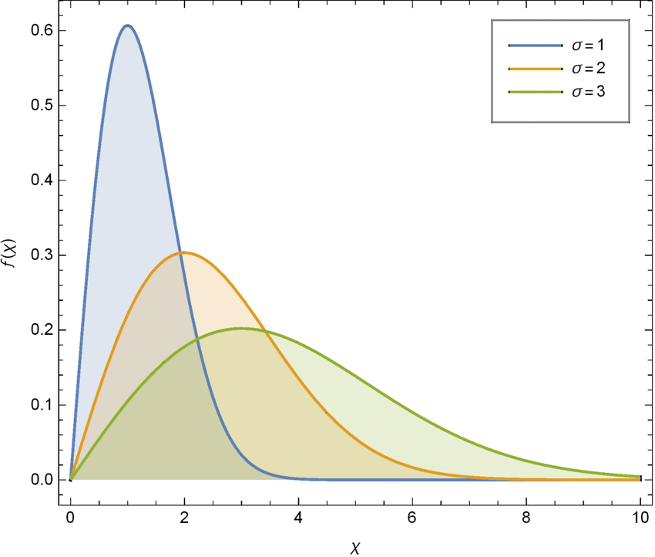
Rayleigh fading
Rayleigh fading is a statistical model used to study the effect of propagation of radio signals in the environment. This model assumes that the amplitude of the signal passing through the communication channel varies randomly following the Rayleigh distribution.
The Rayleigh model is seen as a reasonable model to simulate the tropospheric and ionospheric propagation of the signal but also as an excellent approximation of the effects that the signal undergoes in an urban environment.
Rayleigh fading is more used when there is no dominant propagation along a path in visibility between receiver and transmitter, otherwise it would be more correct to use a Rician fading model. There is, therefore, no direct path but a series of paths born from the reflection and/or refraction of the one in visibility.

Slide 13
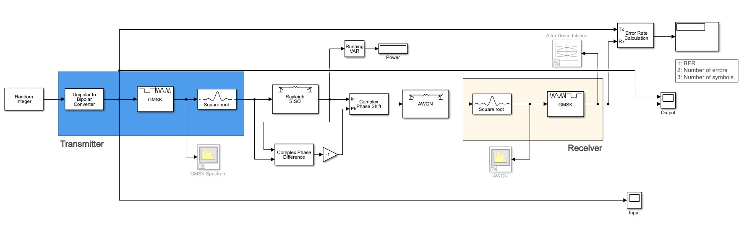
AWGN channel simulation with Rayleigh fading
The SISO Rayleigh block is frequency selective, with a discrete path delay of 1e-5*[0.2, 0.4, 0.6] and an average gain for each path of [0 -3 -6] dB

Slide 14
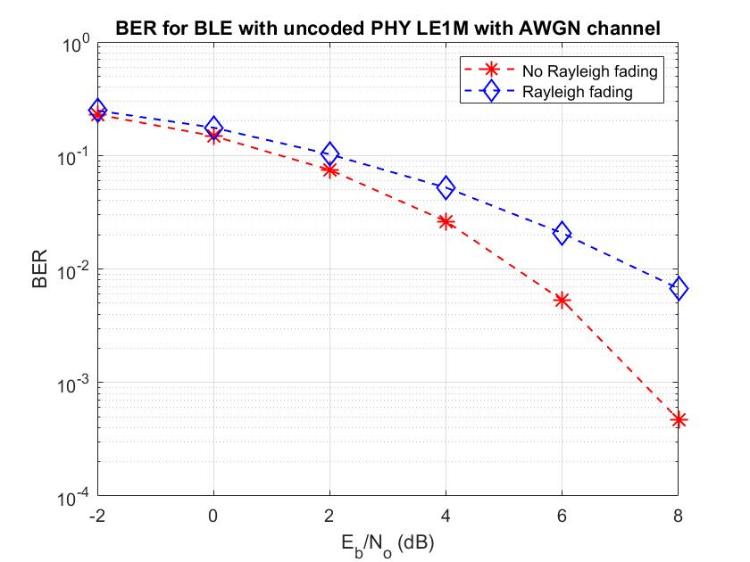

Through the Monte Carlo method is possible to notice the effect of Rayleigh fading. For both simulations, the LE1M PHY mode for information transmission and the AWGN channel are used. As $E_{b}$/$N_{0}$ increases, the difference between the Rayleigh fading and non-Rayleigh effect channel increases.

