Slide 1



Team StudyWare

Slide 2
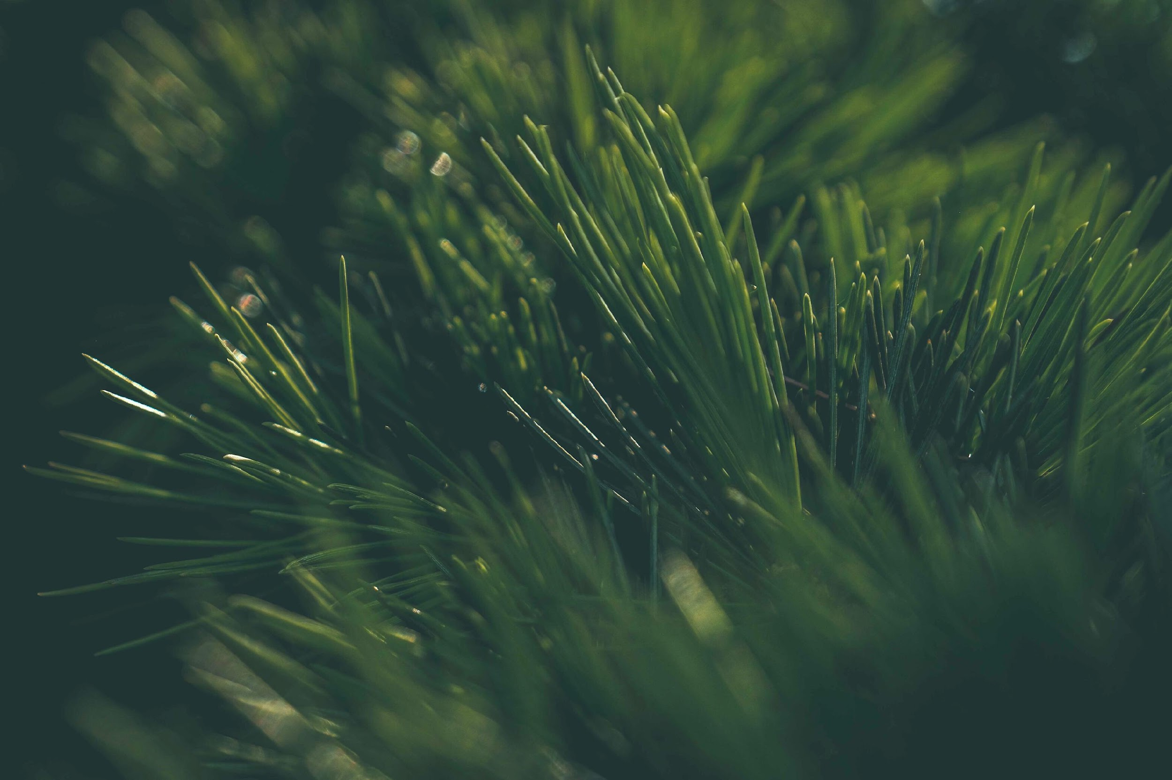
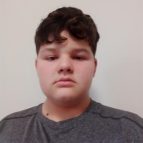
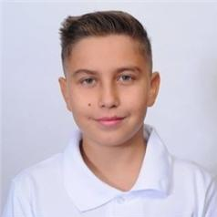
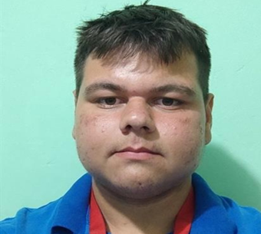
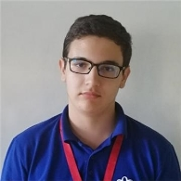
TEAM MEMBERS
Nikola Krushkov
Georgi Kotakov
Ivan Draganov
Dimitar Yoldov
Scrum Trainer
Backend Developer
Backend Developer
Designer

Slide 3






Apps used to create our project

Slide 4
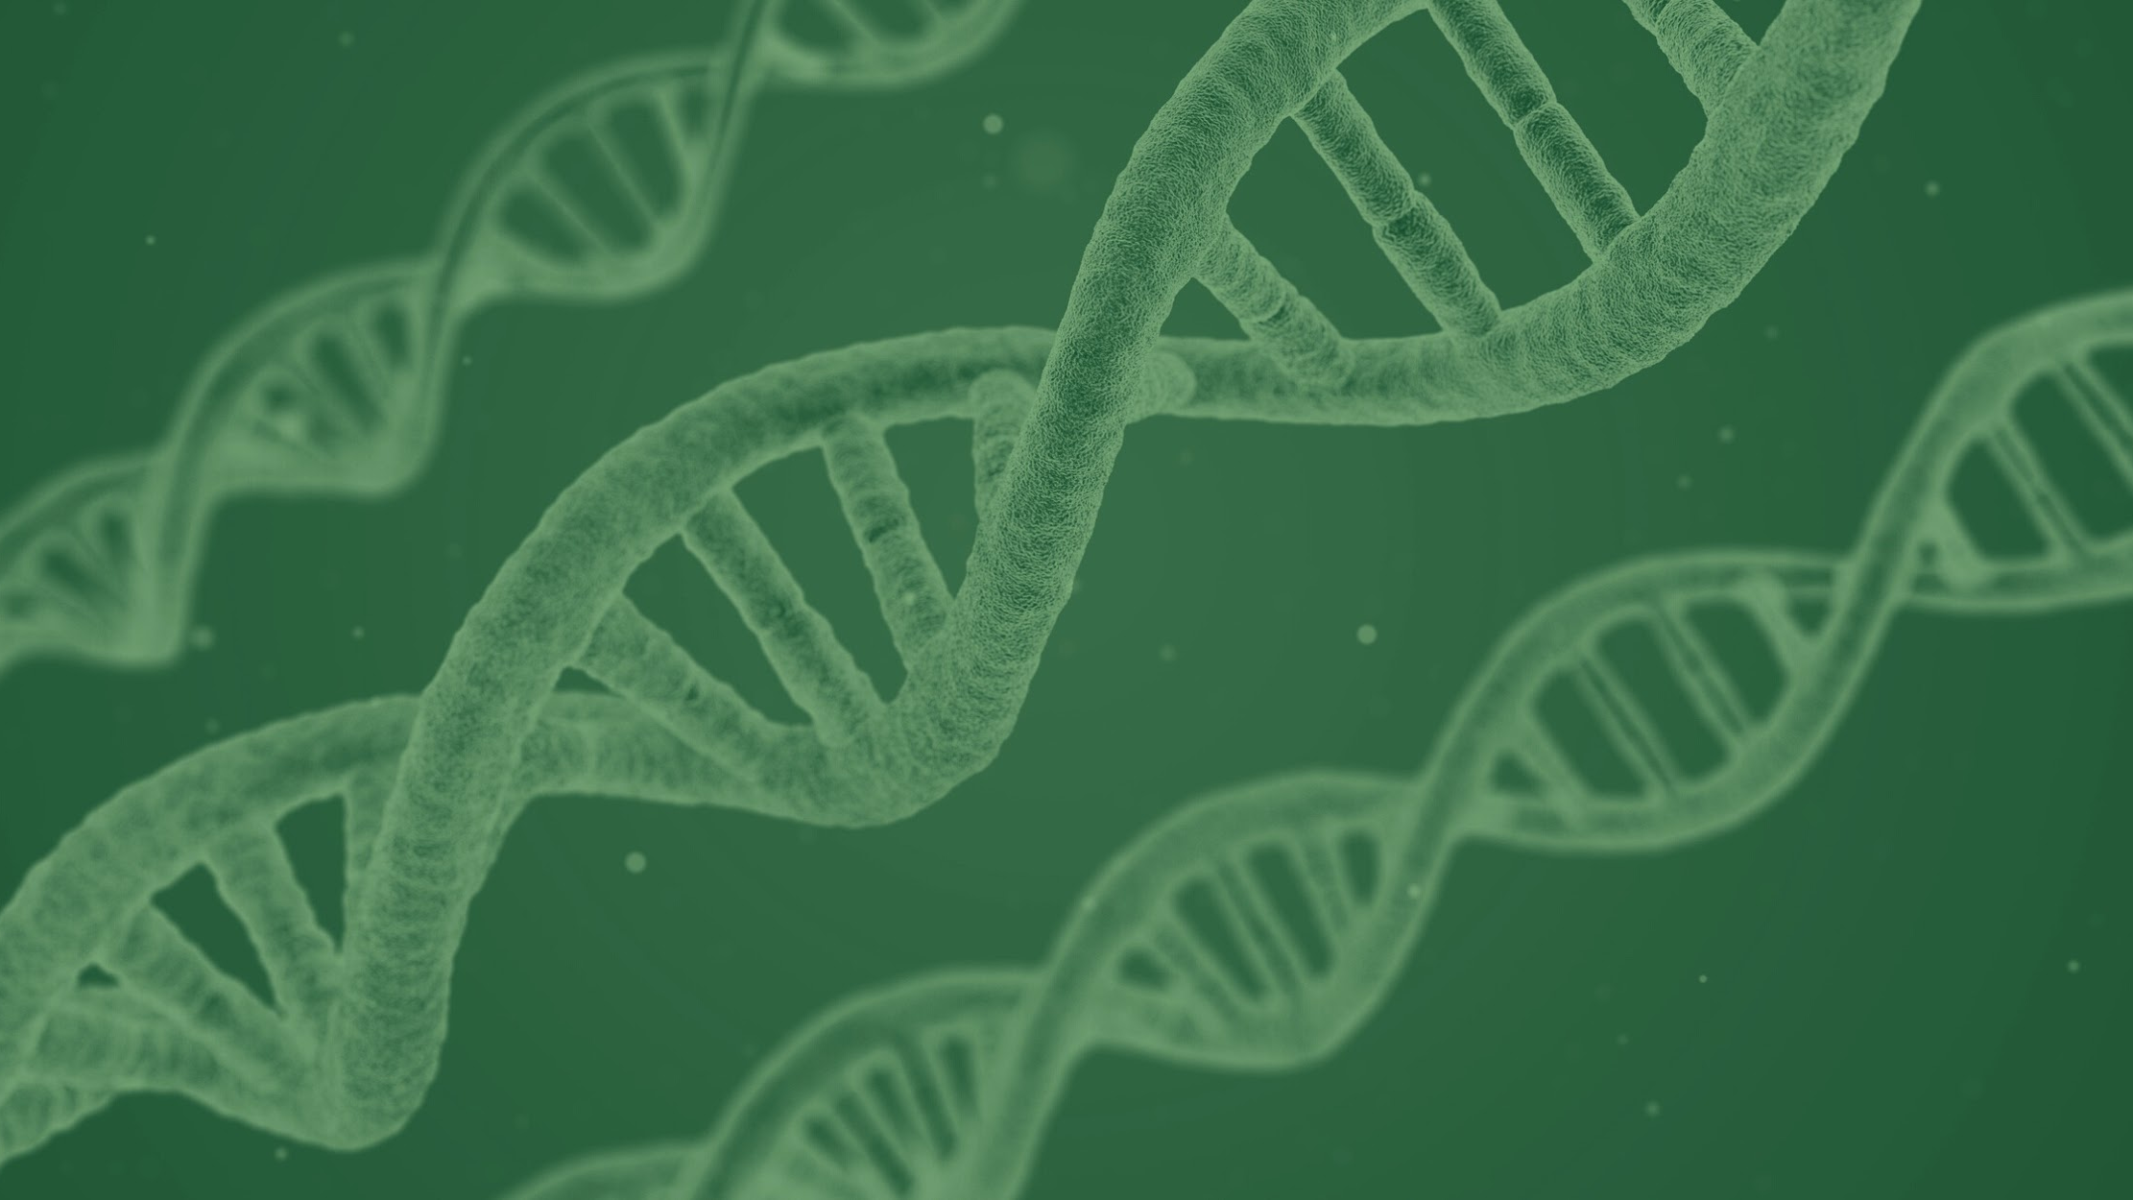
About our project
В нашата програма, ние искаме да запознаем играча с органите на човешкото тяло , техните функции и болести, които могат да доведат до повредата им.

Slide 5

Stages of realization
1.1 Forming the team
1.2 Distributing the roles among the members
1.3 Forming a plan for the app
1.4 Creating the app

Slide 6


Now to our game

