Slide 1
am I compositional? Exploring HTS data pathologies aIc and amIcomp.app
Greg Gloor
Dep’t of Biochemistry
U. Western Ontario
ggloor@uwo.ca @gbgloor

Slide 2
Motivation
Flexible approach to data analysis by trainees
Often under pressure from supervisor
Need a ‘show me’ quickly tool
CoDa approaches most robust (Nearing 2022. Nat. Comm 13:342)
Reviewer 2
If you are in the room, here is your rebuttal

Slide 3
Count data are like sausage contents
microbiome
transcriptome
metagenome
single cell
Discrete random sample of the library which is a random sample of the environment

Slide 4
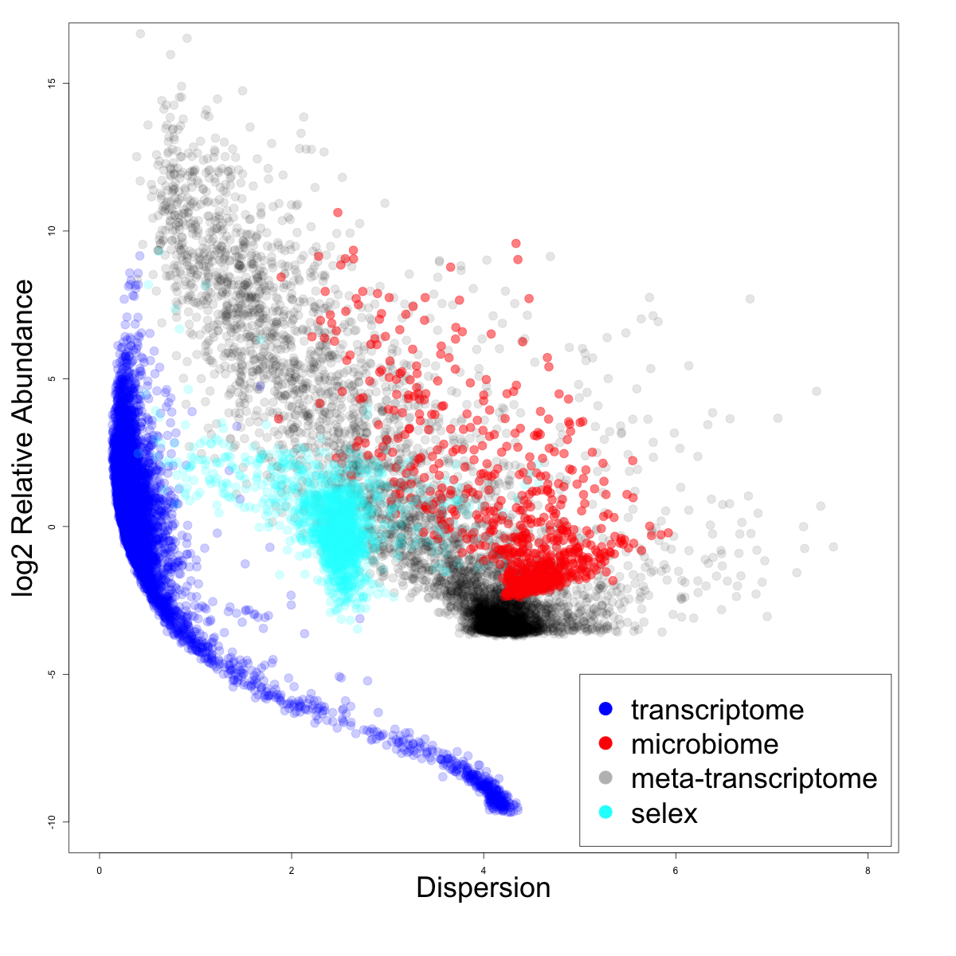
HTS count data are awful
Sparse
Variable
Discrete
Unpredictable
NB or ZIG

Slide 5
Tests and inspiration
Tests from Martín-Fernández (1998)
Sub-compositional dominance
v 50% subset
Perturbation invariance ((+/- 2%)
v 50% non-0 subset
Scale invariance
v 5x change and GBM
Correlation tests (Aitchison and Greenacre 2002)
Sub-compositional coherence
v a 50% subset
Data singularity
Common in HTS data

Slide 6
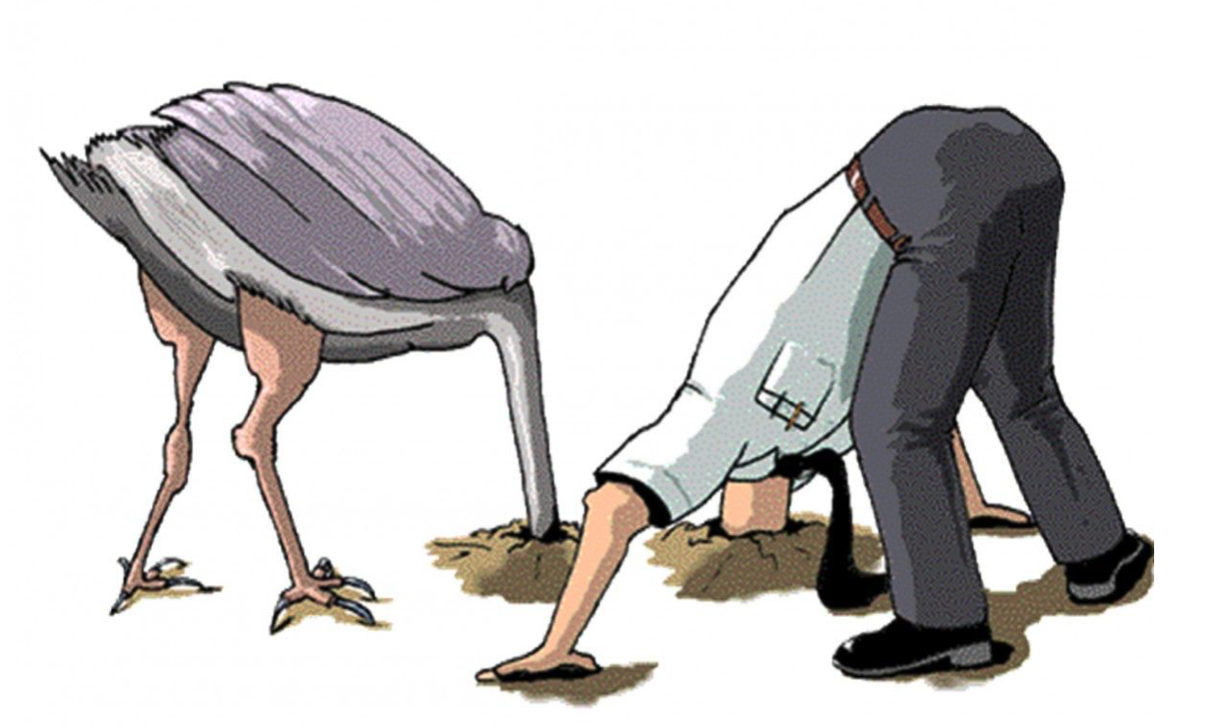
Normalizations
None
Proportion -/+ log
RLE -/+ log (DESeq)
TMM -/+ log (edgeR)
TMMwsp -/+ log (edgeR)
clr

Slide 7
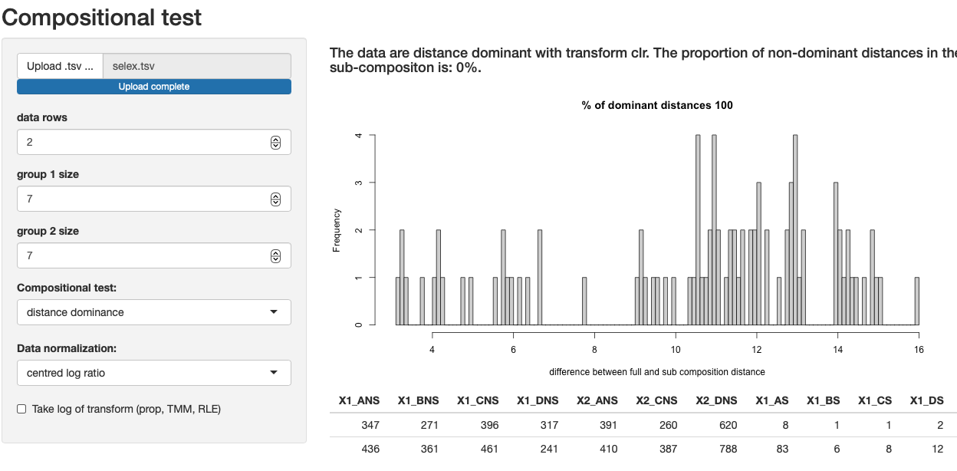
R shiny app with aIc R package backend

Slide 8
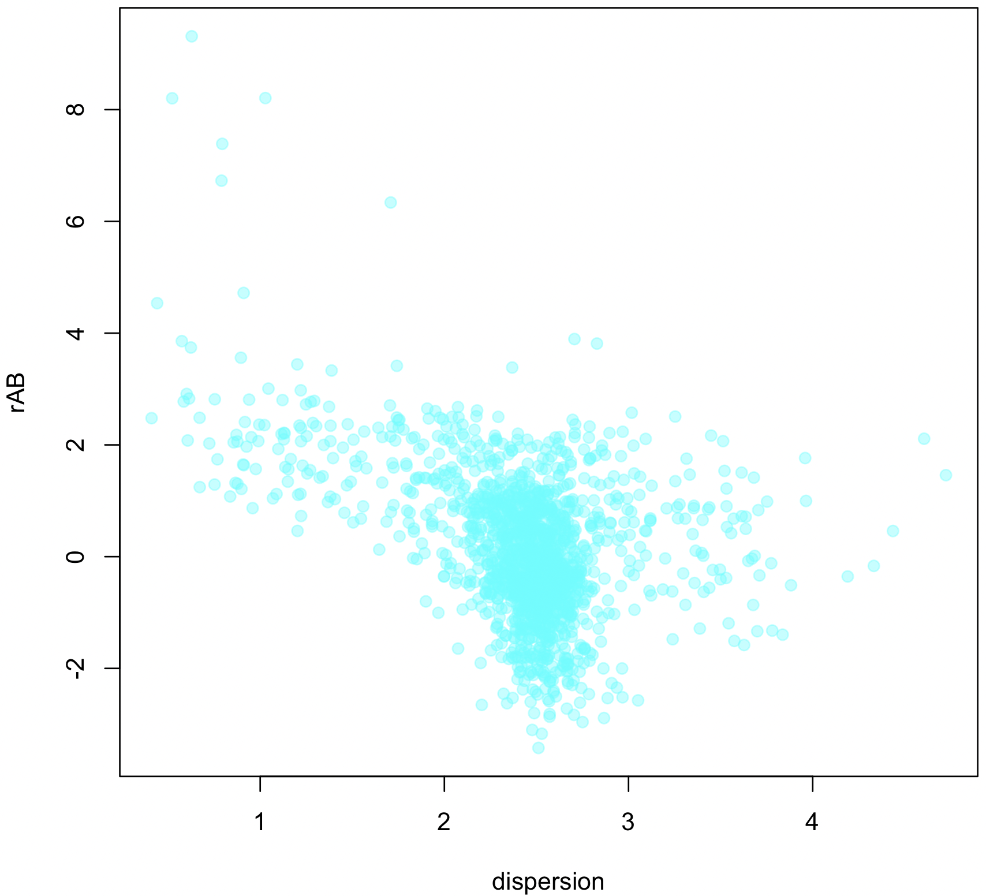
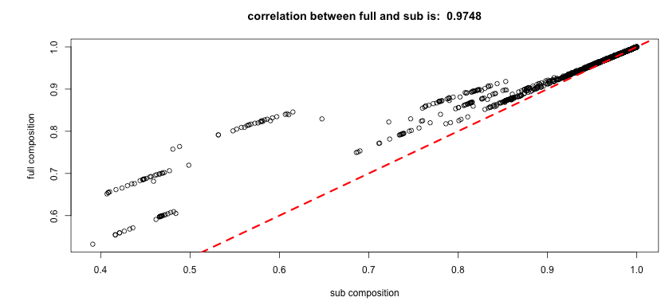
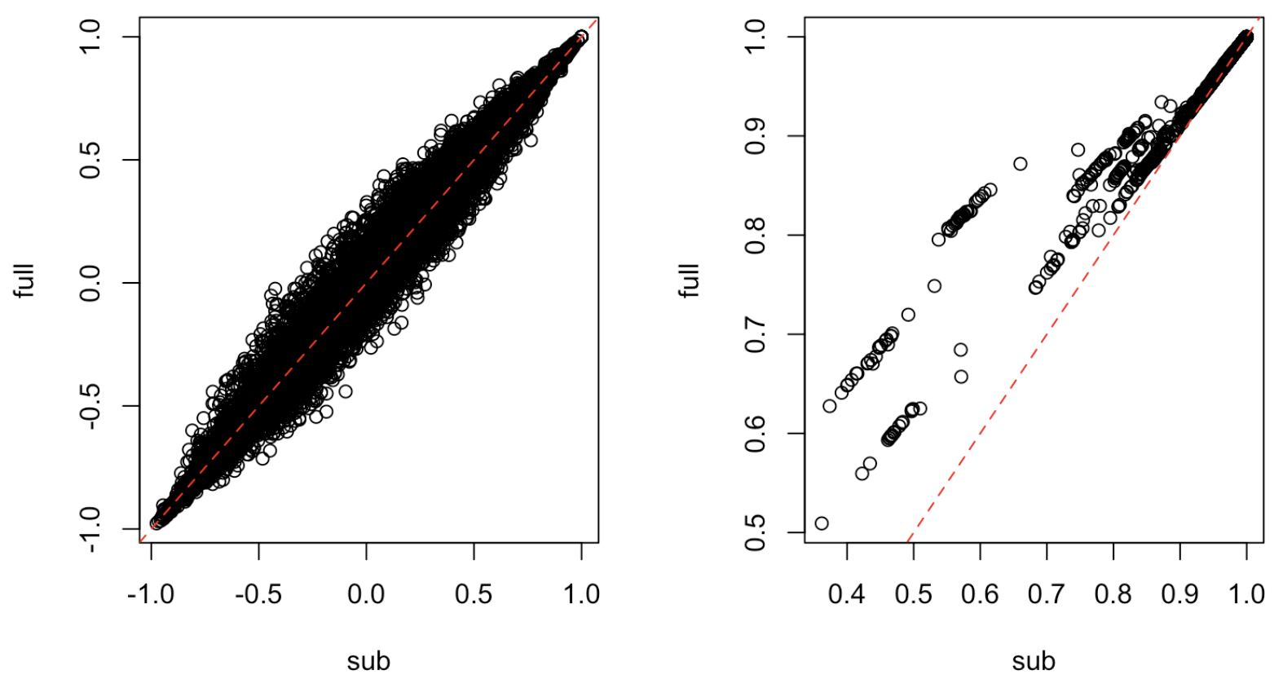

Selex dataset: coherence
CLR
TMM-log

Slide 9
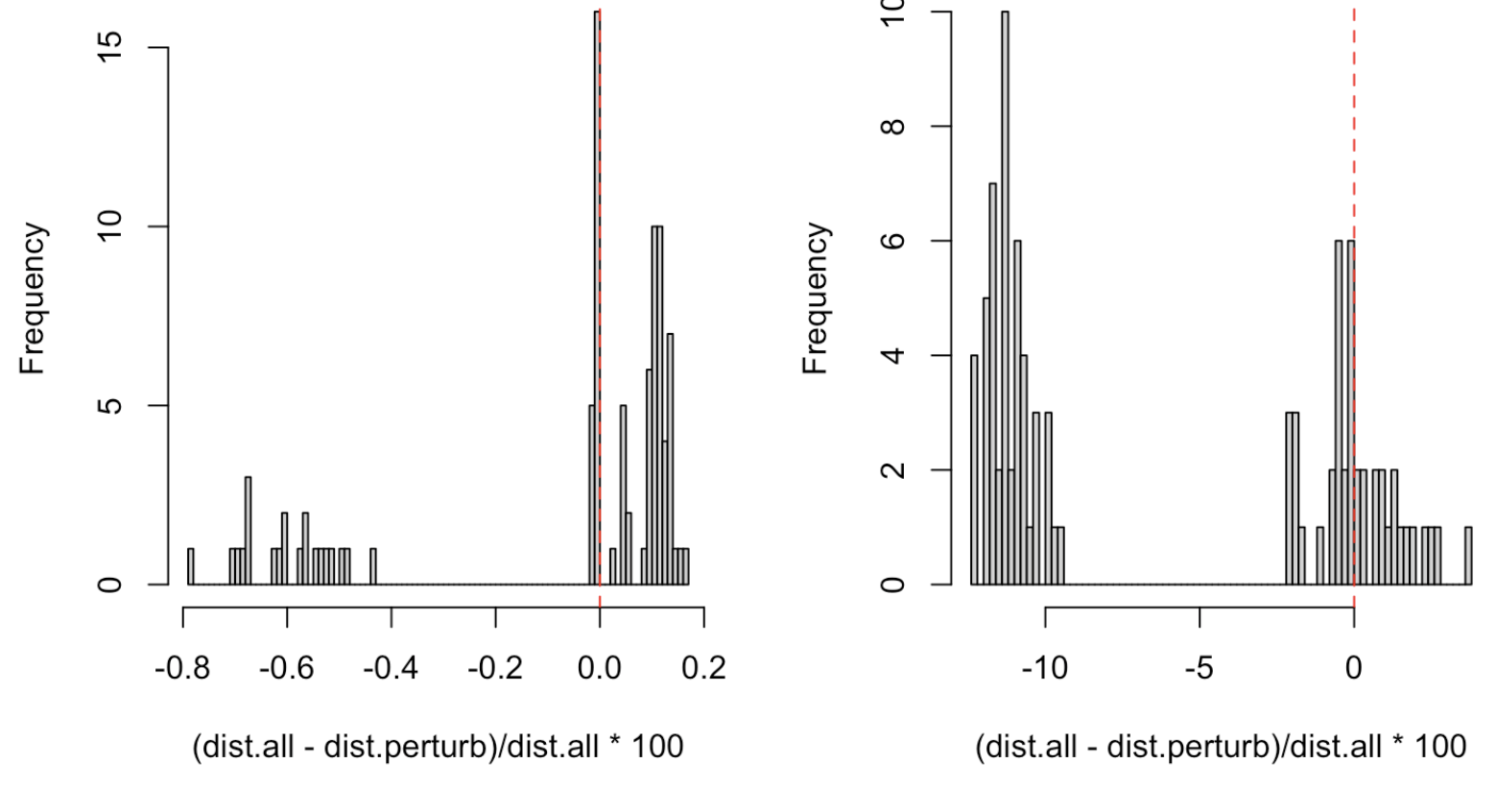
Selex dataset: perturbation invariance
CLR
TMM-log

Slide 10
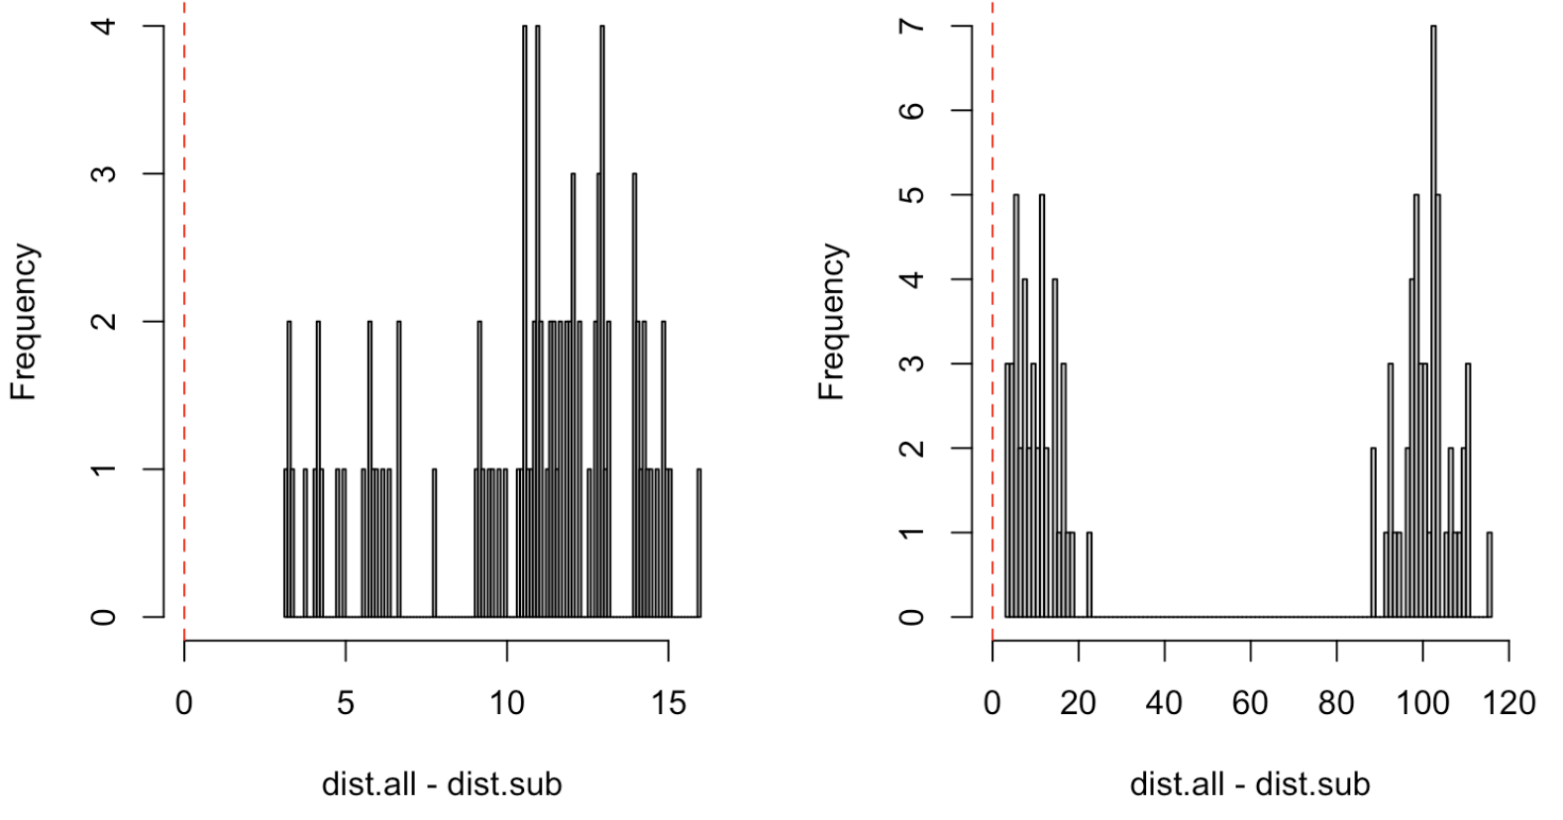
Selex dataset: distance dominance
CLR
TMM-log

Slide 11
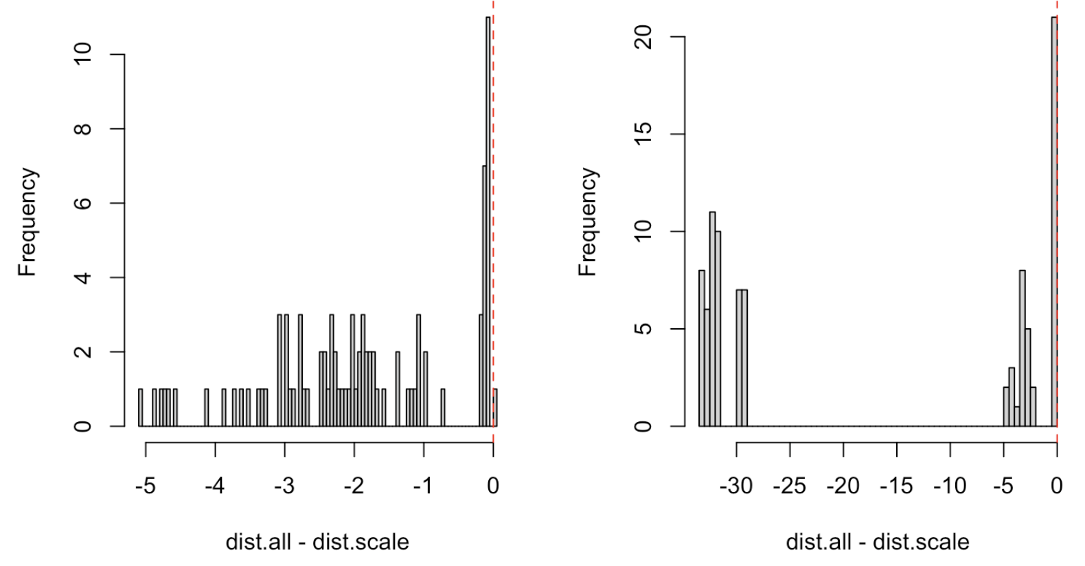
Selex dataset: scale invariance
CLR
TMM-log

Slide 12
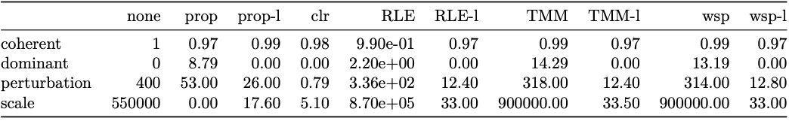




























Selex dataset
DESeq
edgeR

Slide 13
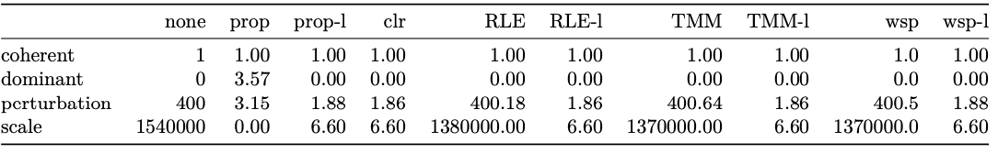



























Transcriptome dataset

Slide 14
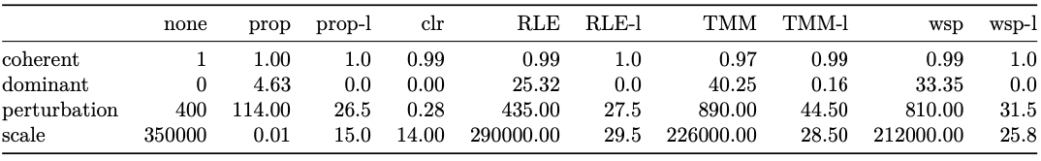


























16S microbiome dataset

Slide 15
Availability and suggestions
github/ggloor/aIc
R package
Passes all requirements for Bioconductor
Next step is to add different distance metrics
github/ggloor/amIcomp
Shiny app
Requires aIc backend
Help with visualizations

Slide 16
Summary
Different experimental designs produce data with wildly different characteristics
Coherence is universally bad when measured by correlation
Distance dominance is nearly universally achievable
Data normalizations often fail unpredictably
Transcriptomes are easy
Tools developed in this space may not be generalizable
Compositional (clr) was by far the closest to the ideal under perturbation invariance, scale invariance and distance dominance tests
Sparsity is the enemy of perfection
‘Show and tell’ should be more convincing than ‘go and read’

