Slide 1
Life Labs
The microbiome analysis problem

Slide 2
The biggest problem is analysis
Sequencing data are high-dimensional
Therefore statistical analyses can be wildly optimistic
Sequencing data are sparse
Therefore we need to estimate many of our values
Sequencing data are constant sum
everything correlates with everything
Most of us are unaware of the problems

Slide 3
Back to basics
DNA or RNA fragments from the environment
A random sample used to make a library
A random sample of the library is sequenced and mapped
This generates a table of counts per feature (OTU, gene) in each sample
The number of reads is determined by the machine!
Gloor et al. 2016. Ann. Epidem.
Gloor et al. 2016. Can. J. Micro.
Gloor et al. 2016 Aus. J. Stats
Notes:
Many more fragments than we can count

Slide 4
Counting our things
🐯
🐞
👽
Example 100 random sample sets
range=1800-2200
range= 8000-12000
range=450-550
🐯
🐞
👽

Slide 5
HTS is not counting
🐯
🐞
👽
Sequencing is a constant-sum operation
We only get the number of reads that the machine can deliver
Any constant sum is equivalent
Fernandes et al, 2013,2014
Mandel et al. 2015
Gloor, et al. 2016. Ann Epidemiology
Gloor, et al. 2016. Can J. Micro

Slide 6
Effect of compositional data?
🐯
🐞
👽
Constant sum of 1000 (or any other)
Count normalization
Rarefaction
Proportion
percentage, relative abundance
RNA-seq, metagenomics, tag-sequencing
Lovell et al, 2015. PLoS Comp Bio
Gloor, et al. 2016. Ann Epidemiology
Gloor, et al. 2016. Can J. Micro

Slide 7
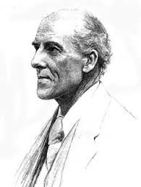
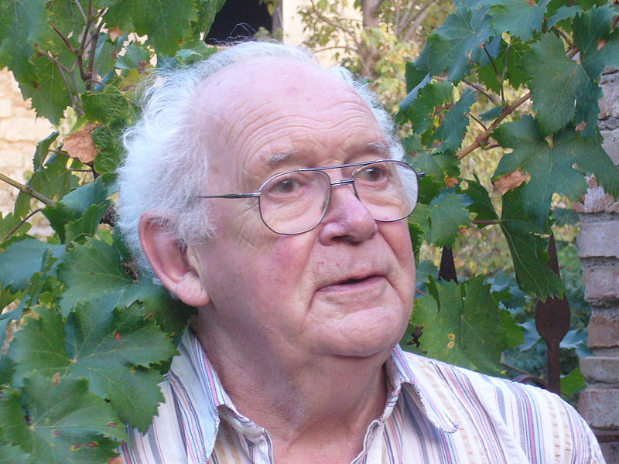
Compositional Data
🐯
🐞
👽
Compositional data are logically inconsistent with most tools in common use (Pearson 1897)
negative binomial, rarefaction, ZIG
correlation, t-test, PCA etc.
The solution is to work in terms of relative difference (ratios)
Aitchison and others
Conceptually similar to qPCR

