Slide 1


High throughput sequencing datasets are ripe for mis-interpetation: or why most analyses to date could be wildly wrong
Greg Gloor, Andrew Fernandes, Jean Macklaim, and Michael Vu
The University of Western Ontario, London, Canada; ggloor@uwo.ca

Slide 2
We have problems
Sequencing data are compositional
everything correlates with everything
the levels are confounded if the bacterial load (or the total amount of mRNA) differs between samples
our conclusions change when we include or exclude different sets of OTUs (genes)
(Pearson 1896 Proceedings of the Royal Society of London 60, 489: Aitchison 1986 The Statistical Analysis of Compositional Data: Lovell 2015 PLoS Comput Bio,11:e1004075 )
Sequencing data are high-dimensional
Therefore statistical analyses can be wildly optimistic
Sequencing data are sparse
Therefore we need to estimate many of our values
Most of us are unaware of the problems

Slide 3

The goal
Given a set of data for two or more groups derived from high throughput sequencing, what are the univariate differences between the groups?
Samples can be RNA-seq, 16S rRNA gene abundances (microbiome), ChIP-seq, selections …
Features can be gene sets, OTU sequences, genomic regions, allele abundances …
Notes:
Many more fragments than we can count

Slide 4
Where does data come from?
We start with random DNA or RNA fragments
We take a random sample and make a library
A random sample of the library is sequenced and mapped to genomes
This generates a table of counts per feature (part) in each sample (observation)
Very sparse data
Many 0 values in one group but not the other – these have information
Notes:
Many more fragments than we can count

Slide 5
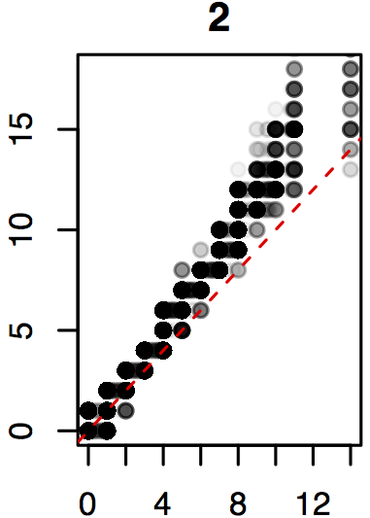
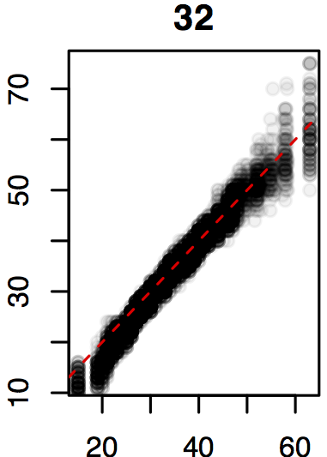
Real sequence data are variable
Count = 2
Count = 32
Same features from same samples from the same library
Sequenced on different lanes
We should get comparable answers regardless of when, where, how we sequence
We can estimate the variability by sampling Dirichlet instances
Dirichlet inferred
Observed
Observed
(Marioni et al, Genome Res 2008)
Notes:
Many more fragments than we can count

Slide 6
What we have …
Counts in the tube
x =[x₁,x₂ … x_{n}], x_{s}=x₀2^{λs}, λ=[1,0 … 0]
Model similar to our test dataset where 1600 variants, ~60 of which have λ > 0
(McMurrough et al, PNAS 2014)
Notes:
Many more fragments than we can count

Slide 7
What we get …
Counts in the tube
x =[x₁,x₂ … x_{n}], x_{s}=x₀2^{λs}, λ=[1,0 … 0]
Sequencing machine returns a random sample with fixed sum
p =[p₁,p₂ … p_{n}] ~ Dir[x₁,x₂ … x_{n}]
Notes:
Many more fragments than we can count

Slide 8
What we use
Counts in the tube
x =[x₁,x₂ … x_{n}], x_{s}=x₀2^{λs}, λ=[1,0 … 0]
Machine returns a random multinomial sample
p =[p₁,p₂ … p_{n}] ~ Dir[x₁,x₂ … x_{n}]
The clr transformation of the proportion or the Dir reconstitutes the shape with estimation error
clr(x) = log2(x₁/gx), log2(x₂/gx) … log2(x_{n}/gx)]
Where gx is the geometric mean of vector x
Notes:
Many more fragments than we can count

Slide 9
Find test values not affected by random sampling in the correct space
Group 1 Group 2
ALDEx2
Generate posterior estimates of the data consistent with the observed data and the chosen prior(s)
Dirichlet instances
clr transform instances
Calculate univariate test values on each instance
Correct for FDR
Report the expected value of each test across instances
Fernandes PLoS One 2013
Macklaim Microbiome 2013
Fernandes Microbiome 2014
McMurrough PNAS 2014
Goneau mBio 2015
McMillan under review
Notes:
Many more fragments than we can count

Slide 10
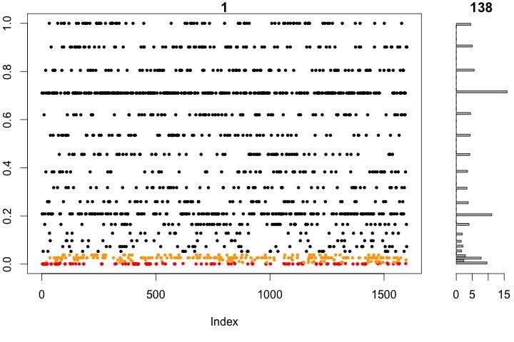
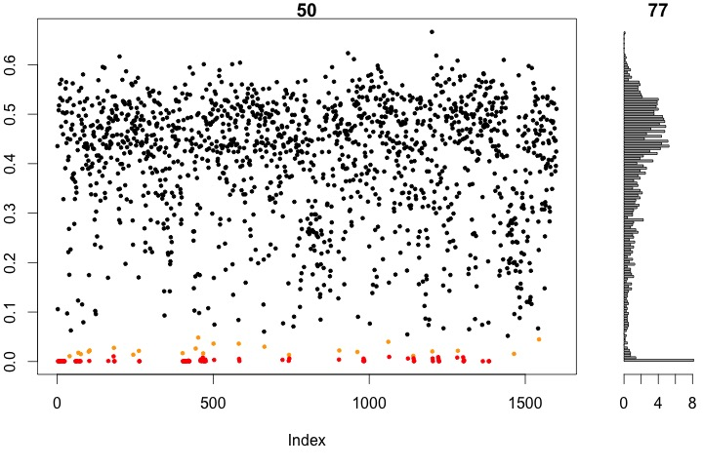
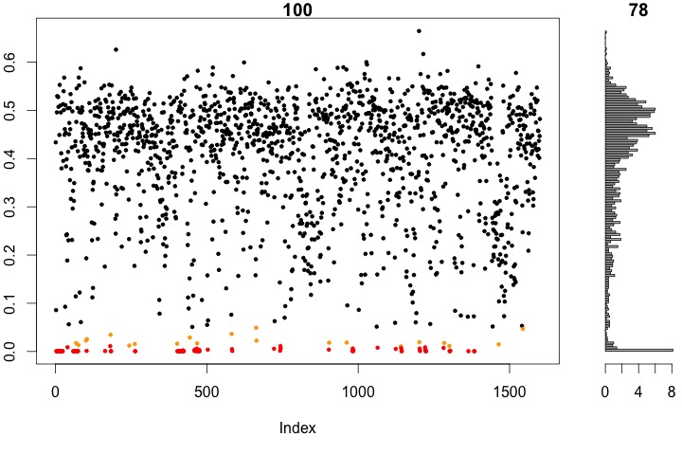
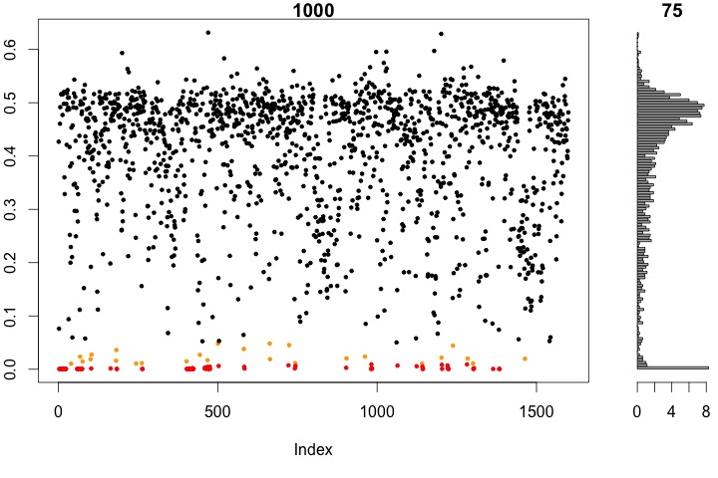
P values are unstable
BH < 0.05
138
BH < 0.05
77
1 Dirichlet instance
50 Dirichlet instances
BH < 0.05
78
BH < 0.05
75
100 Dirichlet instances
1000 Dirichlet instances
Notes:
Many more fragments than we can count

Slide 11
The variance-difference plot
Plot of Within : Between group difference
Convenient way to summarize univarite differences in multivariate data
X axis - maximum variation within either group for each feature
Y axis – Difference between groups for each feature
Lines indicate effect size boundaries
D=1, V=2 E=0.5
D=1 V=0.5 E=2
D=2 V=2 E=1
Read the plot in sectors
Most 16S rRNA sequencing experiments have E<1
Notes:
Many more fragments than we can count

Slide 12
Conclusions
High throughput sequencing datasets are distorted by sequencing
Machine capacity imposes constant sum constraint
High throughput sequencing datasets have significant variation
Variation is proportionally more extreme at low count margins
Modeling and accounting for this variation combined with placing data in the proper space reduces false positive identifications when conducting univariate tests
The ALDEx2 approach is generalizable across experimental designs
Applied to RNA-seq, 16S rRNA gene sequencing, selective growth
Notes:
Many more fragments than we can count

Slide 13
Sources
ALDEx2
http://bioconductor.org/packages/release/bioc/html/ALDEx2.html
Data and this pptx
https://github.com/ggloor/compositions

Slide 14
Analysis 1
# using the supplementary table from Hsio et al, 2013, Cell Microbiota Modulate Behavioral and Physiological Abnormalities Associated with Neurodevelopmental Disorders
# getting ALDEx2: http://www.microbiomejournal.com/content/2/1/15
# you need an R environment installed already
# http://cran.r-project.org
#
# inside of R
# source("http://bioconductor.org/biocLite.R")
# biocLite("ALDEx2”)

Slide 15
Analysis 2
# to read the OTU table
d <- read.table("hsiao5.txt", header=T, row.names=1)
tax.d <- read.table("tax.txt", row.names=1, header=T, sep="\t")
# if you use your own table
# sample1 sample2 sample3 ...
# otu1 0 10 3 ...
# ...

Slide 16
Analysis 3
library(ALDEx2)
# set up the conditions for comparison
# see the documentation for aldex.glm when more than 2 conditions
conds <- c(rep("Bf", 10), rep("C", 10))

Slide 17
Analysis 4
# generate technical replicates and perform the clr transformation
x <- aldex.clr(d, mc.samples=128)
# conduct the statistical tests and calculate FDR corrected values
# data are medians of all Dir instances for each OTU
x.t <- aldex.ttest(x, conds)
# calculate the effect sizes for plotting
x.e <- aldex.effect(x, conds)
# merge into one data frame for plotting and examination
x.all <- data.frame(x.t, x.e)

Slide 18
Analysis 5
aldex.plot(x.all)

Slide 19
Analysis 5
# x.all["837",]
# we.ep we.eBH wi.ep wi.eBH rab.all rab.win.Bf rab.win.C
# 837 0.2413492 0.868727 0.2079292 0.8175367 0.1999454 -0.7850205 1.13357
# diff.btw diff.win effect overlap
# 837 1.783828 3.631399 0.4353015 0.2843751
#
# we.ep - expected P value from a Welch's t-test
# we.eBH - expected Benjamini-Hochberg corrected P value
# wi.ep, wi.eBH - same but using Wilcoxon rank test
#
# rab.all, rab.win.Bf, rab.win.C
# log-ratio abundances relative to the geometric median abundance across all samples,
# within the Bf samples and within the C samples (see conds). These are log2 based ratios
# so a value of -1 is 2-fold less abundant than the median, a value of 2 is 4-fold more
# abundant than the median, and a value of 0 is equal to the median abundance
#
# diff.btw - the difference between the Bf and C values obtained by vector subtraction
# diff.win - the maximum mean absolute difference within the Bf or C group
#
# effect - the ratio of the btw/win differences
#
# overlap - the proportion of the time that the Bf and C distributions overlap in the 128 instances

