Slide 1
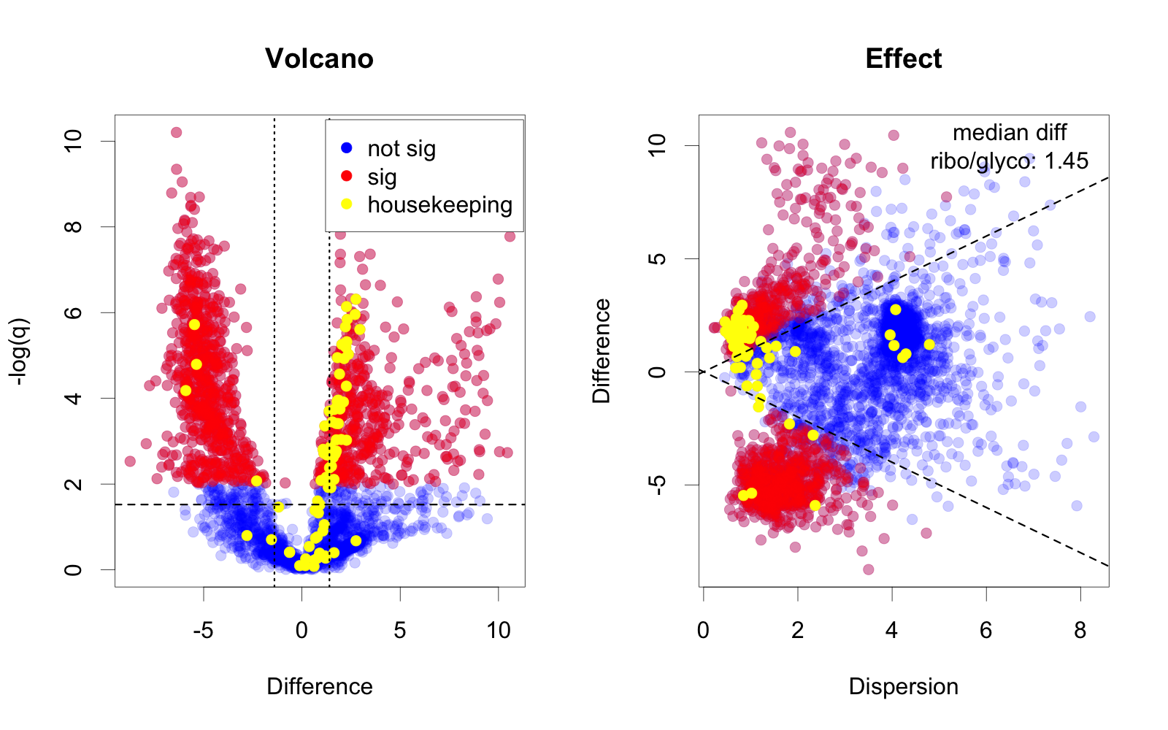
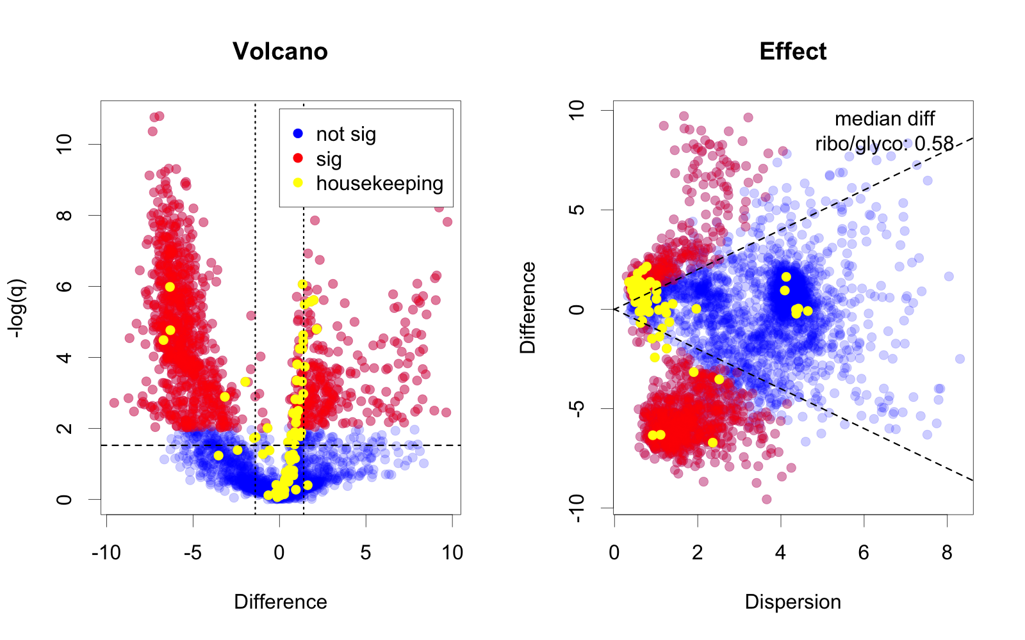
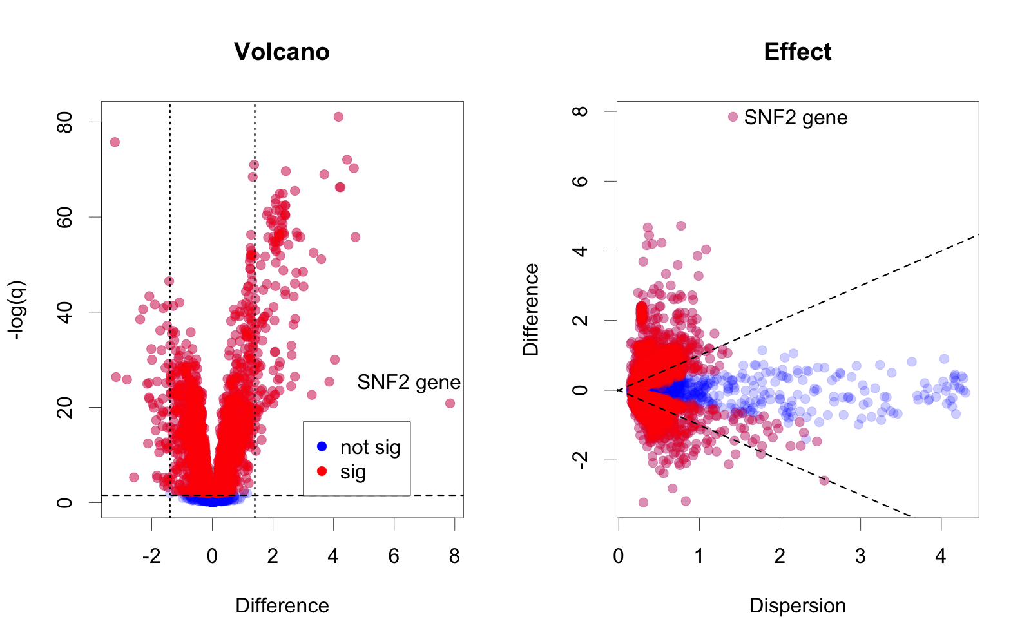
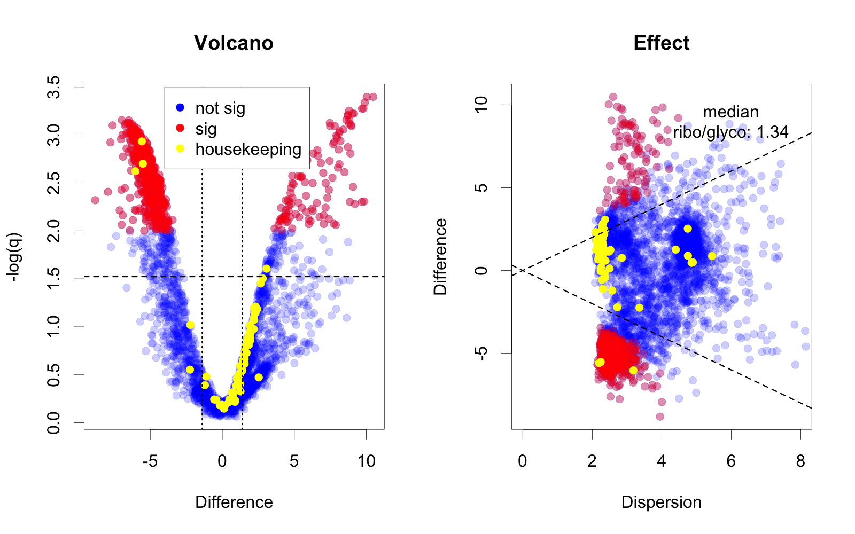
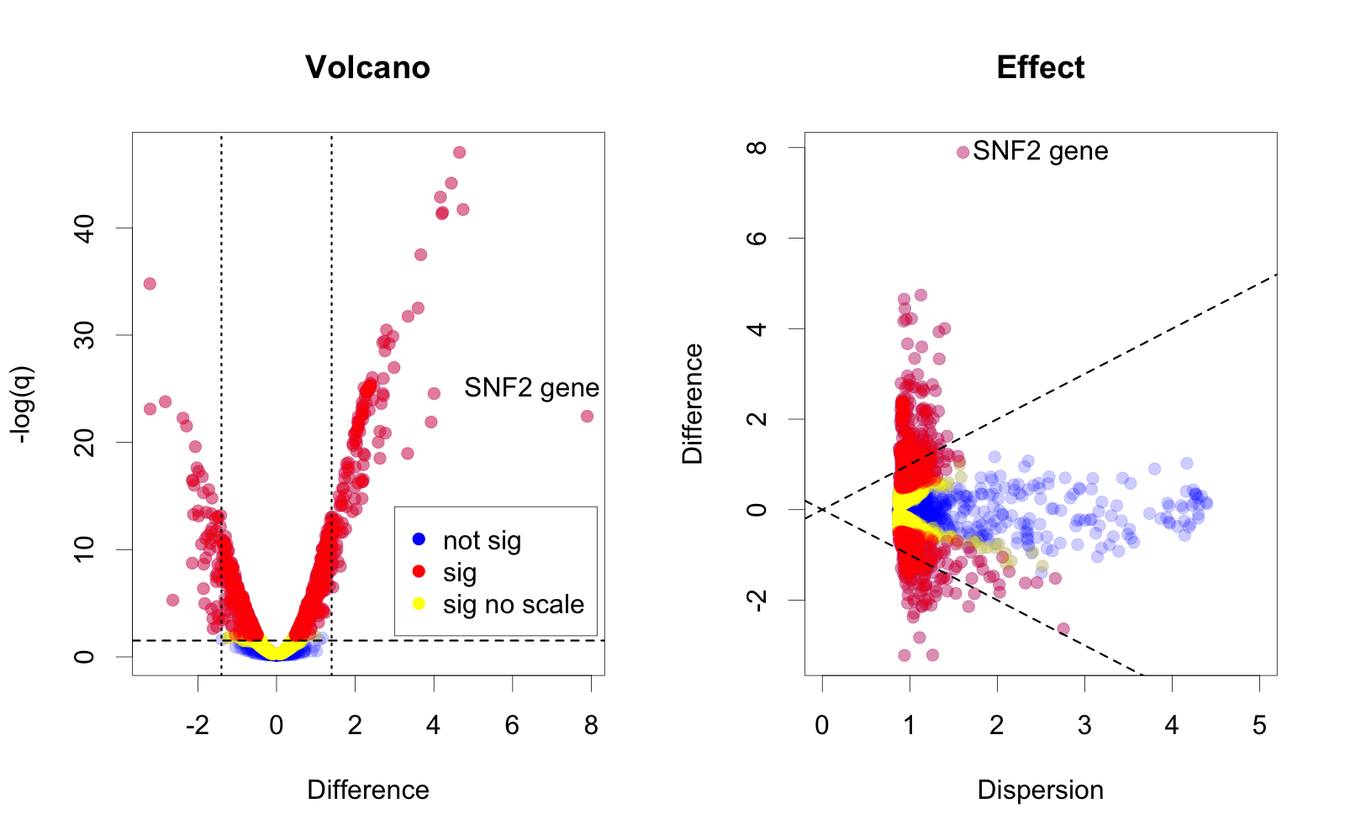
Including location and scale information reduces false positive inference with ALDEx2 when analyzing HTS datasets
Michelle Pistner Nixon°, Justin Silverman°, Greg Gloor*
°College of Information Sciences and Technology, Pennsylvania State University
*Department of Biochemistry, Western Universtity
Determining location and scale of the data is central to proper statistical inference. Current HTS approaches can only compare differences in relative location and assume that scale is a nuisance variable (1,6). This is one of the main reasons that HTS analysis tools appear over-powered (2). Here we introduce a scale estimation parameter (3) that allows the investigator to identify parts that are insensitive to scale differences in the underlying data.
Vaginal metatranscriptome unscaled
Vaginal metatranscriptome centered
Yeast transcriptome unscaled
VAGINAL META-TRANSCRIPTOME: finding the difference and statistical significance for parts is problematic in wildly non-centered data such as this dataset where the underlying absolute abundances of functions differ by two orders of magnitude. Unscaled, we observe 1205 or 33% of all functions being ‘significantly different’ and the majority of housekeeping functions (ribosomal protein and core glycolysis genes) are both significant and different.
To address this, ALDEx2 offers two options scaling and centering. Scaling the data reduces the number of significant parts to 625, or 17% of all functions. While re-centering the data (7) results in 1120 functions (30%). Both of these approaches result in the majority of housekeeping functions from being identified as statistically insignificant and not different.
SCALING and CENTERING: ALDEx2 builds a posterior model of the data through Monte-Carlo Sampling from a multinomial Dirichlet followed by a log-ratio transformation (6). This posterior model can be modified by using a subset of the parts in the denominator to center the data (7) and this shows up as a shift in the location of the data (difference). Difference is plotted in both volcano and effect plots. Alternatively, the posterior model can be altered by using a scale parameter that incorporates uncertainty regarding the underlying scale of the data (2). This shows up as a shift on the dispersion axis on the effect plot but cannot be observed in the volcano plot. Scale is implemented through the ‘gamma’ parameter in the aldex.clr function that is proportional to the underlying scale difference between groups. Scaling and centering will be available in the next release version of ALDEx2 on Bioconductor.
YEAST TRANSCRIPTOME: location is the difference in means, and difference and statistical significance can be determined if the data are centered. We show Volcano and Effect plots (4,5). The yeast transcriptome is a well-centered dataset but is over-powered (2). In part this is because scale is not taken into account as the SNF2 KO strain grows ~2X slower than wt. Scaling the data with ALDEx2 (6) reduces the number of significant genes from 3716 to 1196, or from 63% to 20% of all genes, although the difference cutoff is still likely useful (2).
Vaginal metatranscriptome scaled: gamma = 0.5
Yeast transcriptome scaled: gamma=0.2
Scaling: aldex.clr(data, conds, gamma=value)
Centering: aldex.clr(data, conds, denom=‘lvha’)
References
Robinson (2010) Genome Biol 11:R25.1
Schurch (2016) RNA 22:839
Pistner-Nixon (2023)
https://arxiv.org/pdf/2201.03616.pdf
Cui (2003) Genome Biol 4:210
Gloor (2016) J Comp. Gr. Stat 25:971
Fernandes (2014) Microbiome 2:15
Wu (2021) Adv. Comp. Data. Anal (Springer)

