Slide 1
Microbiome Datasets Are Compositional; Not a Linear Process
Greg Gloor
ggloor@uwo.ca
@gbgloor

Slide 2
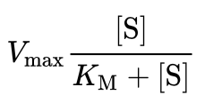
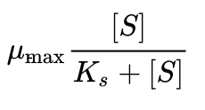
What is linear in the microbiome world?
Both enzyme kinetics and bacterial growth are non-linear
Michaelis-Menten and Monod equations have same form
PCR is an exponential process
Transcriptional and enzymatic activity are measured in ‘fold-change’
Proportional data is relative; i.e., ratio based

Slide 3
Compositional data?
Data with a fixed or arbitrary upper bound
Can always be reduced to a proportion
May be a property of the environment
Fixed carrying capacity
Imposed by sequencing instruments
Nobody ever paid for a MiSeq run and received NovaSeq data!
Not related to total number of types of bacteria that are possible to find in the environment

Slide 4
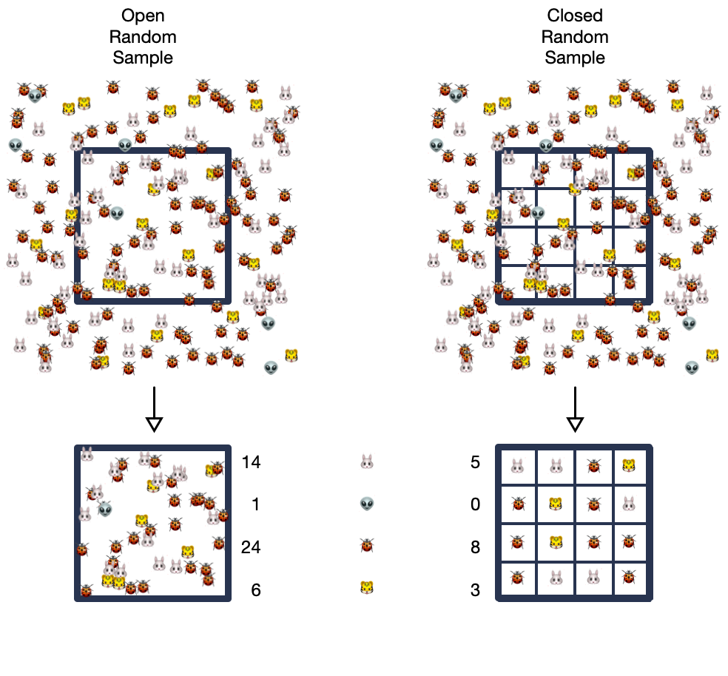
Sequencing is probabilistic sampling …
Open sampling means we count what is in the environment
Closed sampling means we count one event per counting position (sequencing)
Space aliens tend to be under-counted in closed sampling
Each additional rare thing that is added is also undercounted

Slide 5
… that makes proportional sausage
Gloor et al Front. Micro. 2017

Slide 6
Pathologies of sequencing data
Relative data are non-linear
Solution – use log-ratios
Log-ratio linearized data can be used almost without restriction
Correlations are unreliable
Solution – use and look for linear log-ratio relationships
Low count features are sparse and under-represented
Solutions – sequence more deeply, ignore/filter low-count features
Embrace uncertainty to deal with sparsity
No single feature can be interpreted in isolation
Solution – remember that everything is relative to something else

Slide 7
Tools to try:
Compositional biplots of log-ratio transformed data
Replace PCoA plots
True linear relationships easy to observe
Complete summary of dataset
propr
Replaces correlation
ALDEx2, Songbird, ANCOM
Differential abundance
ALDEx2 is probabilistic and compositional
selbal, codacore
Classification using balances: grouped log-ratios with maximal separation
Codacore uses ML to find near optimal groups of log-ratios

