Slide 1
am I compositional? Exploring HTS data pathologies
Greg Gloor
Dep’t of Biochemistry
U. Western Ontario
ggloor@uwo.ca @gbgloor

Slide 2
Motivation
Flexible approach to data analysis by trainees
Often under pressure from supervisor
Need a ‘show me’ quickly tool
CoDa approaches most robust (Nearing 2022. Nat. Comm 13:342)
Reviewer 2
If you are in the room, here is your rebuttal

Slide 3
Count data are sausage contents
Microbiome
transcriptome
Metagenome
Single cell
Discrete random sample of the library which is a random sample of the environment

Slide 4
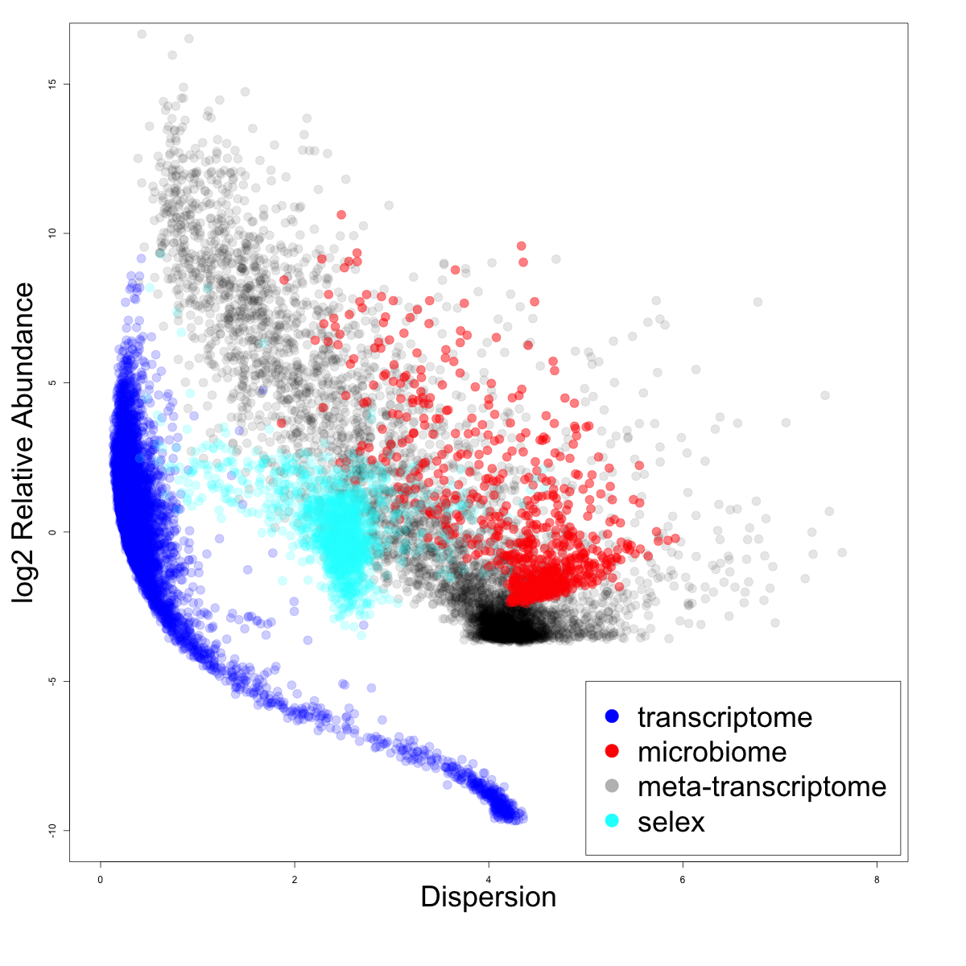
HTS count data are awful
Sparse
Variable
Discrete
Unpredictable
NB or ZIG

Slide 5
Tests and inspiration
Tests from Martín-Fernández (1998)
Sub-compositional dominance
v 50% subset
Perturbation invariance ((+/- 2%)
v 50% non-0 subset
Scale invariance
v 5x change
Correlation tests (Aitchison and Greenacre 2002)
Sub-compositional coherence
v a 50% subset
Data singularity
Common in HTS data

Slide 6
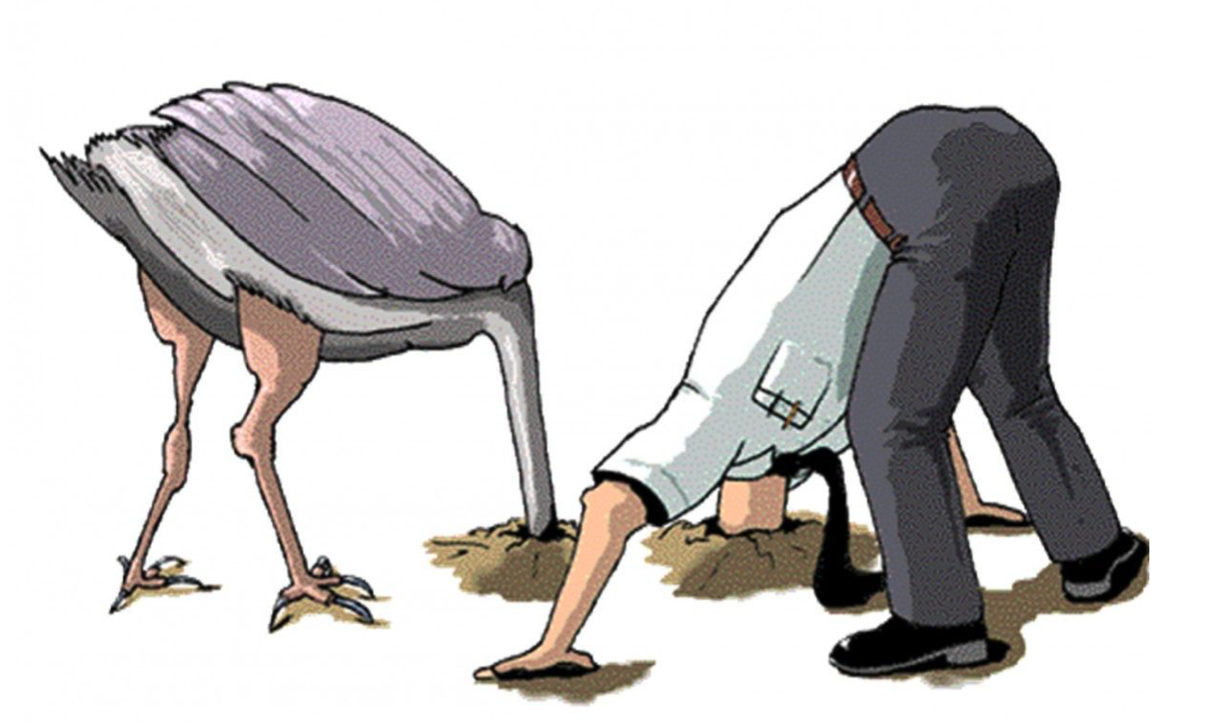
Normalizations
None
Proportion -/+ log
RLE -/+ log (DESeq)
TMM -/+ log (edgeR)
TMMwsp -/+ log (edgeR)
clr

Slide 7
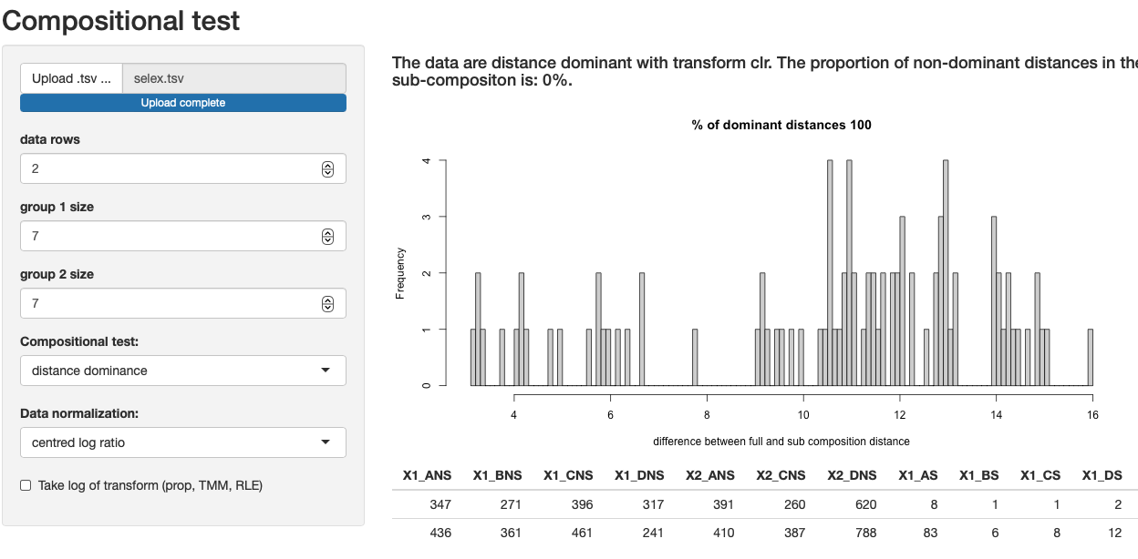
R shiny app with aIc R package backend

Slide 8
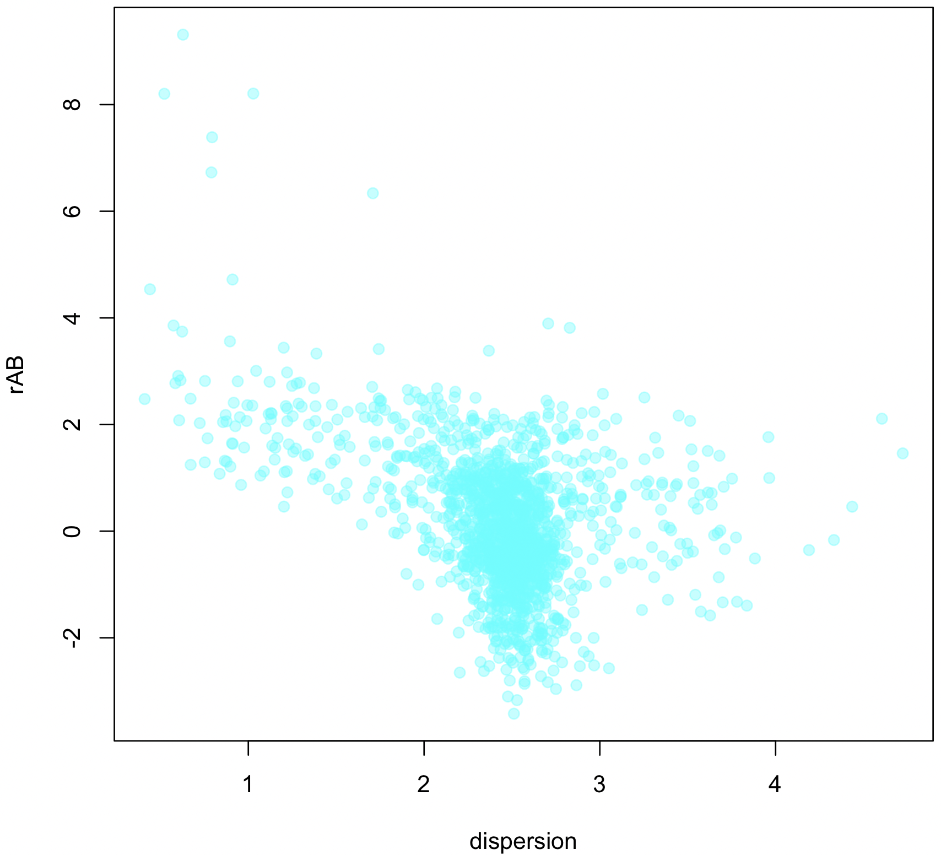
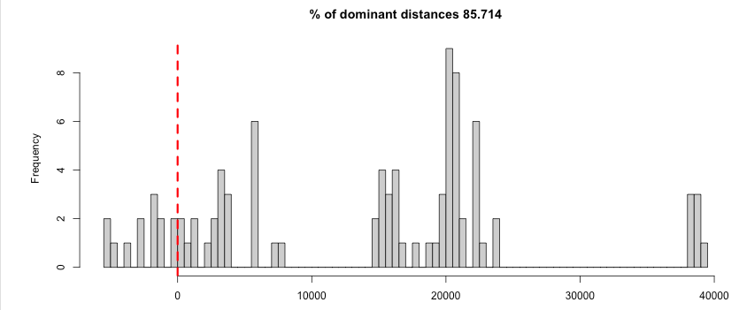
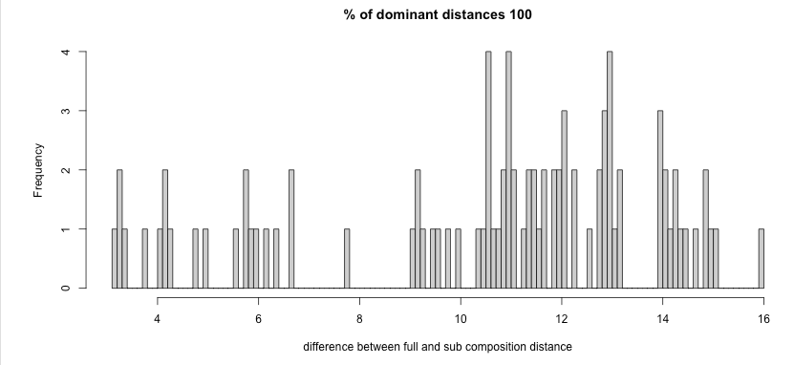
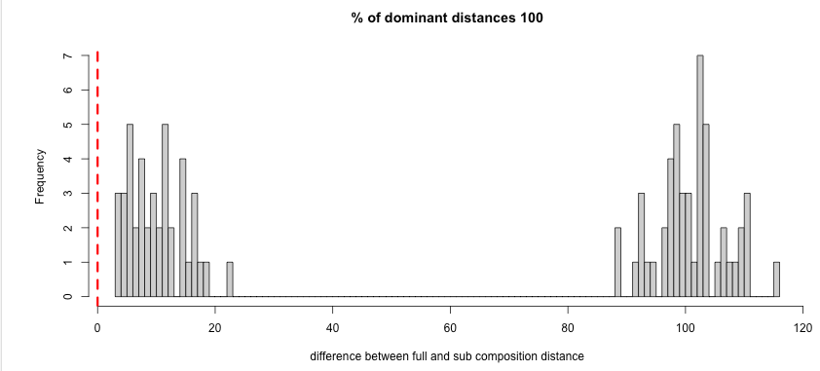

Selex dataset: distance dominance
TMM
CLR
TMM-log

Slide 9
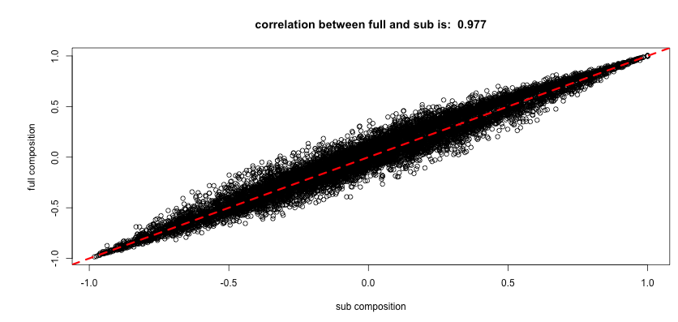
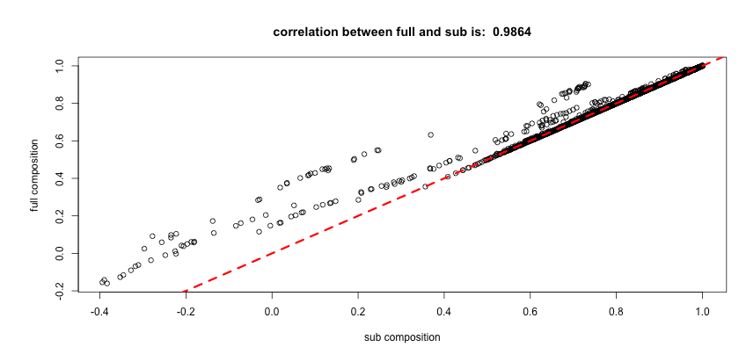
Selex dataset: coherence
CLR
TMM

Slide 10
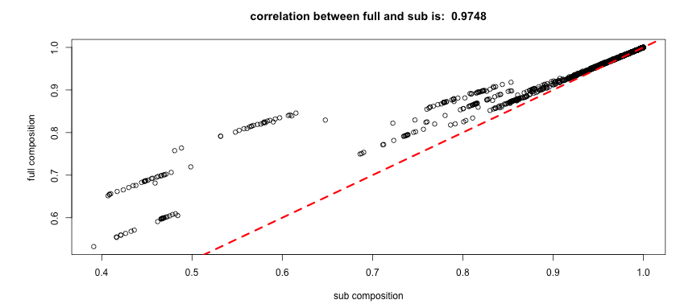
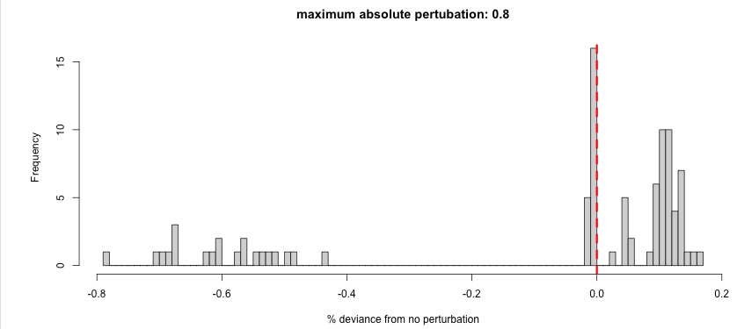
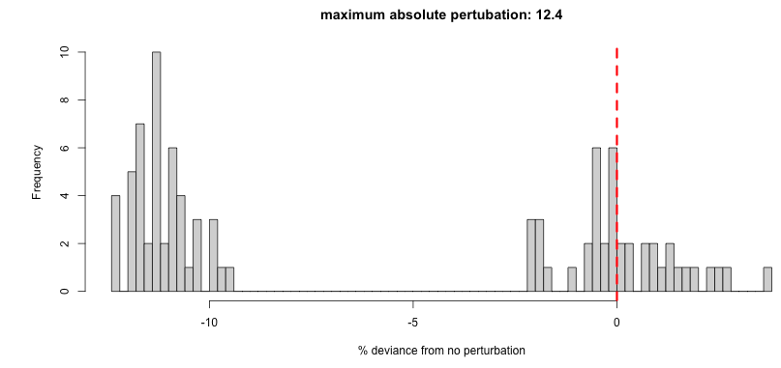
Selex dataset: perturbation
CLR
TMM-log

Slide 11
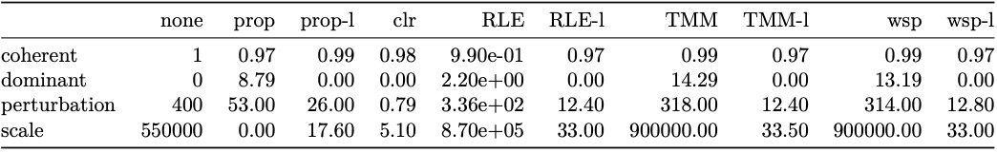




























Selex dataset
DESeq
edgeR

Slide 12
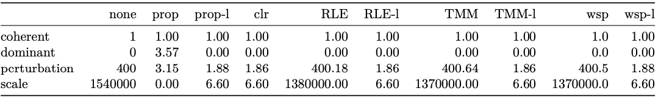



























Transcriptome dataset

Slide 13
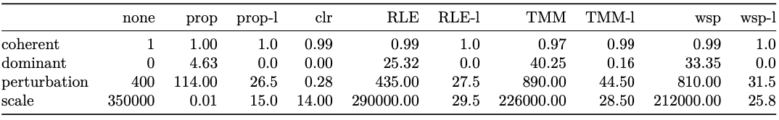


























16S microbiome dataset

Slide 14
Availability and suggestions
Github/ggloor/aIc
R packages
Passes all requirements for Bioconductor
Next step is to add different distance metrics
Github/ggloor/amIcomp
Shiny app
Requires aIc backend
Help with visualizations

Slide 15
Summary
Different experimental designs produce data with wildly different characteristics
Coherence is universally bad when measured by correlation
Data normalizations often fail unpredictably
Transcriptomes are easy
Tools developed in this space may not be generalizable
Compositional (clr) was by far the closest to the ideal under perturbation invariance, scale invariance and distance dominance tests
Sparsity is the enemy of perfection

