Slide 1

Interaction between data normalization and distance metrics in high‐throughput sequencing data
Greg Gloor
Biochemistry, U. Western Ontario
https://github.com/ggloor/compositions/presentations
ggloor@uwo.ca @gbgloor

Slide 2
Motivation
ecological methods spreading to other domains of HTS
'maybe sometimes ecological metrics are useful'
test method designed for probability vectors
want (need) feedback

Slide 3
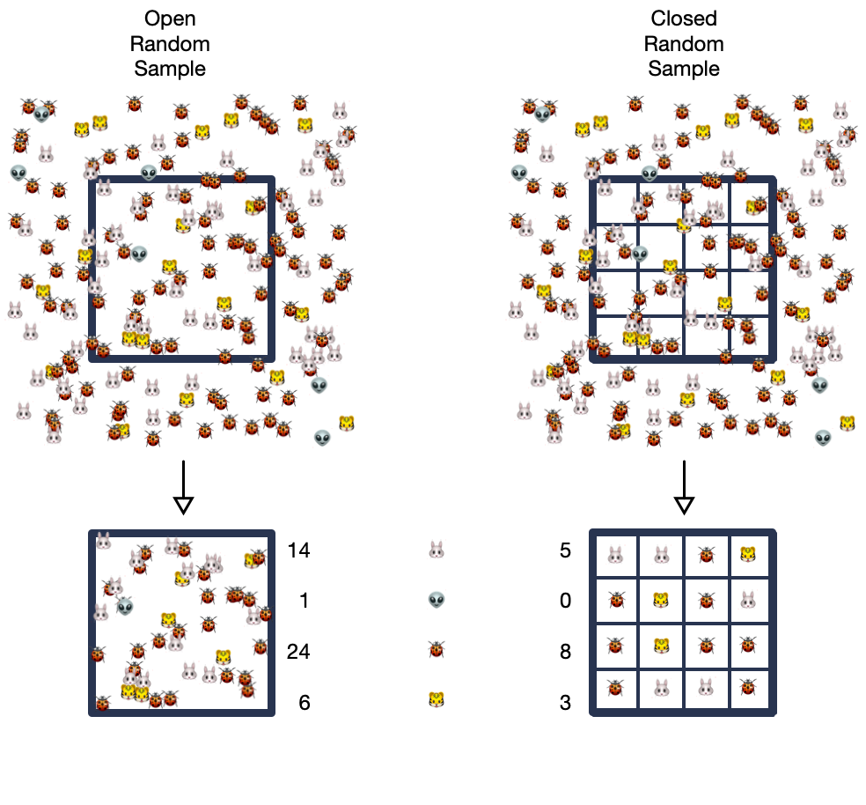
Sequencing is probabilistic

Slide 4
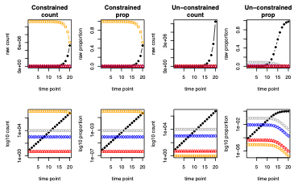
Environments may be constrained or free

Slide 5
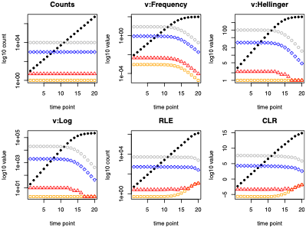
Some common transformations

Slide 6
Early transcriptome normalizations
also called Total Sum Scaling. Often log-transformed
unclosed perturbation of original data. 1 RPKM=1 transcript is C2C12 cells, 3 RPKM = 1 transcript in liver cell line (Mortazavi et al. 2008)
closed RPKM multiple by a constant (Li et al. 2010)
$$rAB_{i}=\frac{s_{i}}{∑\overset{⃗}{\text{s}}}$$
$$RPKM_{i}=\frac{K⋅s_{i}}{∑\overset{⃗}{\text{s}}⋅L_{i}}$$
$$TPM_{i}=\frac{RPKM_{i}}{∑RPKM}⋅K$$
None of these are scale invariant

Slide 7
Scaling normalization methods
Concept here is that counts per sample can be normalized to a per-sample midpoint, and that such a normalization can approximate the numbers of features in the underlying environment
Popular (pervasive) in transcriptome, microbiome, metagenome
Assume that the total count in the environment is the same, and that most features do not vary (constrained environment)
Methods differ in how they choose the midpoint
trimmed mean of M values (TMM, edgeR)
cumulative sum scaling (CSS, metaGenomeSeq)
relative log expression (RLE, DESeq)

Slide 8
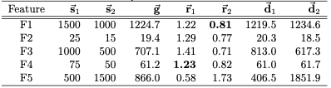
Calculating RLE
feature-wise geometric mean
sample count divided by previous
sample could divided by median of previous sample-wise
$$\overset{⃗}{\text{g}}=G{\overset{⃗}{f}}_{i}$$
$${\overset{⃗}{\text{r}}}_{j}=\frac{{\overset{⃗}{\text{s}}}_{j}}{\overset{⃗}{\text{g}}}$$
$${\overset{⃗}{\text{d}}}_{j}=\frac{{\overset{⃗}{\text{s}}}_{j}}{\overset{˜}{{\overset{⃗}{\text{r}}}_{j}}}$$

Slide 9
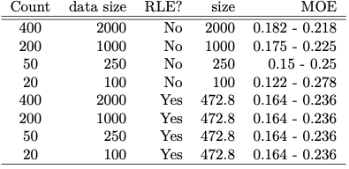
We gain or lose apparent information

Slide 10
A simple test dataset - unconstrained
50 samples of random Normal data, enforced minimum 0.1
50 +/- 25
10000 +/- 2500
1000 +/- 250
5 +/- 2.5

Slide 11
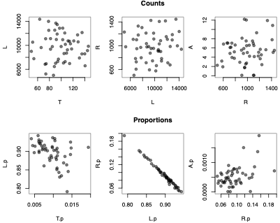
counts vs. proportions (etc)

Slide 12
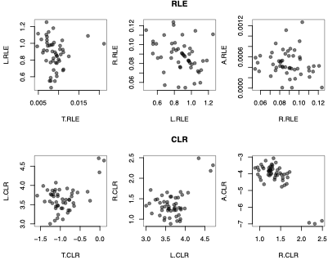
RLE and CLR

Slide 13

Distances
Martín-Fernández et al. 1998
Bray-Curtis dissimilarity (or symmetrized as a distance) is a normalized Manhattan distance
Jensen-Shannon Distance is a symmetric version of the Kulback-Leibler divergence metric widely used to compare probability vectors (Enterotypes: Arumugam Nature 2011)
Aitchison is the Euclidan distance of the CLR

Slide 14
Distances
Martín-Fernández et al. 1998
Perturbation invariance
Remember, we care about the environment, not the data after sequencing!
Subcompositional dominance

Slide 15
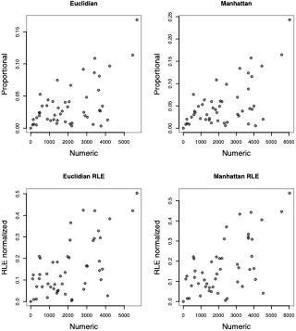
Distances and normalizations
RLE normalization fixes the problem - right?

Slide 16
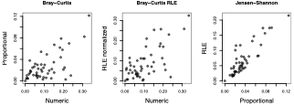
Distances and normalizations
RLE fixes the problem with the right metric - right?

Slide 17
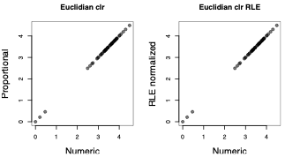
Distances and normalizations
We need to change the problem

Slide 18
Summary
HTS is compositional
The environment can only be safely modelled as an open environment
Sequencing data should tell us about the environment, not just the post-sequencing data
Only compositionally-appropriate distances tell us about the environment

