Slide 1
Manual curation of PPs
:/

Slide 2
Scenario 1: Location Data
In addition, we collect location information (such as tourist attractions, shops, or other points of interest) if you choose to add the location information to your User Content.
We automatically collect information about your approximate location (e.g. country, state, or city) based on your Technical Information (such as SIM card and IP address). Also, where you enable location services for the TikTok app within your device settings, we collect approximate location information from your device. Click here to learn more about how we collect Location Information.

Slide 3
Scenario 1: Location Data
In addition, we collect location information (such as tourist attractions, shops, or other points of interest) if you choose to add the location information to your User Content.
We automatically collect information about your approximate location (e.g. country, state, or city) based on your Technical Information (such as SIM card and IP address). Also, where you enable location services for the TikTok app within your device settings, we collect approximate location information from your device. Click here to learn more about how we collect Location Information.

Slide 4
Scenario 1: Location Data
In addition, we collect location information (such as tourist attractions, shops, or other points of interest) if you choose to add the location information to your User Content.
We automatically collect information about your approximate location (e.g. country, state, or city) based on your Technical Information (such as SIM card and IP address). Also, where you enable location services for the TikTok app within your device settings, we collect approximate location information from your device. Click here to learn more about how we collect Location Information.

Slide 5
Scenario 1: Location Data
In addition, we collect location information (such as tourist attractions, shops, or other points of interest) if you choose to add the location information to your User Content.
We automatically collect information about your approximate location (e.g. country, state, or city) based on your Technical Information (such as SIM card and IP address). Also, where you enable location services for the TikTok app within your device settings, we collect approximate location information from your device. Click here to learn more about how we collect Location Information.

Slide 6
Scenario 2
Contacts!

Slide 7
Scenario 3
We may access, preserve, and share the information described in "What Information We Collect" with law enforcement agencies, public authorities, researchers, copyright holders, or other third parties if we have good faith belief that it is necessary to:
But "What Information We Collect" is all the data they collect!
PoliGraph outputs this as UNSPECIFIED_DATA
Should we say “All the information we collect”?

Slide 8
Other instances of UNSPECIFIED_DATA
When you interact with any third party service (such as third party apps, websites or products) that integrate TikTok Developer Tools, we will receive the information necessary to provide you with features like cross-service authentication or cross-posting.
We may also receive information from third party providers which we use for safety purposes, including to protect users on the Platform and for content moderation.
We share your information directly with advertisers where you give us your permission.
We share your information with independent researchers to facilitate research that meets certain criteria as described in Our Legal Bases and How We Process Your Information.

Slide 9
Other instances of UNSPECIFIED_DATA
When you interact with any third party service (such as third party apps, websites or products) that integrate TikTok Developer Tools, we will receive the information necessary to provide you with features like cross-service authentication or cross-posting.
We may also receive information from third party providers which we use for safety purposes, including to protect users on the Platform and for content moderation.
We share your information directly with advertisers where you give us your permission.
We share your information with independent researchers to facilitate research that meets certain criteria as described in Our Legal Bases and How We Process Your Information.

Slide 10
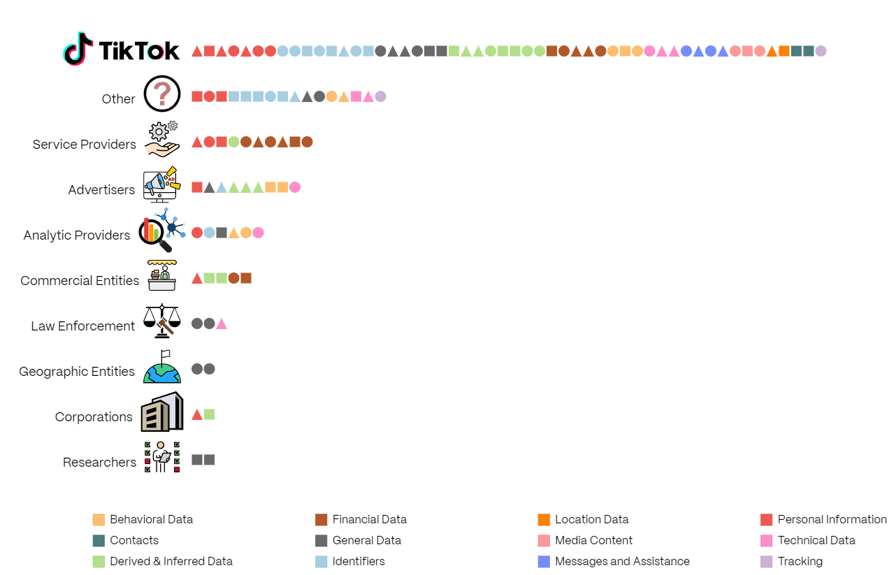

Slide 11
