Slide 1

Improving Privacy Policies with Visual Representations
Design Workshop
Notes:
Hello everyone, my name is Gonzalo Mendez​.
I am here with my colleague Luis Galárraga.
The work we will present in this talk is a collaboration between ourselves,
Katherine Chiluiza, and Patricio Mendoza.

Slide 2
Who is here?
Notes:
In previous work, we presented iCoRA,

Slide 3
Who we are
Gonzalo Gabriel Méndez
Researcher at HASP
Human-centred & AI Security, Ethics and Privacy
We work at the intersection between Artificial Intelligence, Cyber Security, and Human-Computer Interaction
Notes:
An interactive visualization tool that supports academic term planning.
iCoRA provides grade predictions by using students’ historical performance information
and it also provides visual explanations of its predictions.

Slide 4
One thing we are currently doing…
Notes:
In previous work, we presented iCoRA,

Slide 5
Privacy Policies
A Privacy Policy is a statement from an organization that explains:
What personal data they collect
How they use, store, and protect that data
Rights users have over their data
Notes:
An interactive visualization tool that supports academic term planning.
iCoRA provides grade predictions by using students’ historical performance information
and it also provides visual explanations of its predictions.

Slide 6
About Privacy Policies
Privacy Policies are designed to:
Inform users about data practices and protect personal information
Comply with legal requirements, like GDPR or CCPA
Build transparency and trust between users and organizations
Notes:
An interactive visualization tool that supports academic term planning.
iCoRA provides grade predictions by using students’ historical performance information
and it also provides visual explanations of its predictions.

Slide 7
About Privacy Policies
For users, understanding Privacy Policies helps:
Make informed decisions about sharing personal data
Ensure their rights and privacy are respected online
Gain insight into how organizations handle data
Notes:
An interactive visualization tool that supports academic term planning.
iCoRA provides grade predictions by using students’ historical performance information
and it also provides visual explanations of its predictions.

Slide 8
About Privacy Policies
However…
Most policies are complex and not user-friendly
We believe that…
Improving PP comprehension could lead to better-informed users and more trust in digital services
Notes:
An interactive visualization tool that supports academic term planning.
iCoRA provides grade predictions by using students’ historical performance information
and it also provides visual explanations of its predictions.

Slide 9
What are we here for?
Notes:
In previous work, we presented iCoRA,

Slide 10
Our Current Goal
Improving PPs accessibility through visual representations
In this workshop we want you…
To create visual solutions that make PPs easier to understand
Notes:
An interactive visualization tool that supports academic term planning.
iCoRA provides grade predictions by using students’ historical performance information
and it also provides visual explanations of its predictions.

Slide 11
In this Workshop
Four activities:
Activity 1: Reading a Privacy Policy
Activity 2: Design a Visual Representation of a Privacy Policy.
Activity 3: Evaluate a Tool for Visualizing Privacy Policies.
Group Discussion: Gather feedback and discuss improvements.
Notes:
An interactive visualization tool that supports academic term planning.
iCoRA provides grade predictions by using students’ historical performance information
and it also provides visual explanations of its predictions.

Slide 12
Let’s begin!
Notes:
In previous work, we presented iCoRA,

Slide 13
Activity 1: Reading a Privacy Policy
Read the Privacy Policy available at:
English version:
Spanish version:
t.ly/NHwGA
t.ly/OGGs1
You will have about 15 minutes to complete this activity.
Please, try to read as much of the PP as you can in this time.
Notes:
An interactive visualization tool that supports academic term planning.
iCoRA provides grade predictions by using students’ historical performance information
and it also provides visual explanations of its predictions.

Slide 14
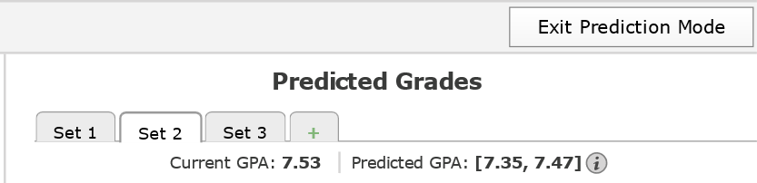
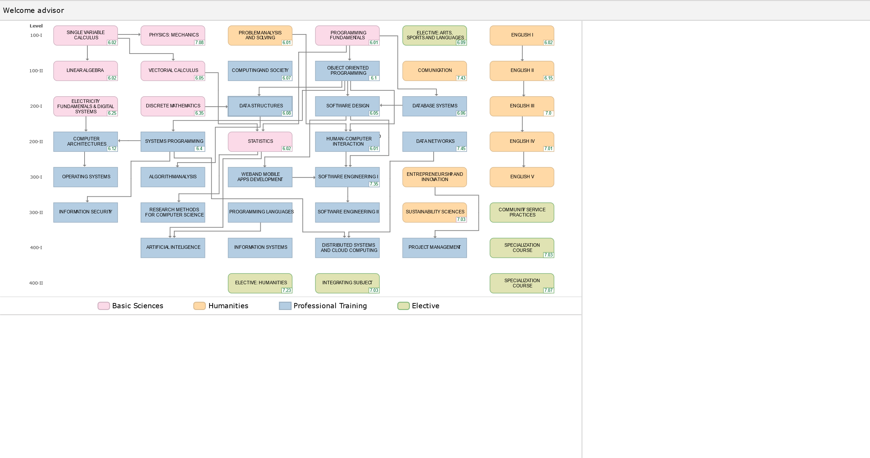
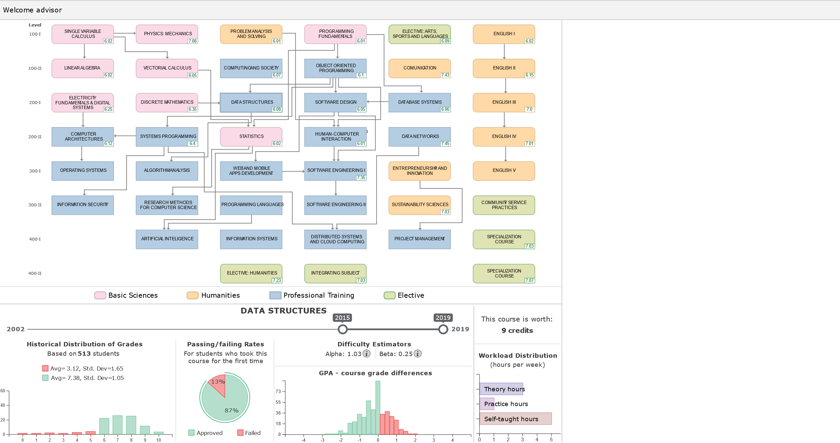
Notes:
This is how the tool looks like.
Upon opening, it shows the student’s academic program.
Clicking on a course in this view shows the course’s general information,
such as its historical distribution of grades, or its passing and failing rates.

Slide 15
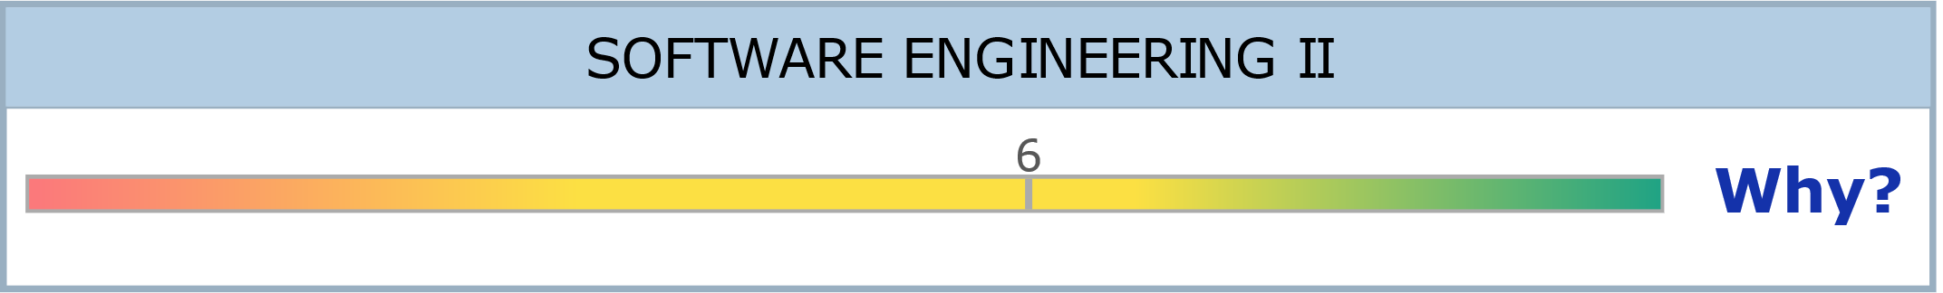

6.93
7.83
Notes:
Users can drag the elements of this view to the tool’s prediction panel.
These interactions trigger iCoRA’s prediction models.

Slide 16
6.93
7.83
6.93
7.83
Notes:
The grade predicted for a course is shown as a range composed of an optimistic and a pessimistic prediction.

Slide 17
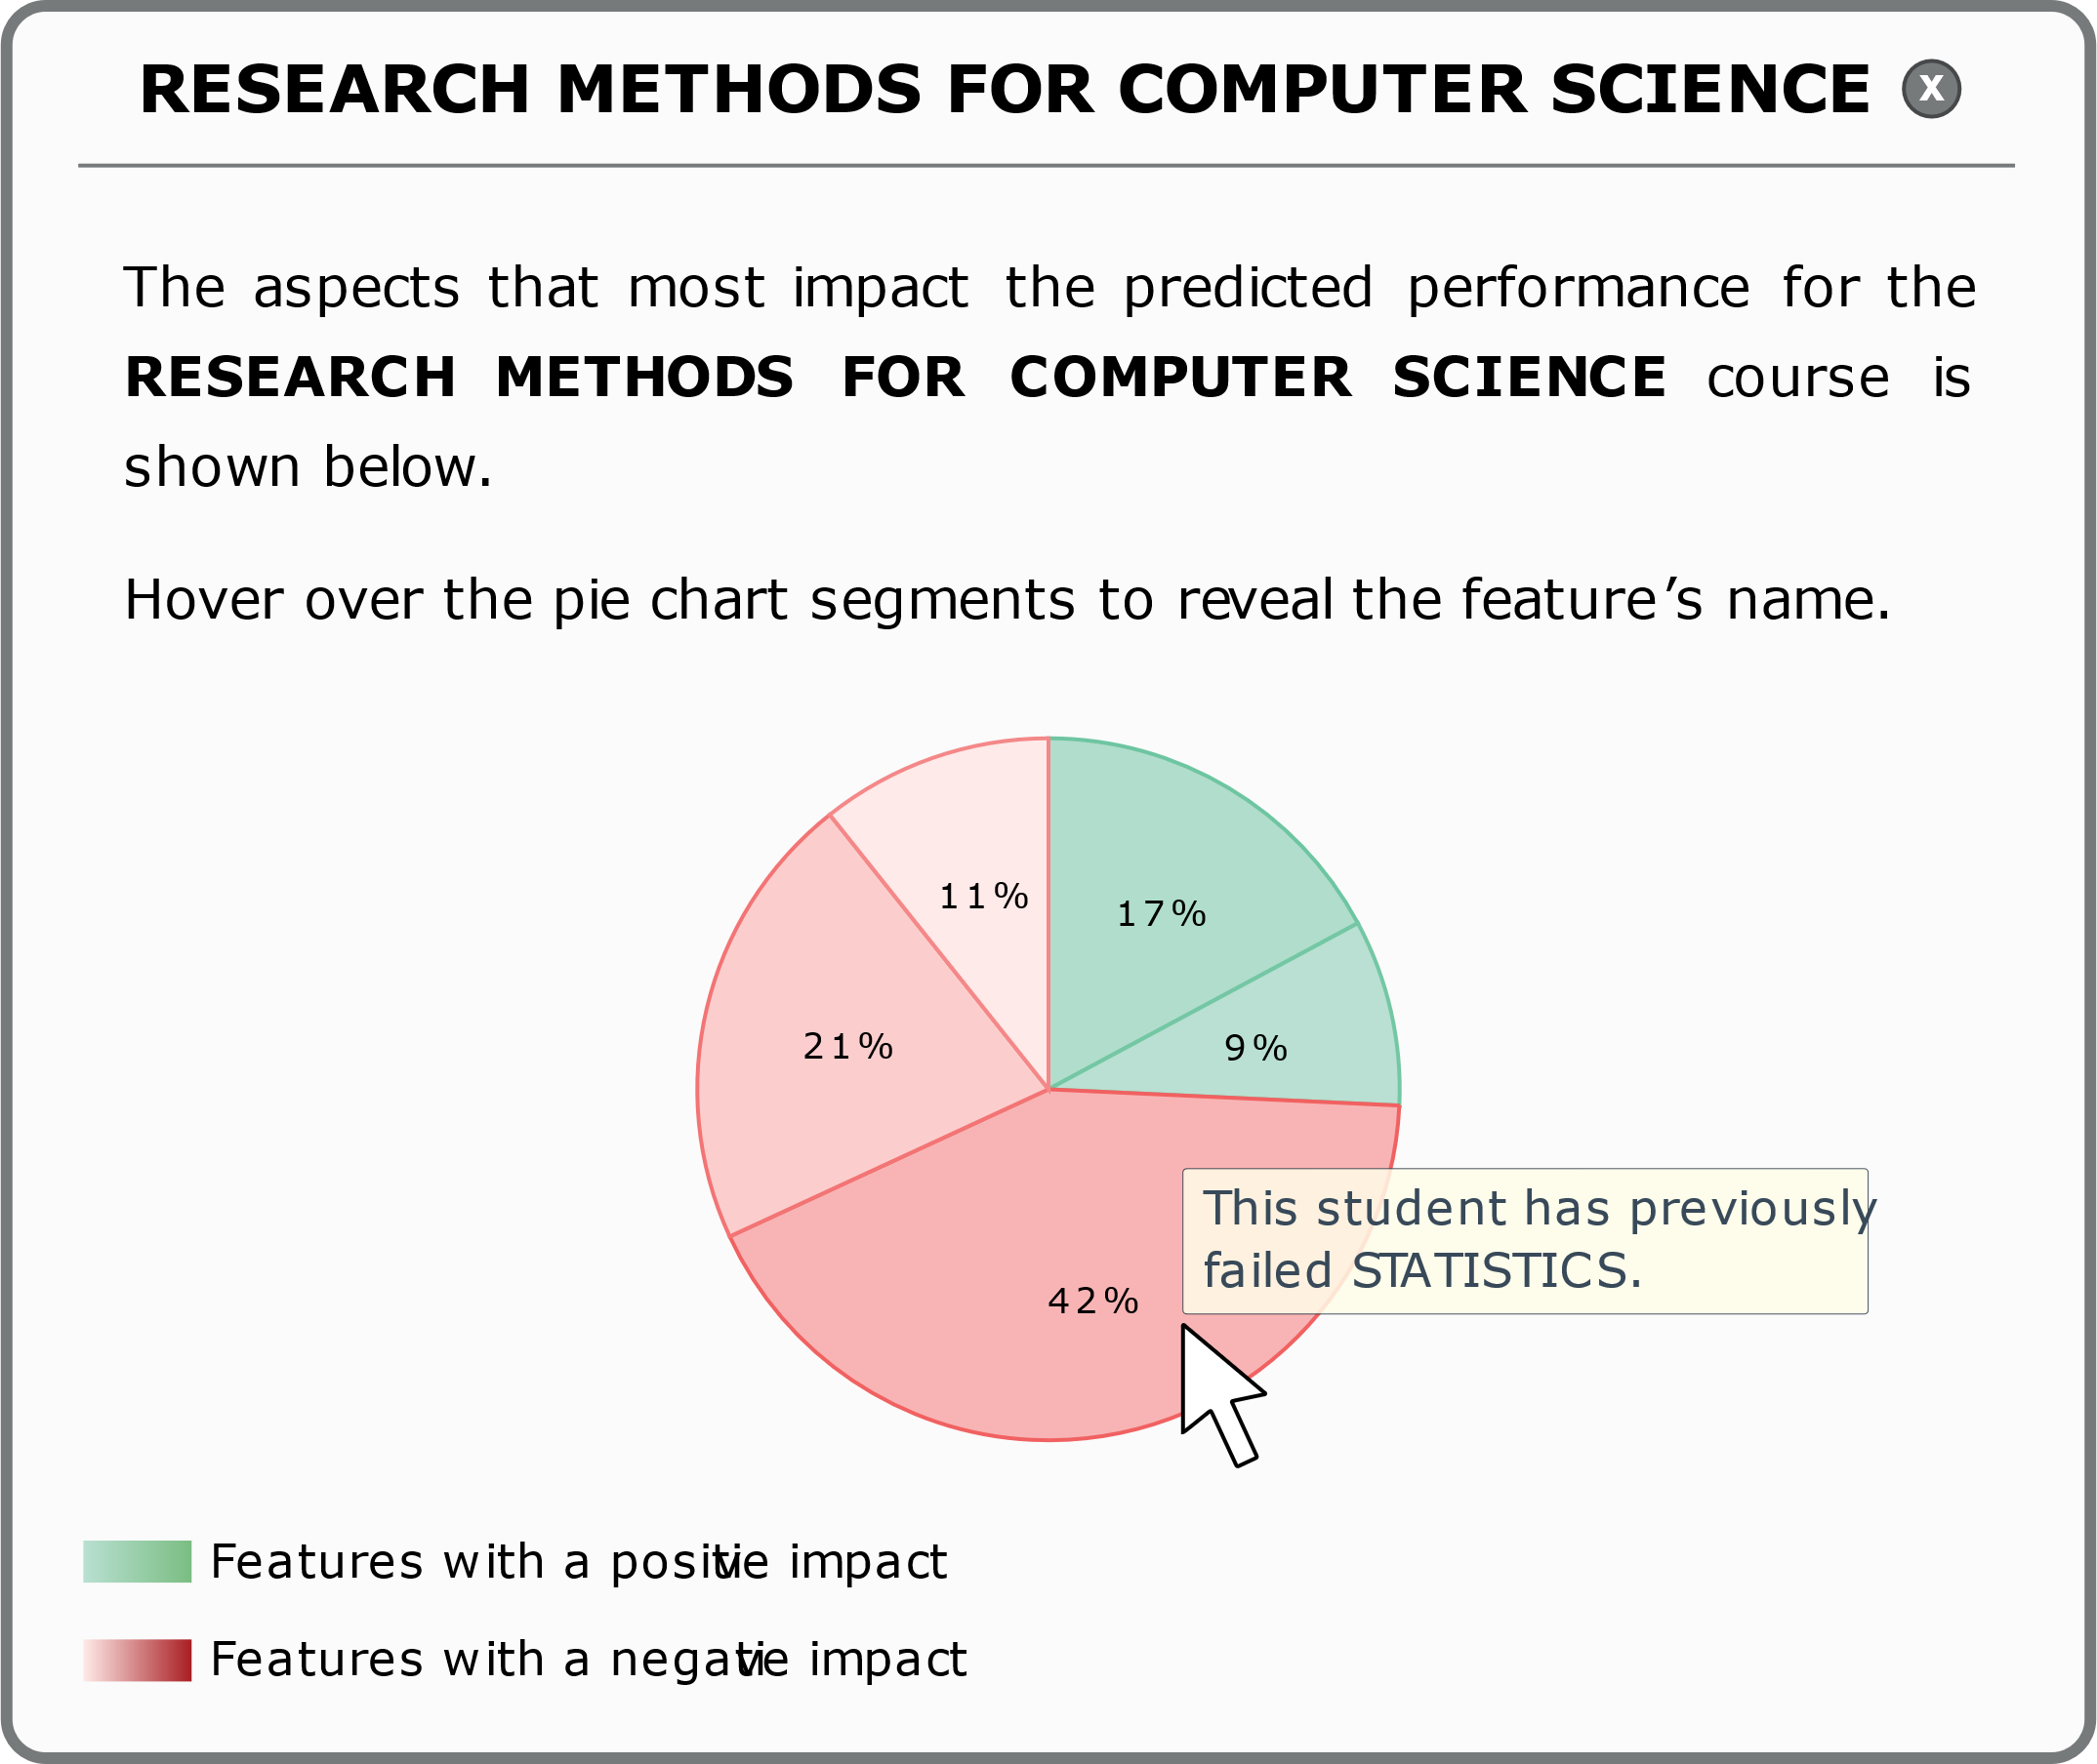
6.93
7.83
Notes:
Additionally, each grade prediction is shown with a “why” button
that enables users to see the positive or negative contribution
of the different features used by the tool’s predictive models.

Slide 18
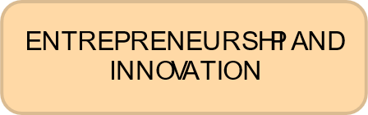
6.93
7.83
Notes:
Finally, when planning an academic term,
adding courses to (or removing the from) a set
automatically updates existing predictions.

Slide 19
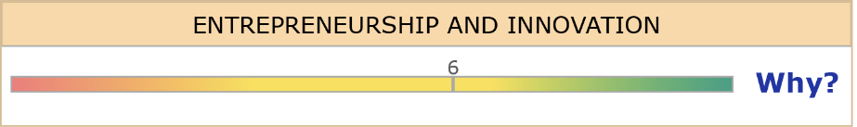
5.50
6.50
6.93
7.83
Notes:
Finally, when planning an academic term,
adding courses to (or removing the from) a set
automatically updates existing predictions.

Slide 20
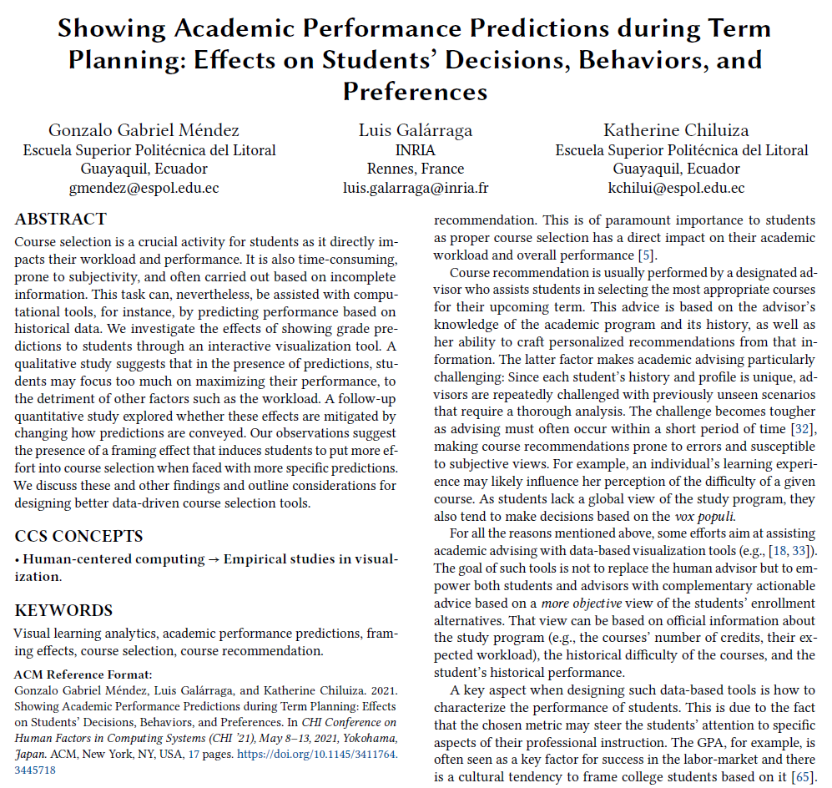
When students plan a forthcoming term
CHI’ 21
They tend to approach course selection as a grade maximization problem
Show little interest in understanding the rationale behind the predictions
Visual representation influences how much students trust the tool’s predictions
https://dl.acm.org/doi/10.1145/3411764.3445718
Notes:
In a 2021 CHI 2021, we investigated the effects that iCoRA had on students
when they plan a forthcoming academic term.
We found that, when using the tool, students tend to approach course selection as a grade maximization problem.
And they showed little interest in the explanations provided by the tool.
We also found that the type of visual representation used to convey the grade predictions influences how much students trust the tool.

Slide 21
In this paper…
Notes:
In this paper, we seek to investigate the perspective of academic advisors when using iCoRA.

Slide 22
The academic advisors’ perspective
RQ1: What are the effects of grade predictions on the advisors’ approach to course recommendation?
RQ2: How does the student’s profile impact the advisors’ strategy to recommend courses?
Notes:
In particular, we seek to answer:
What are the effects of grade predictions on the advisors’ approach to course recommendation?
And
How does the student’s profile impact the advisors’ strategy to recommending courses?

Slide 23



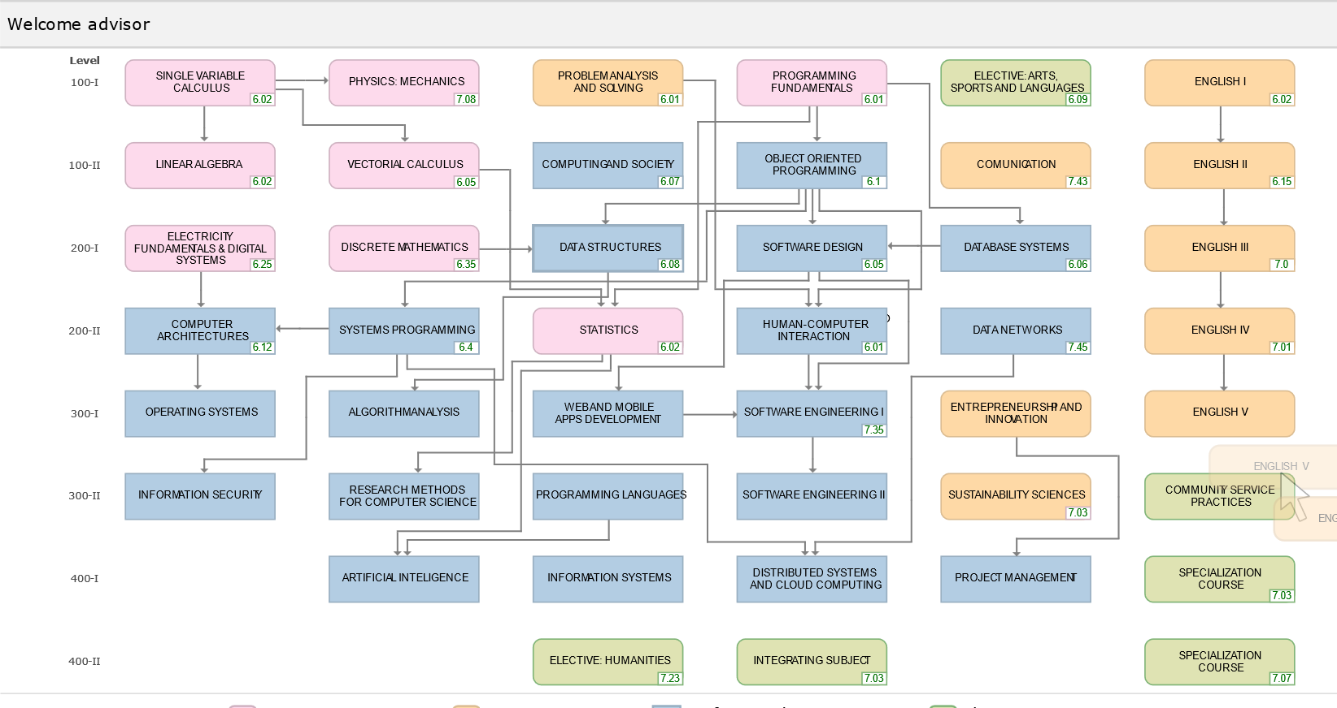



The academic advisors’ perspective
Computer Science Program
15 advisors
Engineering-oriented university
iCoRA
Three students
Outstanding
student
Average
student
Struggling
student
Notes:
To answer these research questions, we invited 15 academic advisors from a computer science program
in an engineering-oriented university.
The advisors used iCoRA to recommend a set of courses to three different students:
One outstanding student, one average-performing student, and one struggling student.

Slide 24
Findings
Notes:
And now, Luis is going to tell us what we found…

Slide 25
Quantitative Results

Slide 26
1) Advisors’ Recommendations
On average, advisors assigned lower workloads to the low-performing student
Positive GPA gain only for the low-performing student
A trend towards disagreement for the low-performing student, and agreement for the high-performing student

Slide 27
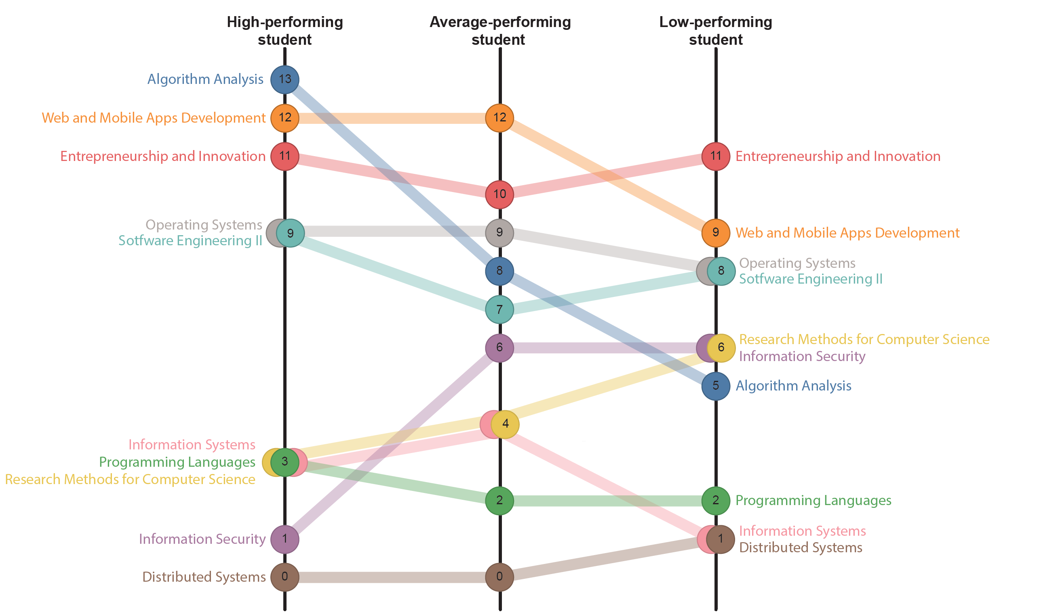
2) Frequently Recommended Courses

Slide 28
3) Interaction Effort of the Recommendation Task
On average, the advisors spent more time making a recommendation for the low-performing student
Most advisors opened the grade explanations at some point. However, overall, they showed little interest in this functionality
The low-performing student sparked more interest in the explanations

Slide 29
Qualitative Analysis

Slide 30
4) Advisors’ Approach to Recommending Courses
Considered their experience and personal perspectives on the courses
Predictions were not considered in all the course recommendations tasks
I would make my recommendations based on my experience, because we know the stuff.
P12
This [the course’s number of hours] is what the curriculum specifies, but not what the students tell me [...] Personally, I would ignore this information.
P15
In these cases, advisors reviewed the student’s academic history thoroughly

Slide 31
4) Advisors’ Approach to Recommending Courses
All advisors tried to balance the load of the sets they suggested
When they have a GPA like this, one normally does not recommend them to take more than four courses.
Particularly important when recommending courses to the low-performing student
P08
There was one student who had a very good GPA, so I recommended them to take the entire row of courses.
For the high-performing student, most advisors were willing to recommend high-load sets
P13

Slide 32
5) Advisors’ Concerns
Trust
I can’t really trust the tool’s predictions. I just don’t think the grades of a group of students can be used to predict the performance of another.
Undesired effects of grade predictions
The tool could push the students to always focus on their grades and not on what they are going to learn, as it is purely based on the grades but provides no information about the contents of a course.
P11
Not a replacement
P10
This tool should not be a replacement of the advisor, because we do more than just recommending courses. There are human aspects that only the advisor can address during the advising sessions.
P04

Slide 33
Conclusions

Slide 34
RQ1: Impact of the Grade Predictions
In general, the advisors’ opinion and experience prevailed over iCoRA’s predictions
Previous exchanges with students
Perception of the actual workload of the courses
Institutional enrollment guidelines
Advisors’ recommendations mainly based on
Advisors’ prior views did not only override iCoRA’s predictions, but also the course’s workload and time commitment information.
These observations are in stark contrast to what we observed with students

Slide 35
RQ2: Impact of the Student’s Profile
Clear distinction in the advising strategy for the low-performing student
Advisors were more willing to take risks for the students with better performance profiles
We observed higher averages and dispersion for the time invested in the low-performing student
This student profile also incurred the highest disagreement among advisors
Notes:
They believed these students could overcome pessimistic grade predictions

Slide 36
Thanks!
Notes:
Hello everyone, my name is Gonzalo Mendez​.
I am here with my colleague Luis Galárraga.
The work we will present in this talk is a collaboration between ourselves,
Katherine Chiluiza, and Patricio Mendoza.

