Slide 1
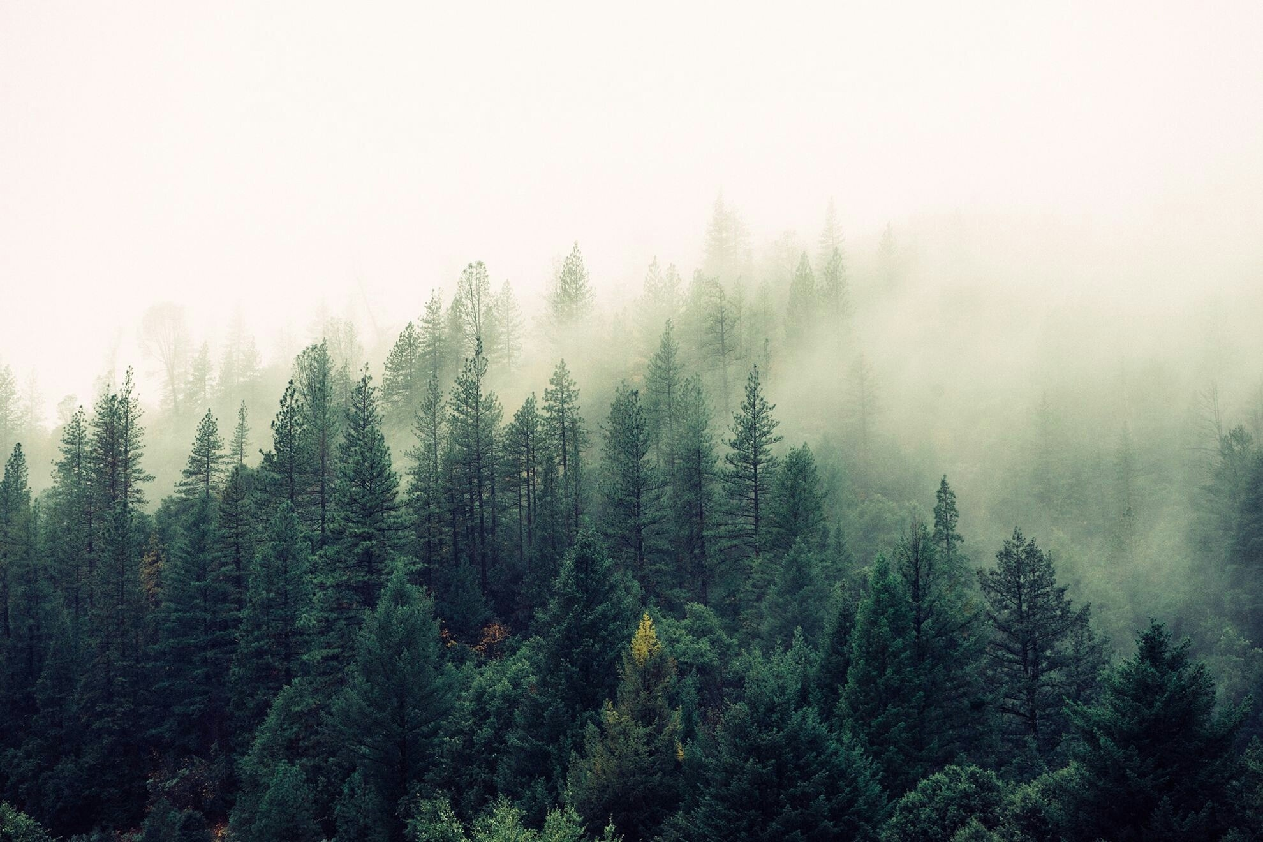
Exploring the use of microworlds to teach about forest management and climate change.

Slide 2
The Tool

Slide 3
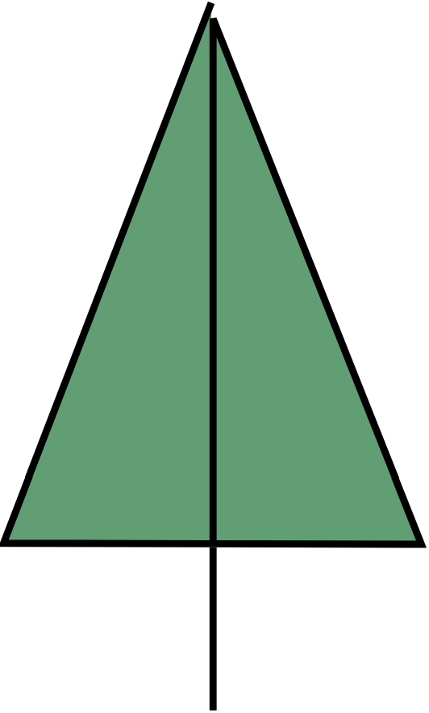
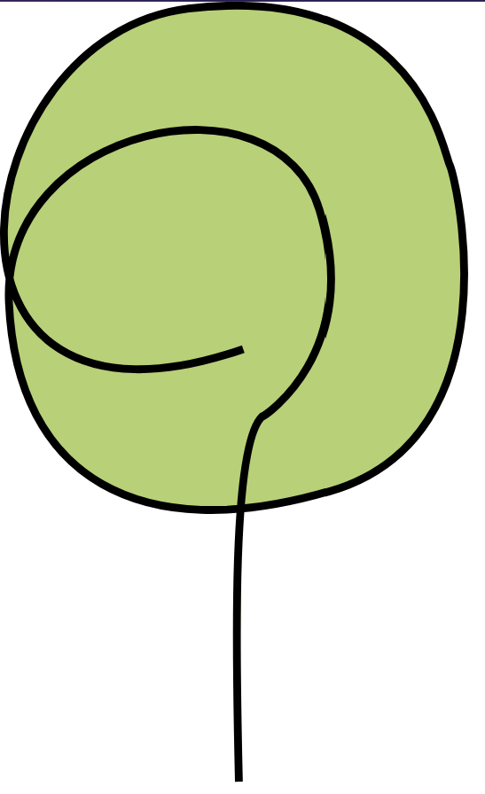

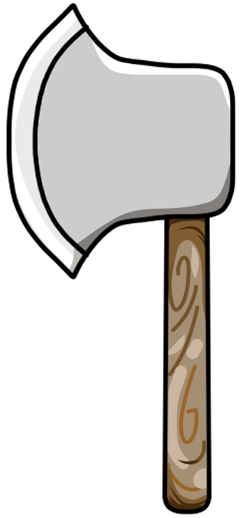

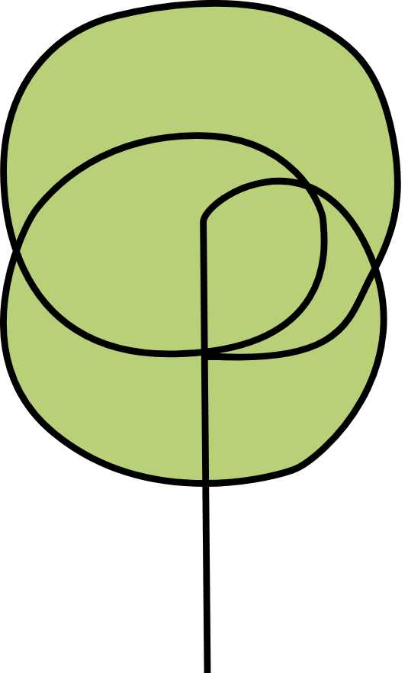
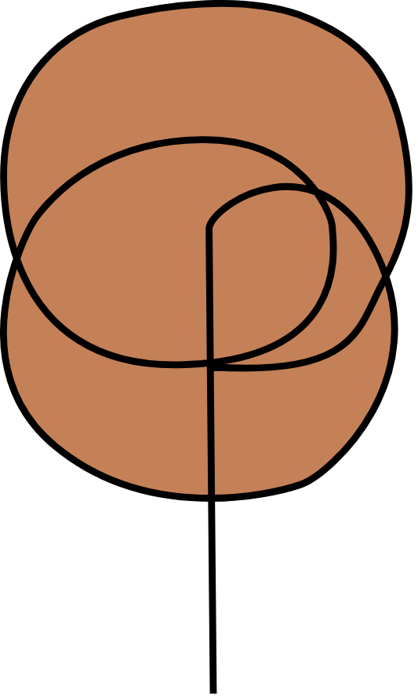



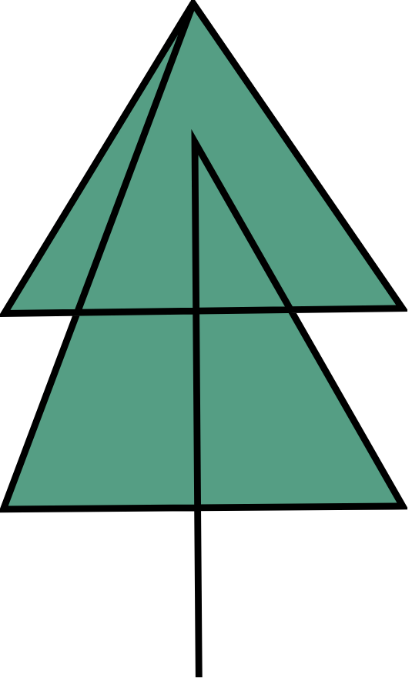
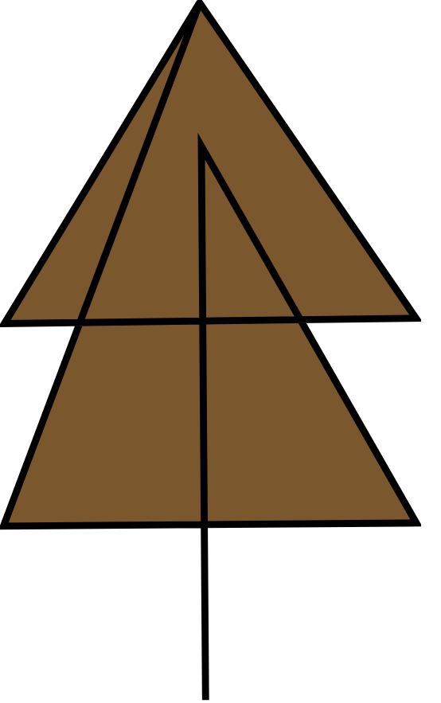
Resources
Actions
Funds
Coniferous
Deciduous
Plant
Fell
Dead
Seedling
Sapling
Mature
Old Growth
Senescent

Slide 4
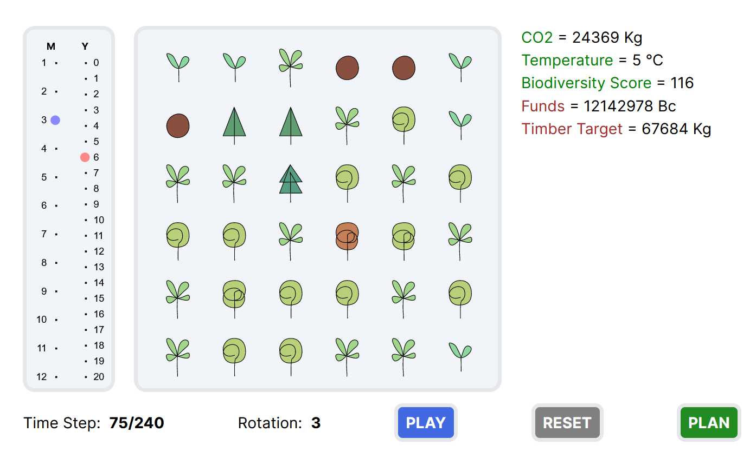
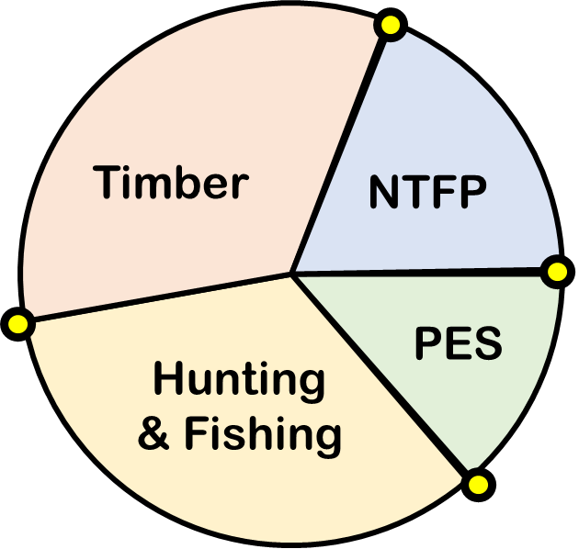
Microworld
Income Goal
xyz
CO2 Threshold
xyz
Income Dependence

Slide 5
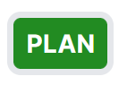
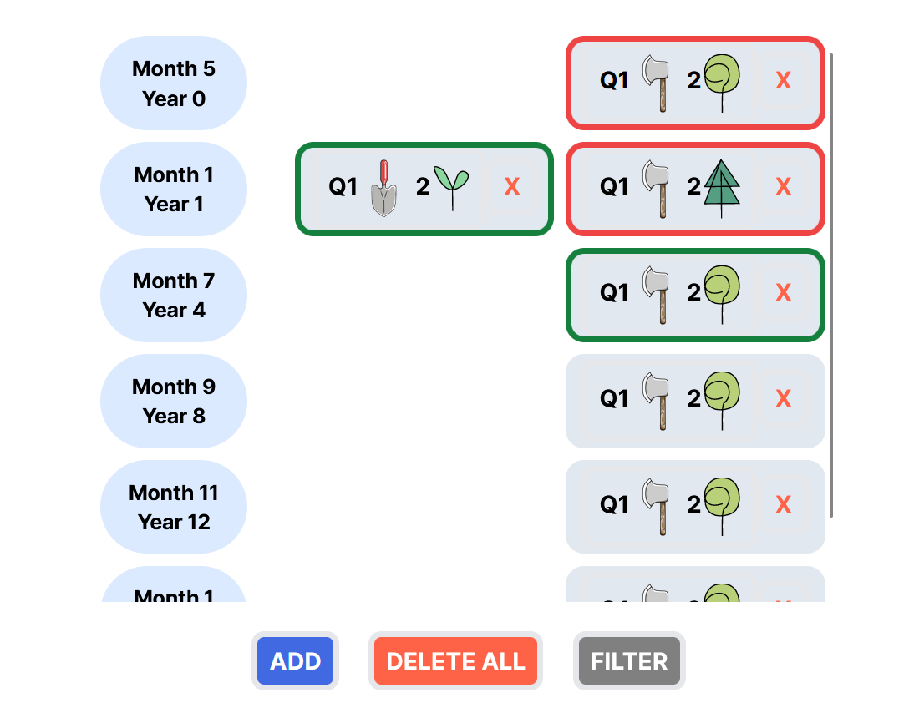
Planner
Rotation
Period
xyz

Slide 6


Edit
QUADRANT
ACTION
AFFECTED
Q1
Q2
Q4
Q3
No. of Trees Affected
X
M
Month
Y
Year
Repeat

Slide 7
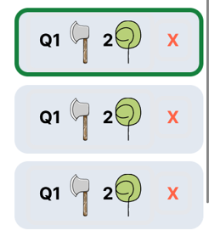
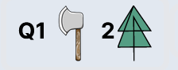

M
Month
Y
Year
CONFIRM

Slide 8
The Learning

