Slide 1
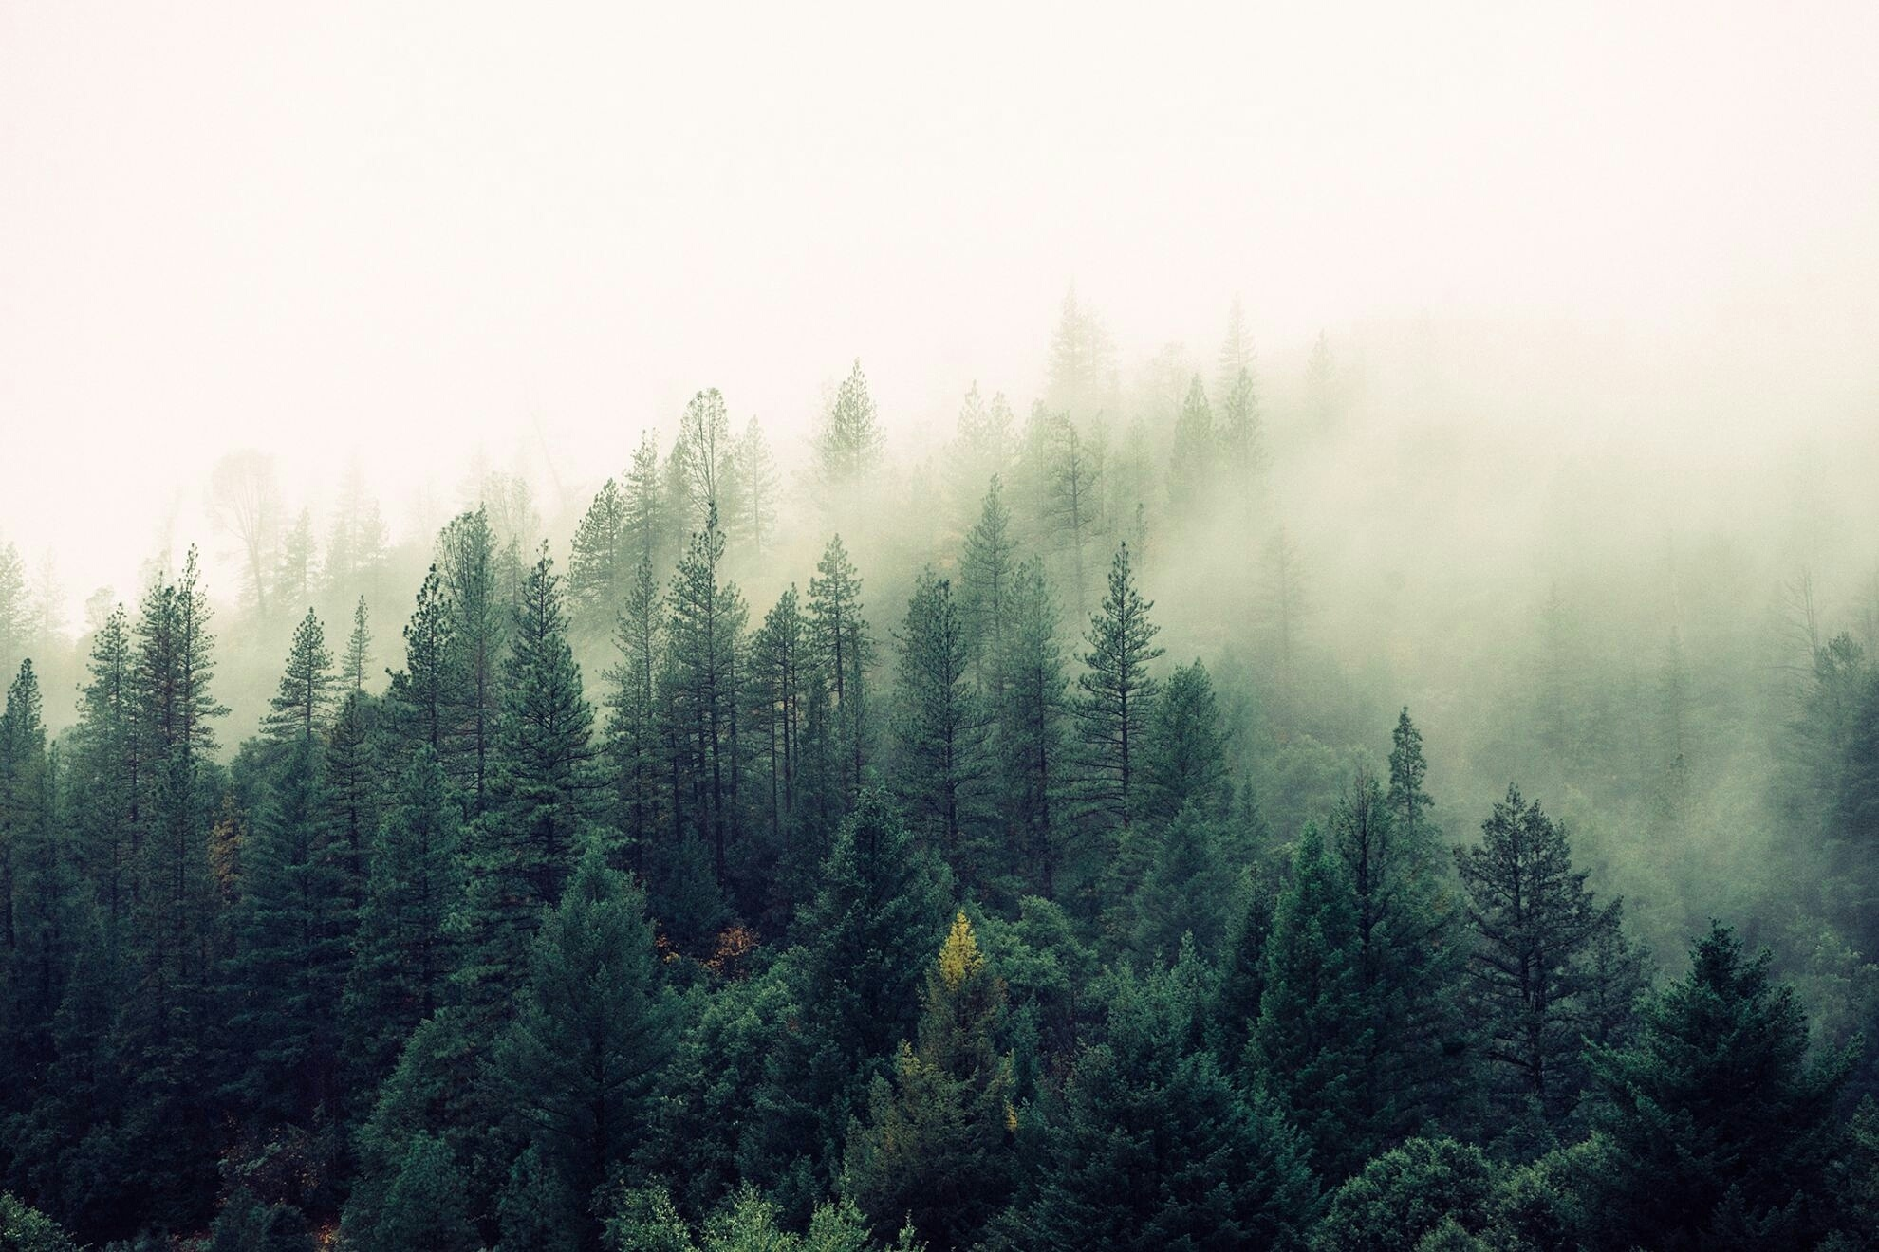
Exploring the use of microworlds to teach about forest management and climate change.

Slide 2
Learning Outcome: Sustainable Forest Management Challenges / Strategies
Challenge 1: Set as low of a CO2 threshold as possible.
Biodiversity is proportional to CO2 sequestered (build an ecosystem, not a plantation).
Preserve old growth.
Amount of CO2 is proportional to the growth rate of trees.
Gain a basic understanding of tool.
Challenge 2: Set as high of a target income as possible.
Streams of revenue from a forest is not limited to just Timber.
Most revenue streams other than Timber are less reliable and less income generating.
Get a good feel for the tool.
Challenge 3: Try to maximize Income & CO2 sequestration.
Stumble upon sustainable forest management practices like intermittent plantation.
Minimising reliance of Timber and determining the correct amount of reliance of different less stable climate friendly sources of income from the forest is challenging.
This is challenging and profit margin may be lower, but using forests as carbon sinks is economically viable.

Slide 3
The Tool

Slide 4













Resources
Actions
Non-Timber Income Streams
Funds
Coniferous
Deciduous
Plant
Fell
Dead
Seedling
Sapling
Mature
Old Growth
Senescent

Slide 5
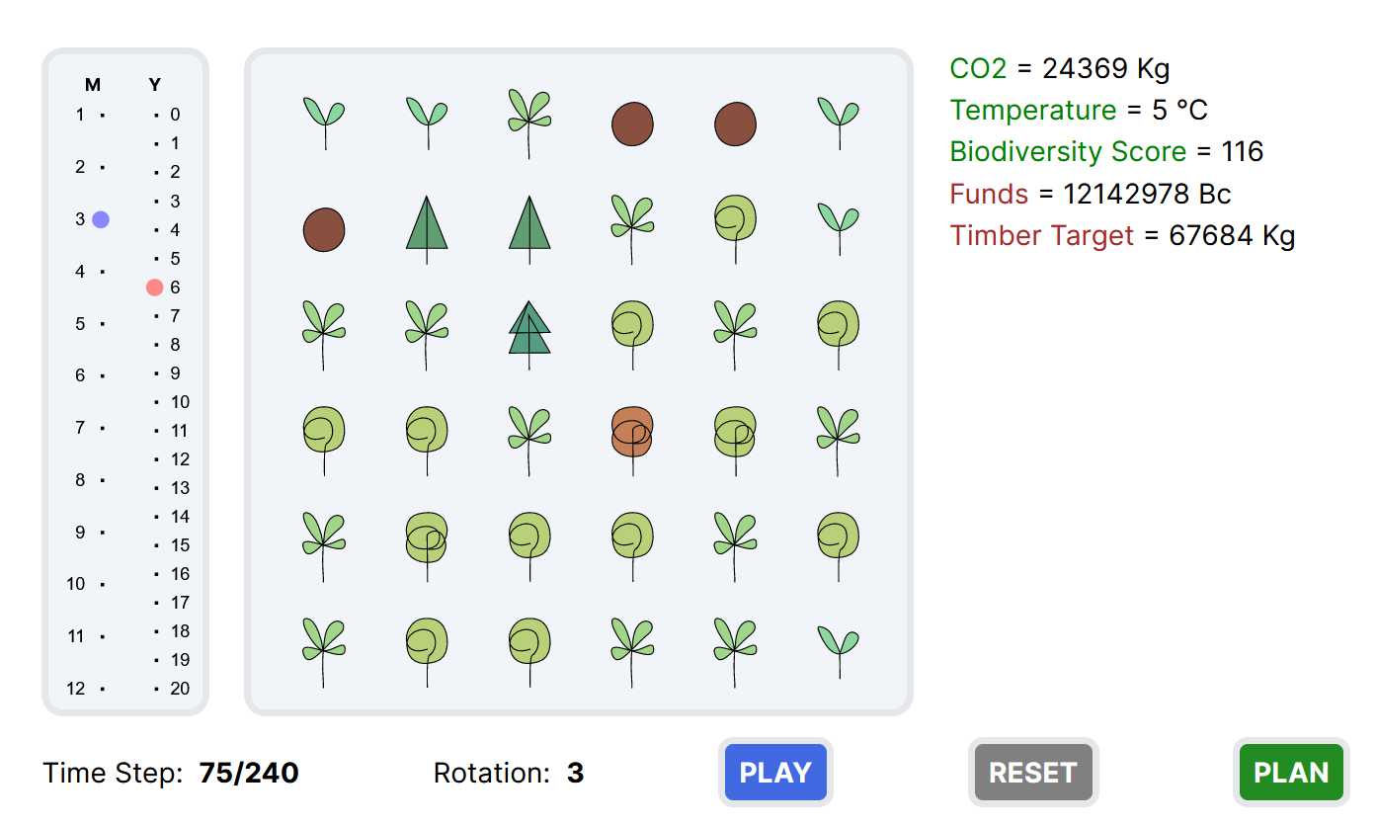
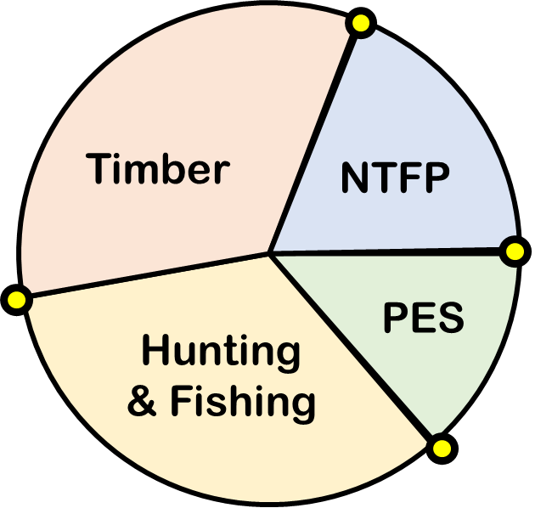
Microworld
Income Goal
xyz
CO2 Threshold
xyz
…
Income Dependence

Slide 6
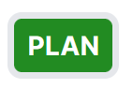
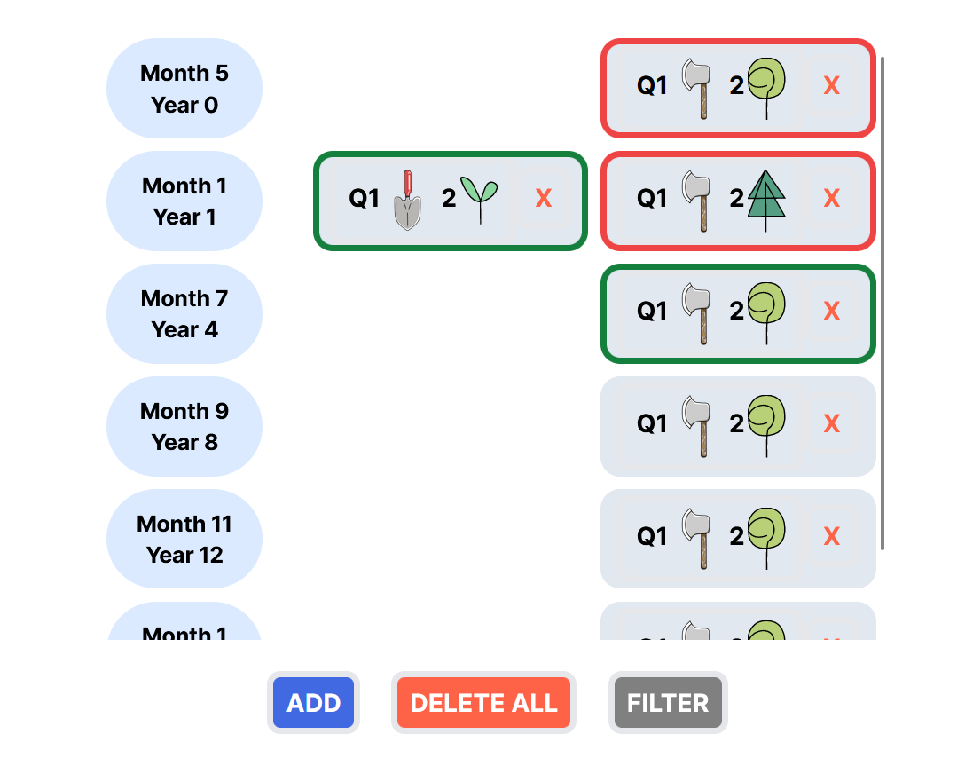
Planner
Rotation
Period
xyz

Slide 7



Edit
QUADRANT
ACTION
AFFECTED
Q1
Q2
Q4
Q3
No. of Trees Affected
X
M
Month
Y
Year
Repeat

Slide 8
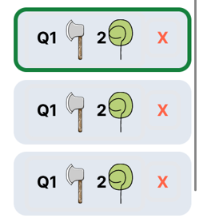
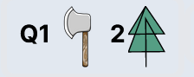

M
Month
Y
Year
CONFIRM

Slide 9
The Model

Slide 10
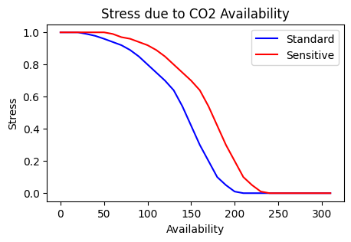
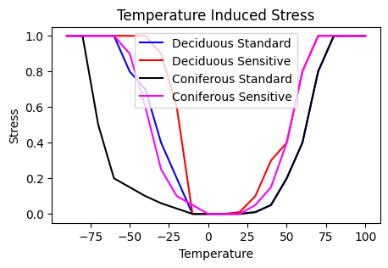
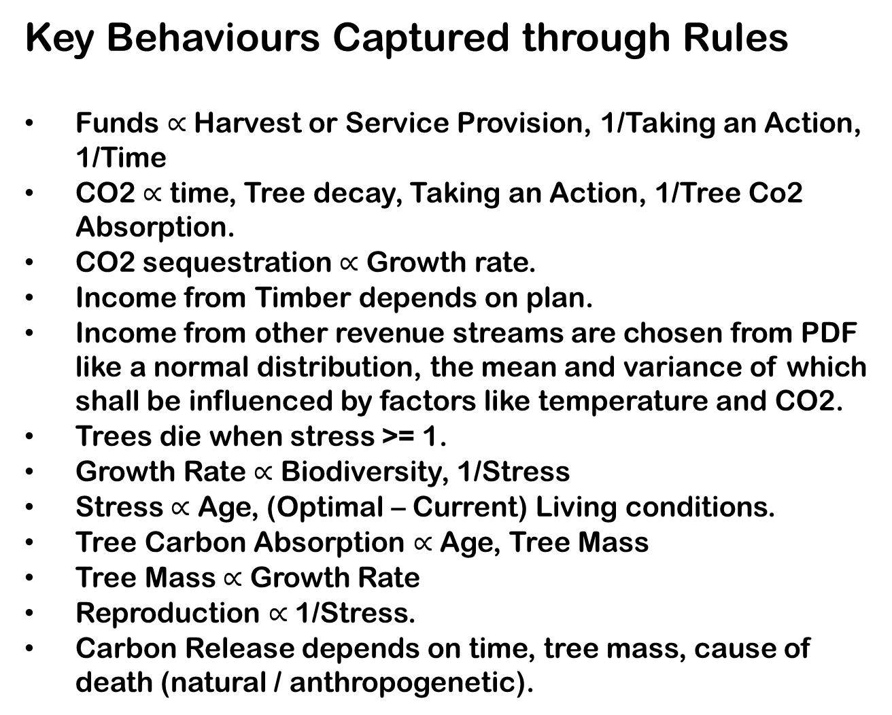
Key Behaviours Captured through Rules
Funds $∝$ Harvest or Service Provision, 1/Taking an Action, 1/Time
CO2 $∝$ time, Tree decay, Taking an Action, 1/Tree Co2 Absorption.
CO2 sequestration $∝$ Growth rate.
Income from Timber depends on plan.
Income from other revenue streams are chosen from PDF like a normal distribution, the mean and variance of which shall be influenced by factors like temperature and CO2.
Trees die when stress >= 1.
Growth Rate $∝$ Biodiversity, 1/Stress
Stress $∝$ Age, (Optimal – Current) Living conditions.
Tree Carbon Absorption $∝$ Age, Tree Mass
Tree Mass $∝$ Growth Rate
Reproduction $∝$ 1/Stress.
Carbon Release depends on time, tree mass, cause of death (natural / anthropogenetic).

