Slide 1
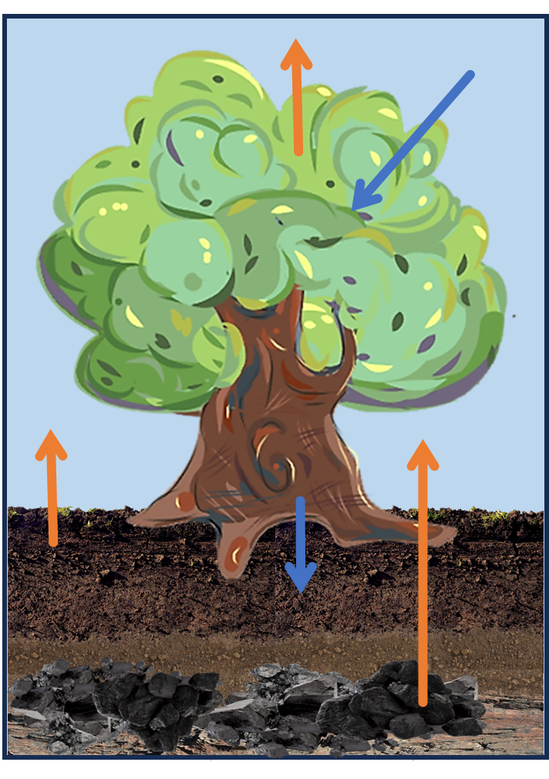
Exploring the use of microworlds to teach about forest management and climate change.

Slide 2
Learning Outcome: Role of forests in the carbon cycle & SFM principles.
Challenge 1: Set as low a CO2 threshold as possible.
Biodiversity is proportional to CO2 sequestered (build an ecosystem, not a plantation).
Amount of CO2 is proportional to the growth rate of trees.
Gain a basic understanding of tool.
Challenge 2: Set as high a target income as possible.
Streams of revenue from a forest is not limited to Timber.
Most revenue streams other than Timber are less reliable and less income generating.
Get a good feel for the tool.
Challenge 3: Try to maximize Income & CO2 sequestration.
Stumble upon sustainable forest management practices (preserve old growth, avoid short rotations, etc.).
Minimising reliance on Timber and determining the correct amount of reliance on less stable climate friendly sources of income from the forest.
This is challenging and profit margin may be lower, but maintaining forests as carbon sinks is economically feasible.

Slide 3
The Tool

Slide 4














Resources
MICROWORLD ARTIFACTS
Actions
Timber
Non-Timber Income Streams
Funds
Coniferous
Deciduous
Plant
Fell
Planning (Rotation Length, Fell / Plant)
Sapling
Set Income Dependency
Dead
Seedling
Mature
Old Growth
Senescent
User Interactions

Slide 5
The Model

Slide 6
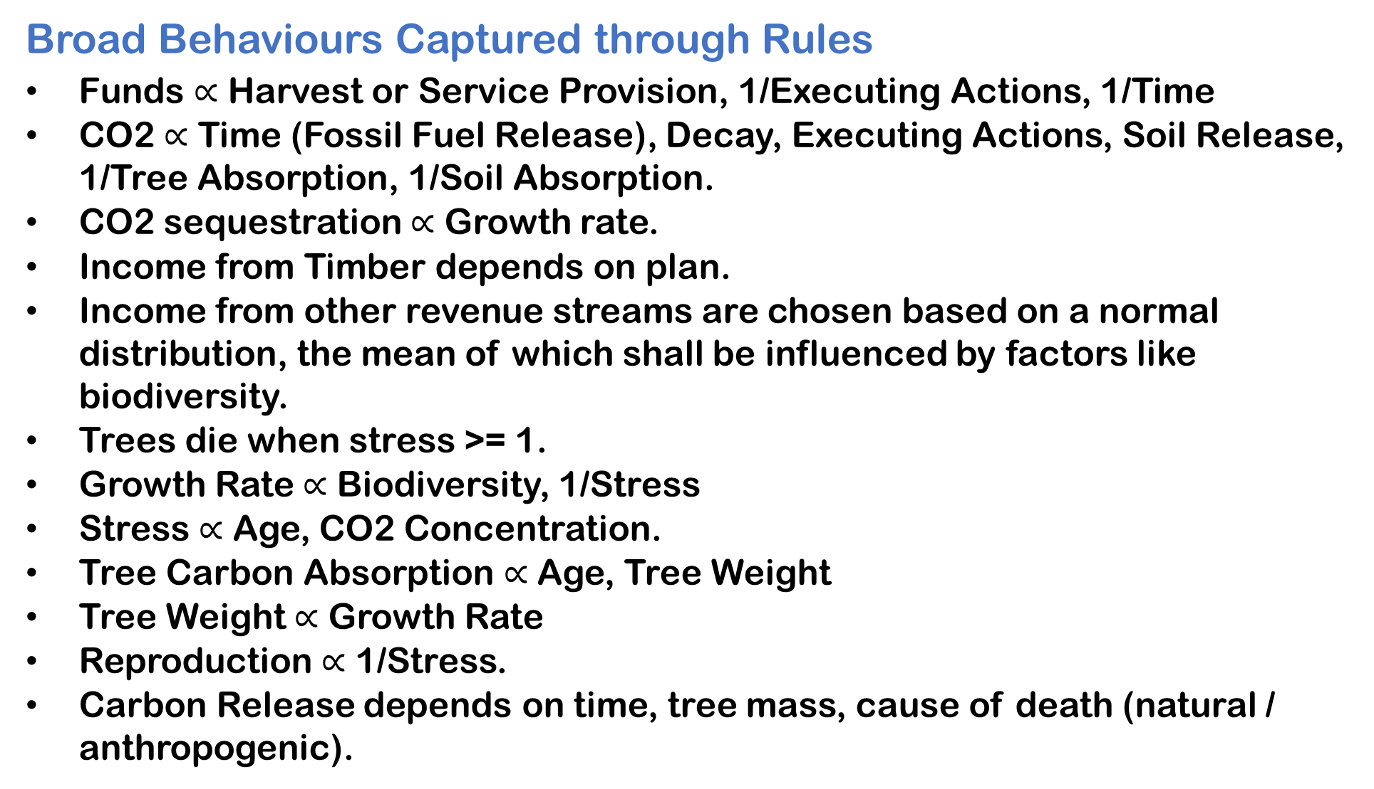
Broad Behaviours Captured through Rules
Funds $∝$ Harvest or Service Provision, 1/Executing Actions, 1/Time
CO2 $∝$ Time (Fossil Fuel Release), Decay, Executing Actions, Soil Release, 1/Tree Absorption, 1/Soil Absorption.
CO2 sequestration $∝$ Growth rate.
Income from Timber depends on plan.
Income from other revenue streams are chosen based on a normal distribution, the mean of which shall be influenced by factors like biodiversity.
Trees die when stress >= 1.
Growth Rate $∝$ Biodiversity, 1/Stress
Stress $∝$ Age, CO2 Concentration.
Tree Carbon Absorption $∝$ Age, Tree Weight
Tree Weight $∝$ Growth Rate
Reproduction $∝$ 1/Stress.
Carbon Release depends on time, tree mass, cause of death (natural / anthropogenic).

