Slide 1
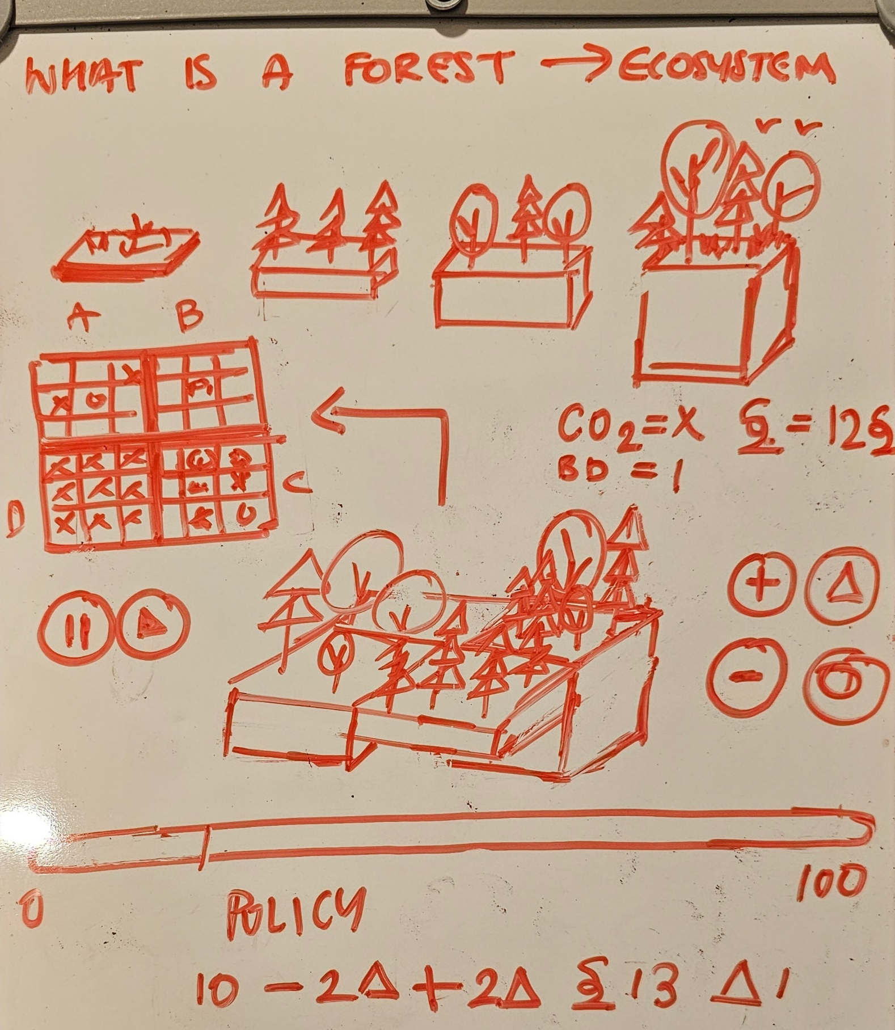
Forests as Carbon Sinks
Teaching Tool

Slide 2
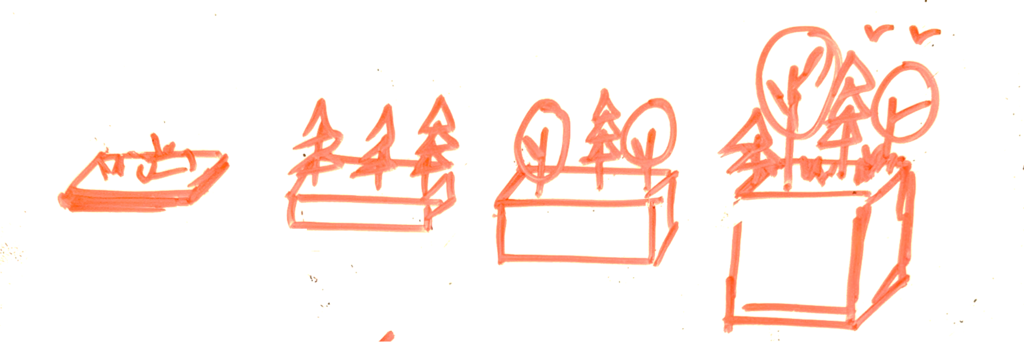
Dead
Seedling
Sapling
Mature
Old Growth
Senescent
Coniferous
Deciduous
Dead Land
Plantation
Forest
Ecosystem

Slide 3


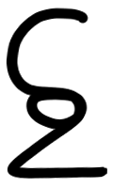


Q1
Q2
II
▶
Policy
50
0
100
1000
100 kg
C: x kg
B: x xx
C: x kg
X °C
Q3
Q4

Slide 4



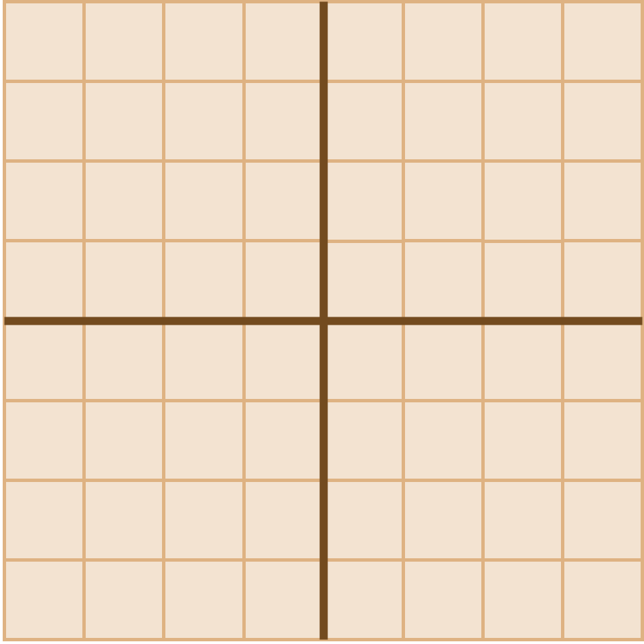

Policy Maker
0
Year
Q1
Q2
1
Q1
x%
2
xxx
3
4
↑
Mitigate
↓
Ok
Rotation:
5
Q4
Q3

Slide 5
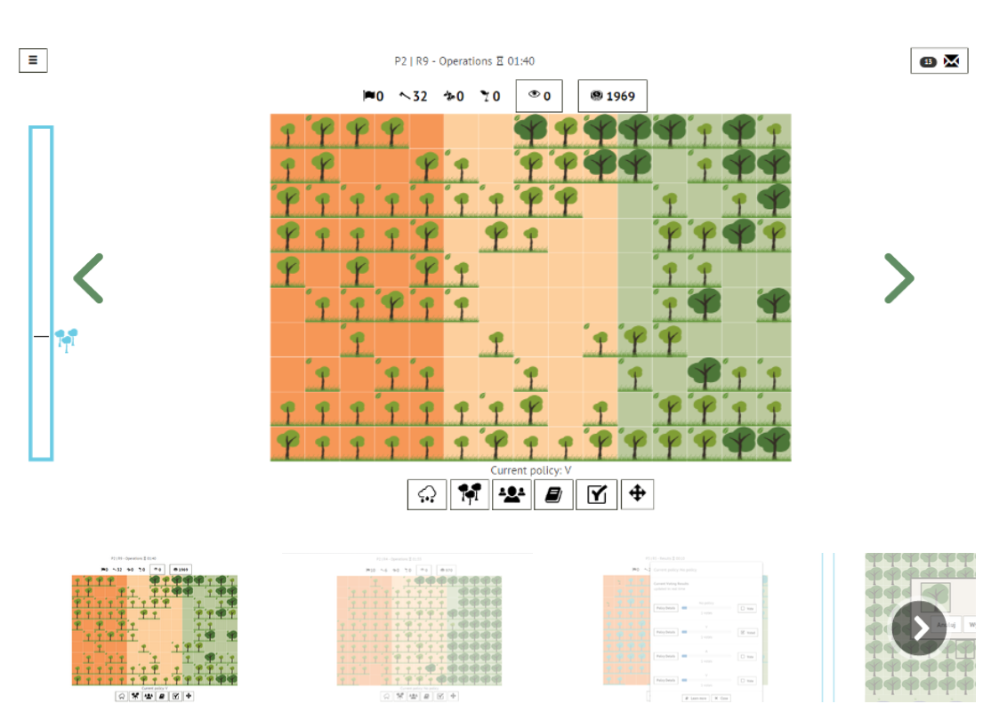
About That Forest Game
https://games4sustainability.org/gamepedia/about-that-forest/
Inspiration

