Slide 1
Research Question
How can the interdependence between natural processes in a forest and its carbon sequestration ability under different management plans whilst accounting for expenses involved, be captured in an Agent-Based Model (ABM) within an engaging web-based e-learning application so that users can discover for themselves, through self-exploration, existing forest management strategies and immediately view their effects on carbon dioxide (CO2) levels in the atmosphere in order to understand effectiveness and economic feasibility of using forests as carbon sinks for combating climate change?

Slide 2
Project Schedule
Now

Slide 3
Ethics Approval
How?
Yes. This project requires ethics approval for trial and field experiments. All experiments are of a similar nature wherein the participant tries to use a prototype or latest version of the application and shares their feedback regarding usefulness and user experience. No sensitive data shall be collected. Participants shall be informed in full detail about the reason for the experiment, exactly what they can expect to be doing as part of it and what data shall be collected. An experiment shall only be conducted with participants who grant consent for the same.

Slide 4
Most Similar Existing Work
[1] Fouqueray, T., et al., Interdisciplinary modeling and participatory simulation of forest management to foster adaptation to climate change. Environmental Modelling &amp; Software, 2022. 151: p. 105338.

Slide 5
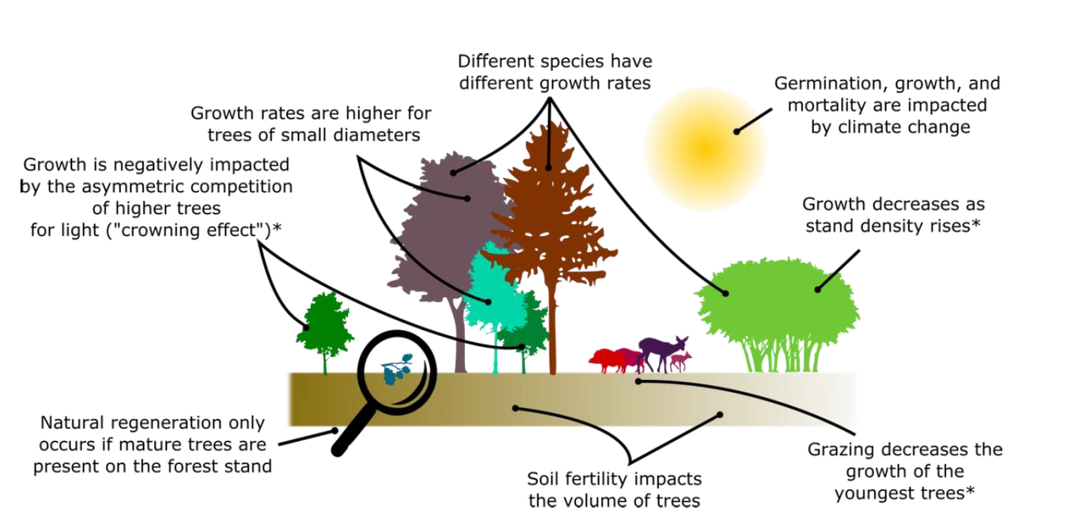
[1]
MAYOR
PUBLIC FORESTER
PROTECTED AREA MANAGER
LANDOWNER 2
LANDOWNER 1

Slide 6
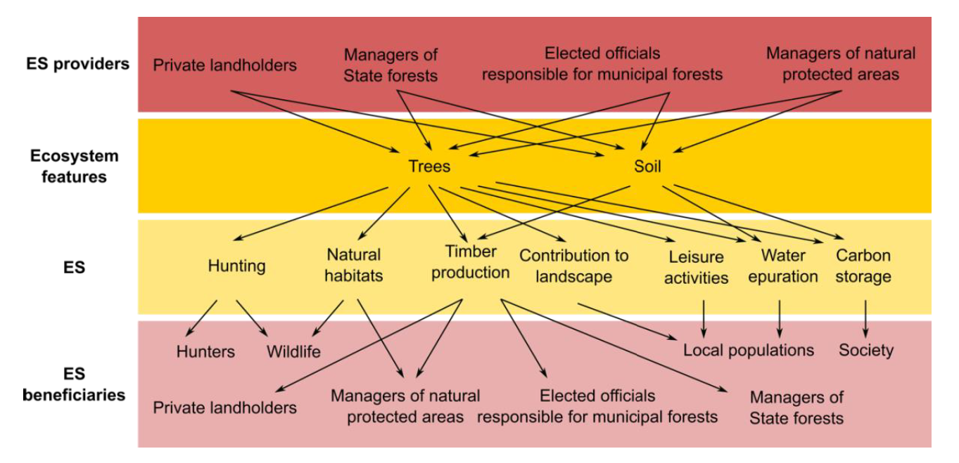
[1]

Slide 7
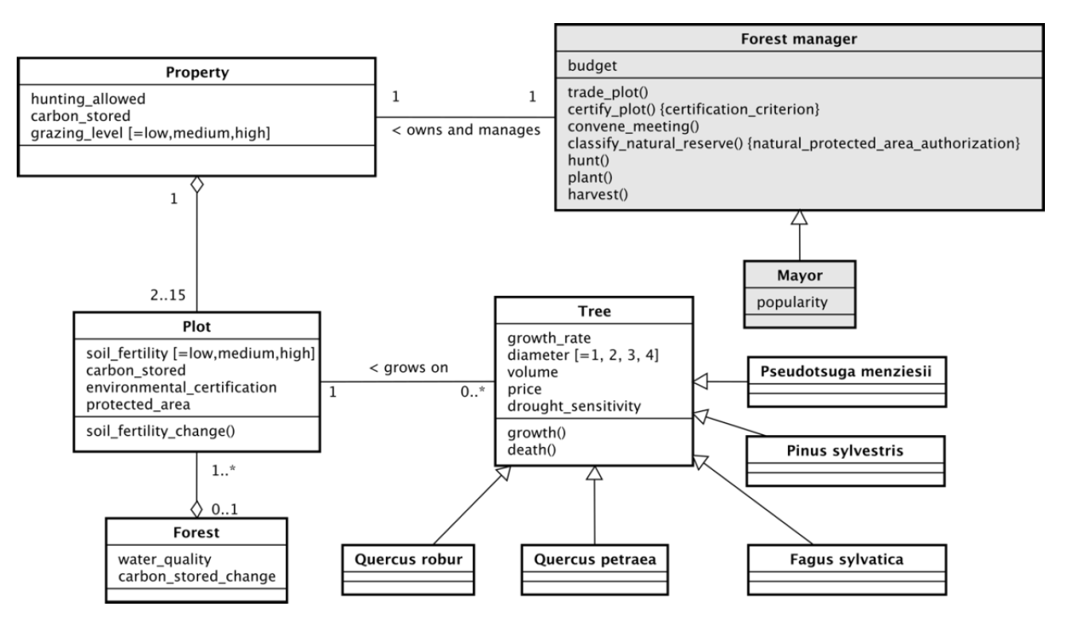
[1]

