Slide 1
Popularity and Harassment on Twitter
CS591: Tools and Techniques in Data Mining
Final Project
Frances Gail Godinez

Slide 2
Motivation & Background
After the recent harassment of several prominent women in gaming and tech (infamously known as #GamerGate) and Twitter's difficulty with dealing with said harassment issue, I wanted to try exploring if there was correlation between "Twitter popularity" and harassment
Issues Twitter has Encountered
Inappropriate/hateful tweets going through without detection
No efficient way of detecting spam accounts of “throwaway” accounts
No efficient way of detecting possible harassment/abuse from users

Slide 3
Defining the Problem
Measuring Popularity:
Number of followers
Number of tweets
Number of favorites per tweet
List membership
Friends count
Timeline Polarity
"Harassment" will be measured by using sentiment analysis by traversing through said user's mentions and measuring the average polarity ranging from [-1.0,1.0] where more 'positive' tweets have higher polarities, while 'negative' tweets will have lower polarity.
Afterwards, I want to predict the polarity (which I will use to define as "harassment") given a twitter user's "popularity."

Slide 4
Data Collection
Using Twitter’s API I collected ~200 users from the following hashtags
#GamerGate (199 users collected)
A recognized hate group, #GamerGate users have been responsible for harassment and sending death threats to prominent women in tech as well as stalking and doxing of said women's’ private information
#StopGamerGate (197 users collected)
A counter hashtag to #StopGamerGate, intended to expose #GamerGate’s ill intentions
#ThanksObama (246 users collected)
I wanted to explore this tag since it's mostly used in a sarcastic way though it would be interesting to explore in terms of polarity since sarcasm detection is still a problem that NLP doesn't have an elegant solution for.

Slide 5
Preliminary Findings & Statistics Averages
Hashtag | Timeline Polarity | Mentions Polarity | Followers | Friends | Tweets
#GamerGate | 0.0315156112402 | 0.044149440041 | 893.467336683 | 884.190954774 | 17710.1557789
#StopGamerGate | 0.0392955921602 | 0.06297849820 | 1029.5786802 | 799.329949239 | 24022.2030457
#ThanksObama | 0.073655483794 | 0.102303311349 | 6488.54878049 | 2604.74796748 | 23089.5853659
As expected #GamerGate has the lowest timeline polarity when compared to #StopGamerGate and #ThanksObama users.
#ThanksObama has the highest overall (timeline and mentions) polarity, which is most likely due to the hashtag being used sarcastically by the average user.
On average, users using the #GamerGate hashtag appear to have the lowest amount of followers and tweets, which is a possible indicator or a “throwaway” account.
On that note, I also decided to investigate the possibility of “throwaway” and “fake” accounts in the data I collected.
Interestingly enough, #StopGamerGate falls behind #GamerGate users in terms of average amount of friends (mutual followers).

Slide 6
Preliminary Findings & Statistics Correlation Coefficients
Hashtag | Followers vs. Mentions Polarity | Mentions Polarity vs. Timeline | Mentions Polarity vs. Status Count | Mentions Polarity vs. Friends
#GamerGate | 0.0375911568119 | -0.0554511228202 | 0.0568853100355 | -0.0375911568119
#StopGamerGate | 0.0296543866388 | 0.278311522481 | 0.17097135397 | 0.293868892763
#ThanksObama | -0.0255483125423 | 0.260303216544 | 0.000887909691385 | -0.0255483125423
For Mentions Polarity vs. Timeline Polarity I wanted to see if there was a correlation between having a “negative” timeline would result in having “negative” mentions as well. It appears that for #GamerGate, this doesn’t seem to be the case. Though more highly correlation than #GamerGate, there is little correlation for this for the other two hashtags as well.
I again suspect that this is due to “throwaway” accounts and “fake accounts” present in the data
Lastly, I wanted to see if there was a correlation between mentions polarity and status count under the belief that more statuses might result in lower mentions polarity. As expected, this was more highly correlated for #StopGamerGate than any of the other hashtags, although not strongly.

Slide 7
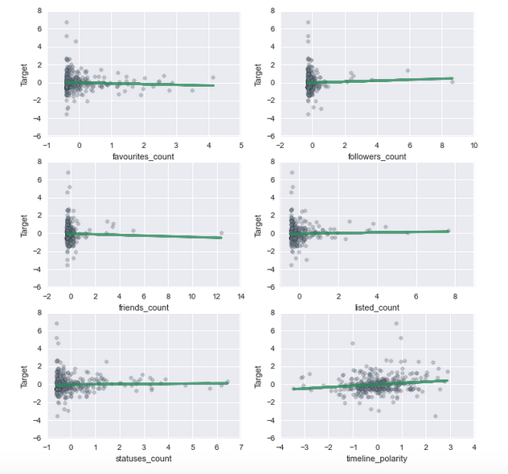
Linear Regression Model Combined Data
Feature | Correlation Coefficient
Favorite Count | --0.078386
Followers | 0.055072
Friends | -0.037872
Listed | 0.029382
Statuses | 0.020675
Timeline Polarity | 0.150661
Regression score: 0.02 (+/- 0.07)
It appears that timeline polarity had the strongest (positive) correlation. Generally, the more "positive" a users' timeline is, the more likely they are to have more positive and "nicer" tweets in their mentions while the opposite is also true (more negative time line would result in more negative mentions, etc)

Slide 8
Logistic Regression & Predicting Harassment
 | Precision | Recall | F1 Score | Support
0 | 0.64 | 0.22 | 0.32 | 268
1 | 0.47 | 0.85 | 0.61 | 223
Avg./Total | 0.56 | 0.51 | 0.45 | 491
Feature | Correlation Coefficient
Favorites | -4.36985482174e-06
Followers | 0.000345204391051
Friends | 0.000268634111991
Listed | -0.0208420665337
Statuses | 5.22732349157e-06
Timeline Polarity | -0.00999609376981
Model Accuracy: 50.509%
Having “negative mentions” was defined as having a mentions polarity below 0.05
The data was split in 80% testing and 20% training
As expected, the given features were not good predictors for harassment detection with a model accuracy of only 50%
I suspected that this was due to the presences of “throwaway” accounts, which I investigated further
Confusion Matrix
 | 0 | 1
0 | 58 | 210
1 | 33 | 190

Slide 9
Logistic Regression Predictions
User 1
User 2
Status Count: 67,000
Following: 1,000
Listed: 5
Friends 700
Favorite Count: 28,000
Timeline Polarity: 0.06
Model Prediction: 67% chance of having negative mentions
Interestingly enough, I based these user stats on Zoe Quinn - who was the main target behind #GamerGate's harassment
Status Count: 21,600
Following: 302
Listed: 0
Friends: 135
Favorite Count: 8383
Timeline Polarity: 0.05
Model Prediction: 57% chance of having negative mentions

Slide 10
Detecting “Fake” and “Throwaway” Accounts
Of all the features I collected, it appears there is no strong correlation between "popularity" and how negative a user's mentions are. The only seemingly correlated feature would be timeline polarity vs. mentions polarity where the more "positive" a users' timeline is, the more likely they are to have more positive and "nicer" tweets in their mentions while the opposite is also true.
I suspect the reason for this would be the presence of "throwaway" accounts (or even spambots) in the collected data, which would result in very low "popularity" stats.
I wanted to test out if this was the reason behind the small correlation in twitter "popularity" vs. harassment.
I believe that the offending set of users would be those using the #GamerGate hashtag
I'm going to attempt to detect "fake" accounts by measuring the readability score of their bio under the hypothesis that fake accounts may have nonsensical bios.
I also want to measure number of statuses and number of followers under the theory that users with fewer statuses and fewer followers

Slide 11
Detecting “Fake” Accounts
Hashtag | Avg. Bio Score | Nonsense Bios | Avg. Followers | Avg. Statuses | Deleted Accounts
#GamerGate | 41.6727932961 | 63 | 893.467336683 | 17710.1557789 | 20
#StopGamerGate | 43.844512821 | 63 | 1029.5786802 | 24022.2030457 | 2
#ThanksObama | 47.118489796 | 86 | 6488.54878049 | 23089.5853659 | 1
On average, the readability index for each hashtag falls under the "Difficult" to understand range, which is expected as these are short bios on twitter.
#GamerGate and #StopGamerGate have the same amount of nonsensical bios. #ThanksObama has the most nonsense bios but this is most likely due to the higher amount of users collected for that hashtag.
While grabbing user bios, I ran into an error where the user no longer existed. To deal with this, I caught the exception and set that user’s bio score to None.
As expected, #GamerGate users have the most deleted accounts among all the explored hashtags. This possibly supports the theory that users using the #GamerGate tag are mostly "throwaway" and "fake" accounts. There is also the possibility that said users were also suspended or reported and had their accounts deleted.
To determine if a bio was nonsensical I used the Flesch Reading Ease Score:
90-100 : Very Easy
80-89 : Easy
70-79 : Fairly Easy
60-69 : Standard
50-59 : Fairly Difficult
30-49 : Difficult
0-29 : Very Confusing

Slide 12
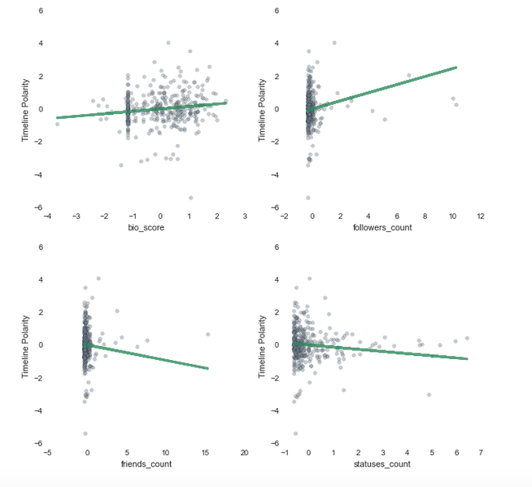
Linear Regression Model “Fake” Accounts
Feature | Correlation Coefficient
Bio Score | 0.148936
Followers | 0.246393
Friends | -0.094082
Statuses | -0.132669
Regression score: -0.01 (+/- 0.06)
I wanted to measure timeline polarity as opposed to mentions polarity due to the fact that a throwaway account may not have many mentions.
There appears to be a strong correlation between "followers count" and "niceness" of a user's timeline, which is somewhat expected. The more followers one has, the stronger their internet presence, thus it is highly likely they they are "nicer" on twitter.
The feature with the second highest correlation was "bio score" which was the readability of a user's bio on twitter. Although there isn't a strong correlation, this was still expected as per my theory that mostly "throwaway" and "fake" accounts were used for tweeting "negatively". The higher the readability index the higher the timeline polarity.

Slide 13
Logistic Regression & Predicting “Throwaway” Accounts
 | Precision | Recall | F1 Score | Support
0 | 0.90 | 0.87 | 0.88 | 403
1 | 0.41 | 0.57 | 0.52 | 88
Avg./Total | 0.83 | 0.81 | 0.82 | 491
Feature | Correlation Coefficient
Favorites | -1.69099442351e-06
Followers | 0.000742844084404
Friends | -1.45588275282e-05
Listed | -0.0182618438354
Statuses | -1.53023084365e-05
Timeline Polarity | -0.00334255062419
Mentions Polarity | -0.0143780006155
Bio Score | -0.0595431374498
Model Accuracy: 81.47%
I defined the possibility of being a “throwaway” as having a bio score < 29 and mentions polarity < 0.05
Using bio score and mentions polarity as features to predict if an account is a throwaway appears to be decent predictors with ~81% accuracy
However, the model appears to have better accuracy in predicting if an account is NOT a "throwaway"
This is as expected as twitter still has difficult in detecting spam accounts (example: horse_ebooks)
Confusion Matrix
 | 0 | 1
0 | 350 | 53
1 | 38 | 50

Slide 14
Logistic Regression Predictions “Fake” Accounts
User 1
Favorites count: 1250
Followers count: 3756
Friends count: 3345
Listed: 0
Mentions Polarity: 0.045
Statuses: 1245
Timeline polarity: -0.03
Bio Score: 20
Model Prediction: 78.61% chance of being a throwaway account
User stats were based on a random user I grabbed from the #GamerGate tag
User 2:
Favorites count: 3451
Followers found: 317
Friends count: 245
Listed: 3
Mentions polarity: 0.05
Statuses count: 4534
Timeline polarity: 0.07
Bio Score: 31
Model Prediction: 6.24% chance of being a throwaway account
User stats were based on my own twitter’s stats.

Slide 15
Conclusions
It appears that there is no strong correlation between "popularity" and how "mean" or negative a users' mentions are.
The only seemingly correlated feature would be statuses count vs. mentions polarity where more statuses generally meant more positive tweets. I believe this is due to people making "throwaway" accounts to allow anonymity in negative tweets. I decided to investigate this further by detecting any fake accounts that might me "throwaways" or spam by measuring the readability index of their bios (cont. in next slide)
An interesting metric I wanted to evaluate was if there was a correlation between gender and negative mentions, however twitter's API does not return this information.
Overall, it appears that how "negative" people are to each other is arbitrary which is perhaps why twitter is currently having a hard time in dealing with predicting and dealing with harassment on their website as well as detecting any abusive accounts.

Slide 16
Conclusions (cont.)
I suspected the #GamerGate tag to be the offending dataset (with the most "throwaway" accounts)
There were 20 deleted accounts in the #GamerGate data set when I tried to explore their bios which supports the idea that users of this hashtag are using "throwaway" accounts.
Both #GamerGate and #StopGamerGate had the most "nonsense" bios.
There is a small correlation between low readability index of their bios and the polarity in their time line. The more nonsensical their bio (aka. the more likely they are fake accounts), the more "negative" their account's tweets are, which was as expected under the assumption that "throwaway" accounts are being used for harassment.
Using bioscore and mentions polarity appear to be good predictors for detecting "throwaway" accounts with 81% accuracy.

