Slide 1
Model → OMG Specifications AML OMG Submission
Deepak Sharma
October 2014

Slide 2
Before Magic Draw
IBM Rational Software Architect (RSA).
Business Intelligence Reporting Tool (BIRT).
Learning curve.
Configure Dataset and queries.
Format query output.
Not easy to manage, limited free support.
Works with IBM RSA only.
Apache Velocity is better. Write script directly in document (docx 2 docx).
Script can be made to run outside Cameo MD.

Slide 3
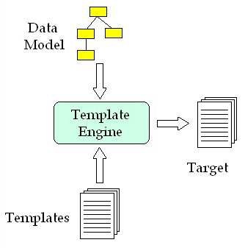
Generation
specifications
MD
docx
docx
Diagram taken from : http://www.onjava.com/pub/a/onjava/2004/05/05/cg-vel1.html

Slide 4
What do we need?
Source model in UML (specification.mdzip)
Creating template:
Velocity Template Language
Extension Libraries by MD
MD Examples
Decide target format (MSWord)
Report generation workflow
Velocity engine embedded/within MD.

Slide 5
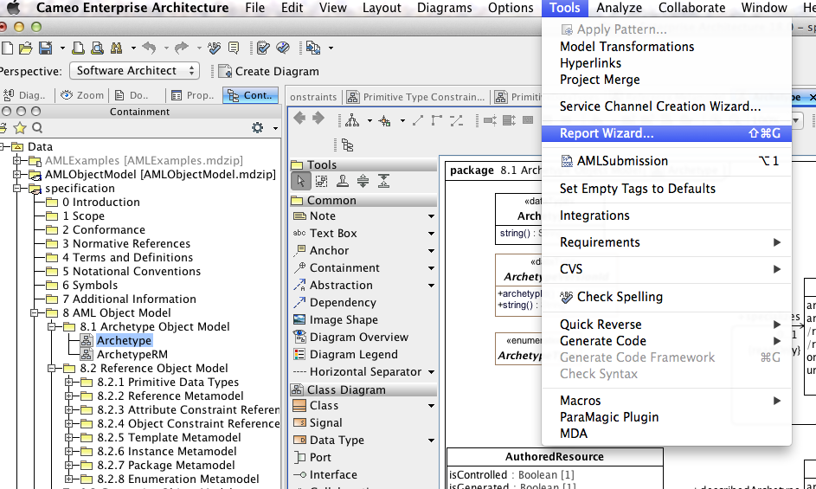
Cameo/MD Report Wizard

Slide 6
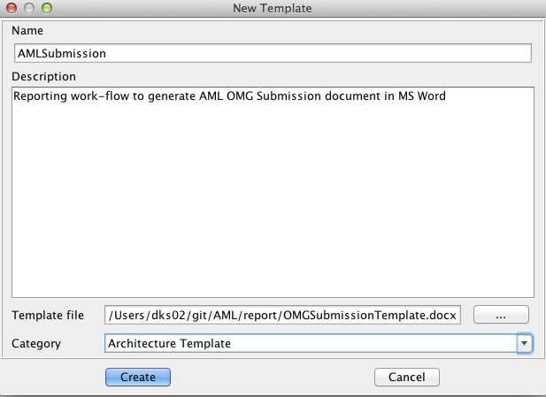
Cameo/MD Report Wizard
Template

Slide 7
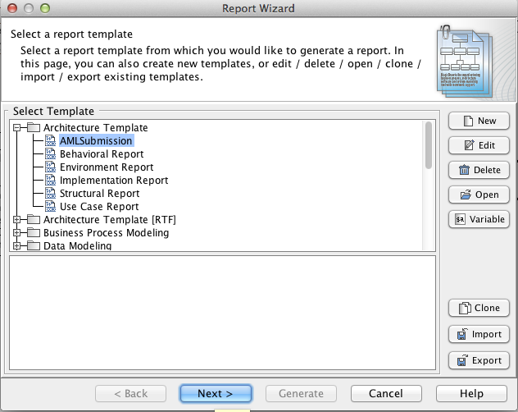
Cameo/MD Report Wizard

Slide 8
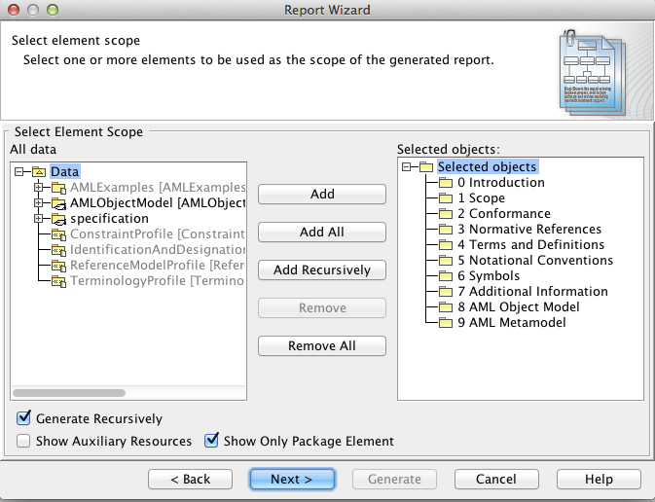
Cameo/MD Report Wizard
Pkgs in scope

Slide 9
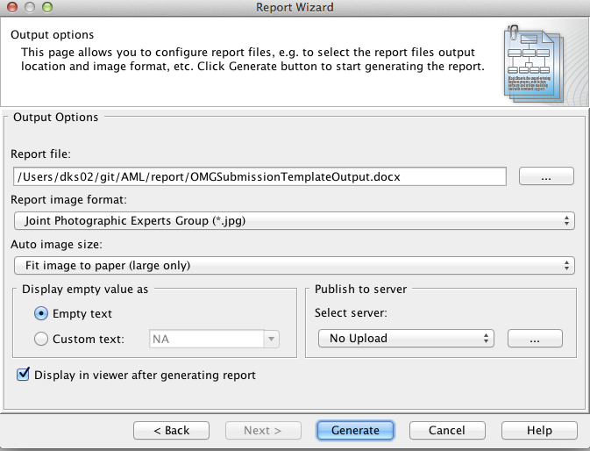
Cameo/MD Report Wizard
Output

Slide 10
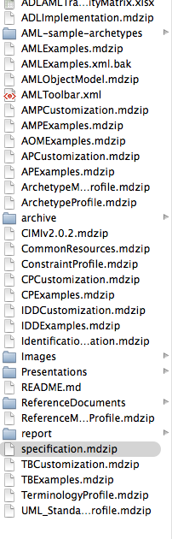
AML Model
Specifications (GitHub)
<github>/AML/specification.mdzip
Open in Cameo/MagicDraw

Slide 11
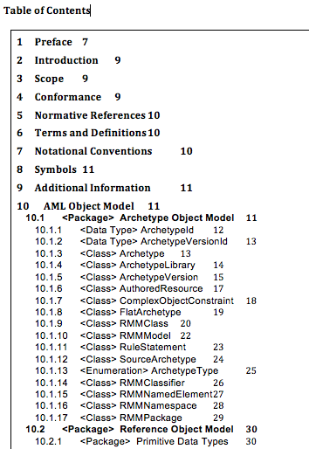
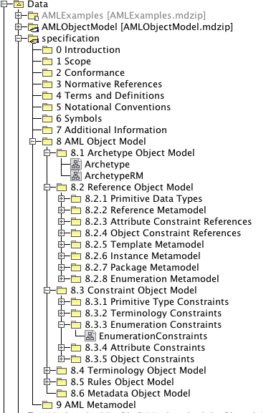
Ordering
Helps maps to corresponding section in generated document
Ordered by first numeral in package name

Slide 12
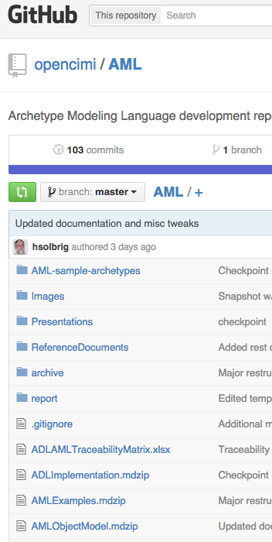
Velocity Template

Slide 13
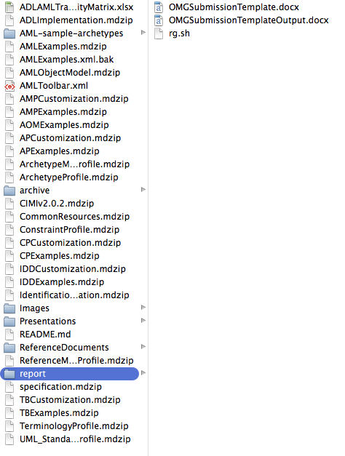
Velocity Template

Slide 14
Steps
Iterate over the packages in scope.
For each package – get diagrams
For each diagram
Get elements in the diagram
Render
Top Packages are first sections
Sub-packages are Model components
Classes, Interfaces, Enumerations, Data types, Stereotypes, profiles (???)

Slide 15
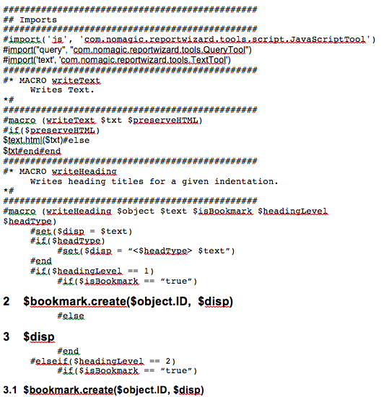
Velocity Code Snippet

Slide 16
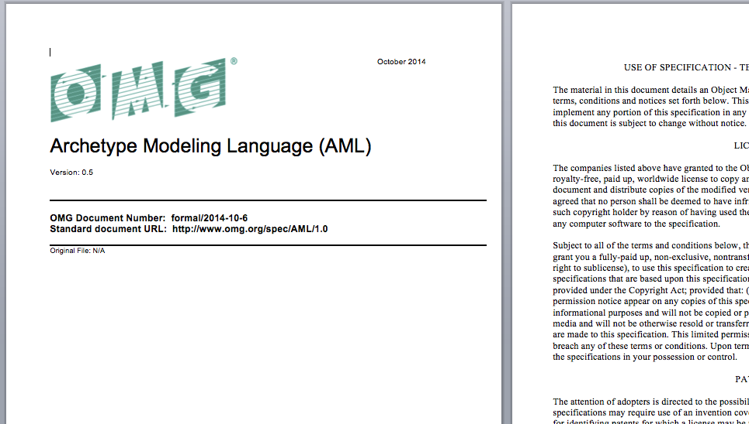
Output Document

Slide 17
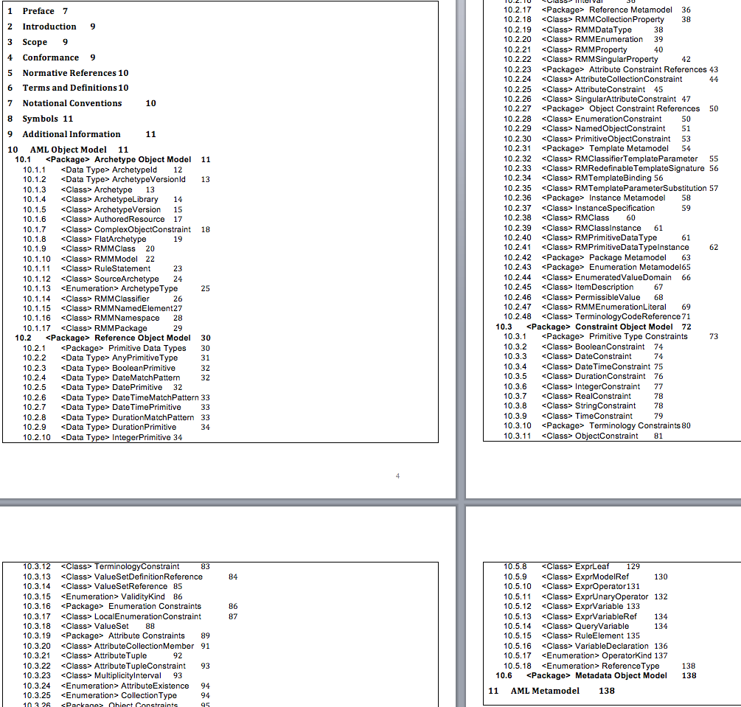
Output Document

Slide 18
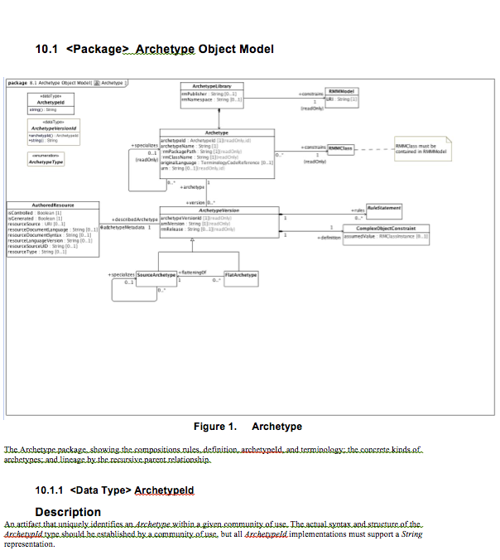

Slide 19
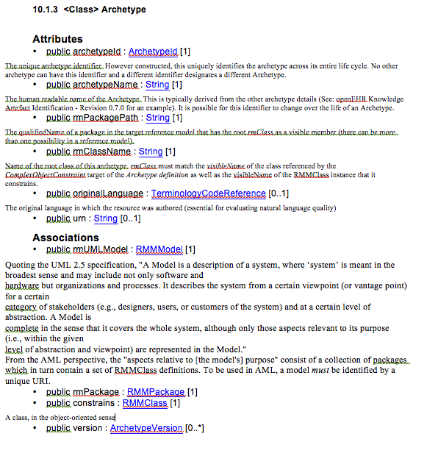

Slide 20
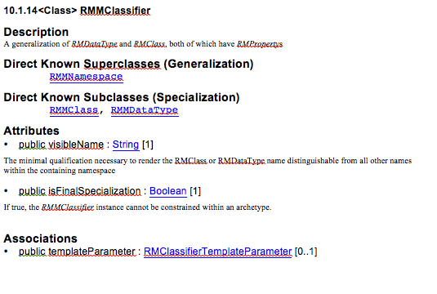

Slide 21
TODOs
Enumeration, Data types, Interfaces, Stereotypes, Profiles (merge with any changes from Senthil – no updates as of 10/6/2014)
Import RSA documentation, manual ?
Fix format issues
Adjust to final format requirements
Follow NIEM ? UPDM ?
Manual formatting
Manually fill out first 9 (preamble) sections.
Anything I missed? Not much time ☹

